Slide 1
Information for life
Decipher Prostate, Decipher Bladder and Decipher GRID

Slide 2



Genomic information company founded in 2007 to transform the practice of urologic oncology
Fastest growing genomics company in the space
  #1 Post-RP test on the market
  Launched Decipher Biopsy test in 2016, 4,000+ study patients in pipeline
  Launched Bladder Cancer test in 2017
  Licensing agreement with Color Genetics to market Hereditary Testing
  Average 3-4 publications/month between all products
Most accurate and actionable genomic information
  “Pure” genomic test that does not rely on clinical inputs
  Most accurate test (to our knowledge) based on published studies
  First company with Predictive data that provides meaningful information to Patients, Practitioners and value to the health care system
  Only company that’s focusing studies on hormone, radiation and chemo-sensitivity
Open Research platform (GRID) that allows for the advancement of Biomarker discovery
  Platform allows for capture of 1.4 million data points per patient
  Whole genome data sharing and collaborative research program
.
HQ + R&D
Vancouver, BC
Commercial Facility
San Diego, CA

Slide 3




















Top 10 urology programs collaborated to develop and validate Decipher®
H. LEE
MOFFITT
Cancer Center & Research Institute
MEDICAL CENTER

Slide 4
Decipher: Most widely published genomic test and test platform
220 published abstracts
174 Presented posters
94 Podium Presentations
84 Peer-reviewed Publications

Slide 5


Role of decipher
Biopsy
Surgery
PSA Rise

Slide 6
TECHNOLOGY
Genomic Testing

Slide 7
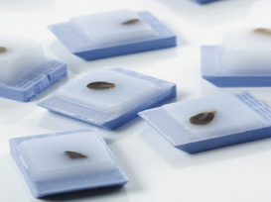
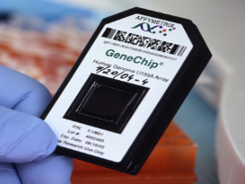

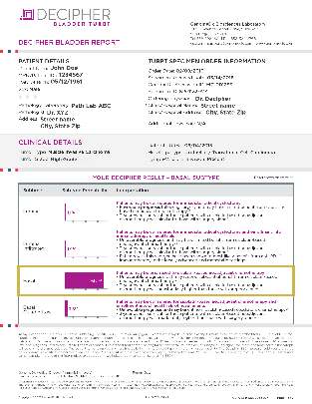
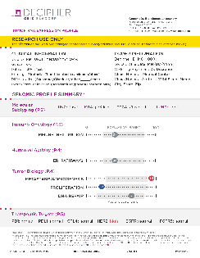
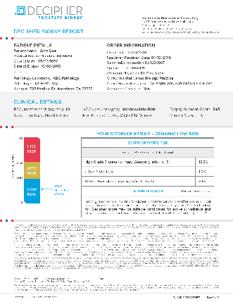
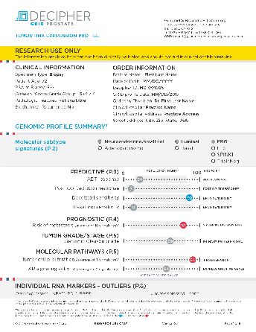
Decipher technology
+
+
ANY FFPE
TUMOR TISSUE
Long term follow-up available
GENECHIP TECHNOLOGY
Genome-wide expression analysis
MACHINE LEARNING
Cancer disease signatures
DECIPHER CLINICAL REPORTS
GRID RESEARCH USE ONLY (RUO) REPORTS
GRID RESEARCH DATA
Guides treatment decisions
Provides additional tumor insights
Fuels new discoveries
Bladder
Bladder
Prostate
Bladder
Other
Prostate
Prostate

Slide 8
Decipher and Clinical Risk Information
Independent Genomic Risk on both biopsy and prostatectomy
Does not require clinical information to be accurate
Karnes et al., Journal of Urology 2013
Den et al, Journal of Clinical Oncology, 2015
Ross et al, European Urology, 2016
Glass et al., Journal of Urology, 2016
Freedland et al., European Urology, 2016
Klein et al., Urology, 2016
Notes:
CD: Format font

Slide 9
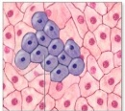
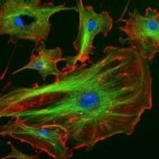

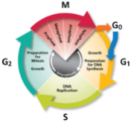
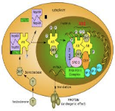
The Decipher metastasis signature represents multiple biological pathways involved in aggressive prostate cancer
Cell Proliferation, Differentiation
Cell Structure, Adhesion, Motility
Immune System Modulation
Cell Cycle Progression
Androgen-Signaling
CAMK2N1
MYBPC1
PBX1
THBS2
UBE2C
ANO7
EPPK1
IQGAP3
LASP1
MYBPC1
PCDH7
RABGAP1
GLYATL1P4
S1PR4
TNFRSF19
TSBP
NFIB
NUSAP1
ZWILCH
ANO7
PCAT-32
UBE2C

Slide 10

Decipher PROSTATE Biopsy

Slide 11
Role of decipher
Classifies men by Decipher genomic risk for:
  % likelihood of Metastasis 5 years post prostatectomy
  % likelihood High grade disease (Primary Gleason 4 or 5)
  % likelihood Prostate Cancer Specific Mortality (PCSM) 10 years post prostatectomy
Active Surveillance
Local Therapy
RP + PLND
EBRT + ADT
BRACHY
Biopsy
1st Line Treatment
Local + Systemic Therapy
RP + EPLND +/- early RT
EBRT + ADT (> 6mth)
EBRT+BRACHY
EBRT+BRACHY+ADT

Slide 12
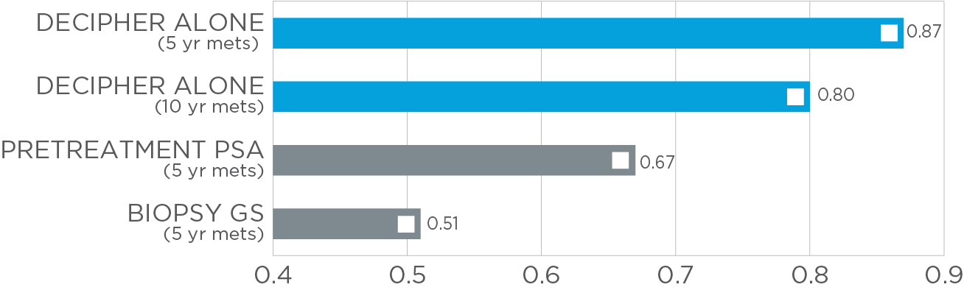
Comparison of Accuracy for Predicting Metastasis after Radical Proctectomy
1
AUC > 0.7 is clinically actionable
AUC=0.5 accuracy is comparable to a coin toss
1. Klein et al., Urology, 2016
Notes:
CD: References

Slide 13
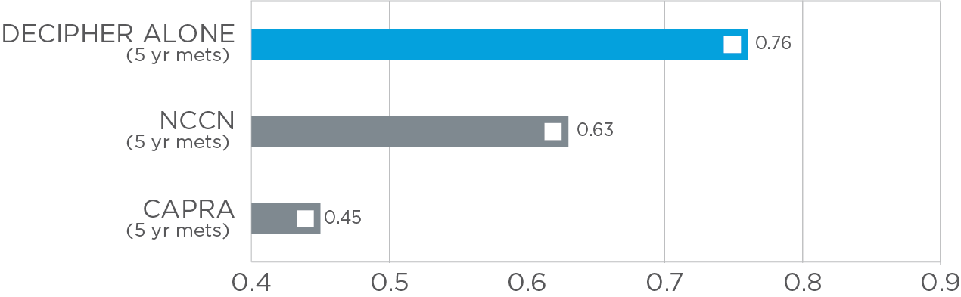
Comparison of accuracy for predicting 5 year metastasis after first line radiation

Slide 14
PROSPECTIVE STUDY OF BIOPSY DECIPHER SCORES IN POTENTIAL CANDIDATES FOR ACTIVE SURVEILLANCE
Examined Decipher score distribution in a prospective biopsy population (n=1,694)
Loeb, Klein et al., AUA 2017, Podium Presentation

Slide 15

Decipher Prostate rp

Slide 16
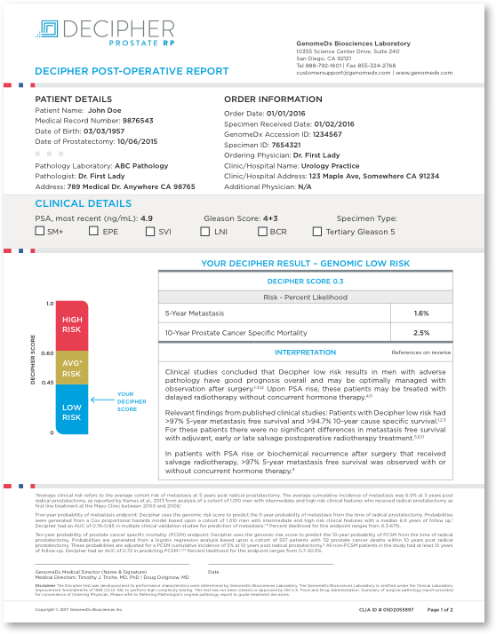
What is ?
Genomic signature selected for the ability to predict rapid metastasis after RP
Outputs a Genomic Classifier (GC) score that ranges from 0 to 1
Actionable genomic test results
  Be safely observed after RP?
  Need adjuvant or early salvage radiation?
  Be better managed with salvage radiation at BCR?
  Possibly avoid concurrent hormone therapy with
  radiation at BCR?
Medicare Indications**
• Positive Surgical Margin (SM+)
• Extraprostatic Extension (pT3a disease)
• Seminal Vesicle Invasion (pT3b disease)
• Bladder Neck Invasion (pT4 disease)
• Rising PSA or Biochemical Recurrence

Slide 17

Decipher outperforms clinical risk factors and nomograms
0.79
Extra prostatic Extension
0.65
Gleason Score
0.64
AUC > 0.7 is clinically actionable
AUC=0.5 accuracy is comparable to a coin toss
Seminal Vesicle Invasion
0.59
Lymph Node Invasion
0.56
Pre-Op PSA
0.56
Surgical Margins
0.49
0.45
0.80
Predictive power measured by Area Under the Curve (AUC)
Karnes et al., Journal of Urology 2013
Notes:
Decipher accuracy is primarily measured by AUC which is better than any existing path or clinical information. Also better than any combination of features (nomograms). This accuracy data is repeated in multiple validation studies.

Slide 18
Decipher High Risk Patients Who Received Adjuvant Therapy Had Improved Metastasis Free Survival
Decipher high risk patients may experience lower incidence rates of metastasis when treated with adjuvant radiation post-RP
Decipher low-risk patients may be managed safely with observation until PSA rise.
Decipher high-risk (GC ≥ 0.4)
P-value = 0.008
Salvage RT
Adjuvant RT
Decipher low-risk (GC < 0.4)
P-value = 0.788
Adjuvant RT
Salvage RT
Den et al. Journal of Clinical Oncology 2015
Notes:
This study (Den et al JCO, 2015) shown here provides further validation for the use of Decipher® as a tool to guide radiotherapy and represents a collaboration between the Mayo Clinic and TJU. It demonstrates that Decipher can predict metastasis in men following postoperative radiotherapy.
You can see incidence of metastasis of post-surgery treated with adjuvant or salvage radiation for each Decipher risk category (i.e. Decipher low-risk (A), Decipher high-risk (B), N=188).
For Decipher low-risk men, the results demonstrate that these patients do not benefit from adjuvant therapy and suggest these men may be safely managed with observation with PSA monitoring, while for Decipher high-risk men, there is a clear benefit in receiving adjuvant radiation.
Hazard ratio (HR) for adjuvant radiotherapy relative to salvage radiotherapy is 0.2 indicating that Decipher high-risk men who received adjuvant radiotherapy had 80% reduction in metastasis risk compared to those Decipher high-risk men who received salvage radiotherapy.

Slide 19
Decipher low risk patients may avoid concurrent hormones after BCR
Patient treated with salvage radiotherapy*
Decipher high-risk patients may require intensification of therapy beyond radiation as incidence of metastasis remains high.
Decipher low-risk patients have excellent prognosis with salvage radiation and may avoid concurrent hormonal therapy, as incidence of metastasis remains low.
Freedland et al. European Urology 2016
Notes:
Freedland Salvage RT study results.
All cases had RP followed by SRT (>0.2ng/mL)
Decipher was able to predict which patients would respond well to SRT (blue), which would not (red).
~30% of Decipher high-risk men failed SRT by 5 years and probably need more systemic, intensified therapy.

