Slide 1

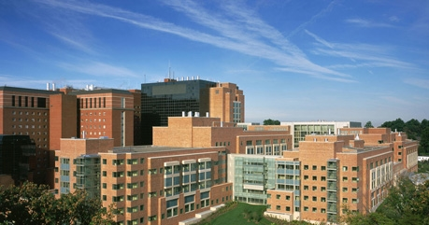
NIH Building 10: Immunotherapy & Prostate Cancer
James L. Gulley M.D., Ph.D., F.A.C.P.
Head, Immunotherapy Section
Chief, Genitourinary Malignancies Branch
& Director, Medical Oncology Service
Center for Cancer Research
National Cancer Institute, NIH
Notes:
13th Annual Meeting of the National Alliance of State Prostate Cancer Coalitions (NASPCC). The Meeting will take place at the Liaison Capitol Hill Hotel in Washington, D.C.

Slide 2
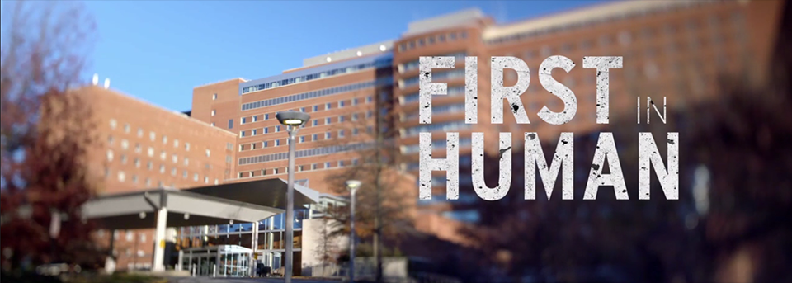

Slide 3


Slide 4
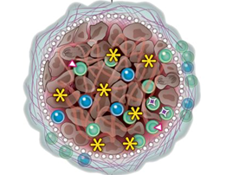

T-cell Inflamed Tumor
T-cell Poor Tumor
Virus associated cancer
Mutation associated neoantigens
Adapted from Padmanee Sharma, and James P. Allison Science 2015;348:56-61

Slide 5
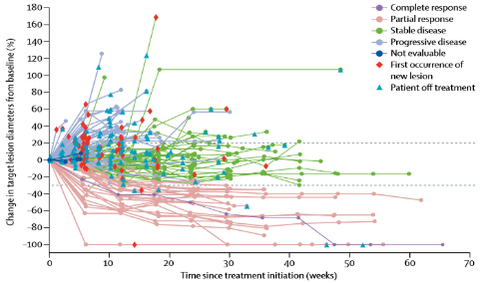
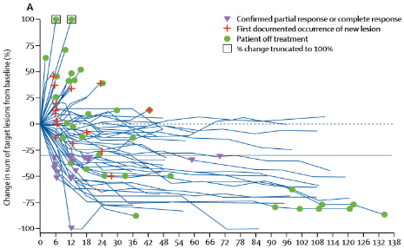
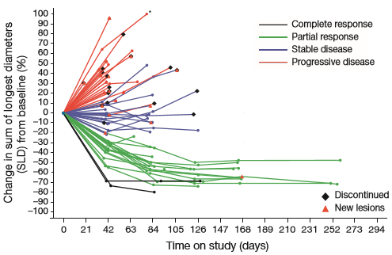
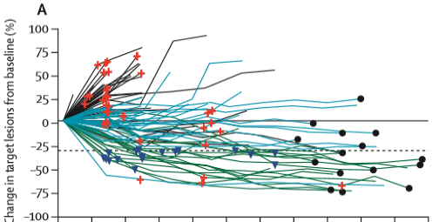
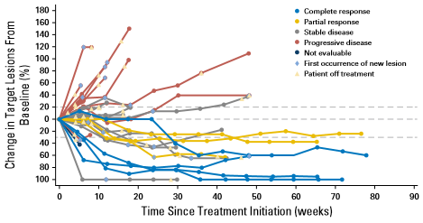
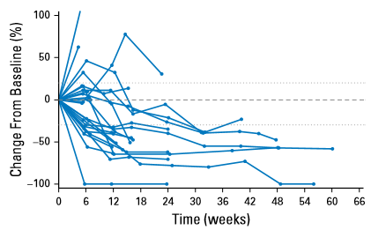
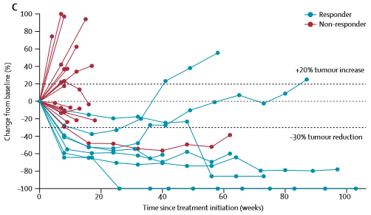
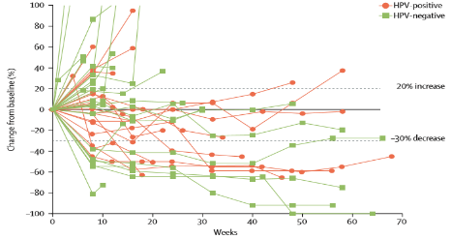

PD-1/PD-L1 inhibition
Rapid, deep, durable responses
Across a wide range of tumours
Seen in a subset of patients
NSCLC: avelumab
Gulley JL et al. Lancet Oncol 2017
MSI hi CRC: nivolumab
Overman MJ et al. Lancet Oncol 2017
Urothelial: atezolizumab
Powles T et al. Nature 2014
NSCLC (squamous only): nivolumab
Rizvi NA et al. Lancet Oncol 2015
Urothelial: avelumab
Apolo AB et al. J Clin Oncol 2017
Urothelial: durvalumab
Massard C et al. JCO 2016
HNSCC: pembrolizumab
Seiwert TY et al. Lancet Oncol 2016
Urothelial: pembrolizumab
Plimack ER P et al. Lancet Oncol 2017

Slide 6
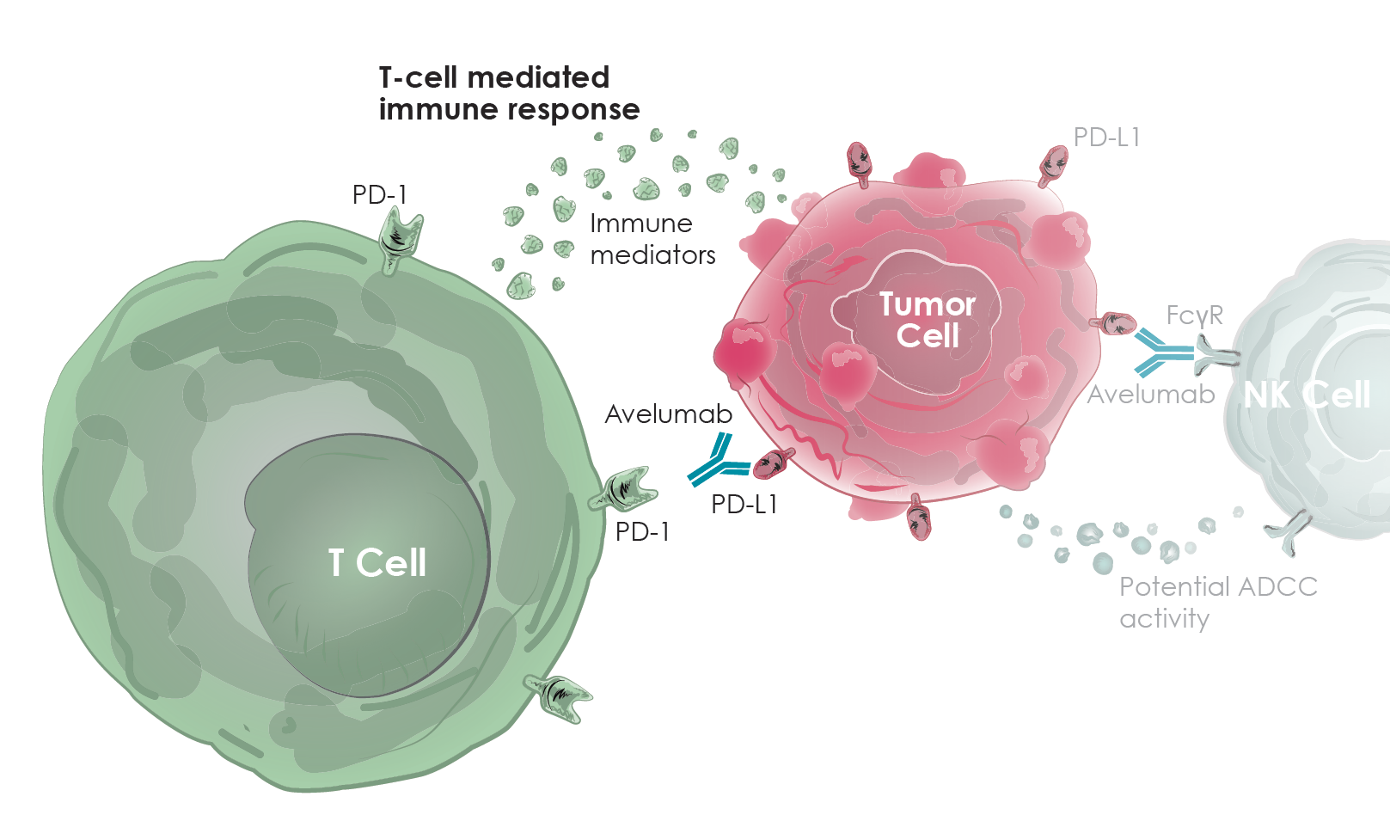
Importance of PD-1/PD-L1 blockade
NIH. News Headlines: https://ccr.cancer.gov/news/article/investigators-lead-first-human-trials-of-new-immunotherapy-drug (accessed August 2017)

Slide 7
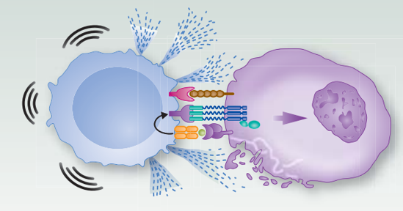

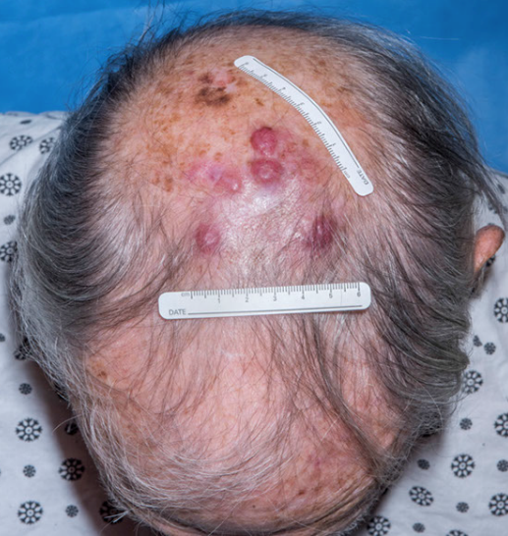
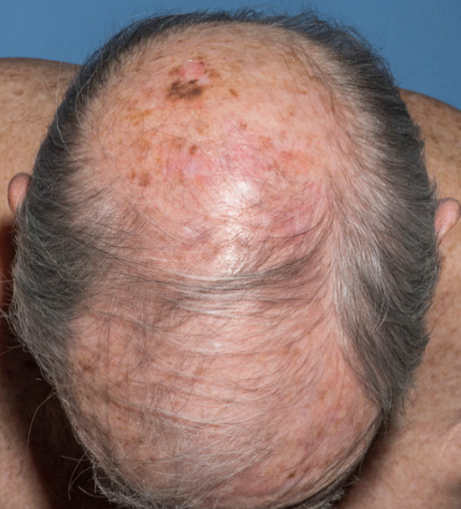
Enhancing an anti-tumor Immune Response in TME
Avelumab
  MCC
  Bladder
Bavencio
Merkel Cell Carcinoma (n = 88)
Urothelial (n = 44 → 249)
Kaufman H…Brownell I et al, Lancet Oncol, 2016
Apolo AB…Gulley JL et al. J Clin Oncol 2017

Slide 8
Prostate Cancer
T-cell Inflamed Tumor
T-cell Poor Tumor
Virus associated cancer
Mutation associated neoantigens
Adapted from Padmanee Sharma, and James P. Allison Science 2015;348:56-61

Slide 9
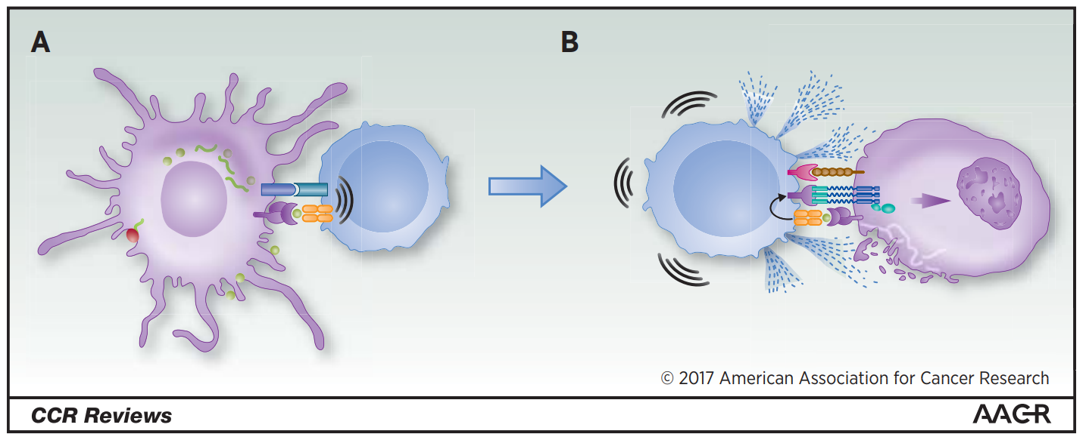
Requirements for Effective Immunotherapy
Engage → Expand → Enhance
Bilusic M, Madan RA, Gulley JL Clin Ca Res 2017

Slide 10
Anti-tumor Immune Response More Efficient with Vaccine vs. SOC
 | Cancer-free controls (n = 15) | AS (n = 9) | EBRT (no vaccine; n = 8) | EBRT + ADT (n = 15) | EBRT+ Vaccine (n = 33)
Western blot | 0 (0%) | 1 (11.1%) | 1 (12.5%) | 3 (20.0%) | 15 (45.5%)
Antigen array | 0 (0%) | 1 (11.1%) | 0 (0%) | 2 (13.3%) | 7 (21.2%)
Overall | 0 (0%) | 1 (11.1%) | 1 (12.5%) | 3 (20.0%) | 17 (51.5%)
Nesslinger… Schlom, Gulley et al, Clin Ca Res, 2010

Slide 11
APC Vaccine: Sipuleucel-T (Provenge)
Day 2-3
sipuleucel-T is manufactured
Day 1
Leukapheresis
Day 3-4
Patient is infused
Apheresis Center
Company (Dendreon)
Doctor’s Office
Notes:
11

Slide 12
Sipuleucel-T: IMPACT trial
P = 0.032 (Cox model)
HR = 0.775 [95% CI: 0.614, 0.979]
Median Survival Benefit = 4.1 Mos.
Sipuleucel-T (n = 341)
Median Survival: 25.8 Mos.
Placebo (n = 171)
Median Survival: 21.7 Mos.
Kantoff et al., NEJM 2010
Notes:
12
12
These results have significantly spurred interested in the field of therapeutic vaccines and I am confident that there will be other successful vaccines in the near future.

Slide 13
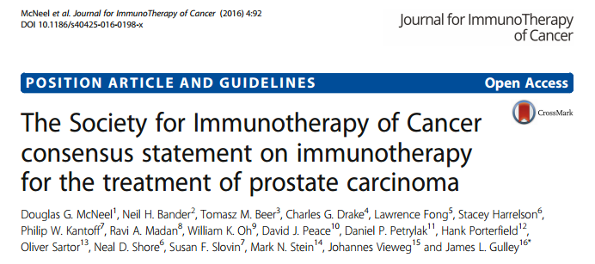
Sipuleucel-T
-Use early, in less aggressive disease
Dec, 2016

Slide 14
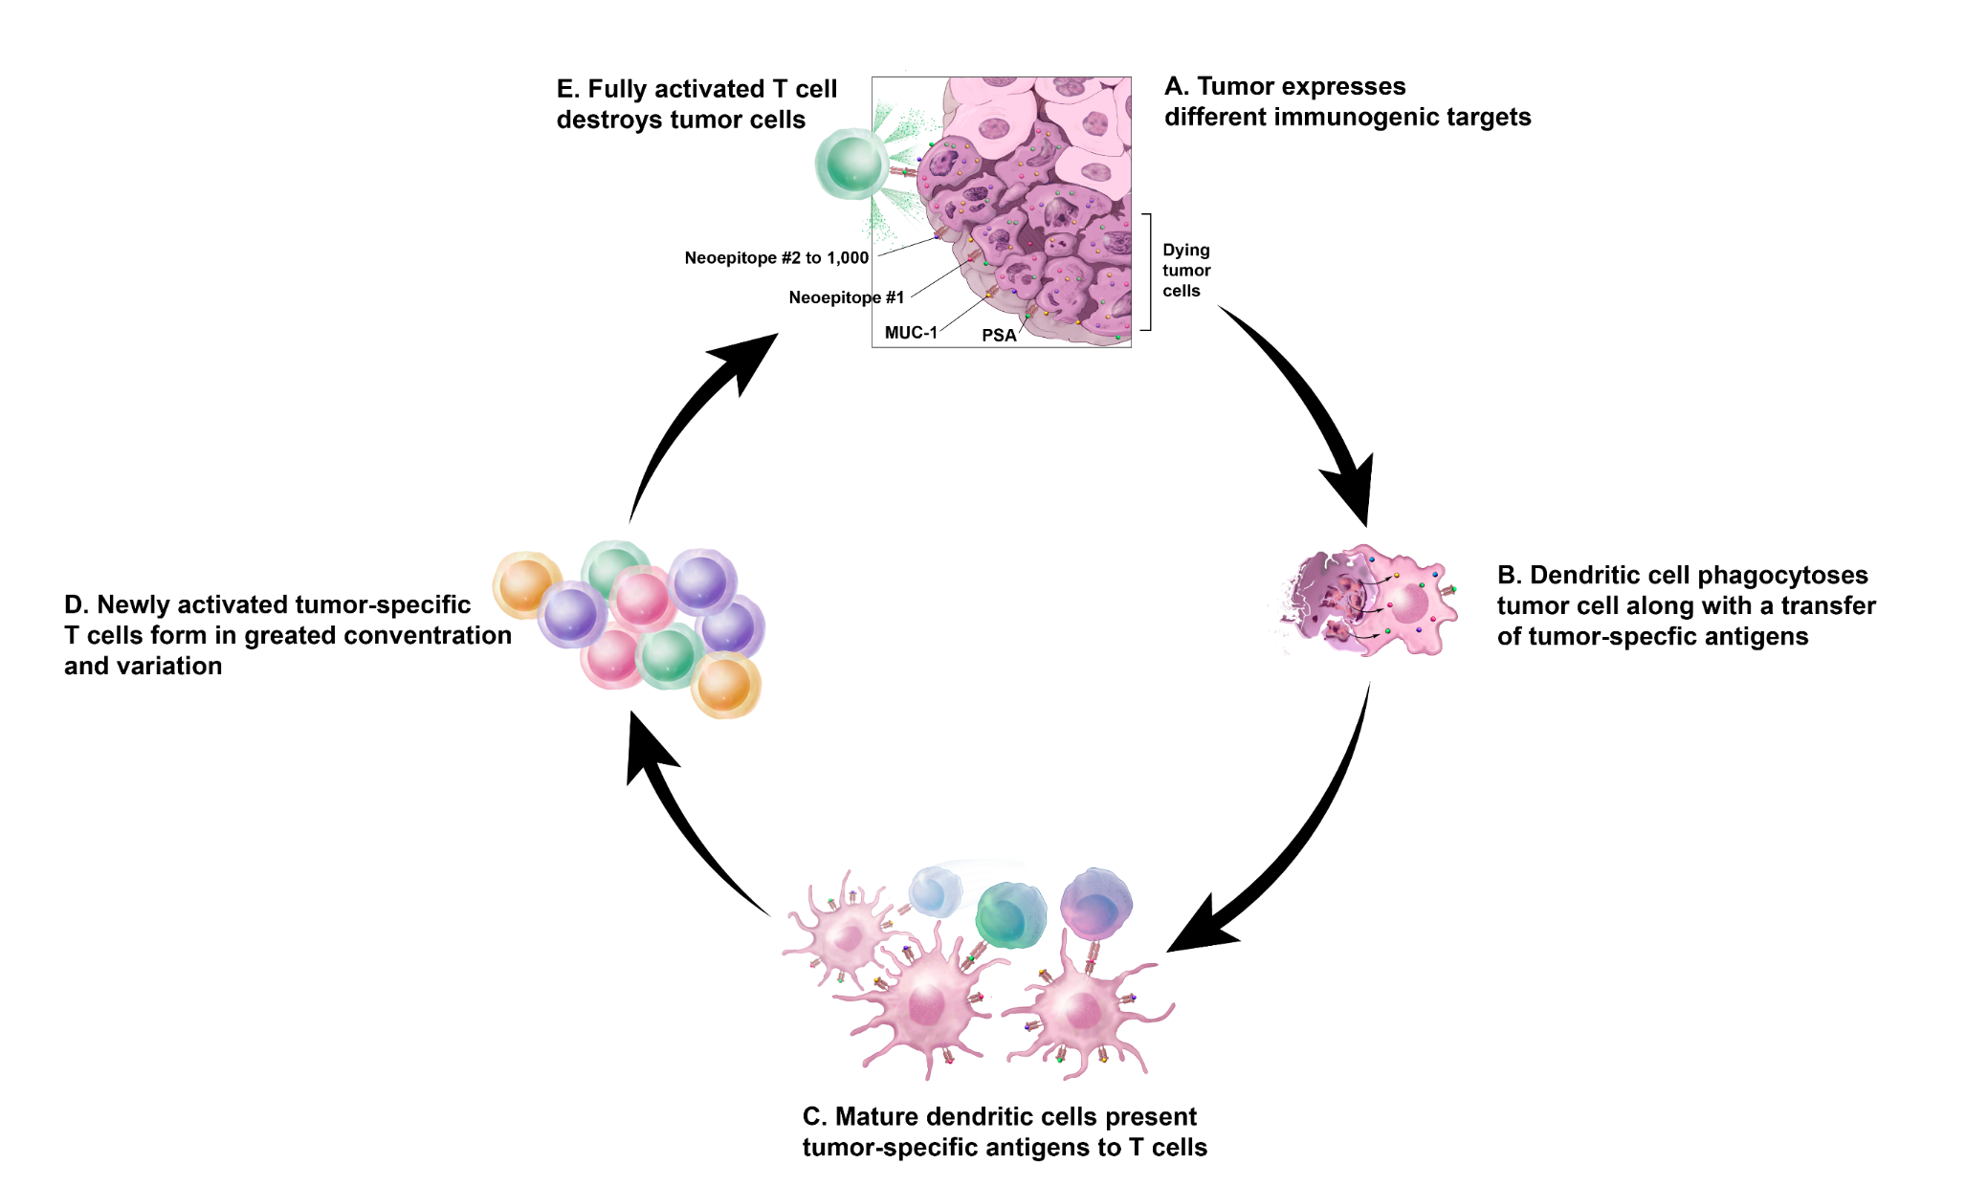
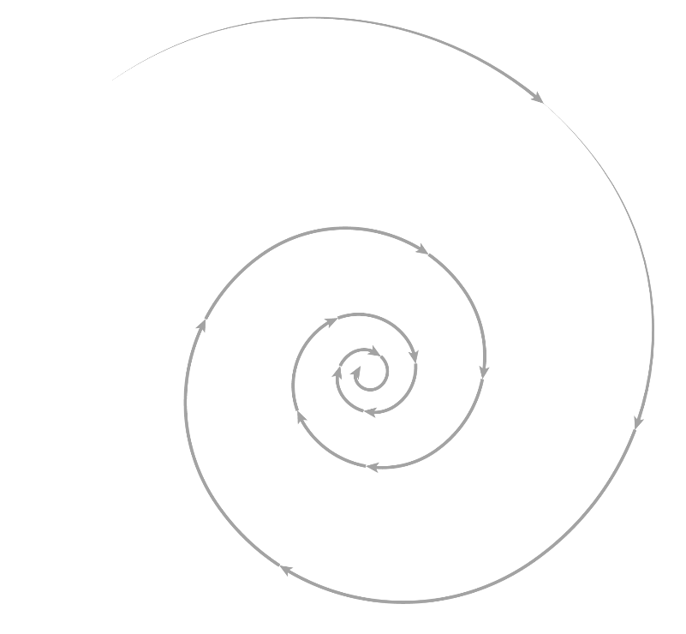
Tumor Immunity Cycle
(Antigen Spreading)

Slide 15
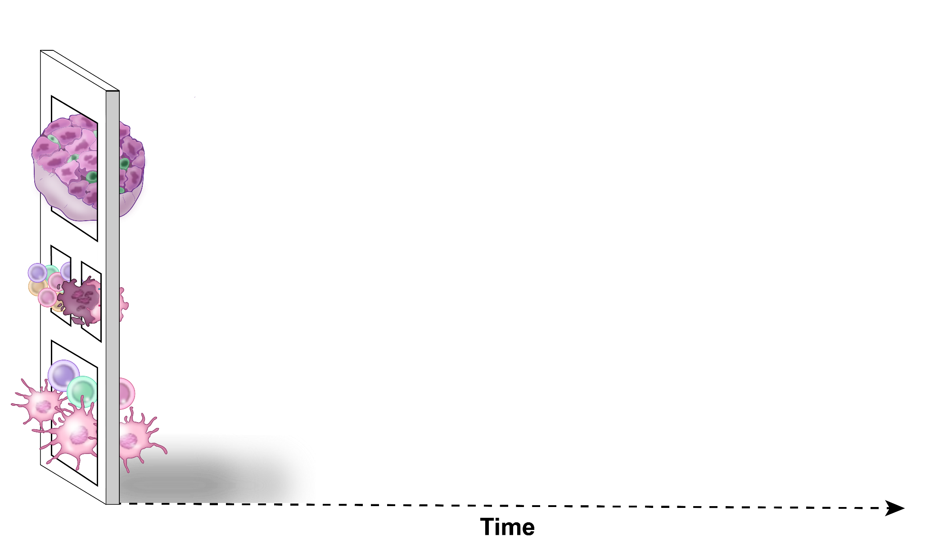
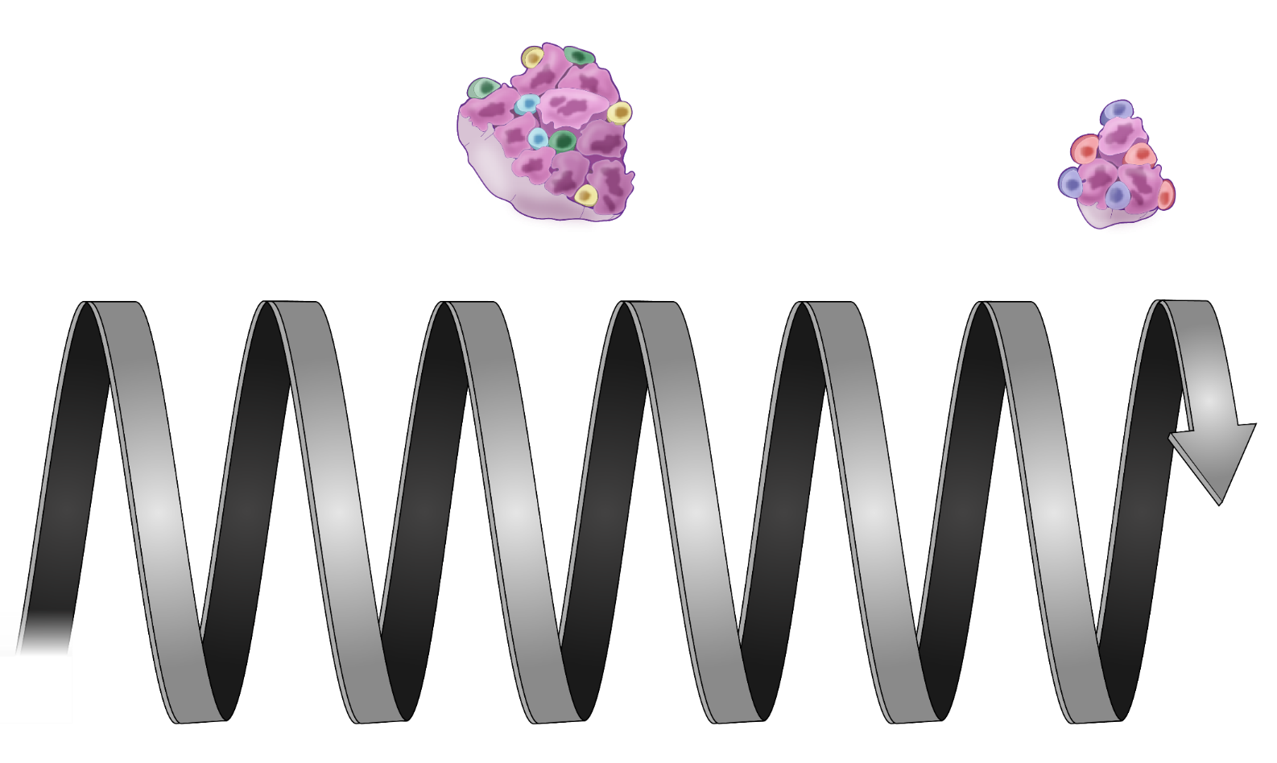
Vaccine and neoantigen
specific T-cells
Vaccine specific T-cells
Neoantigen
specific T-cells
(#IterativeAuger)

Slide 17
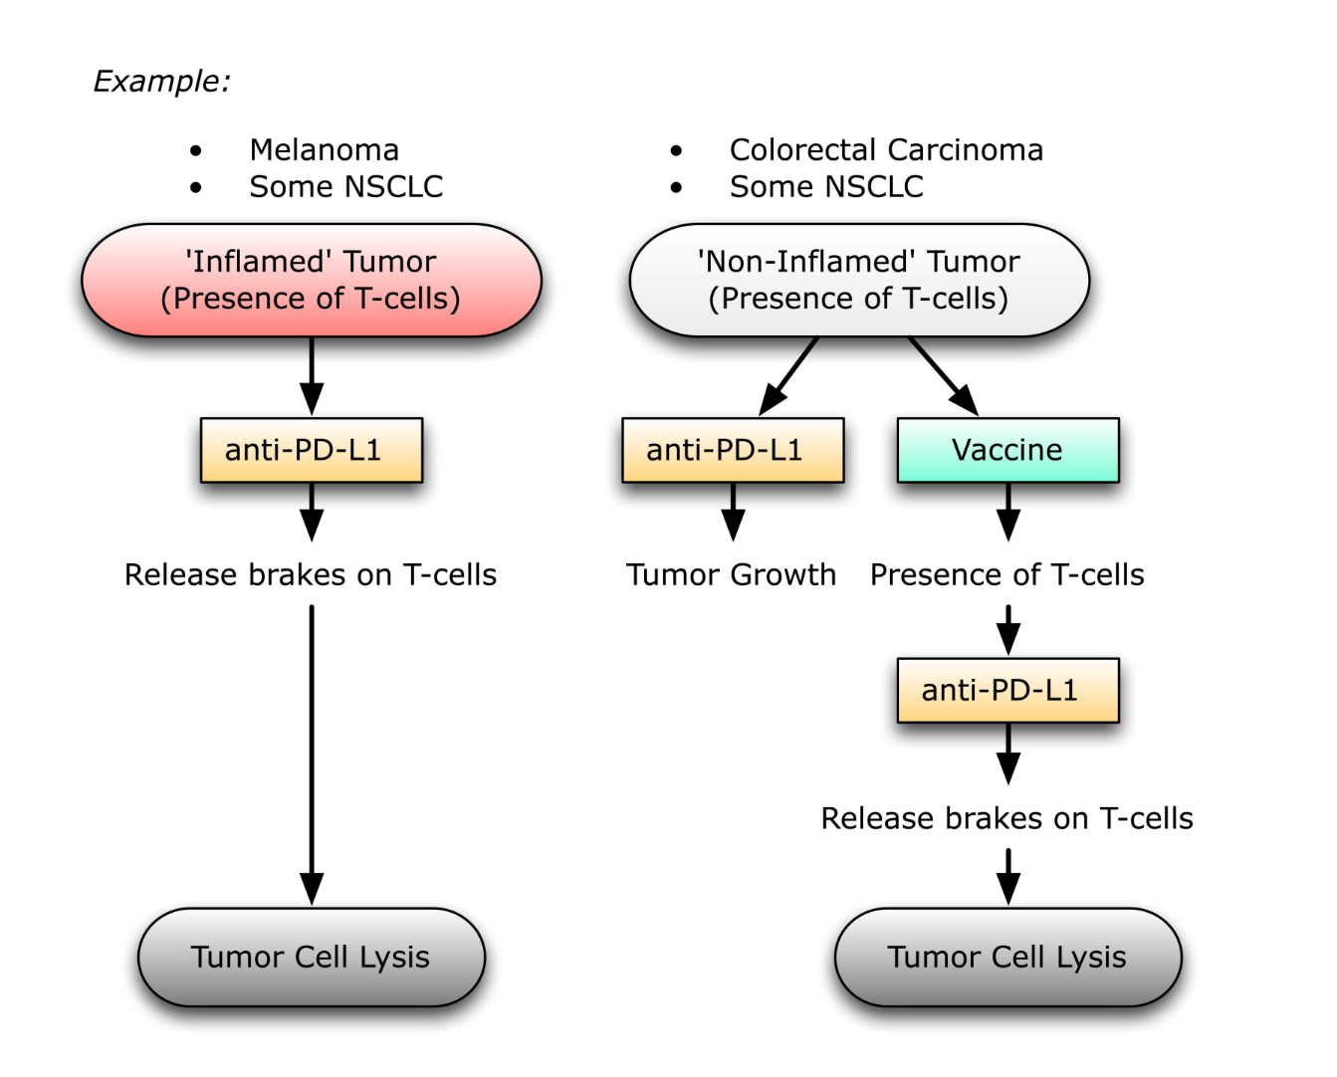
Working Model for T-cell infiltration and Immunotherapy
Prostate Cancer
(Absence
17

Slide 18

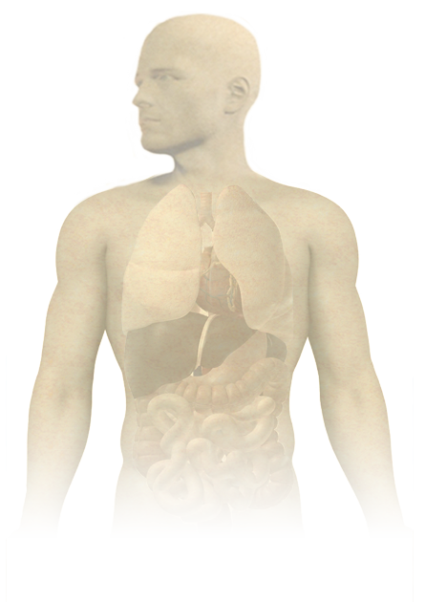

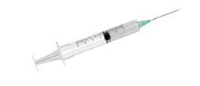
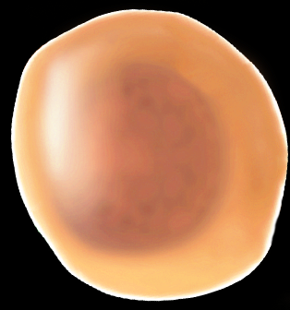

PROSTVAC-VF
Proposed Mode of Action
Tumor antigen gene
Costimulatory molecule genes
PSA
LFA-3
ICAM-1
B7-1
(TRIad of COstimulatory Molecules)
Induction of tumor-specific immune responses (T-cells)
Vaccines:
PROSTVAC-V
PROSTVAC-F
Developed within the CCR, NCI
--Preclinical (Schlom et al.)
--Clinical (Gulley et al.)
NIH Medical Arts and Photography
Notes:
78 publications on PubMed “Prostvac OR PSA-TRICOM”

Slide 19
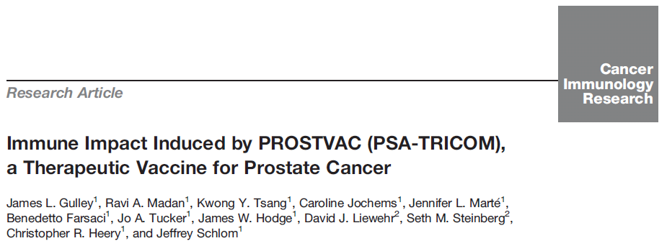
Test | Result | Comment
PSA Specific Immune response | 56.7% (59/104) | 28 days after last vaccine
--Median fold increase in PSA specific immune response | 5X | # of PSA specific T-cells similar to flu T-cells
Antigen Spreading | 67.9% (19/28)
Anti-PSA Ab | 0.57% (2/349)
2014

Slide 20
Prostvac (+ Ipilimumab) + Nivolumab (NCT02933255)
Background:
No sustained decreases in PSA or tumor size with either vaccine or checkpoint inhibitor alone
Lead-in cohort
mCRPC
No prior chemotherapy
Week 0 | Week 2 | Week 5 | Week 8 & q3wk
Prostvac-V | Prostvac-F | Prostvac-F | Prostvac-F
 | Ipilimumab | Ipilimumab | --
 | Nivolumab | Nivolumab | Nivolumab
Ipilimumab 1 mg/kg, Nivolumab 240 mg

Slide 21
PSA Changes
(88% PSA decline, Confirmed PR)
(95% PSA decline)
Previous trial of ipilimumab with nivolumab had a >50% PSA decline in 1 of 15 mCRPC patients (Boudadi, K et al, ASCO 2017)
Clinical Trial Number: NCT02933255
Primary Investigator: James L. Gulley

Slide 22
Prostvac, Ipilimumab, Nivolumab: Patient 1
Patient 1 with 88% PSA Decline
Patient 1: Case History
62 year old with mCRPC in retroperitoneal and pelvic lymph nodes
Prior treatment for metastatic disease: ADT
Had cystitis after two doses of ipilimumab and nivolumab
Cystitis treated with prednisone
Patient continues prostvac alone
Doses of ipilimumab & nivolumab with vaccine
Presentation of Cystitis
Continues Vaccine Alone
Clinical Trial Number: NCT02933255
Primary Investigator: James L. Gulley

Slide 23
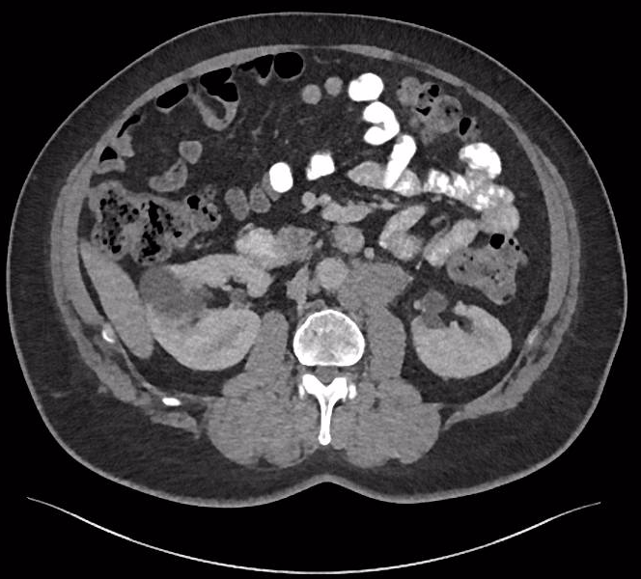
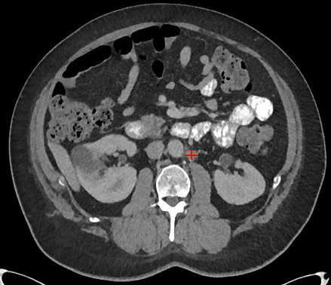
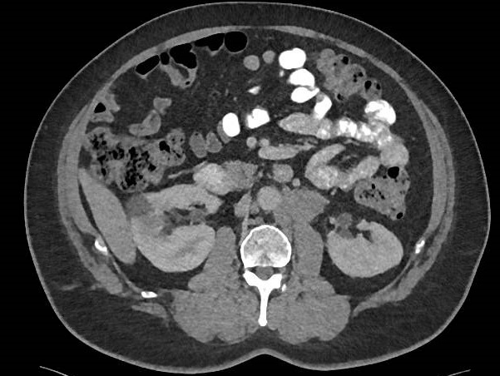
Prostvac, Ipilimumab, Nivolumab:
Partial Response in Patient 1:
Patient 1 with
88% PSA Decline,
Partial Response
3 x2 (right)
Retroperitoneal Lymph Node 4.2 x 2.7 cm at baseline
Retroperitoneal Lymph Node 1.0 x 1.0 cm at 23 weeks
Clinical Trial Number: NCT02933255
Primary Investigator: James L. Gulley

Slide 24
Prostvac, Nivolumab: Patient 4
Patient 4 with 95% PSA Decline
Nivolumab
added
to vaccine
Patient 4: Case History
68 year old with mCRPC and multiple bone lesions and an obstructing bladder mass at enrollment
Prior treatments include (adjuvant) docetaxel, ADT, bicalutamide, sipuleucel-T, and enzalutamide
Patient only treated with prostvac and nivolumab
Clinical Trial Number: NCT02933255
Primary Investigator: James L. Gulley

Slide 25
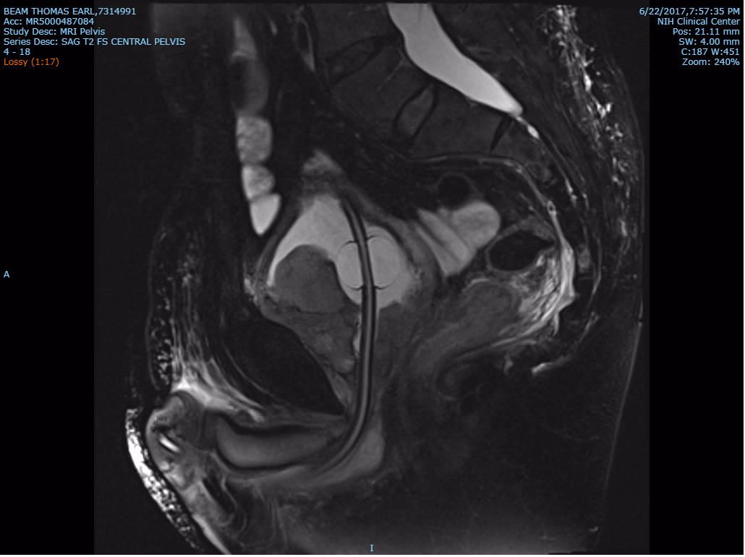
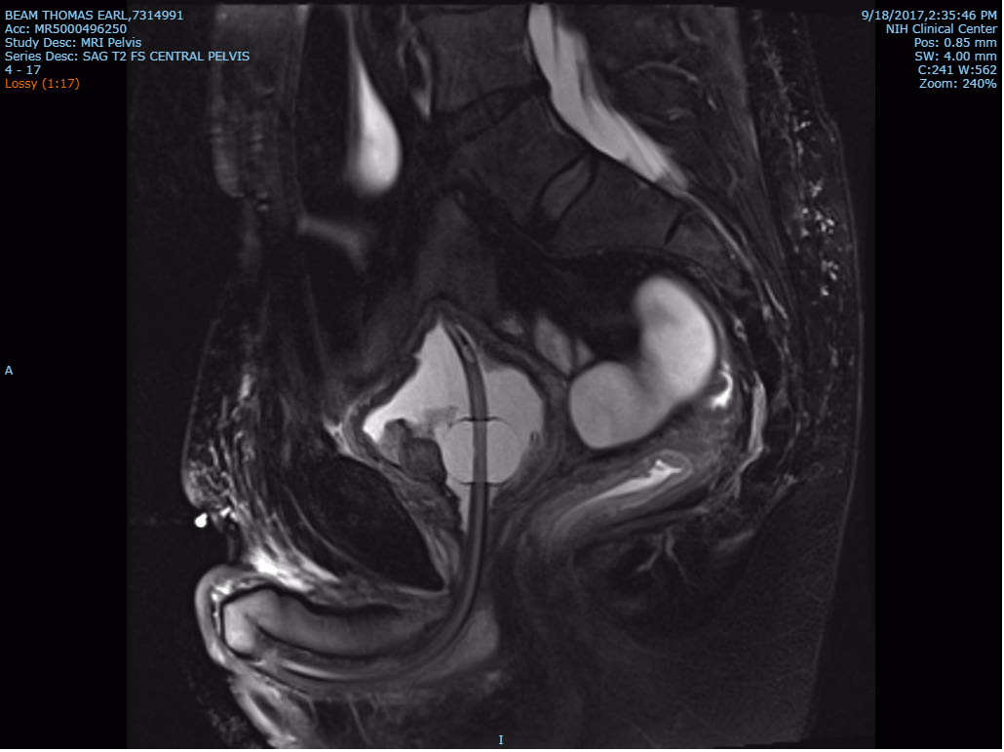
Prostvac, Nivolumab: Patient 4 with Substantial Reduction in Bladder Mass
Patient 4 with 95% PSA Decline
Baseline Bladder Mass 3.4 x 2.5 cm
Bladder Mass 2.4 x 1.3 cm after 12 weeks
Clinical Trial Number: NCT02933255
Primary Investigator: James L. Gulley

Slide 26
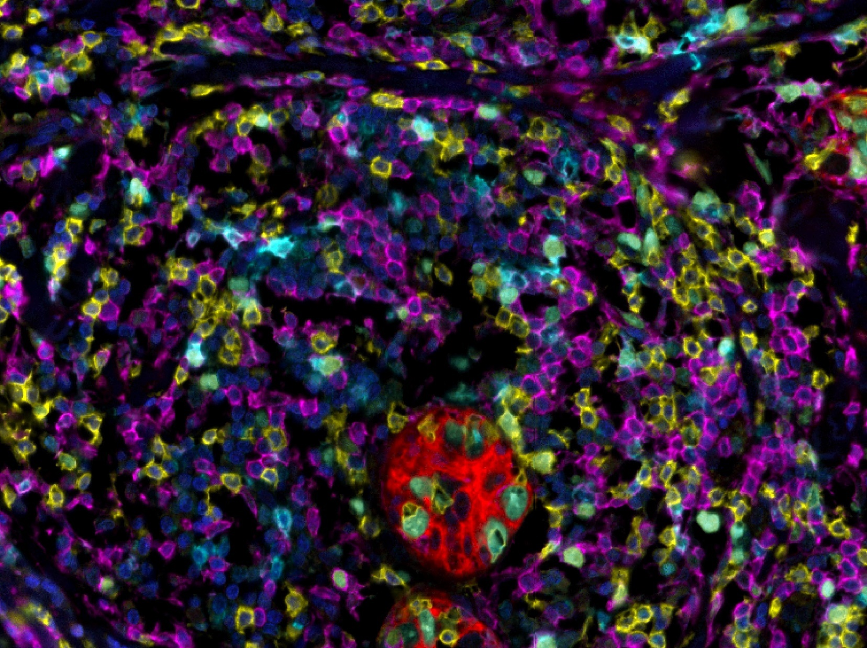
DAPI
PD-1
CD4
CD8
CK

Slide 27
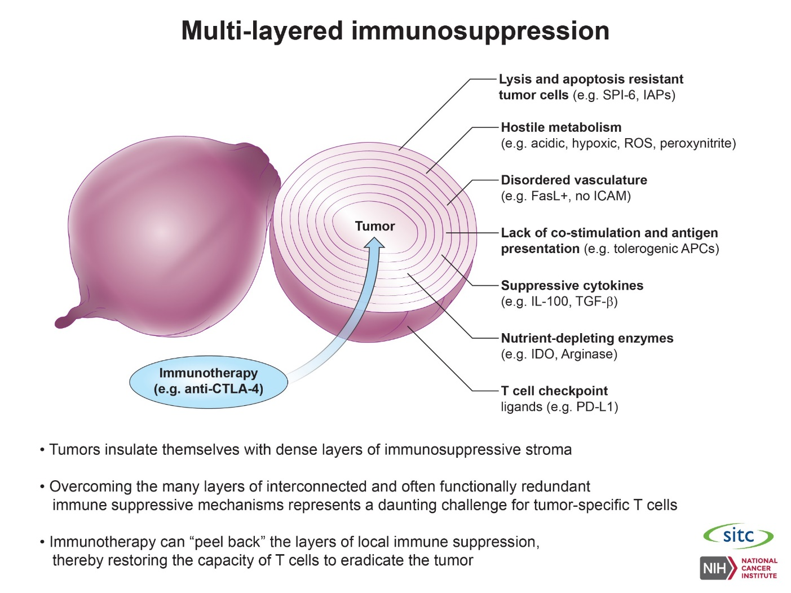

Slide 28
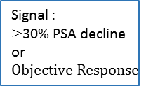




QuEST (Quick Efficacy Seeking Trial)*
anti-PDL1 / TGF-β Trap
+ ALT-803
MVA/rF-Brachyury TRICOM
+ anti-PDL1 / TGF-β Trap
2) MVA/rF-Brachyury TRICOM
+ anti-PDL1 / TGF-β Trap
+ ALT-803
3) MVA/rF-Brachyury TRICOM
+ anti-PDL1 / TGF-β Trap
+ ALT-803
+Epacadostat
ALT-803 Dose-finding
Safety Cohort (fixed dose M7824)
n = 6-12
Cohort 1
n=12
+ signal in $≥2$
Expand to n=35
Cohort 2
n=12
+ signal in $≥2$
Engage: Vaccine
Expand: IL-15
Enhance: PD-L1, TGF-β, IDO
+ signal in $≥6$
Expand to n=35
Cohort 3
n=12
Further study
+ signal in $≥2$
+ signal in $≥6$
Expand to n=35
Further study
+ signal in $≥6$
Signal :
$≥$30% PSA decline
or
$$Objective Response$$
Further study
*NCI sponsored study, in review

Slide 29
Conclusions
T-cell poor tumors may require a “spark” to get the immune system to recognize and seek to destroy the tumor.
One of the most efficient ways of doing this is with vaccine
Sipuleucel-T is approved in the US and data from the study of PSA-TRICOM is eagerly awaited.
The tumor immunity cycle is an ongoing iterative process that may lead to an individualized evolution of the immune response to focus on targets most immunologically relevant for a given patient (e.g., neoantigens) (#PrecisionMedicine #PersonalizedMedicine)
Approaches that both steer the immune system and allow effector cells to get to and remain functional within the TME will be optimal

Slide 30
