Slide 1
A Tale of Two Cancers or
How Genomics Can Guide Treatment Decisions
Bela S. Denes, MD, FACS
Genomic Health, Inc.
Redwood City, CA

Slide 2

Decisions for a Man with Clinically Low Risk Prostate Cancer
If I choose surgery or radiation, I worry about ED…if I choose surveillance, I worry about cancer spreading
Surgery
Robotic radical prostatectomy
Open radical prostatectomy
Focal Therapy (cryotherapy, HIFU, etc.)
External beam radiotherapy
Radiation
Active surveillance
Brachytherapy
Notes:
2

Slide 3
NCCN Guideline for Management of
LOW RISK CaP
RISK GROUP
EXPECTED PATIENT
SURVIVAL
INITIAL THERAPY
Active surveillance^{g}
PSA no more often than every 6 mo unless clinically indicated
DRE no more often than every 12 mo unless clinically indicated
Repeat prostate biopsy no more often than every 12 mo unless clinically indicated
≥ 10 y
EBRT or brachytherapy
RP + PLND if predicted probability of
lymph node metastasis ≥ 2%
Low
T1-T2a
Gleason score ≤ 6
PSA < 10 ng/mL
< 10 y
Observation
^{g}Active surveillance involves actively monitoring the course of disease with the expectation to intervene with potentially curative therapy if the cancer progresses. See Principles of Active Surveillance and Observation (PROS-C).
NCCN Clinical Practice Guidelines in Oncology™, Prostate Cancer v1.2015. © National Comprehensive Cancer Network, 2015
NCCN is a registered trademark of the National Comprehensive Cancer Network, which does not endorse any product or therapy.
Notes:
For men with Low risk cancer, active surveillance is the primary recommendation with ≥10 years life expectancy
For men with Low Risk cancer and ≥10 years life expectancy OR with Very Low risk cancer and ≥20 years life expectancy, the NCCN guidelines specify 3 options, including active surveillance, radiation therapy (external beam or brachytherapy), or radical prostatectomy.
According to the AUA guidelines (2007), “Active surveillance, interstitial prostate brachytherapy, external beam radiotherapy, and radical prostatectomy are all options for treatment of the low-risk patient. Study outcomes data do not provide clear-cut evidence for the superiority of any one treatment.”
As distinguished from Watchful Waiting, Active Surveillance involves:
Careful selection of men at low risk of harm from prostate cancer without treatment
Careful monitoring of those who select active surveillance
Curative intervention for men who no longer meet criteria for active surveillance
In current practice, selection of candidates for active surveillance is based on:
Tumor clinical and pathologic features
Patient factors
Life expectancy, age, and overall health
Patient preferences
Reference: National Comprehensive Cancer Network (NCCN) prostate cancer guidelines. Available at: www.nccn.org (Accessed January 2014).

Slide 4
The Challenge of Risk Classification with TRUS biopsy
The Correlation of Biopsy GS with Radical Prostatectomy GS
Biopsy | Prostatectomy
 |  | 3+3=6 | 3+4=7 | 4+3=7 | 3+5=8 | 5+3=8 | 4+4=8 | GS 9,10
 | 3+3=6 | 72% | 22% | 4% | 0% | 0% | 1% | 1% | 5610
 | 3+4=7 | 21% | 56% | 18% | 1% | 0% | 1% | 2% | 2216
 | 4+3=7 | 9% | 32% | 40% | 1% | 0% | 9% | 9% | 1136
 | 3+5=8 | 4% | 36% | 36% | 13% | 0% | 2% | 9% | 55
 | 5+3=8 | 5% | 30% | 20% | 10% | 15% | 0% | 20% | 20
 | 4+4=8 | 3% | 11% | 26% | 1% | 0% | 38% | 21% | 436
 | GS 9,10 | 1% | 7% | 10% | 4% | 2% | 8% | 67% | 338
 |  | 4609 | 2968 | 1246 | 86 | 18 | 364 | 520 | 9811
Single Institution Experience (JHH) Matched Bx & RP 2004-2014;J. Epstein 9-13-15

Slide 5
The Challenge of Random Biopsies
3
+
4
4
+
4
Final Pathology – GS 7 (3 + 4)
3
+
3
3
+
3
5
(-)

Slide 6
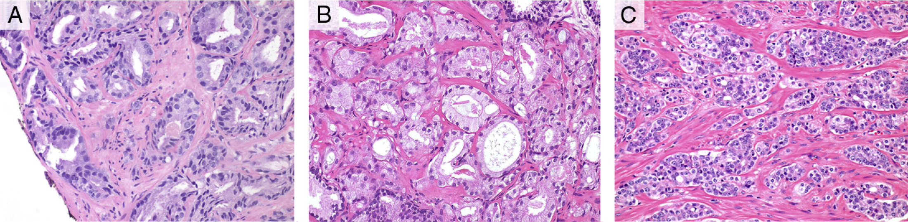
Is this Gleason 3 or Gleason 4 Cancer?
Gleason pattern 3
Gleason pattern 4
25% active surveillance patients contained foci where this distinction had to be considered
Interobserver reproducibility classic Gleason patterns substantial (κ 0.76)
Interobserver reproducibility for the distinction of tangentially sectioned Gleason pattern 3 from Gleason pattern 4 was only fair(κ 0.27)
McKenney. J of Urology 2011. 186:465
Notes:
Definition: cluster of poorly formed glands seen at 10X where it is unlikely that they all represent tangentially sectioned glands should GP4 be diagnosed. “with regard to GP3 and 4, the major problem appeared to be defining the limits of tiny poorly defined acinar structures. IN additional at times, it may be difficult to determine whether loss of acinar spaces is caused by compression artifact or by real inability to form spaces.

Slide 7


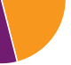
The Importance of Getting It Right
Favorable Pathology @ RP
Organ Confined
Gleason 3+3 OR Gleason 3+4
`
CLINICALLY
LOW-RISK
BIOPSY
?
60 -70%
Does my patient have aggressive
disease?
5-Year
BCR
15-Year
PCSM
10-Year
Mets
Post RP
30-40%
Adverse Pathology @ RP
Gleason ≥4+3 and/or ≥pT3
Progression-free
Survival (Time 0)
Biochemical Recurrence
(5 years)
Metastasis
(10 years)
Prostate Cancer–specific Mortality (15 years)
Epstein JI et al. Eur Urol. http://dx.doi.org/10.1016/j.eururo.2015.06.046; Eggener SE et al. J Urol. 2011; Dinh KT et al. J Urol. 2015; Cooperberg MR et al. Cancer. 2011;
Tilki D et al. J Urol. 2015.
Notes:
Key Messages
Approximately 70%-80% of men who have favorable pathology on initial biopsy will have favorable pathology on RP, in contemporary series. Favorable pathology on biopsy in the setting of clinically low-risk disease is in most cases predictive of favorable pathology on radical prostatectomy (RP). However, between 20%-30% of men who are clinically low risk on biopsy will harbor occult adverse pathology (AP) features on surgical pathology after RP. AP is a critical determinant of long-term prognosis.
Because the men who have AP at surgery are the ones at greatest risk of disease progression, accurately determining which patients are at high risk of having AP at surgery (and hence benefit from immediate treatment) should be determined BEFORE surgery. Similarly, men who are at low risk for AP and have favorable disease are the best candidates to defer treatment and consider active surveillance.
A genomic test can provide the actionable information about who is at risk for AP.
Speaker Notes
How do we most accurately answer these questions: “How bad is my cancer?” and “What are my treatment options?”
Gleason score on surgical pathology is the best indicator of long-term prognosis in men with prostate cancer (PCa). Existing metrics to predict surgical pathology (prostate-specific antigen [PSA], biopsy Gleason score, age, clinical stage, etc) are helpful but limited in their ability to accurately predict surgical pathology. In cases where these parameters suggest high risk, there is minimal controversy about whether treatment is indicated. Much of the contemporary controversy about PCa detection and treatment is centered on patients who are clinically low risk based on existing metrics. Many of these men will do well with Active Surveillance; however, a small but important percentage may be under-sampled due to limitations of current imaging and biopsy techniques. A way to predict which patients have AP will help inform management discussions and facilitate optimal patient management.
[builds]
Approximately 70%-80% of men who have favorable pathology on initial biopsy will have favorable pathology on RP. However, between 20%-30% of men who are clinically low risk harbor occult AP features on surgical pathology after RP. AP (defined here as Gleason >4+3 and/or pT3+) at the time of surgery is a critical determinant of long-term prognosis.
Over time, few men with favorable pathology on prostatectomy specimens progress to biochemical recurrence, metastasis, and prostate cancer–specific mortality. Men with adverse surgical pathology are likely to have significantly worse outcomes over time; they are more likely to progress to biochemical recurrence (BCR), metastases, and death. Because the men who have AP at surgery are the ones at greatest risk of disease progression, accurately determining which patients have AP (and hence benefit from immediate treatment) should be determined BEFORE surgery.
What is needed is a tool that can predict the likelihood of favorable pathology and provide both physicians and patients with the confidence that they have made the appropriate management decision. The GPS was designed to provide this actionable information.
How the pie chart proportions were generated
The estimates for rate of adverse versus favorable pathology have been gleaned from a variety of studies including Epstein, Eggener, and Dinh.¹⁻³ There is obvious variability in rate of pathologic upgrading in different patient populations but this range is broadly reflective of current trends.
The estimates for rates of biochemical recurrence, metastasis, and death from PCa are composites from Epstein (BCR within 5 years),¹ Cooperberg and Tilki (metastasis within 10 years),^{4,5} and Eggener (prostate cancer–specific mortality within 15 years),² respectively. In the raw data, the rate of metastasis at 10 years (reported by Cooperberg⁴ and Tilki⁵) was somewhat lower than the rate of death at 15 years reported by Eggener.² This led to some formatting issues with the way the data would be presented so the metastasis slice of pie is a bit higher than Tilki and Cooperberg reported but within an approximate range.
Because AP as defined in the Oncotype DX® test comprises a wide range of aggressiveness (Gleason 4+3 to Gleason 5+5 and pT3a to pT4), the percentage estimates are derived from averaging between prognostic groups. Compared with the percentages depicted here, the rate of BCR/mets/death is lower in men with Gleason 4+3 and higher in men with Gleason 8-10, but to keep the slide simple all these groups were collapsed together.
The pie chart depicting the Favorable Pathology group includes men ranging from low volume Gleason 3+3=6 to men with higher volume but organ-confined Gleason 3+4=7 disease. Hence, the ranges depicted here are also a composite of a variety of percentage estimates which were collapsed together. The difference in rate of various adverse events is obviously lower in this group compared with the AP group because outcomes are generally similar for organ-confined Gleason 3+3 and organ-confined Gleason 3+4.
The outcomes data is an approximation based on multiple sources.
Transition Note
On the next slide, we discuss the Oncotype DX® family of tests, which have been developed and widely utilized to help patients facing cancer make more informed and personalized decisions. Consider a transition statement along the lines of “We need better tools to help patients determine their likelihood of prostate cancer that merits immediate action (ie, cancer with adverse pathological features).”
References
1. Epstein JI, Zelefsky MJ, Sjoberg DD, et al. A contemporary prostate cancer grading system: a validated alternative to the Gleason score. Eur Urol. http://dx.doi.org/10.1016/j.eururo.2015.06.046.
2. Eggener SE, Scardino PT, Walsh PC, et al. Predicting fifteen-year cancer-specific mortality based on the pathological features of prostate cancer. J Urol. 2011;185:869-875.
3. Dinh KT, Mahal BA, Ziehr DR, et al. Incidence and Predictors of Upgrading and Up Staging among 10,000 contemporary patients with low risk prostate cancer. J Urol. 2015;194:343-349.
4. Cooperberg MR, Hilton JF, Carroll PR. The CAPRA-S score: a straightforward tool for improved prediction of outcomes after radical prostatectomy. Cancer. 2011;117:5039-5046.
5. Tilki D, Mandel P, Schlomm T, et al. External validation of the CAPRA-S score to predict biochemical recurrence, metastasis and mortality after radical prostatectomy in a European cohort. J Urol. 2015;193:1970-1975.

Slide 8
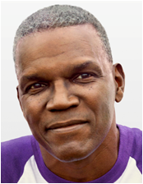
Michael is NCCN Low Risk has Been Advised to Have Radiation
PSA of 6.0
PSAD of 0.30 ng/mL
Prostate Volume of 20cc
Biopsy revealed Gleason score 6 (3+3), 1/12 positive cores
By NCCN® clinical factors alone he has NCCN® low-risk cancer and is interested in Active Surveillance
Michael
68-year-old
healthy man;
Positive family hx
His physician ordered GPS to assess the risk of occult higher-risk disease
Patient names, images, and pathology photos are illustrative.
American Society of Clinical Oncology (ASCO) and ASCO are registered trademarks of ASCO; National Comprehensive Cancer Network (NCCN) and NCCN are registered trademarks of NCCN. ASCO and NCCN do not endorse any product or therapy.
Notes:
This patient is the typical low-risk prostate cancer patient:
Elevated PSA of 6.0
PSAD of 0.30 ng/mL
Prostate Volume of 20cc
Biopsy revealed Gleason score 6 (3+3), 1/12 positive cores
This patient has low-risk prostate cancer patient and would like to consider active surveillance

Slide 9
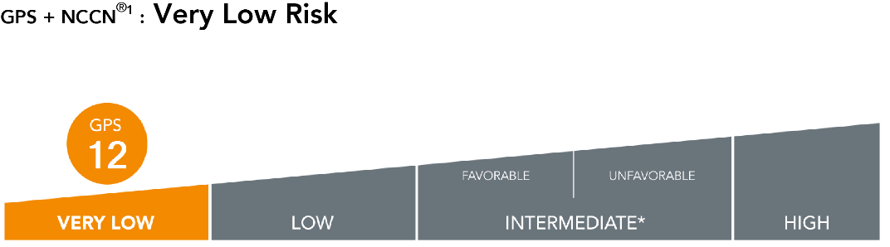
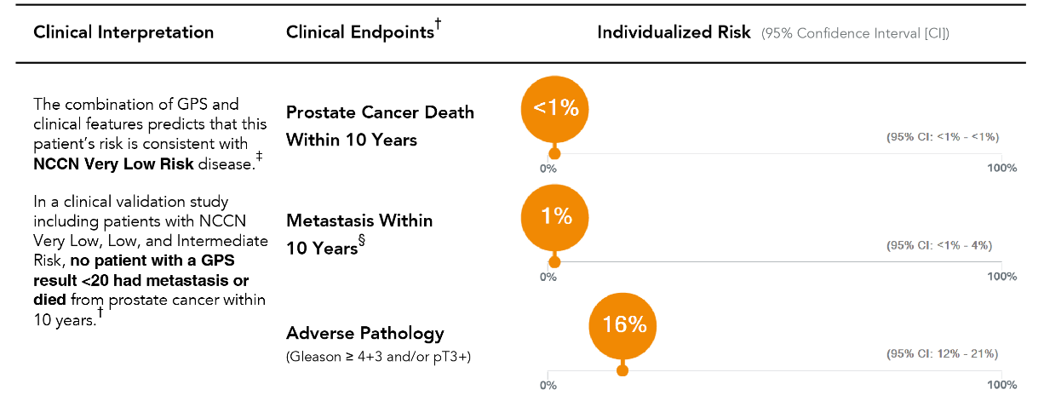
Michael’s Oncotype DX GPS Report
No patients with GPS
< 20 in the validation study experienced metastasis or prostate cancer death
Based on GPS his physician recommended that Michael proceed with Active Surveillance
This phrase appears only in reports with
GPS < 20
Notes:
Key Education Points:
Michael’s individual risk is most consistent with NCCN very-low-risk disease.
Based on the third validation study results,¹ Michael has a <1% chance of dying or metastasis within 10 years from his prostate cancer. This information helped his physician put his long-term risk in context in discussions with Michael.
In this same study, no patients with a GPS <20 and NCCN intermediate or less risk disease died or experienced metastasis within 10 years.
Based on these results Michael and his physician were confident in pursuing active surveillance as initial management
Reference
Van Den Eeden et al. J Urol. 2017 Abstract MP20-05.

Slide 10
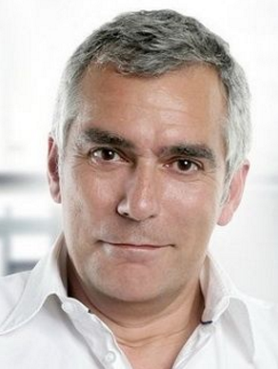
George is NCCN Risk and has Been Advised to Pursue Active Surveillance
John
PSA of 5.4
PSAD of 0.18 ng/mL
Prostate Volume of 30cc
Biopsy revealed Gleason score 6 (3+3),
2/12 positive cores
By NCCN® clinical factors alone he has NCCN® low-risk cancer and is not sure what to do next
George
58-year-old
healthy man;
Negative family hx.
His physician ordered Oncotype DX GPS to assess the risk of occult higher-risk disease
Patient names, images, and pathology photos are illustrative.
American Society of Clinical Oncology (ASCO) and ASCO are registered trademarks of ASCO; National Comprehensive Cancer Network (NCCN) and NCCN are registered trademarks of NCCN. ASCO and NCCN do not endorse any product or therapy.
Notes:
Again, we have a patient with low-risk prostate cancer biology:
Slightly elevated PSA of 5.4
PSAD of 0.18 ng/mL
Prostate Volume of 30cc
Biopsy revealed Gleason score 6 (3+3), 2/12 positive cores
This patient has low-risk prostate cancer patient and based on his age and is not sure what to do

Slide 11
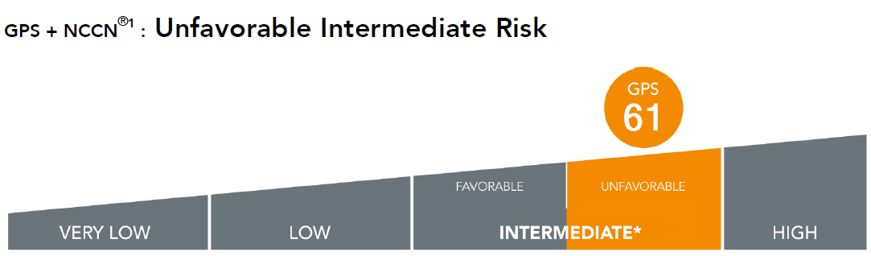
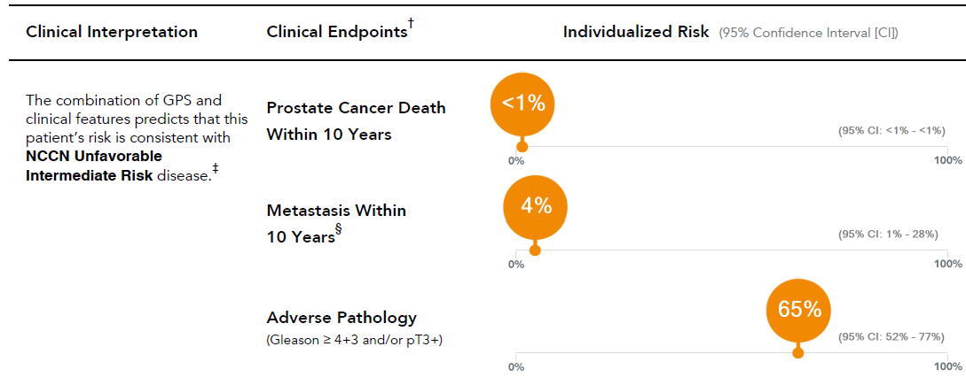
George’s GPS Results
His physician recommended that George proceed with a prostatectomy
Final pathology was demonstrative of Gleason 4+3 (75% pattern 4), focal EPE
Notes:
Key Education Points:
George’s risk is consistent with NCCN unfavorable intermediate, a group in whom NCCN recommends immediate treatment.
George has <1% chance of prostate cancer death and 4% chance of metastasis within 10 years. This information helped his physician put his long-term risk in context.
George's risk of adverse pathology was 65%. Based on these results, his physician recommended immediate treatment.

Slide 12

How Oncotype DX® GPS Can Help Decision Making
Favorable Pathology
Organ Confined
Gleason 3+3 OR Gleason 3+4
?
60 – 70%
GPS = 12
AP = 16%
Active Surveillance
They Look Alike Clinically but Are They Alike Biologically
Key Decision Point
Likelihood of Adverse Pathology is pivotal in the risk assessment of PCa and initial treatment selection
30 – 40%
Adverse Pathology
Gleason ≥4+3 and/or ≥pT3
GPS = 61
AP= 65%
Surgery
Notes:
Speaker Notes
The addition of GPS to the NCCN classification provided actionable information to inform treatment decisions for these patients.
For our first patient, the GPS interpretation provided increased confidence (>80%, based on the likelihood of favorable pathology calculation) in Active Surveillance (AS) as an option for this patient. The low GPS score gave this patient confidence to start an AS protocol.
For our second patient, the GPS provided the additional information that his cancer was likely more aggressive than his NCCN classification would suggest. He was initially interested in AS as an option, but based on his GPS and favorable pathology result, he decided to have surgery where he was found to be harboring adverse pathology.
For our third patient, the GPS impacted the treatment decision, as it confirmed that the patient’s initial NCCN risk classification was appropriate. Thus, the physician and patient had increased confidence in the AS treatment choice. The GPS provided a precise risk assessment, as the patient had been struggling with his treatment decision.
Finally, based on the additional information provided by the GPS, this patient had surgery. The compelling reason for the physician’s decision was the high probability of the patient having occult adverse pathology. The GPS=43 indicated a substantial chance of the patient harboring disease (Gleason score= 4 or 5; >T3 stage of disease). Final pathology was demonstrative of GS 4+3=7, focal EPE.
Transition Note
Consider a transition statement along the lines of “These are three representative cases that demonstrate how GPS works in the real world. On the next slide, we’ll see the aggregate data on how GPS has performed in the real-world setting.”

Slide 13
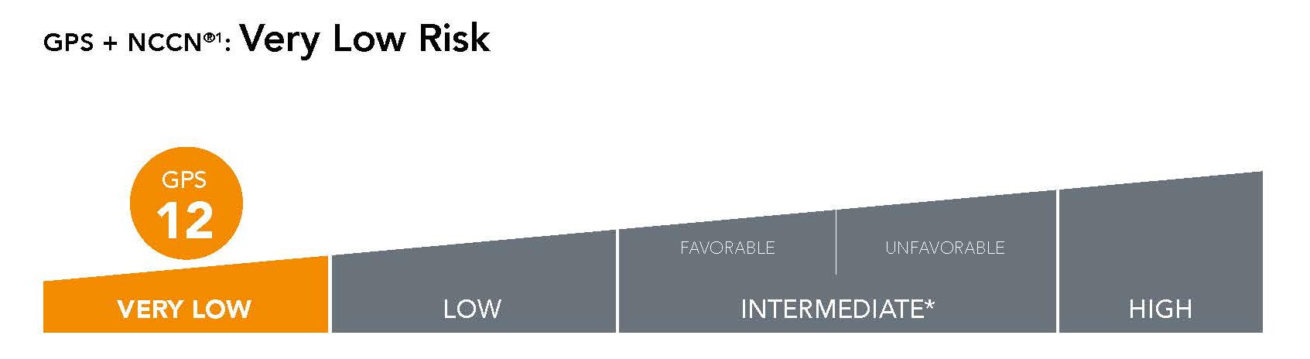
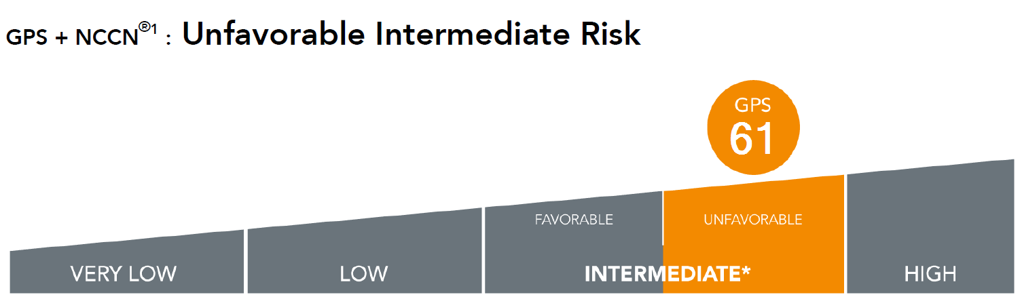

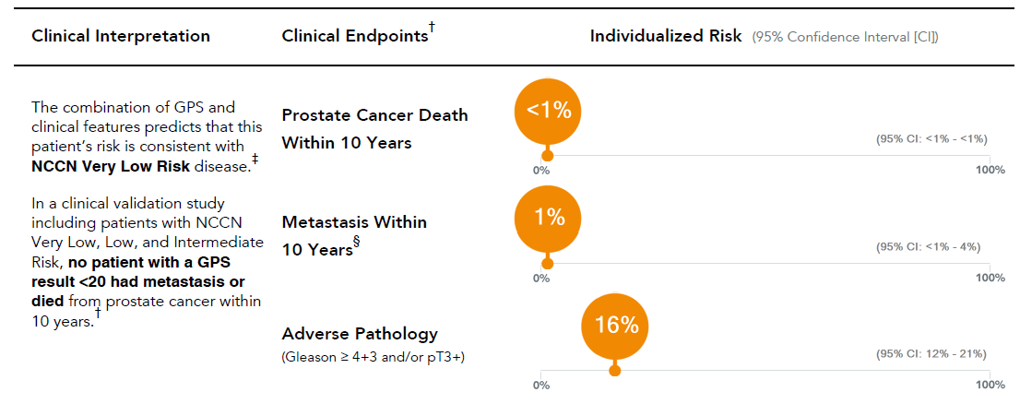
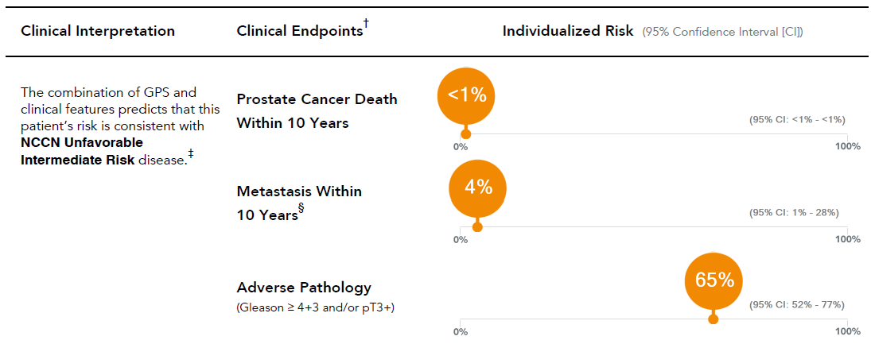
Endpoints Driving Treatment decisions
Michael
George
Clinically Low Risk
PSA of 6.0
PSAD of 0.30 ng/mL
Volume of 20cc
1 – 2 Cores Positive
GPS CAN HELP GUIDE TREATMENT DECISIONS BASED ON CANCER BIOLOGY
Notes:
Key Education Points:
Decipher and Prolaris provide death and mets data. It is evident from these estimates that the difference in 10 year mortality and metastasis risk are minimal but the difference in risk of AP is substantial.
Adverse Pathology is the most immediate and actionable endpoint to guide management decisions in low-risk prostate cancer

Slide 14
GPS and Clinical Risk Refinement
Cleveland Clinic Foundation (N=168)
Clinical Risk Assessment Alone
VERY LOW RISK
35% (N=60)
LOW RISK
37% (N=62)
INTERMEDIATE RISK
28% (N=48)
.............................. ..............................
..............................................................
GPS and Clinical Risk Assessment
LOW RISK
24% (N=41)
INTERMEDIATE RISK
29% (N=49)
.........................................
.................................................
more favorable
LIKELIHOOD OF FAVORABLE PATHOLOGY
less favorable

Slide 15
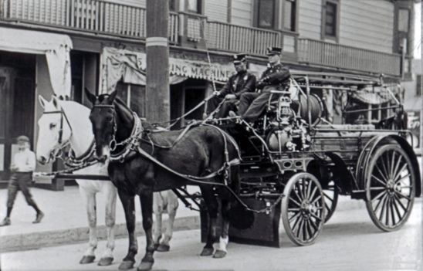
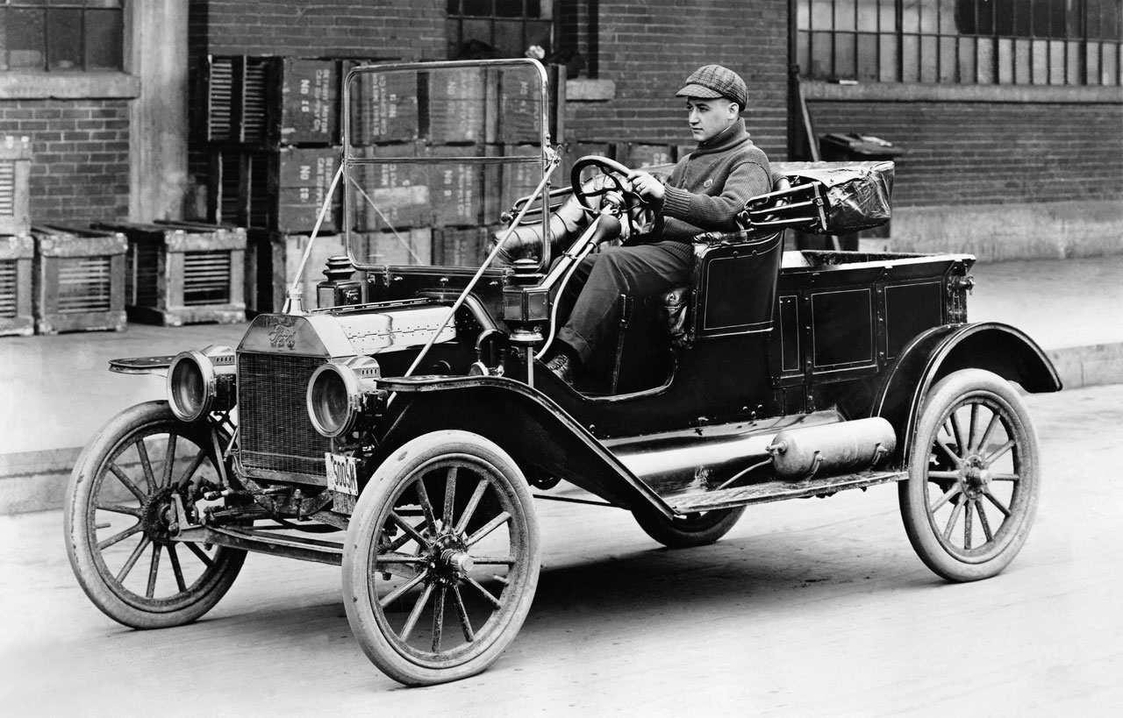


Slide 16

Don’t get into a car with a stranger
Keep both hands on the steering wheel
ONLY Politicians become US President
Do We Follow conventional Wisdom in 2017?
Gleason Score accurately stages CaP

Slide 17
Thank You
bdenes@genomichealth.com

