Slide 1
Epigenetic Diagnostics for Urological Cancer
Notes:
Genomic Markers
What is the challenge (do they know biopsies only test a small % and why)
What are patient challenges (want confirmation that a neg. is a neg.)
What is the solution MDx and how does it change practice and improve patient care (its worth the effort)

Slide 2
Wendy Poage, MHA
President, Prostate Conditions Education Council
Co-Chair, Global Action for Men’s Health
Advisor, University of Colorado Cancer Center
PCEC has been leading awareness and education efforts in genomic markers for over 5 years.

Slide 3
MDxHealth Has Two Prostate Cancer Products
1.SelectMDx for Prostate Cancer
A non-invasive urine assay to improve patient selection for initial biopsy
2.ConfirmMDx for Prostate Cancer
A epigentic test on negative prostate biopsy tissue to identify cancer field effect at the DNA level

Slide 4
PCEC Resources
1.www.ProstateMarkers.com
2.Markers Grid

Slide 5
Personalizing Care
5
What is a marker?
A molecule that can be found in blood, tissue or body fluids that is a sign of a normal or abnormal process
Tissue
Blood
Urine
Notes:
You have heard about genomic testing, the human genome project and more – this is leading to individualizing patient care.
Personalized care is a key trend in health care. In every disease state we would like to know how to find significant disease, who to treat and how best to treat each individual. Markers are the key to accomplishing this.

Slide 6
Where Markers Fit
Who to offer Interventional Therapy vs. Active Surveillance
Whom to treat or not treat post-prostatectomy:
Who To Biopsy
Negative Biopsy
Who to
Re-biopsy
Whom to offer
Genetic Testing
SelectMDx
ConfirmMDx
Ambry Genetics
OncotypeDx
Prolaris
phi
Myriad Genetics
Prolaris
Decipher
4kscore
GeneDx
ARV7

Slide 7
Prostate Cancer Markers: Current Needs
USPSTF
Journal
Finding Significant Cancers
Reduce the number of unnecessary repeat biopsies
Stratify low risk from higher risk tumors / reduce over treatment³
Staging disease or classifying extent of disease^{3,4}
Personalizing – predicting and monitoring clinical response to an intervention³
1) de la Taille A, et al. J Urol 2011;185:2119-25; 2) Hessels D, et al. Expert Rev Mol Diagn 2004;4:513–26
3) Hessels D, et al. Expert Rev Mol Diagn 2004;4:513–26; 4)Madu CO, et al. Journal of Cancer 2010; 1:150-77.
Notes:
We all know the challenges of PSA as marker, and the criticism we are under for over treating prostate cancer. Markers are tools that have been used in other diseases (breast) for years and are now in the urology realm. They are tools that help provide us with more information as we address these key decision making times.

Slide 8
Benefits of Markers for Patients
Improved information for patients and physicians on:
  Risk of significant prostate cancer
  Need for repeat biopsy – or not!
  Need for Treatment / Aggressive Surveillance
  Likelihood of Progression
  Response to Therapy
Notes:
One of the most common questions I get Is how do we engage the patient groups. Do’s and Don’ts

Slide 9
SelectMDx
Notes:
What to communicate with mid-level practitioners /office staff:
Genomic Markers
What is the challenge (do they know biopsies only test a small % and why)
What are patient challenges (want confirmation that a neg. is a neg.)
What is the solution MDx and how does it change practice and improve patient care (its worth the effort)

Slide 10

1
Million
negative biopsies
Need for improved selection for initial prostate biopsy
Aubry W et al; American Health Drug and Benefits 2013.6(1): 15-24
American Cancer Society 2016

Slide 11
Unmet Clinical Neet
Improved Patient Selection for the
Decision on Initial Biopsy
~1.3 million
men will undergo biopsy
1
Million
negative biopsies
Notes:
A non-invasive urine based test to identify men
at high risk for aggressive cancer

Slide 12
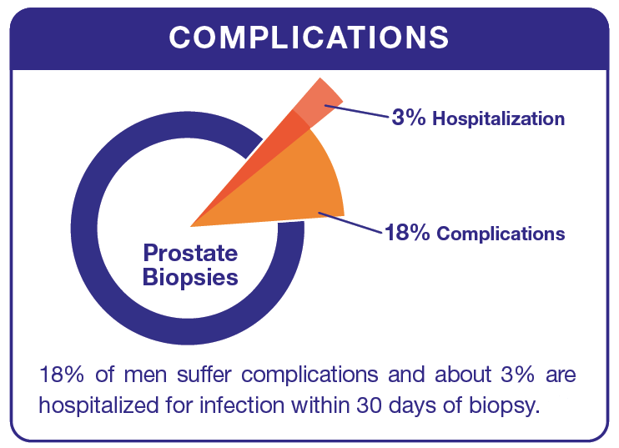
Biopsy is the Gold Standard for Cancer Detection
25%
Will receive a false-negative result
15%
Will suffer complications from biopsy (e.g. bleeding, infections, etc.)
~ 3%
Will be hospitalized in 30 days following biopsy
Gershman et al.; Eur Uro 2016; Loeb et al.; Eur Uro 2013; Loeb et al.; J Urol. 2011.
Notes:
Improve Patient Selection for Prostate Biopsy
Prostate Biopsy Remains the Gold Standard for Cancer Detection

Slide 13
SelectMDx for Prostate Cancer
A non-invasive urine assay to improve patient selection for initial biopsy
Convenient & easy to use
Urine sample collect during office visit

Slide 14
Where SelectMDx Fits
PCAW Case Study
Increased Risk
for GS ≥ 7 PCa
Consider
Biopsy
Routine Screening
Elevated PSA,
Abnormal DRE
SelectMDx
Very Low Risk
for GS ≥ 7 PCa
Avoid Biopsy
For patients being considered for initial prostate biopsy
Identify men at high risk for aggressive cancer
Assay performed on non-invasive, urine sample
Very Low Risk
99.6% NPV for GS ≥8
98% NPV for GS ≥7
Notes:
RT qPCR method
Urine-based test
Two mRNA genes (HOXC3, DLX1)
LDT under CLIA
CE marked IVD kit

Slide 15
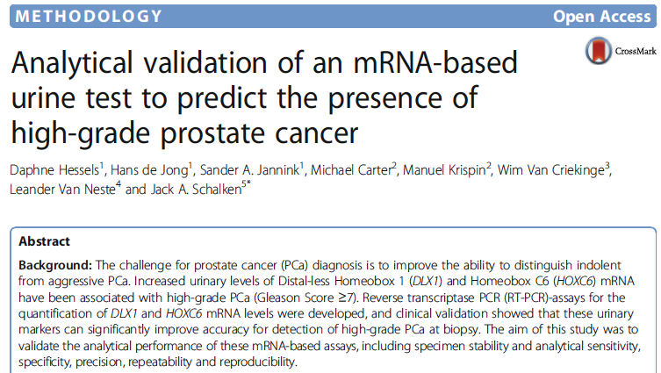
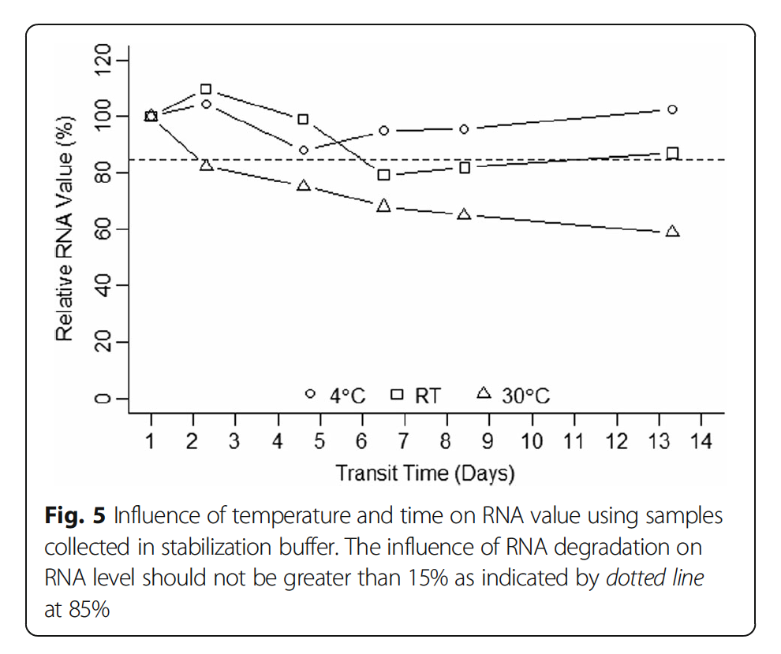
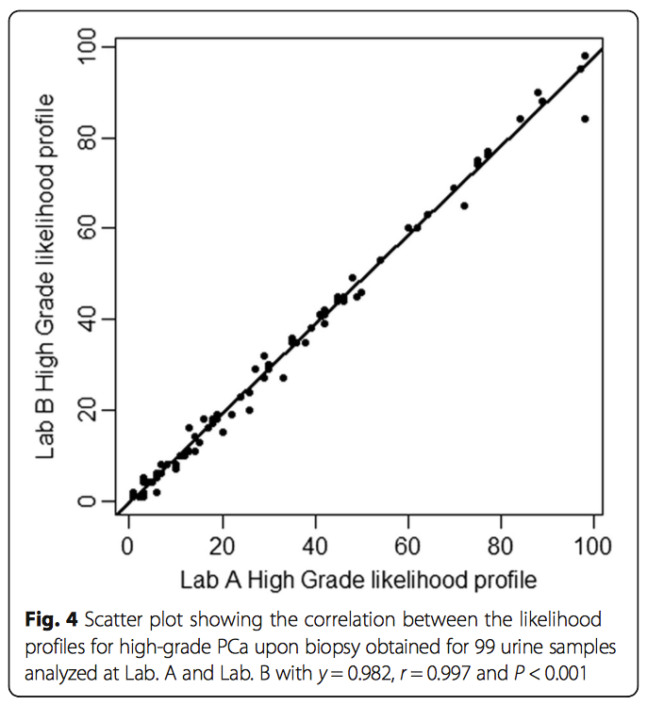
Validation
SelectMDx for Clinically Significant Prostate Cancer
Notes:
This study illustrates the robustness of the mRNA assays, enabling testing in clinical routine
laboratories and molecular pathology laboratories where the here described automated RNA extraction and
PCR platforms are available.
Influence of temperature and time on RNA value using samples collected in stabilization buffer. The influence of RNA degradation onRNA level should not be greater than 15% as indicated by dotted line
at 85%
Scatter plot showing the correlation between the likelihood profiles for high-grade PCa upon biopsy obtained for 99 urine samples analyzed at Lab. A and Lab. B with y = 0.982, r = 0.997 and P < 0.001

Slide 16

Clinical Validation
Risk Profile for the Detection of High Grade Cancer
SelectMDx for Prostate Cancer
Strongest predictor of high-grade PCa
98% NPV for GS ≥7 cancer
AUC of 0.89 (95% CI 0.85-0.95)
2016
Van Neste et al., European Urology 2016

Slide 17
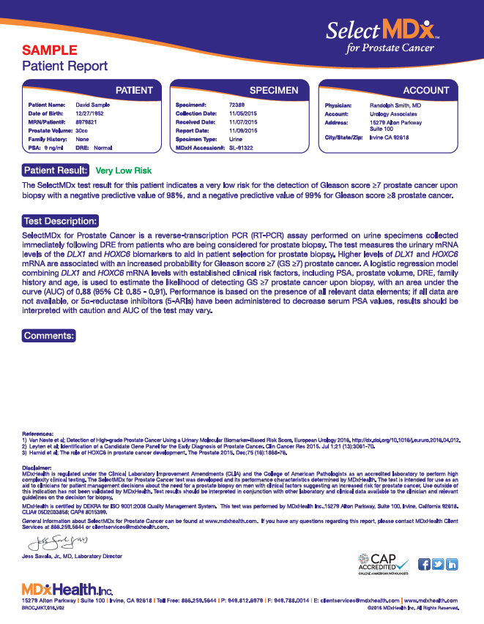
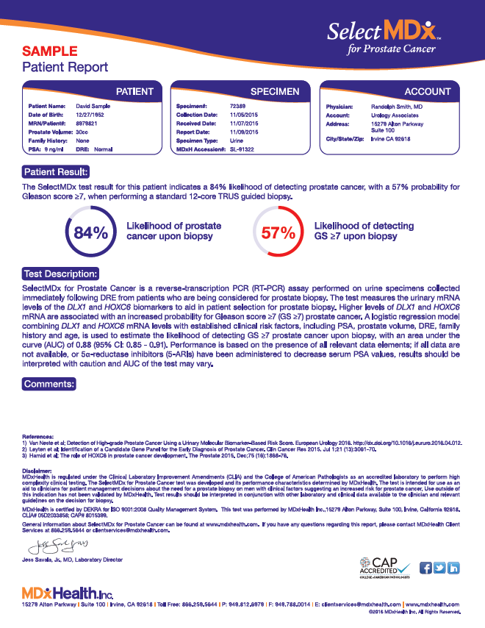
Elevated PSA, Abnormal DRE
Very Low Risk
Personalized
Risk Profile
98% NPV for aggressive cancer
May avoid biopsy
Return to routine screening
Increased risk for aggressive cancer
Men who may benefit from biopsy
Notes:
RT qPCR method
Urine-based test
Two mRNA genes (HOXC3, DLX1)
LDT under CLIA
CE marked IVD kit

Slide 18
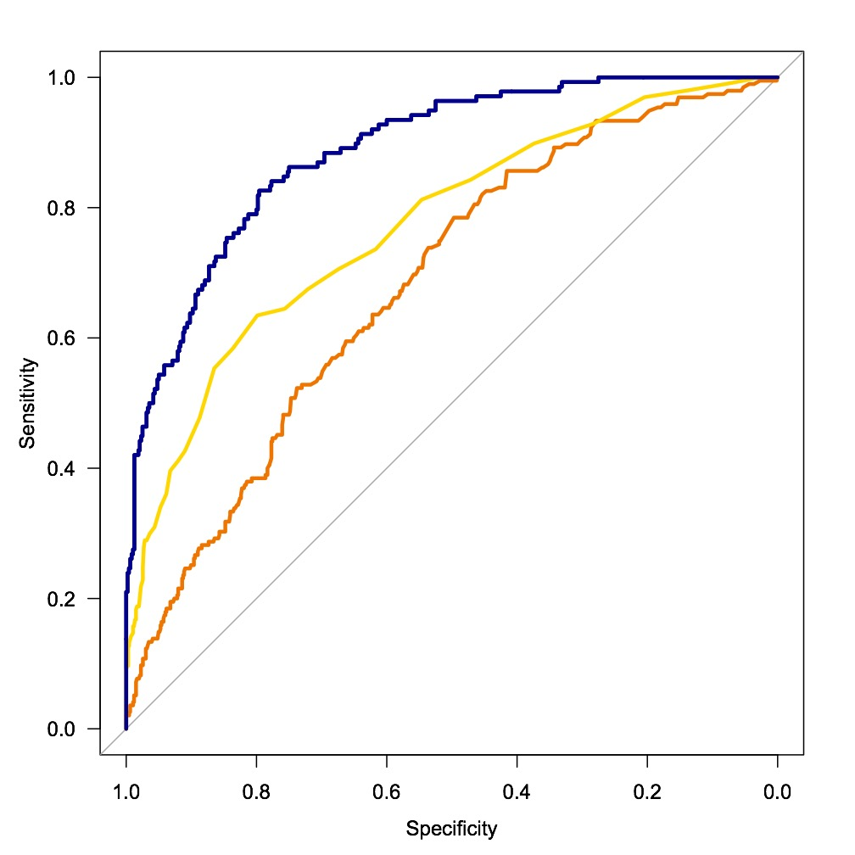
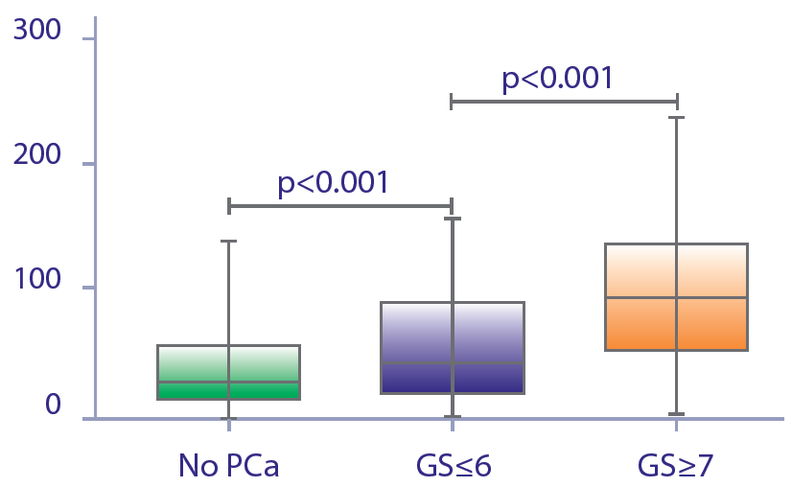
SelectMDx Outperforms PCA3 & PCPT Risk Calculator
for Detection of High Grade Cancer
1.0
300
p<0.001
0.8
0.6
200
SelectMDx Risk Score
p<0.001
Sensitivity
0.4
0.89 SelectMDx
0.77 PCPTRC 2.0
100
0.2
0.68 PCA3
0.0
1.0 0.8 0.6 0.4 0.2 0.0
No PCa
GS ≤ 6
GS ≥ 7
Specificity
Van Neste L, Hendriks RJ, Schalken JA et al; Detection of High-grade Prostate Cancer Using a Urinary Molecular Biomarker–Based Risk Score, Eur Uro 2016 Accepted

Slide 19
SelectMDx for Prostate Cancer
Offers non-invasive, in office specimen collection
Improves detection of high grade cancer with patient-specific risk profile
Binary patient result that helps identify men at Very Low Risk for aggressive cancer
Outperforms standard clinical risk factors and other biomarkers
Cost-effective option to guide MRI & biopsy

Slide 20
ConfirmMDx
Notes:
What to communicate with mid-level practitioners /office staff:
Genomic Markers
What is the challenge (do they know biopsies only test a small % and why)
What are patient challenges (want confirmation that a neg. is a neg.)
What is the solution MDx and how does it change practice and improve patient care (its worth the effort)

Slide 21
False Negative
Biopsy Challenge
% Prostate Sampled?
Approximately:
1 .3 million prostate biopsy procedures
1 million men receive a negative biopsy diagnosis
25% of the negative biopsies are harboring occult cancer
Notes:
So we have talked a little bit about where markers fit and which ones are being used in your practice but why does it matter and what is the first step for patients.

Slide 22
Prostate biopsies don’t tell the whole story.
  Each core represents
  1/2000
  of a normal size
  prostate (30 g).
  25%
  of initial negatives
  prove to be positive
  on repeat biopsies.
False-negative results are common with initial and follow-up biopsies.
Patients with false-negative results are managed in the same manner as those with true negatives…
…Leaving many at risk for undetected cancer
Notes:
Lets remember MEN DON’T LIKE THEM

Slide 23
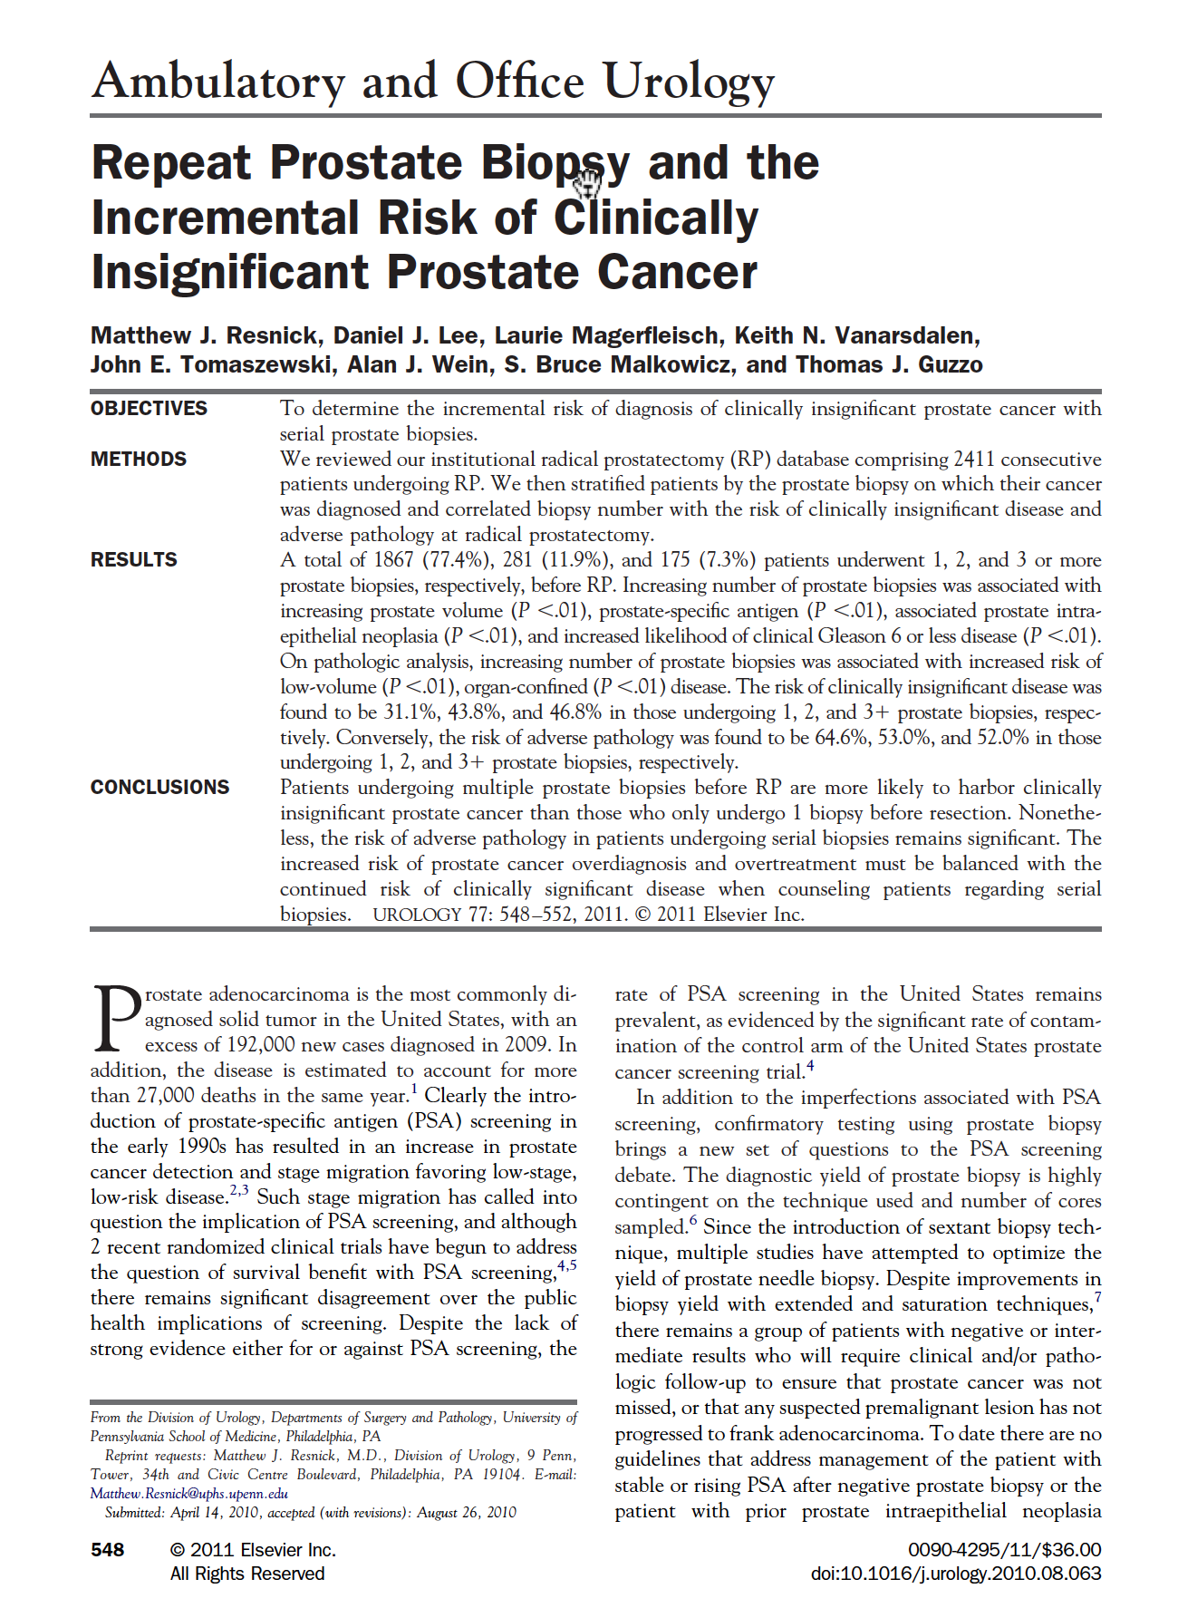
Are Significant Cancers Found on Repeat Biopsy?
1867 patients of their RP database underwent 1, 2, and 3 or more prostate biopsies
Bx number when cancer identified | “Significant” Cancer
1st Biopsy | 65%
2nd Biopsy | 53%
3rd Biopsy | 52%
>50% of cancers found upon repeat biopsy were clinically significant.
Resnick M et al:, Urology 2011. Mar 77: 548–552
Notes:
Resnick M et al. Repeat Prostate Biopsy and the Incremental Risk of Clinically Insignificant Prostate Cancer. Urology 2011. Mar 77: 548–552
Why do we keep biasing men:
1st biopsy 65% significant cancers are found
2nd biopsy another 53% of significant cancers are found
3rd biopsy we find another 52% significant cancers
****SIGNIFICANT CANCER***

Slide 24

Associated Complications with Biopsies
Recent review of SEER data reports that 6.9% of men are hospitalized in the 30 days following a prostate biopsy.
Bleeding
Infection
Sepsis/bacteremia
Endocarditis
Urinary symptoms/retention
Sexual dysfunction
Loeb S, Carter HB, Berndt SI, et al:, J Urol. 2011;186:1830-1834
Notes:
Loeb S, Carter HB, Berndt SI, et al. Complications after prostate biopsy: data from SEER-Medicare. J Urol. 2011;186:1830-1834
I question this rate in my clinic and I doubt your clinic has this rate but the fact is its happening in clinics somewhere in the US.

Slide 25
Fear of Undetected Cancer
Leads to High Rate of Repeat Biopsy
Elevated Clinical Risk Factors
Elevated PSA, Abnormal DRE, Family History
TRUS Guided Prostate Biopsy
Standard 12-core biopsy
Unnecessary Repeat Biopsy
Patient Compliance, Infections,
Negative Prostate Biopsy
Sampling error, Needle Missed Mark
43% have repeat biopsy
Welch HG et al:. J Natl Cancer Inst 2007;99: 1395 – 400. Pinsky PF et al:. BJU International 99, no. 4 (April 2007): 775–779.

Slide 26
Where ConfirmMDx Fits
Patient Profile: Men being considered for repeat prostate biopsy based on clinical risk factors indicating risk for malignancy.
ConfirmMDx Negative
Avoid Repeat Bx
Step Two
ConfirmMDx
Previous negative biopsy
ConfirmMDx Positive
Consider Repeat Bx
Performed on residual tissue from previous negative biopsy
Does not require repeat patient visit

Slide 27

ConfirmMDx detects an epigenetic field effect associated with the presence of cancer at the DNA level
Foci heterogeneity and multi-focality
<1% of gland is sampled
Anterior region difficult to sample
Biopsy
Cancer
Field Effect
The Needle May Miss the Cancer
Henrique R, et al:,Mol Cancer Res 2006;4:1-8

Slide 28


Genetics vs. Epigenetics
DNA Methylation
Epigenetics refers to changes in gene expression (active vs. inactivated genes) that does not involve alterations to the underlying DNA sequence; a change in phenotype without a change in genotype.
Genetics refers to heredity or how the characteristics of living things are transmitted from one generation to the next, genes, origin, cannot be changed.
VS.
Notes:
“epi” means above so “above the genes”
** This test looks at epigenetic changes in methylation of cancer cells
Study of changes in gene expression when certain genes being turned “off or on”
This switch, caused by methylation, alters the function and/or regulation of these genes, without altering the actual DNA sequences
Unlike simple genetics based on changes to the DNA sequence (the genotype), epigenetics refers to methylation changes from other causes
Epi- (Greek: επί- over, outside of, around) -genetics

Slide 29
Clinical Validation
Journal of Urology 2013
Clinical Utility of an Epigenetic Assay to Detect Occult Prostate Cancer in Histopathologically Negative Biopsies: Results of the MATLOC Study
Study Design:
483 men with previous negative biopsy
Parameters: age, PSA level, DRE, pathology, epigenetic panel
ConfirmMDx Overall Performance:
Negative Predictive Value of 90% over standard histopathology (~75%)
ConfirmMDx is the most significant independent predictor of cancer detection on repeat biopsy with Odds Ratio of 3.17 (p-value 0.0001)
Improved stratification of patients leads to more informed repeat biopsy decisions and reduction of unnecessary repeat biopsies

Slide 30
Confirmatory Clinical Validation
Journal of Urology 2014
Multicenter Validation Study of a Tissue Methylation Assay to Predict Histopathologically Cancer-negative Repeat Prostate Biopsy
DOCUMENT: Detection of Occult Cancer Using Methylation Events in Negative Tissue
Senior PI = Alan Partin, MD, PhD
Central Pathologist = Jonathan Epstein, MD
Sites: Johns Hopkins Univ, Cleveland Clinic, UCLA, Lahey Clinic, EVMS
350 subjects enrolled
Results: Reconfirms MATLOC study results using same assay cutoffs

Slide 31
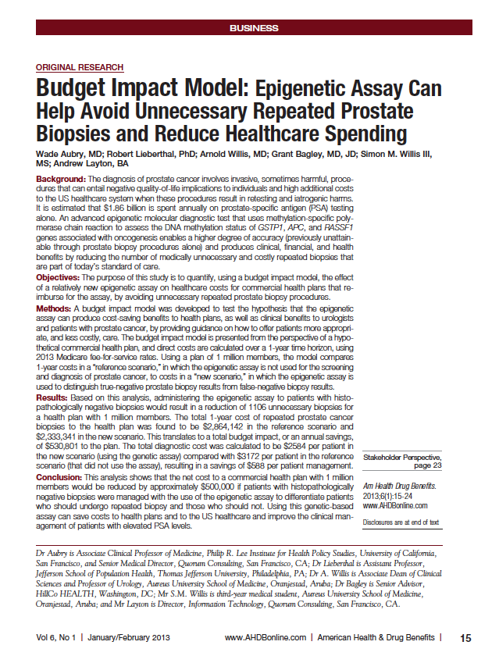

ConfirmMDx Health Economics
ConfirmMDx Can Help Avoid Unnecessary Repeated Prostate Biopsies and Reduce Healthcare Spending
1 million members could save: $500,000 annually
Savings per patient managed: > $588
Positive Economic Impact
Aubry et al:, 2013 AH&DB

Slide 32
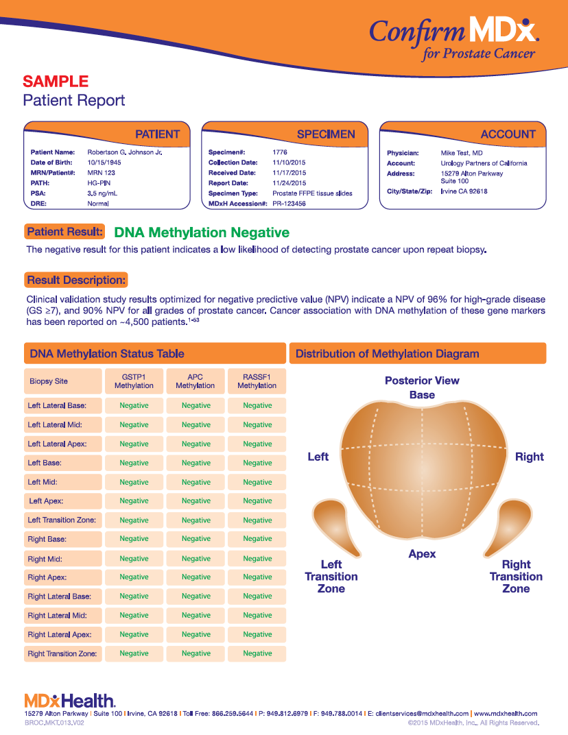
ConfirmMDx Negative Patient Result
Avoid repeat biopsy
Routine screening by PSA & DRE
Results valid 24 months from previous biopsy
96% NPV for “significant” PCa
90% NPV for all PCa
Partin AW et al. (2014). J Urol. Stewart GD et al. (2013). J Urol

Slide 33
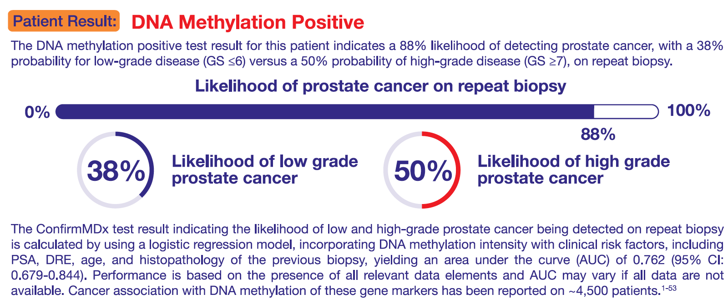
DNA Methylation Positive

Slide 34
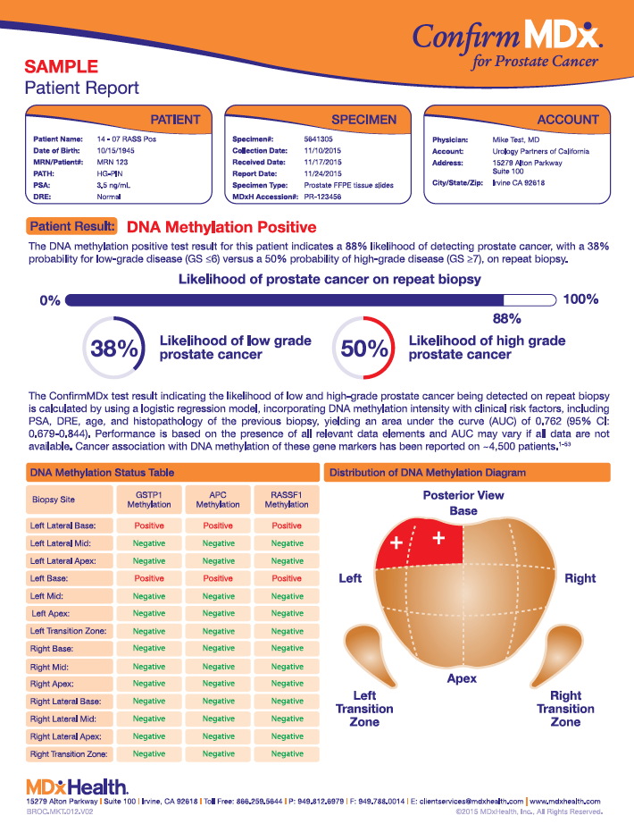
ConfirmMDx Positive Patient Result
Obtain additional cores in and around methylated hot spots
Perform mpMRI
Co
nfirmMDx is the Most Significant Independent Predictor for Prostate Cancer Detection on Repeat Biopsy

Slide 35
Welcome tests like these that improve patient outcomes
Notes:
What to communicate with mid-level practitioners /office staff:
Genomic Markers
What is the challenge (do they know biopsies only test a small % and why)
What are patient challenges (want confirmation that a neg. is a neg.)
What is the solution MDx and how does it change practice and improve patient care (its worth the effort)

