Slide 1



Genomics and Genetic Testing
Copyright © 2017 Myriad Genetics, Inc., all rights reserved. www.Myriad.com

Slide 3
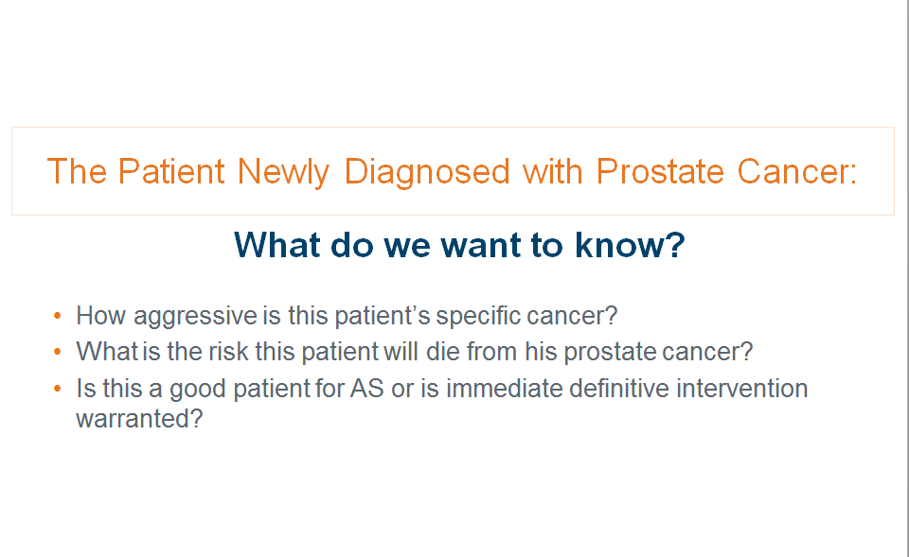

Slide 4
Answers Aren’t Always as Clear as We Would Like
PATIENT
SUBGROUP
REALITY
TREATMENT
PARADIGM
RESULT WITHOUT
IMPROVED TOOLS
Without immediate treatment less than
5% of low risk patients
will die of PCa
Yet many are treated upfront
AUA Low Risk Patients
Over-treatment
Problem
AUA Intermediate
Risk Patients
More than half will experience BCR with single-modality treatment alone
Yet the majority do not receive multi-modality treatment
AUA High Risk Patients
Under-treatment
Problem
Wilt et al. Prostate Cancer Intervention versus Observation Trial (PIVOT) Study Group. N Engl J Med. 2012;367:203-213.
Protstate cancer infolink. (2011). CAPRA-S scores and projection of prostate cancer recurrence post-surgery. Accessed February 20, 2013
from http://prostatecancerinfolink.net/2011/06/29/capra-s-scores-and-projection-of-prostate-cancer-recurrence-post-surgery/

Slide 5
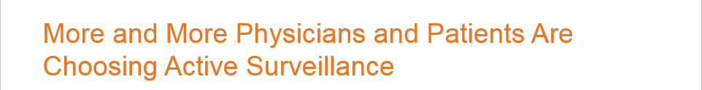
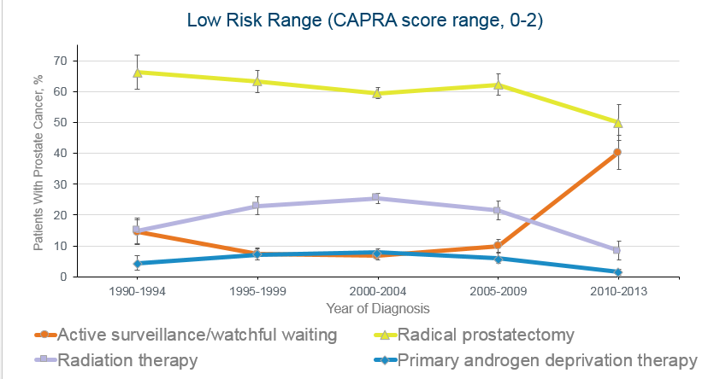
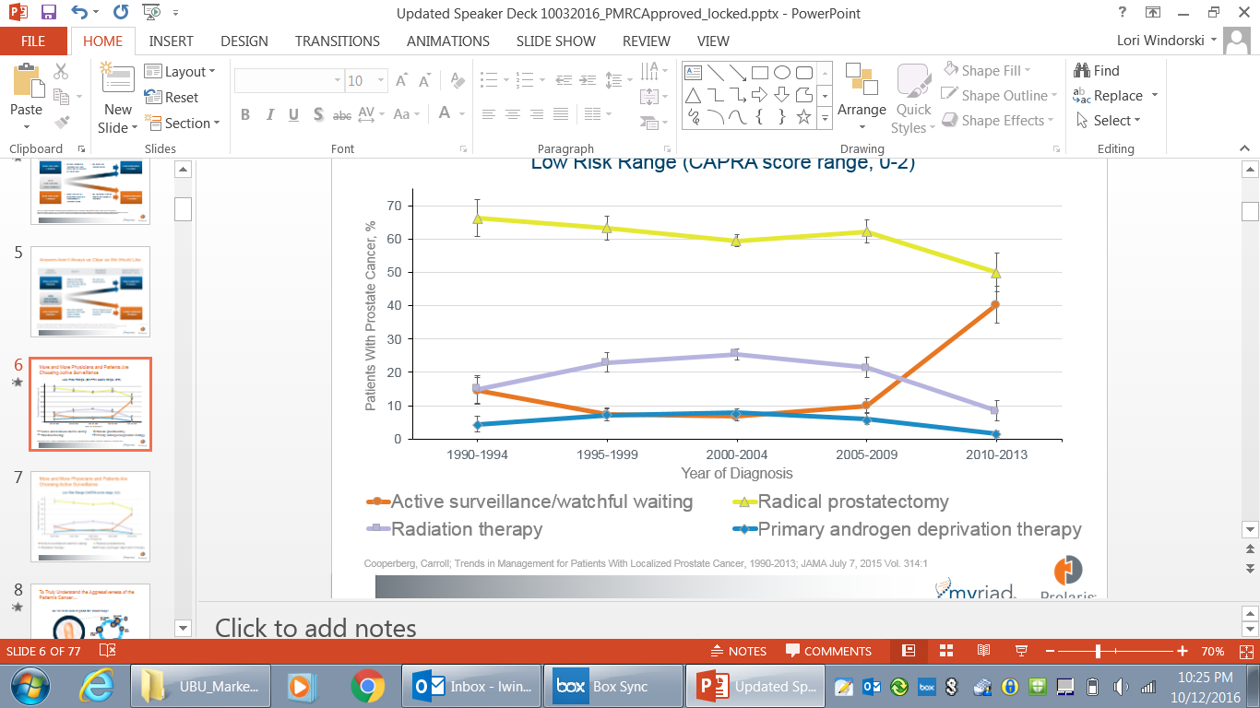

Slide 6















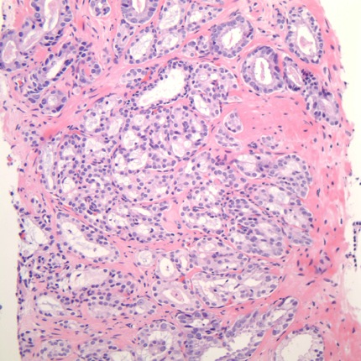





To Truly Understand the Aggressiveness of the Patient’s Cancer
We need to look beyond the microscope.
Cell division
(mitosis)
Cell prepares
to divide
M
G2
Normal
Abnormal
Cycle
begins
Replication
of DNA
S
G1
R
Cell grows
Cell decides
whether to continue
Genes Associated With Cell Cycle Measure the
True Hallmark of Cancer - Proliferation

Slide 7


Back To Our Two Patients:
AUA Risk categorizes these two patients as the same average risk category bucket…
100
50
20
10
John, age 65
AUA PCa Mortality Risk %
Carl, age 68
5
2
HIGH
INTERMEDIATE
LOW
1
3%
1
2
5
10
20
50
100
AUA + Prolaris PCa Mortality Risk %
Data on file Myriad Genetic Laboratories, Inc.

Slide 8
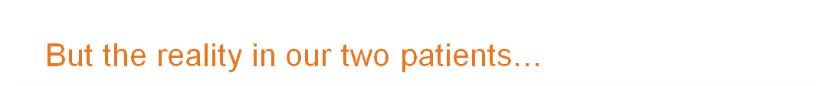
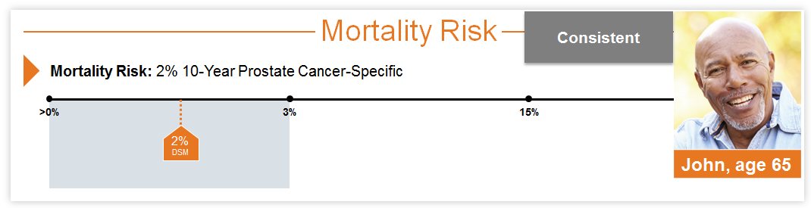
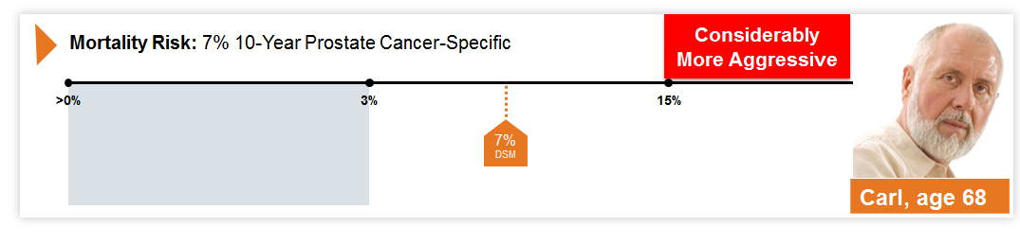
Notes:
Despite similar pathology, the two specific tumors have very different aggressiveness measures

Slide 9


Slide 10

Tumor Testing vs. Germline Testing
Tumor testing can help guide treatment management (e.g., Prolaris)
Tumor Biopsy
Germline testing (blood or buccal) can help determine if a mutation was inherited and help guide treatment and risk management options for patient and family members (e.g., myRisk)
Blood Test

Slide 11



Why is genetic testing important to you?
Impact on immediate treatment decisions
Identify risks for additional cancers and management strategies
Identify family members at risk

Slide 12
How Common Is Hereditary Prostate Cancer?
Annual Incidence of Hereditary Cancer
SITE | ANNUAL INCIDENCE* | % of HEREDIATRY CANCER† | # PATIENTS WITH HEREDITARY CANCER
Breast | 255,000 | 12-14% | 35,700
PROSTATE | 161,000 | 14% | 22,500 a year
Colorectal | 135,000 | 10% | 13,500
Uterus | 61,000 | 9% | 5,400
Ovary | 22,000 | 24% | 5,300
*American Cancer Society, 2017
†www.MyriadPro.com

Slide 13
Identifying Patients At-Risk for Hereditary Cancer is
The Standard of Care
NCCN Guidelines Version 2.2017
Prostate Cancer
INITIAL PROSTATE CANCER DIAGNOSIS
DRE
PSA
Gleason primary and secondary grade
Family history*

Slide 14
Identifying Patients At-Risk for Hereditary Cancer is
The Standard of Care
NCCN Guidelines Version 1.2018
BRCA-Related Breast and/or Ovarian Cancer Syndrome
Hereditary cancer testing is recommended for patients with prostate cancer who meet the following criteria:
  Metastatic prostate cancer
  Higher grade prostate cancer (Gleason score 7 or higher) AND a close blood relative* with ANY of the following:
      Breast cancer ≤ 50 years
      Ovarian cancer at any age
      Pancreatic cancer at any age
      Two or more Breast Cancers, Pancreatic cancers, or higher grade prostate cancers (Gleason 7 or higher) at any age
*Close blood relatives include parents, children, siblings, grandparents, aunts/uncles, nieces/nephews, great-grandparents, and first cousins.

Slide 15
For More Information:
800-469-7423 or helpmed@myriad.com
www.Prolaris.com
www.HereditaryCancerQuiz.com
Copyright © 2017 Myriad Genetics, Inc., all rights reserved. www.Myriad.com

