Slide 1

Accelerating Precision Medicine
for Advanced Cancer Patients
Notes:
My name is Dan Rhodes, CEO of Strata Oncology. This presentation is intended for cancer care providers considering joining us in the Strata Trial.

Slide 2
a precision oncology company broadening patient access &
accelerating breakthrough drug approvals
Notes:
At Strata Oncology, we are precision oncology company with dual purpose – broaden patient access today, and at the same time accelerate new drug approvals for cancer patients tomorrow.

Slide 3
The Long Tail of Rare, Targetable Genetic Alterations in Cancer
ROS1
Approved Drugs
NTRK1-3
MAP2K1
MAPK1
Investigational Drugs
Nat Biotechnol. 2013 Nov;31(11):1023-31
Notes:
Approval for firsrt indication – always are others.

Slide 4
CATCH-22
In Precision Oncology
$$
Reimbursement
X
X
Genomic Testing
X
Precision Medicine Trials

Slide 5
Tumor Sequencing + Tx Protocols
100,000 advanced solid tumor patients for screening, with biomarker-positive patients matched to relevant therapeutic protocols
1. No-cost Tumor Sequencing 2. Pharma Trial Portfolio
Strata-sponsored observational study provides no-cost tumor sequencing for ALL advanced cancer patients
State-of-the-art CLIA NGS testing – StrataNGS™
Best-in-class pharma trials
Most compelling early data
Notes:
The Strata Trial is new kind of clinical trial, unprecedented in scope and size. The Strata Trial is strutured as a screening protocol and a portfolio of affiliated pharma sponsored therapeutic protocols. The trial just began in January of 2017 and seeks to enroll 100,000 advanced cancer patients over the coming years, providing these patients with free tumor sequencing, a test that can cost $3-5,000, as well as for those who match, the opportunity to enroll on a precision medicine clinical trial.
Recruiting 100,000 advanced solid tumor and lymphoma patients for screening, with biomarker-positive patients matched to relevant therapeutic protocols

Slide 6


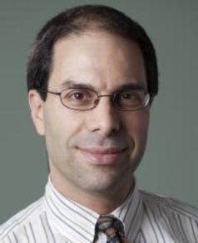
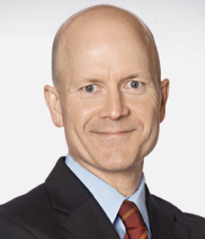
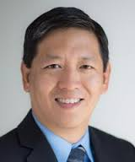


No-cost Tumor Sequencing and Clinical Trial Options for 10,000 Men with Metastatic Prostate Cancer
Eric Small, MD
Professor of Medicine; Urology; and Chief, Division of Hematology/Oncology, UCSF
Deputy Director; Prostate Cancer Program Leader, UCSF Helen Diller Family Comprehensive Cancer Center
Keith Flaherty, MD
Director of Developmental Therapeutics Program, Massachusetts General
Professor, Harvard Medical School
Principal Investigator, NCI MATCH
Co-founder; Chair, Clinical Advisory
Board, Strata Oncology
Felix Feng, MD
Associate Professor of Radiation Oncology; Urology; Vice Chair for Faculty Development and Director of Translational Research, Department of Radiation Oncology, UCSF
Scott Tomlins, MD, PhD
Assistant Professor, Pathology and Urology, University of Michigan Medical School
Michigan Center for Translational Pathology
Co-founder; Laboratory Director, Strata Oncology

Slide 7
No-cost Tumor Sequencing and Clinical Trial Options for 10,000 Men with Metastatic Prostate Cancer
PROGRAM AIMS
Expand access to tumor sequencing for men with metastatic prostate cancer
Accelerate enrollment of select precision medicine clinical trials in advanced prostate cancer (rucaparib for BRCA and ATM-mutants)
Catalyze new studies for patients harboring other targetable alterations
ELIGIBLE PATIENTS
Metastatic prostate cancer; hormone-refractory or hormone-sensitive
FFPE tumor material available

Slide 8
No-cost Tumor Sequencing and Clinical Trial Options for 10,000 Men with Metastatic Prostate Cancer
INFORM your physician
PROVIDER ORDERS free NGS test
PROVIDER SENDS specimen to Strata CLIA lab
REVIEW NGS test report & trial options

Slide 9
For more information
www.stratifyprostate.com
contact us
stratifyprostatte@strataoncology.com

