Slide 1
The Importance of Hereditary Cancer Testing in Prostate Cancer
Rob Finch, MS, CGC
Certified Genetic Counselor
Medical Science Liaison – Urology
Myriad Genetics Laboratories

Slide 2
Agenda
Genes overview
Genetic mutations
Personalized treatment decisions
Indicators for genetic testing
Importance of genetic testing

Slide 3


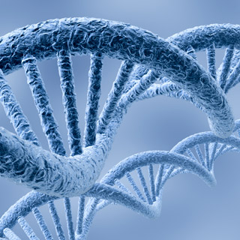
What Causes Cancer?

Slide 4
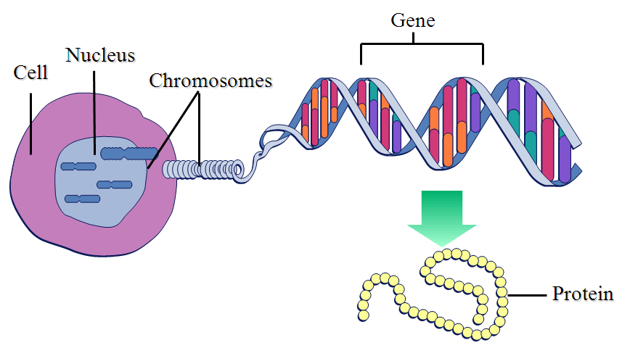
Genes Contain Instructions for Making Proteins
Notes:
2
2
Genes Contain Instructions for making proteins
The genes are made up of DNA. DNA is a double stranded molecule - as you can see here by the famous twisted ladder structure - and comprised of paired nucleotide bases which make up the genetic code. The 4 paired bases are adenine, thymine, guanine and cytosine and normally we just abbreviate the name of those bases to just “A”, “T”, “G”, and “C”. Specific sections of the DNA are called genes. Each gene can be a few thousand to many thousands base pairs in lengths and contains the instructions for making a protein. Some sections of a gene, known as exons, are used to make proteins and other sections have less clear function and are known as intron. In order for DNA to be decoded by the cell, or used by the cell, and make the protein, it proceeds through a series of complex steps that create molecules such as RNA and messenger RNA. The protein is made based on the instructions contained in the DNA and RNA of the gene. Since only the exon portions of the genes are transcribed into protein products, these are the primary regions of the genes that are sequenced during genetic testing. Proteins, which do the work in the cell, are made up of a chain of amino acids, like beads on a string.
It is the sequence of the bases within a gene that determine the specific amino acids contained in the protein product. If the genetic instructions are correct, then the protein should be made and function properly. Errors in the genetic code, however, can cause an abnormal protein product. We will discuss this concept more, and what it means with regard to hereditary cancer test results, during the Genetic Testing section.

Slide 5
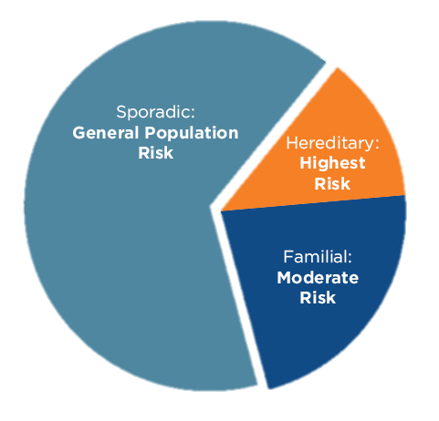
Evaluating Hereditary Cancer Risk
Certain ancestries may have greater risk for hereditary cancer syndromes
(e.g. Ashkenazi Jewish ancestry)

Slide 6
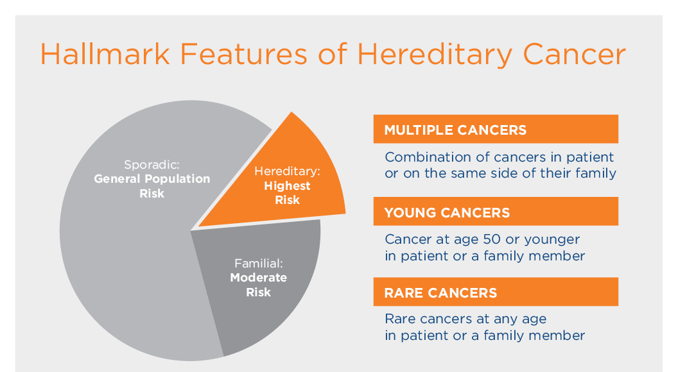

Slide 7
Development of Sporadic and Hereditary Cancer
2 normal genes
1 damaged gene
1 normal gene
2 damaged genes
Tumor
develops
Notes:
As we’ve talked about, cancer has been shown to occur in a multi-step process. Although this is a complex process, the development of cancer is often simplified into a model called the “two hit hypothesis.” This means that when both copies of a gene are mutated or damaged, malignant transformation in the cell.
In a sporadic cancer, as shown in the top part of the slide, the first gene mutation, or the first “hit,” occurs in a cell either due to an error in cell replication or by an environmental insult. This is what occurs in most people who develop cancer. We are usually born with a pair of genes that work just fine and then as we age, normal biology occurs and we may have a copy mistake leading to a mutation on one of the genes. Or there may be an environmental exposure, like sun exposure or tobacco, that leads to this mutation. Either way, through normal biology or environmental exposure, there ends up being one working gene and one non-working gene. This is not a problem because there is still one working gene copy. However every time this cell copies itself, it will copy this mutation. As time goes on, there is potential for more copy mistakes through other environmental exposures or normal biological mistakes and if the other gene gets damaged in the same cell, the gene can no longer produce the protein it is supposed to and tumor development is initiated. So the top picture illustrates what we understand about sporadic cancer. It’s important to remember that while mutations occur all the time, the chance that a cell will go from having 2 normal gene copies to having 1 damaged gene copy is very low;
So, what does this tell us about sporadic cancer? First, sporadic cancer tends to occur at later ages since it takes time for 2 mutational events to happen in a single cell. Second, sporadic cancer tends to only happen once to an individual (since the likelihood of both mutations occurring in any given cell is 1 in 1 billion) so we generally don’t worry too much about a person who’s had cancer getting a second primary cancer. And finally, some cancers are much more common and likely to occur than others. Some cells in the body are constantly turning over, for example cells in the breast, colon, and skin, and there is more opportunity then for acquired gene mutations to occur in those cells that divide more often. So we see some cancers much more frequently like breast cancer, colon cancer, skin cancer, endometrial cancer, etc. Other kinds of cells in our body don’t turn over cells as often such as the pancreas, the ovaries, the brain so these cancers tend to be very rare cancers. So with sporadic cancers, we see a much higher rate of common cancers with the less common cancers occurring much less frequently.
References:
1. Weinberg RA. One renegade cell: how cancer begins. New York: Basic Books, 1998), 63-78.

Slide 8
Development of Sporadic and Hereditary Cancer
2 normal genes
1 damaged gene
1 normal gene
2 damaged genes
Tumor
develops
In hereditary cancer, one damaged gene is inherited.
1 damaged gene
1 normal gene
2 damaged genes
Tumor
develops
Notes:
Contrast that with hereditary cancer. In hereditary cancer, we are born with one of our genes damaged already and that mutation is present is every cell of the body. Now, it still takes a second “hit” or mutation to occur in the other gene copy for cancer initiation to occur and that second mutational event occurs by an environmental exposure or normal biological mistake. However, this second mutation in the other gene copy can happen in any cell though (remembering that each cell has a 1 in 1000 chance of becoming cancerous) making the chance of cancer occurrence much more likely. So this explains the pattern we normally see with hereditary cancer. In hereditary cancer, we typically see those common cancers occurring at much earlier ages, such as breast, colon, and endometrial cancer. So one of the hallmarks of hereditary cancer is seeing a common cancer at an uncommon age. A second hallmark of hereditary cancer is seeing the presence of uncommon or rare cancers occurring at a much higher frequency; remembering that every cell in the pancreas, ovary, brain already has one gene mutation so it only takes one additional mutation for that cell to turn into cancer. So, we will see more rare cancers occurring at a much higher frequency in these individuals and families with hereditary cancer. Finally, we see multiple primary cancers more commonly in hereditary cancer. This is because after a person with hereditary cancer develops a cancer from a single cell, for example a colon cell, the remaining colon cells all still have a mutation and a 1 in 1000 chance of becoming another cancer. So there is a much higher rate of second primary cancers in hereditary cancer.
To summarize again, inherited or germline mutations causing hereditary cancer not only make the occurrence of cancer more likely, but they also increase the probability of developing multiple primary cancers and developing cancer at an earlier age than seen in the general population. In addition, we see rare and unusually cancer more frequently.

Slide 9
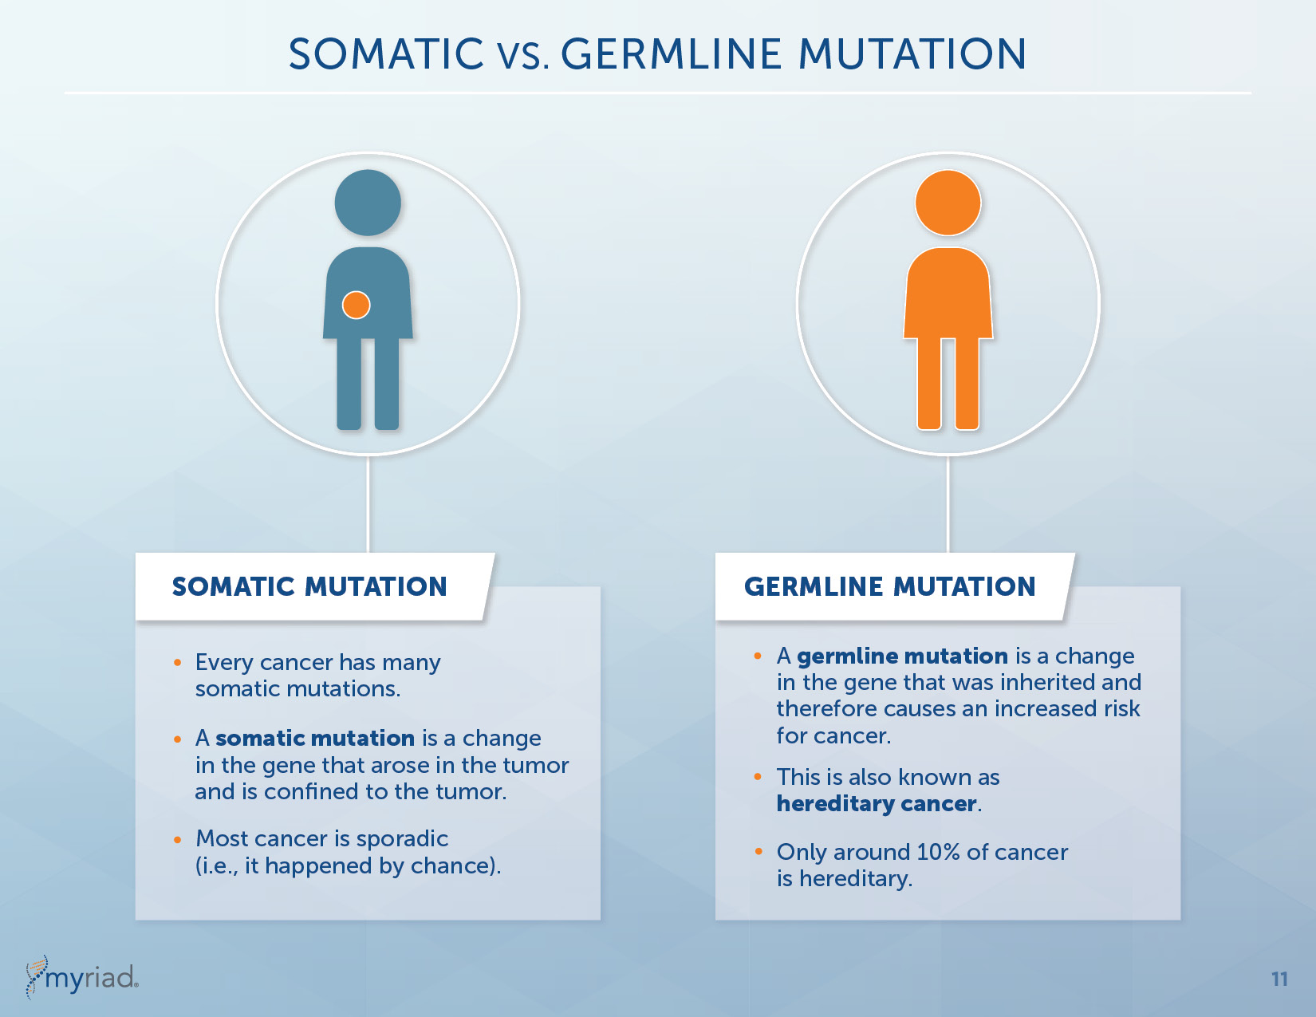
Genetics: Somatic vs Germline Mutations

Slide 10
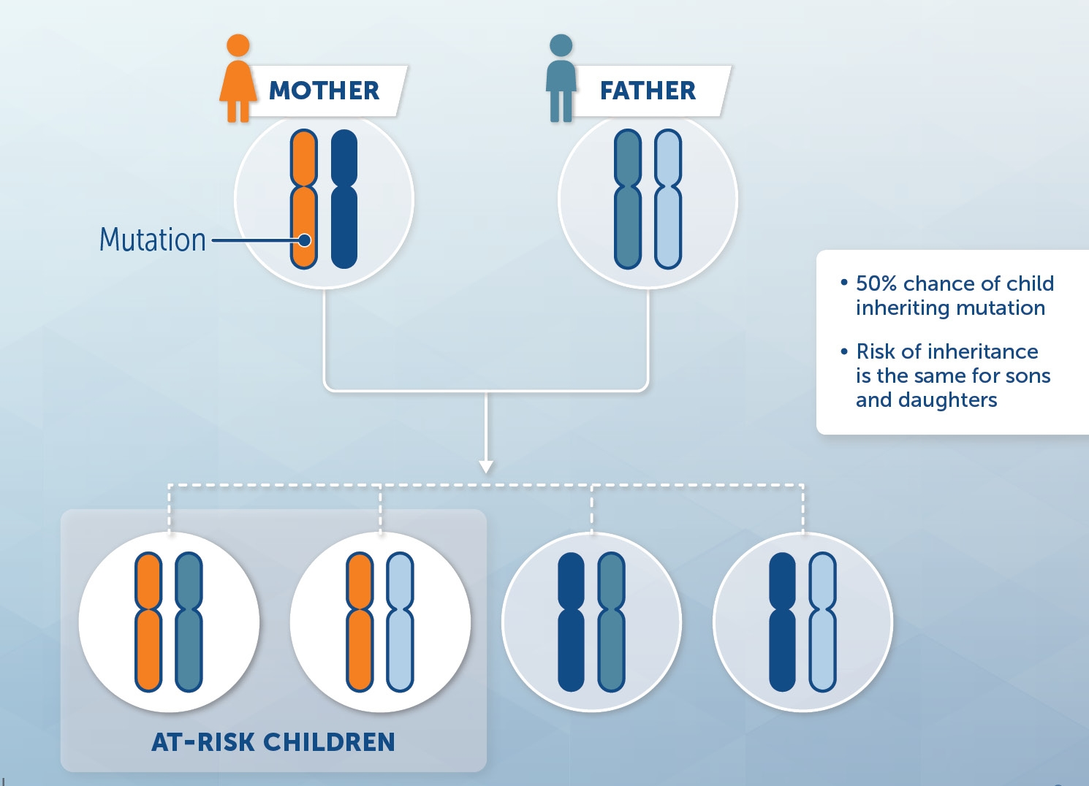


Inheritance

Slide 11
Familial and Hereditary Prostate Cancer
Prostate cancer is rarely diagnosed in men <50 years old, but then increases rapidly
Other than age, the strongest risk factor for prostate cancer is a family history of prostate cancer
  Suggests importance of genetic factors in disease development
Genes currently associated with an increased risk for prostate cancer
  BRCA1/BRCA2
  MMR genes
  ATM
  CHEK2
  TP53
  NBN
  HOXB13
  Several others

Slide 12
Background on BRCA Genes
Myriad discovered the BRCA1 and BRCA2 genes in the early 1990s
The BRCA genes, along with other genes, are very important in helping to repair damaged DNA
When these genes are altered (have a mutation) DNA damage may not be repaired properly
Additional genetic mutations continue to build up which can lead to cancer

Slide 13



Why is genetic testing important to you?
Impact on treatment decisions for current prostate cancer
Identify second cancer risks and management strategies
Identify family members at hereditary risk

Slide 14


How does genetic testing impact Gene?
Gene has a Gleason Score of 3+4 and could consider a radical prostatectomy. However, Gene is also a candidate for active surveillance and is interested in this option.
Gene
Patient Age: 67
Clinical Stage: T1c
PSA prior to Biopsy: 6.3
Gleason Score: 3 + 4 = 7
AUA Risk Classification: Favorable Intermediate
Family History
Relative | Cancer Site | Age of DX
Father | Prostate | 63
Sister | Breast | 49
The urologist also notes that Gene has a family history of cancer and orders hereditary cancer testing….

Slide 15








Based on recent studies and Gene’s family history, the urologist orders a multi-gene hereditary cancer test
Gene
Patient Age: 67
Clinical Stage: T1c
PSA prior to Biopsy: 6.3
Gleason Score: 3 + 4 = 7
AUA Risk Classification: Favorable Intermediate
Deceased
Deceased
Pr Ca - 67
June 60yo
Family History
Relative | Cancer Site | Age of DX
Father | Prostate | 63
Sister | Breast | 49
Br Ca - 49
Ron - 63
Pr Ca - 67
Holly - 35
Jenny - 35
Jean - 40

Slide 16
Gene has a mutation in BRCA2 gene
Gene
Patient Age: 67
Clinical Stage: T1c
PSA prior to Biopsy: 6.3
Gleason Score: 3 + 4 = 7
AUA Risk Classification: Favorable Intermediate
Treatment Impact: Based on studies that BRCA-associated prostate cancers are more likely to be lethal, active surveillance may not be the best choice for Gene
    Gene and his urologist agree on a radical prostatectomy
    On the small chance Gene progresses to metastatic cancer, targeted therapies may be available based on BRCA status
Family History
Relative | Cancer Site | Age of DX
Father | Prostate | 63
Sister | Breast | 49

Slide 17
BRCA-Related Prostate Cancer is more Aggressive
Clinicopathologic Features | BRCA carriers | Non-carriers
Gleason >8 | 35% | 15%
T3/T4 | 37% | 28%
Nodal Involvement | 15% | 5%
Metastatic | 18% | 9%
Outcome | BRCA carriers | Non-carriers
Disease Specific Survival | 8.6 years | 15.7 years
Overall Survival | 8.1 years | 12.9 years
Localized PCa 5 year DSM | 18% | 4%
Localized PCa 5 year Metastasis | 23% | 7%
Copyright © 2018 Myriad Genetics, Inc., all rights reserved. www.Myriad.com

Slide 18
Personalized Prostate Cancer Treatment
Patients with germline BRCA mutations may respond much better to platinum based chemotherapy for metastatic disease
  Trials underway in prostate cancer
Patients with germline mutations in Lynch syndrome genes (mismatch repair) respond to certain immunotherapy drugs
  Trials underway in prostate cancer
Patients with germline mutations in TP53 gene should avoid therapeutic radiation unless no other option for treatment¹
Other DNA repair genes being evaluated for response to PARP inhibitors
¹NCCN Clinical Practice Guidelines in Oncology – Genetic/Familial High-Risk Assessment: Breast and Ovarian (V.1.2018)

Slide 19
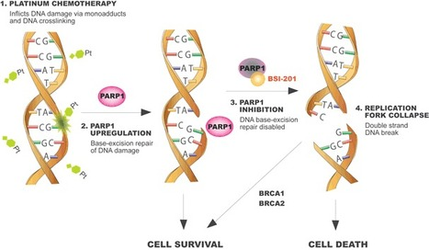
Clinical Trials Around BRCA Mutations
New class of drug known as PARP inhibitors
  Only effective or most effective in patients with germline BRCA mutations
  Already FDA-approved in metastatic breast and ovarian patients
  Shown to improve progression-free survival, improved response to other chemotherapy
  Numerous trials underway in metastatic prostate cancer
Consideration of early use of platinum-based therapies if cancer progresses
Image source: https://blogs.shu.edu/cancer/2014/06/26/parp-inhibitor-rejected-by-fda-advisory-committee/

Slide 20
Gene has a mutation in BRCA2 gene
Gene
Patient Age: 67
Clinical Stage: T1c
PSA prior to Biopsy: 6.3
Gleason Score: 3 + 4 = 7
AUA Risk Classification: Favorable Intermediate
General Practitioner: Regular clinical male breast exams
Dermatologist: Annual skin checks
Family History
Relative | Cancer Site | Age of DX
Father | Prostate | 63
Sister | Breast | 49
Copyright © 2018 Myriad Genetics, Inc., all rights reserved. www.Myriad.com

Slide 21
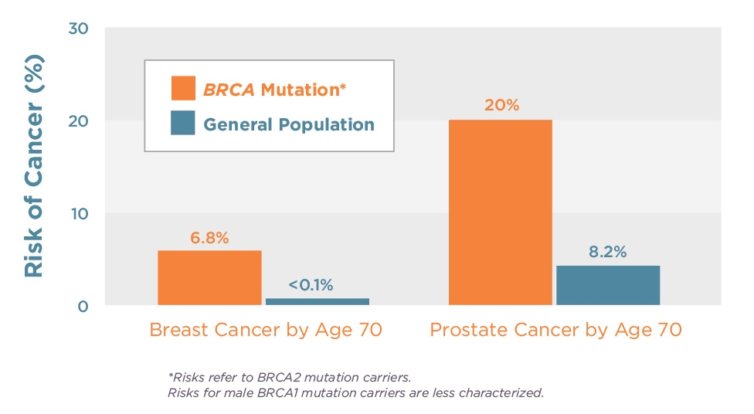
BRCA Mutation Risks in Men
May account for ~15% of all male breast cancer
JCO 2004;22:735-42
NCI (SEER) 2012
JNCI 2007;99(23)1811-4
JNCI 1999;15:1310-16
Notes:
Prevalence of BRCA Mutations in HBOC Families
All cancer results from an accumulation of mutations in genes that normally control cell division. Most of these mutations are acquired during a person's lifetime, but in some individuals, an initial mutation in a critical gene is inherited. Approximately 7%¹ of breast cancer and approximately 14% ^{2,3,14} of invasive ovarian cancer results from such genetic mutations passed down from either the father or mother. The majority (approximately 84%) of hereditary breast and ovarian cancer results from inherited mutations in two genes called BRCA1 (52%) and BRCA2 (32%).^{4,5} Although sometimes referred to as the “breast cancer genes,” BRCA1 and BRCA2 are also associated with the majority of hereditary cancers of the ovary.
Although the risk of breast or ovarian cancer may sometimes be increased in other hereditary cancer syndromes, there do not appear to be other genes (such as a so-called "BRCA3") that are responsible for a significant proportion of hereditary breast and ovarian cancer. ⁶ Other genes that have been associated with an increased lifetime risk of breast cancer include TP53, PTEN, CDH1, CHEK2, ATM, STK11,PALB2, RAD51C, BRIP1, BARD1, and NBN.⁷⁻¹² It is important to note that syndromes associated with these other gene mutations often include additional types of cancers and/or associated physical characteristics of the particular syndrome. In general, these “other” gene mutations carry an overall lower lifetime risk of breast cancer when compared to BRCA gene mutations and occur less frequently in the general population.⁸ In addition to BRCA gene mutations, mismatch repair gene mutations are associated with hereditary ovarian cancer. South et al. found that approximately 2% of 77 ovarian cancer patients who had negative BRCA gene sequencing and did not meet Amsterdam II criteria, had a deleterious mismatch repair gene mutation identified.¹³”
References:
Claus EB, Schildkraut JM, Thompson WD, Risch NJ. The genetic attributable risk of breast and ovarian cancer. Cancer. 1996;77:2318-24.
Risch HA, McLaughlin JR, Cole DEC, et al. Prevalence and penetrance of germline BRCA1 and BRCA2 mutations in a population series of 649 women with ovarian cancer. American Journal of Human Genetics. 2001;68:700-710.
Pal T, Permuth-Wey J, Betts JA, et al. BRCA1 and BRCA2 mutations account for a large proportion of ovarian carcinoma cases. Cancer. 2005;104(12):2807-2816.
Ford D, Easton DF, Stratton M, et al. Genetic heterogeneity and penetrance analysis of the BRCA1 and BRCA2 genes in breast cancer families. American Journal of Human Genetcs. 1998;62:676-89.
Frank TS, Deffenbaugh AM, Reid JE et al. Clinical characteristics of individuals with germline mutations in BRCA1 and BRCA2: Analysis of 10,000 individuals. Journal of Clinical Oncology. 2002 20:1480-1490.
Narod SA, Foulkes WD. BRCA1 and BRCA2: 1994 and beyond. Nature Reviews: Cancer. 2004;4(9):665-76.
Petrucelli N, Daly MB, Feldman GL. BRCA1 and BRCA2 Hereditary Breast and Ovarian Cancer . 1998 Sep 04 [updated 2013 Sep 26]. In: Pagon RA, Adam MP, Ardinger HH, Bird TD, Dolan CR, Fong CT, Smith RJH, Stephens K, editors. GeneReviews® [Internet]. Seattle (WA): University of Washington, Seattle; 1993-2014. Available from http://www.ncbi.nlm.nih.gov/books/NBK1247/
Seal S, et al. Breast Cancer Susceptibility Collaboration (UK). Truncating mutations in the Fanconi anemia J gene BRIP1 are low-penetrance breast cancer susceptibility alleles. Nat Genet. 2006 38:1239-41. PMID: 17033622.
De Brakeleer S, et al. Cancer predisposing missense and protein truncating BARD1 mutations in non-BRCA1 or BRCA2 breast cancer families. Hum Mutat. 2010 31:E1175-85. PMID: 20077502.
Ratajska M, et al. Cancer predisposing BARD1 mutations in breast-ovarian cancer families. Breast Cancer Res Treat. 2012 131:89-97. PMID: 21344236.
Steffen J, et al. Germline mutations 657del5 of the NBS1 gene contribute significantly to the incidence of breast cancer in Central Poland. Int J Cancer. 2006 119:472-5. PMID: 16770759.
Zhang B, Beeghly-Fadiel A, Long J, Zheng W. Genetic variants associated with breast-cancer risk: comprehensive research synopsis, meta-analysis, and epidemiological evidence. Lancet Oncol. 2011 May;12(5):477-88.PMID: 21514219.
South et al. Consideration of hereditary nonpolyposis colorectal cancer in BRCA mutation-negative familial ovarian cancers. Cancer. 2009 Jan 15;115(2):324-33.
Zhang S. et al. Frequencies of BRCA1 and BRCA2 mutations among 1,342 unselected patients with invasive ovarian cancer. Gynecol Oncol. 2011 May 1;121(2):352-7.

Slide 22
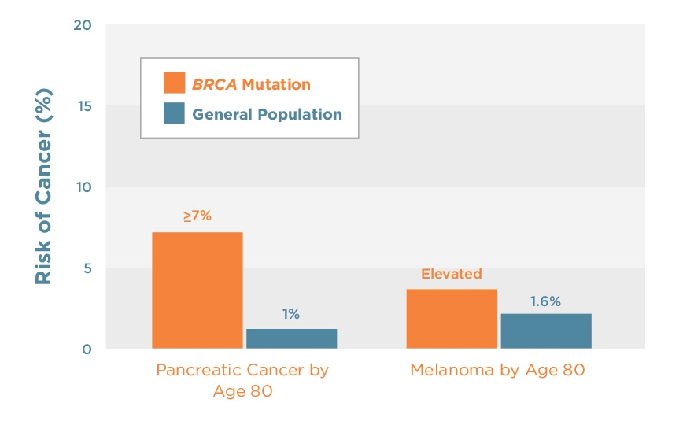
BRCA Mutations and Other Cancers
JNCI 1999;15:1310-16
JNCI 2002;15:1365-72
J Med Genet 2005;42(9):711-9
NCI (SEER) 2012
Notes:
Prevalence of BRCA Mutations in HBOC Families
All cancer results from an accumulation of mutations in genes that normally control cell division. Most of these mutations are acquired during a person's lifetime, but in some individuals, an initial mutation in a critical gene is inherited. Approximately 7%¹ of breast cancer and approximately 14% ^{2,3,14} of invasive ovarian cancer results from such genetic mutations passed down from either the father or mother. The majority (approximately 84%) of hereditary breast and ovarian cancer results from inherited mutations in two genes called BRCA1 (52%) and BRCA2 (32%).^{4,5} Although sometimes referred to as the “breast cancer genes,” BRCA1 and BRCA2 are also associated with the majority of hereditary cancers of the ovary.
Although the risk of breast or ovarian cancer may sometimes be increased in other hereditary cancer syndromes, there do not appear to be other genes (such as a so-called "BRCA3") that are responsible for a significant proportion of hereditary breast and ovarian cancer. ⁶ Other genes that have been associated with an increased lifetime risk of breast cancer include TP53, PTEN, CDH1, CHEK2, ATM, STK11,PALB2, RAD51C, BRIP1, BARD1, and NBN.⁷⁻¹² It is important to note that syndromes associated with these other gene mutations often include additional types of cancers and/or associated physical characteristics of the particular syndrome. In general, these “other” gene mutations carry an overall lower lifetime risk of breast cancer when compared to BRCA gene mutations and occur less frequently in the general population.⁸ In addition to BRCA gene mutations, mismatch repair gene mutations are associated with hereditary ovarian cancer. South et al. found that approximately 2% of 77 ovarian cancer patients who had negative BRCA gene sequencing and did not meet Amsterdam II criteria, had a deleterious mismatch repair gene mutation identified.¹³”
References:
Claus EB, Schildkraut JM, Thompson WD, Risch NJ. The genetic attributable risk of breast and ovarian cancer. Cancer. 1996;77:2318-24.
Risch HA, McLaughlin JR, Cole DEC, et al. Prevalence and penetrance of germline BRCA1 and BRCA2 mutations in a population series of 649 women with ovarian cancer. American Journal of Human Genetics. 2001;68:700-710.
Pal T, Permuth-Wey J, Betts JA, et al. BRCA1 and BRCA2 mutations account for a large proportion of ovarian carcinoma cases. Cancer. 2005;104(12):2807-2816.
Ford D, Easton DF, Stratton M, et al. Genetic heterogeneity and penetrance analysis of the BRCA1 and BRCA2 genes in breast cancer families. American Journal of Human Genetcs. 1998;62:676-89.
Frank TS, Deffenbaugh AM, Reid JE et al. Clinical characteristics of individuals with germline mutations in BRCA1 and BRCA2: Analysis of 10,000 individuals. Journal of Clinical Oncology. 2002 20:1480-1490.
Narod SA, Foulkes WD. BRCA1 and BRCA2: 1994 and beyond. Nature Reviews: Cancer. 2004;4(9):665-76.
Petrucelli N, Daly MB, Feldman GL. BRCA1 and BRCA2 Hereditary Breast and Ovarian Cancer . 1998 Sep 04 [updated 2013 Sep 26]. In: Pagon RA, Adam MP, Ardinger HH, Bird TD, Dolan CR, Fong CT, Smith RJH, Stephens K, editors. GeneReviews® [Internet]. Seattle (WA): University of Washington, Seattle; 1993-2014. Available from http://www.ncbi.nlm.nih.gov/books/NBK1247/
Seal S, et al. Breast Cancer Susceptibility Collaboration (UK). Truncating mutations in the Fanconi anemia J gene BRIP1 are low-penetrance breast cancer susceptibility alleles. Nat Genet. 2006 38:1239-41. PMID: 17033622.
De Brakeleer S, et al. Cancer predisposing missense and protein truncating BARD1 mutations in non-BRCA1 or BRCA2 breast cancer families. Hum Mutat. 2010 31:E1175-85. PMID: 20077502.
Ratajska M, et al. Cancer predisposing BARD1 mutations in breast-ovarian cancer families. Breast Cancer Res Treat. 2012 131:89-97. PMID: 21344236.
Steffen J, et al. Germline mutations 657del5 of the NBS1 gene contribute significantly to the incidence of breast cancer in Central Poland. Int J Cancer. 2006 119:472-5. PMID: 16770759.
Zhang B, Beeghly-Fadiel A, Long J, Zheng W. Genetic variants associated with breast-cancer risk: comprehensive research synopsis, meta-analysis, and epidemiological evidence. Lancet Oncol. 2011 May;12(5):477-88.PMID: 21514219.
South et al. Consideration of hereditary nonpolyposis colorectal cancer in BRCA mutation-negative familial ovarian cancers. Cancer. 2009 Jan 15;115(2):324-33.
Zhang S. et al. Frequencies of BRCA1 and BRCA2 mutations among 1,342 unselected patients with invasive ovarian cancer. Gynecol Oncol. 2011 May 1;121(2):352-7.

Slide 23
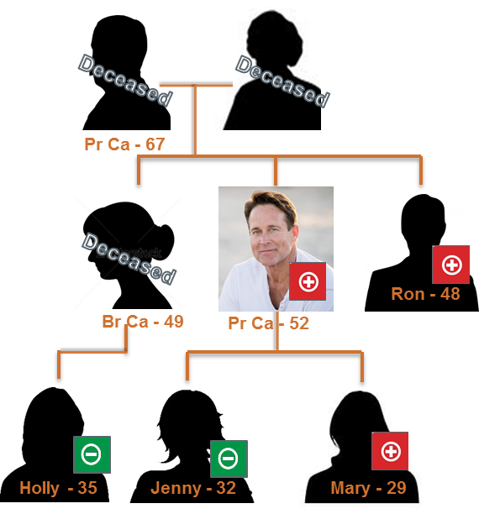



Importance to Gene’s family:
Ron - Brother : BRCA2
Urologist: Earlier and more frequent prostate cancer screening
General Practitioner: Regular clinical male breast exams
Dermatologist: Annual skin checks.
Mary – Daughter: BRCA2
Breast Specialist: Scheduled prophylactic double mastectomy with reconstruction
Gynecologic Oncologist: Consider oophorectomy after she is finished having children
Dermatologist: Annual skin checks
Pr Ca - 67
Jenny and Holly – Daughter and Niece: BRCA2
Primary Care/ Gynecologist: Evaluate for general population screening
Copyright © 2018 Myriad Genetics, Inc. all rights reserved. www.Myriad.com

Slide 24
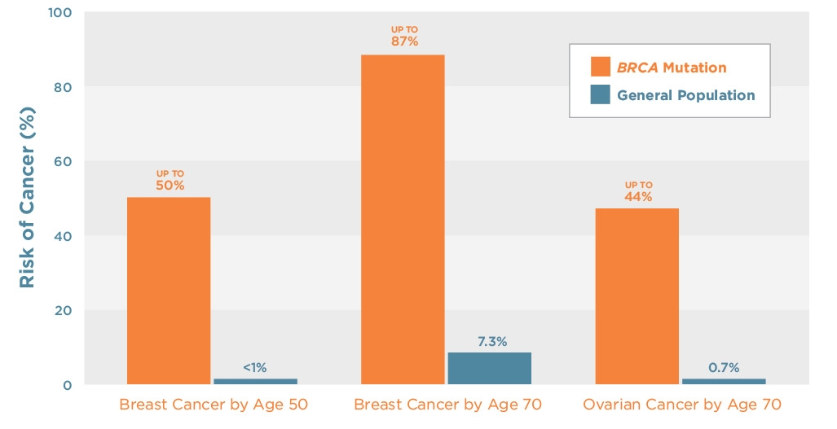
BRCA Mutations Increase Breast and Ovarian Cancer Risks
Lancet 1994;343:692-5
NEJM 1997;336:1401-8
AJHG 2003;72-117-30
JNCI 1999;15:1310-6
JCO 2007;25(11):1329-33
AJHG 1999:56:265-71
Science 2003;643-6
JCO 2005;23(8)1656-63
NCI (SEER) 2012
Notes:
Prevalence of BRCA Mutations in HBOC Families
All cancer results from an accumulation of mutations in genes that normally control cell division. Most of these mutations are acquired during a person's lifetime, but in some individuals, an initial mutation in a critical gene is inherited. Approximately 7%¹ of breast cancer and approximately 14% ^{2,3,14} of invasive ovarian cancer results from such genetic mutations passed down from either the father or mother. The majority (approximately 84%) of hereditary breast and ovarian cancer results from inherited mutations in two genes called BRCA1 (52%) and BRCA2 (32%).^{4,5} Although sometimes referred to as the “breast cancer genes,” BRCA1 and BRCA2 are also associated with the majority of hereditary cancers of the ovary.
Although the risk of breast or ovarian cancer may sometimes be increased in other hereditary cancer syndromes, there do not appear to be other genes (such as a so-called "BRCA3") that are responsible for a significant proportion of hereditary breast and ovarian cancer. ⁶ Other genes that have been associated with an increased lifetime risk of breast cancer include TP53, PTEN, CDH1, CHEK2, ATM, STK11,PALB2, RAD51C, BRIP1, BARD1, and NBN.⁷⁻¹² It is important to note that syndromes associated with these other gene mutations often include additional types of cancers and/or associated physical characteristics of the particular syndrome. In general, these “other” gene mutations carry an overall lower lifetime risk of breast cancer when compared to BRCA gene mutations and occur less frequently in the general population.⁸ In addition to BRCA gene mutations, mismatch repair gene mutations are associated with hereditary ovarian cancer. South et al. found that approximately 2% of 77 ovarian cancer patients who had negative BRCA gene sequencing and did not meet Amsterdam II criteria, had a deleterious mismatch repair gene mutation identified.¹³”
References:
Claus EB, Schildkraut JM, Thompson WD, Risch NJ. The genetic attributable risk of breast and ovarian cancer. Cancer. 1996;77:2318-24.
Risch HA, McLaughlin JR, Cole DEC, et al. Prevalence and penetrance of germline BRCA1 and BRCA2 mutations in a population series of 649 women with ovarian cancer. American Journal of Human Genetics. 2001;68:700-710.
Pal T, Permuth-Wey J, Betts JA, et al. BRCA1 and BRCA2 mutations account for a large proportion of ovarian carcinoma cases. Cancer. 2005;104(12):2807-2816.
Ford D, Easton DF, Stratton M, et al. Genetic heterogeneity and penetrance analysis of the BRCA1 and BRCA2 genes in breast cancer families. American Journal of Human Genetcs. 1998;62:676-89.
Frank TS, Deffenbaugh AM, Reid JE et al. Clinical characteristics of individuals with germline mutations in BRCA1 and BRCA2: Analysis of 10,000 individuals. Journal of Clinical Oncology. 2002 20:1480-1490.
Narod SA, Foulkes WD. BRCA1 and BRCA2: 1994 and beyond. Nature Reviews: Cancer. 2004;4(9):665-76.
Petrucelli N, Daly MB, Feldman GL. BRCA1 and BRCA2 Hereditary Breast and Ovarian Cancer . 1998 Sep 04 [updated 2013 Sep 26]. In: Pagon RA, Adam MP, Ardinger HH, Bird TD, Dolan CR, Fong CT, Smith RJH, Stephens K, editors. GeneReviews® [Internet]. Seattle (WA): University of Washington, Seattle; 1993-2014. Available from http://www.ncbi.nlm.nih.gov/books/NBK1247/
Seal S, et al. Breast Cancer Susceptibility Collaboration (UK). Truncating mutations in the Fanconi anemia J gene BRIP1 are low-penetrance breast cancer susceptibility alleles. Nat Genet. 2006 38:1239-41. PMID: 17033622.
De Brakeleer S, et al. Cancer predisposing missense and protein truncating BARD1 mutations in non-BRCA1 or BRCA2 breast cancer families. Hum Mutat. 2010 31:E1175-85. PMID: 20077502.
Ratajska M, et al. Cancer predisposing BARD1 mutations in breast-ovarian cancer families. Breast Cancer Res Treat. 2012 131:89-97. PMID: 21344236.
Steffen J, et al. Germline mutations 657del5 of the NBS1 gene contribute significantly to the incidence of breast cancer in Central Poland. Int J Cancer. 2006 119:472-5. PMID: 16770759.
Zhang B, Beeghly-Fadiel A, Long J, Zheng W. Genetic variants associated with breast-cancer risk: comprehensive research synopsis, meta-analysis, and epidemiological evidence. Lancet Oncol. 2011 May;12(5):477-88.PMID: 21514219.
South et al. Consideration of hereditary nonpolyposis colorectal cancer in BRCA mutation-negative familial ovarian cancers. Cancer. 2009 Jan 15;115(2):324-33.
Zhang S. et al. Frequencies of BRCA1 and BRCA2 mutations among 1,342 unselected patients with invasive ovarian cancer. Gynecol Oncol. 2011 May 1;121(2):352-7.

Slide 25
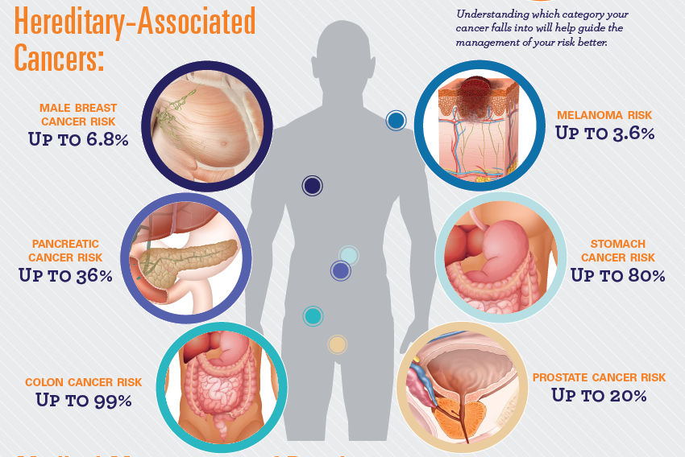
Patients with Hereditary Cancer Syndromes have elevated risk for multiple cancers

Slide 26
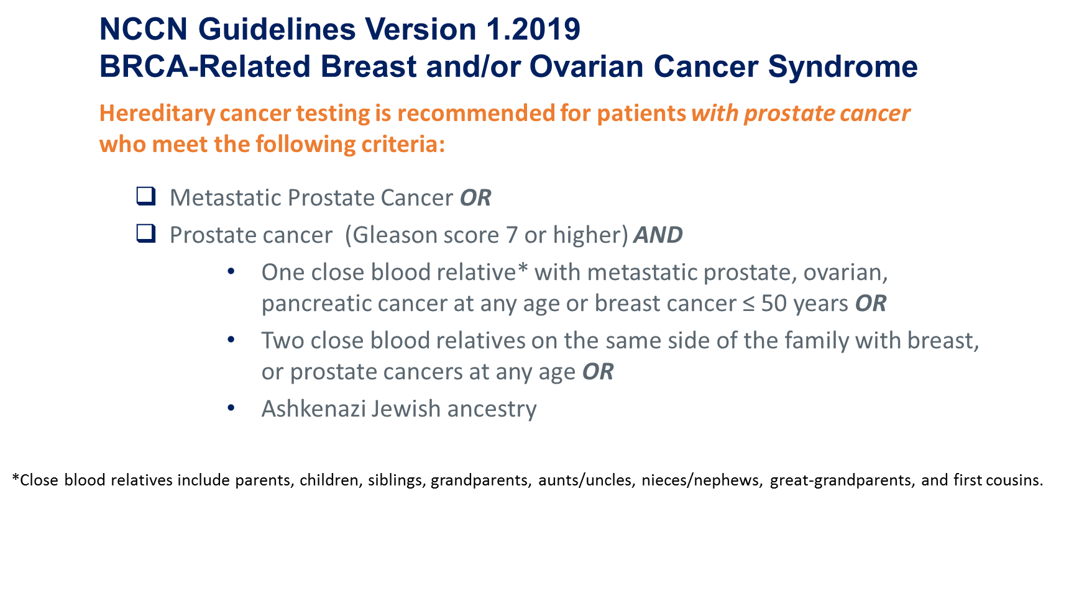
Identifying Patients At-Risk for Hereditary Cancer is
The Standard of Care

Slide 27

Identifying if you might be a candidate for testing
www.hereditarycancerquiz.com
Copyright © 2018 Myriad Genetics, Inc. all rights reserved. www.Myriad.com

Slide 28
Keys to Genetic Testing
Know your personal and family history
  Men with metastatic prostate cancer
  Family history of prostate, breast, ovarian, pancreatic cancer
Complete Hereditary Cancer Quiz
If you may be an appropriate candidate for genetic testing, talk to your urologist or health care provider
Panel testing (multiple genes associated with hereditary cancer risk) is considered the best option
Education and informed consent
Results generally available in 2-3 weeks

Slide 29
Questions

