Slide 1
Radiation Therapy for Prostate Cancer
Ronald Chen, MD MPH
Associate Professor, Radiation Oncology
University of North Carolina – Chapel Hill
Associate Director, UNC Lineberger Comprehensive Cancer Center
NASPCC 10-13-18

Slide 2
Disclosures
Accuray Inc: consulting and research funding
Bayer: consulting

Slide 3
Outline
1) Shortening radiation treatment for prostate cancer
2) “Oligometastatic” prostate cancer

Slide 4
Reducing radiation treatment time

Slide 5
Definitions
 | Daily Dose (Gy) | Number of Treatments | Total Dose (Gy) | Duration (Weeks)
Conventional | 1.8-2 | 38-45 | 75-81 | 8-9
Moderate Hypofractionation | 2.4-3.4 | 15-30 | 57-70 | 3-6
Extreme Hypofractionation | 7-10 | 4-5 | 35-50 | 1-2

Slide 6
Concern – is this effective?
 | Daily Dose (Gy) | Number of Treatments | Total Dose (Gy) | Duration (Weeks)
Conventional | 1.8-2 | 38-45 | 75-81 | 8-9
Moderate Hypofractionation | 2.4-3.4 | 15-30 | 57-70 | 3-6
Extreme Hypofractionation | 7-10 | 4-5 | 35-50 | 1-2

Slide 7
Concern – is this safe?
 | Daily Dose (Gy) | Number of Treatments | Total Dose (Gy) | Duration (Weeks)
Conventional | 1.8-2 | 38-45 | 75-81 | 8-9
Moderate Hypofractionation | 2.4-3.4 | 15-30 | 57-70 | 3-6
Extreme Hypofractionation | 7-10 | 4-5 | 35-50 | 1-2

Slide 8
Moderate Hypofractionation
 | N | Daily Dose | # Doses | Total Dose | Daily Dose | # Doses | Total Dose
Italy | 168 | 2 | 40 | 80 | 3.1 | 20 | 62
MDACC | 204 | 1.8 | 42 | 75.6 | 2.4 | 30 | 72
Australia | 217 | 2 | 32 | 64 | 2.75 | 20 | 55
Fox Chase | 303 | 2 | 38 | 76 | 2.7 | 26 | 70.2
HYPRO | 804 | 2 | 39 | 78 | 3.4 | 19 | 64.6
Lukka | 936 | 2 | 33 | 66 | 2.62 | 20 | 52.5
RTOG | 1092 | 1.8 | 41 | 73.8 | 2.5 | 24 | 60
PROFIT | 1206 | 2 | 39 | 78 | 3 | 20 | 60
CHHiP | 3216 | 2 | 37 | 74 | 3 | 20 | 60

Slide 9
Moderate Hypofractionation
9 clinical trials
Low risk prostate cancer to high risk cancer
Hypofractionation
  No increase in recurrence
  Similar side effects
Benefits to patients:
  Patient convenience
  Equally effective and cheaper cost = more cost-effective

Slide 10
Extreme Hypofractionation
Reducing radiation treatment to only 1-2 weeks
“Cyberknife” is a branded machine that is often used

Slide 11
Extreme Hypofractionation
Largest reported study to date:
  Pooled analysis of patients from 8 institutions (UCLA, Harvard/Beth-Israel, Italy, Georgetown, Swedish Medical Center/Seattle, etc)
  N=1100, enrolled 2003-2011
  35-40 Gy/4-5 fractions
King CR et al. Radiat Oncol 109:217-221, 2013.

Slide 12
Efficacy
5-year relapse free survival
  Low risk (N=641): 95%
  Intermediate (N=334): 84%
  High (N=125): 81%

Slide 13
Efficacy
N=477, low or intermediate risk
7-7.25 Gy/fraction x 5 = 35-36.25 Gy total
Katz AJ et al. Frontier Oncol 4:article 240, 2014.

Slide 14
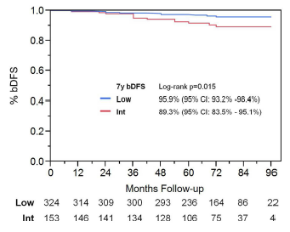
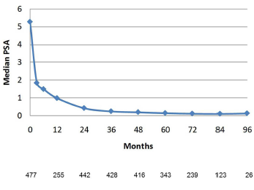
Efficacy
Median PSA at 7 years: 0.11

Slide 15
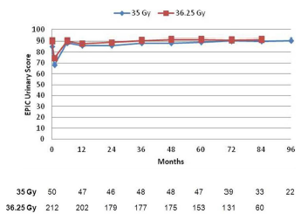
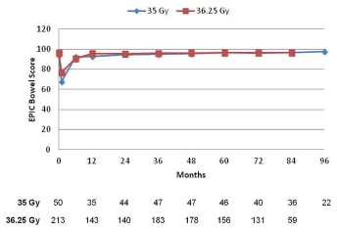
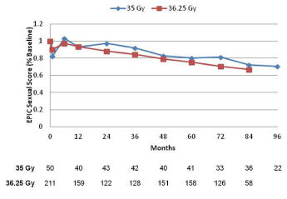
Quality of Life
Prospectively collected using EPIC
Urinary
Bowel
Sexual
(14% ADT)
Katz AJ et al. Frontier Oncol 4:article 301, 2014.

Slide 16
Randomized Trial
Intermediate/high risk prostate cancer
2 Gy x 39 = 78 Gy
6.1Gy x 7 = 42.7 Gy
N=1180 patients
5-year free from recurrence: 84% vs 84%
No difference in toxicity
Widmark A et al. ESTRO 2018.
Notes:
No ADT

Slide 17
Conclusions
 | Daily Dose (Gy) | Number of Treatments | Total Dose (Gy) | Duration (Weeks)
Conventional | 1.8-2 | 38-45 | 75-81 | 8-9
Moderate Hypofractionation | 2.4-3.4 | 15-30 | 57-70 | 3-6
Extreme Hypofractionation | 7-10 | 4-5 | 35-50 | 1-2

Slide 18
Treatment for oligometastatic prostate cancer

Slide 19
Oligometastatic Cancer
Cancer that has metastasized to only a few places
Currently, standard treatment is ADT
Can aggressive treatment help some patients? Is this potentially curable?

Slide 20
STOMP Trial
62 patients with prostate cancer recurrence
≤ 3 metastases
Randomize:
  Observation
  Surgery or stereotactic body RT to all metastases
Ost P et al. JCO 36(5):446-53, 2018.

Slide 21
Results
Time to starting ADT
Obs: 13 months
Treatment: 21 months

Slide 22
Conclusion
Targeted (surgery or SBRT) to all metastases for patients with oligometastatic prostate cancer is
  Well tolerated
  Delays the need for ADT – which may be beneficial to patients

Slide 23
Other Ongoing Trials
Patient with newly diagnosed metastatic prostate cancer
  Few areas of metastasis
Treat all the areas of disease (prostate and metastases) – does that help improve patient outcomes?

