Slide 1
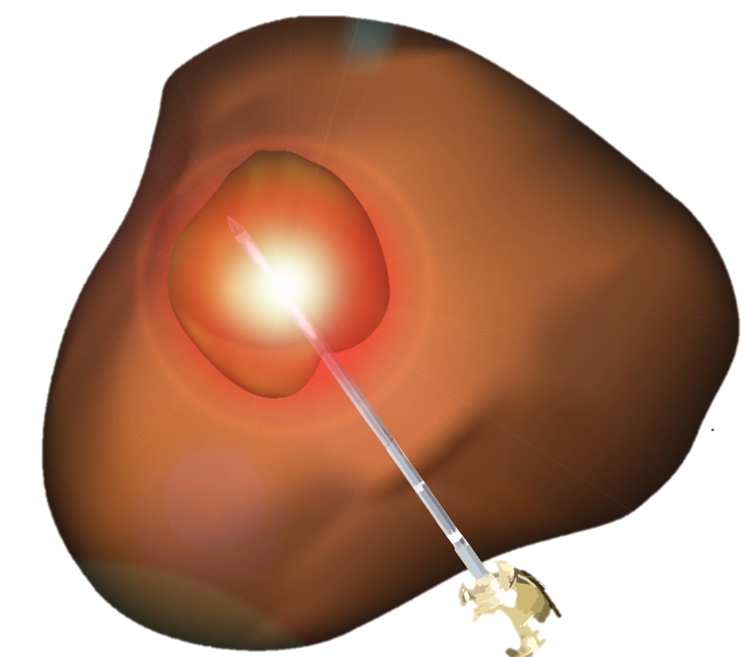
Patient-specific Treatment of Prostate Cancer
Shyam Natarajan, PhD
Co-Founder, Avenda Health
October 12, 2018
14th Annual NASPCC National Meeting

Slide 2
Prostate Cancer Treatment Choices (simplified)
Active Surveillance
Whole Gland Therapy
Source: Meropol et al, Cancer, 2008. Cooperberg 2013, Sanda MG, Dunn RL, Michalski J, et al. Quality of Life and Satisfaction with Outcome among Prostate-Cancer Survivors. March 2008:1-12..

Slide 3
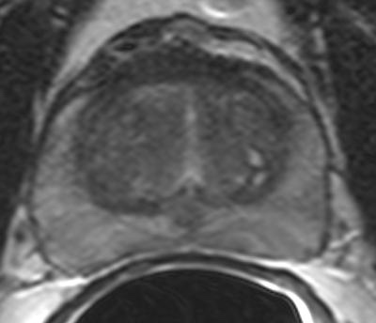
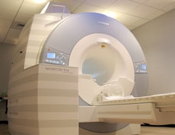
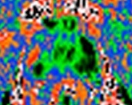
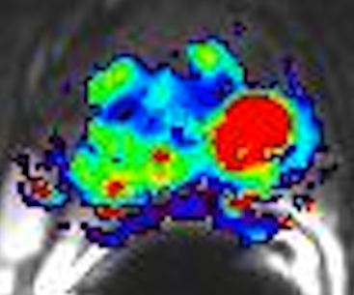
Imaging with Multi-Parametric MRI
Anatomy
(T2)
Cellular Density
(Diffusion)
Perfusion
(Contrast)

Slide 4
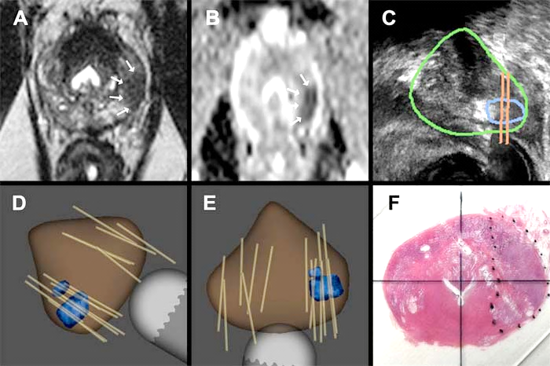
Diagnosis via MRI / Ultrasound Fusion
MRI
Real-Time
Ultrasound
3D Model of Prostate
Histology of
Prostate Tumor
Natarajan, S, Marks L et al, Urol Onc, 29; 334-342, 2011

Slide 5
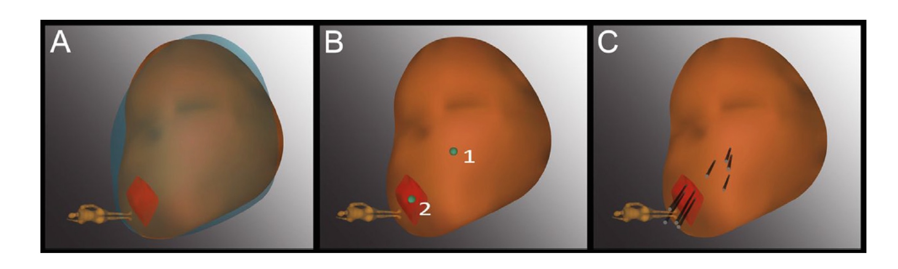
What we’ve learned from targeted biopsy
MR / Ultrasound fusion is accurate within ~3mm
Targeted biopsy finds more significant cancer in men with prior biopsy
Ability to biopsy the same site and same tumor months and years later
Both targeted and mapping biopsy are needed, particularly for first-time biopsy
10-20% of prostate cancers are invisible on mpMRI
Fusion
Prior Biopsy Sites
Tracking
Kasivisvanathan V, Rannikko AS, Borghi M, et al. MRI-Targeted or Standard Biopsy for Prostate-Cancer Diagnosis. N Engl J Med. 2018;378(19):1767-1777.
Siddiqui MM, Rais-Bahrami S, Turkbey B, et al. Comparison of MR/Ultrasound Fusion–Guided Biopsy With Ultrasound-Guided Biopsy for the Diagnosis of Prostate Cancer. JAMA. 2015;313(4):390-398
Filson CP, Natarajan S, Margolis DJA, et al. Prostate cancer detection with magnetic resonance-ultrasound fusion biopsy: The role of systematic and targeted biopsies. Cancer. 2016;122(6):884-892

Slide 6
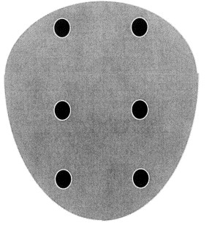
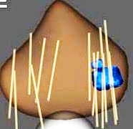
Blind
(1986 – Present)
Image-Guided
(Present)

Slide 7
What is Focal Therapy?
Targeted (image-guided) treatment of prostate cancer that avoids or reduces impact to critical structures
“A male lumpectomy”

Slide 8
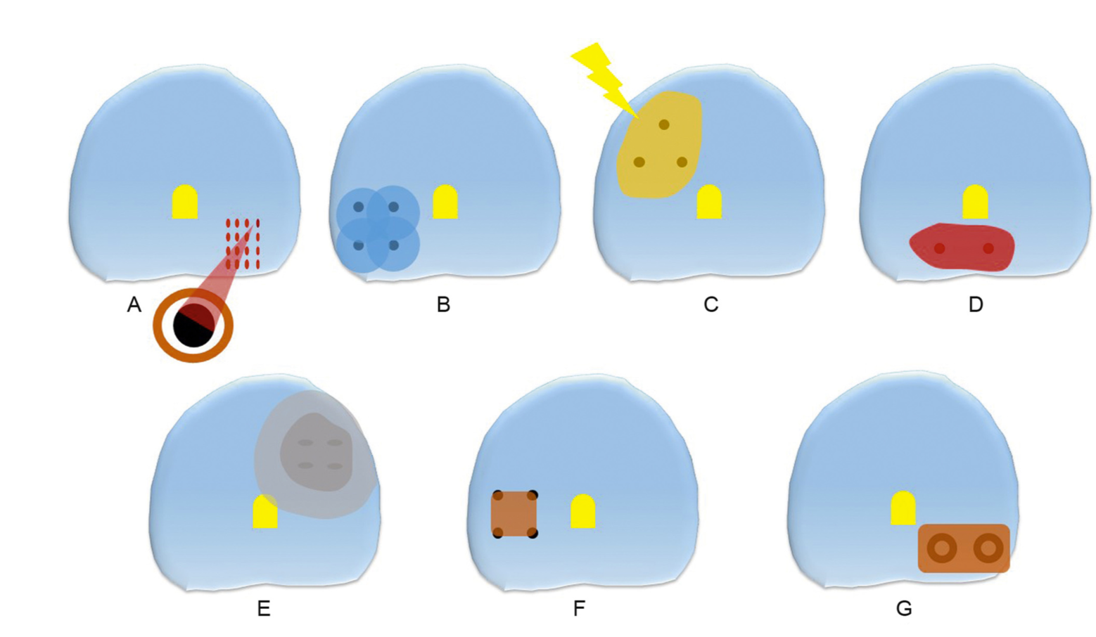
Many Choices with Energy Source
High Intensity Focused Ultrasound (HIFU)
Cryotherapy
Photodynamic Therapy
Focal Laser Ablation
Irreversible Electroporation
Radiofrequency Ablation
Brachytherapy
Valerio M, Cerantola Y, Eggener SE, et al. New and Established Technology in Focal Ablation of the Prostate: A Systematic Review. European Urology. 2017;71(1):17-34.

Slide 9
Near and Intermediate-term Outcomes
37 studies, 3230 patients
83.3-100% retained leak-free continence
81.5-100% retained sexual potency
55-85% intermediate-term cancer control (any Gleason)
87-100% intermediate-term cancer control (Gleason 7+)
References
Ward JF, Jones JS. Focal cryotherapy for localized prostate cancer: a report from the national Cryo On-Line Database (COLD) Registry. BJU International. 2011;109(11):1648-1654.
B Barqawi Al, Huebner E, Krughoff K, O'Donnell CI. Prospective Outcome Analysis of the Safety and Efficacy of Partial and Complete Cryoablation in Organ- confined Prostate Cancer. URL. 2018;112:126-131.
Ahmed HU, Dickinson L, Charman S, et al. Focal Ablation Targeted to the Index Lesion in Multifocal Localised Prostate Cancer: a Prospective Development Study. European Urology. 2015;68(6):927-936.
Chao B, Llukani E, Lepor H. Two-year Outcomes Following Focal Laser Ablation of Localized Prostate Cancer. European Urology Oncology. 2018;1(2):129-133.
Valerio M, Cerantola Y, Eggener SE, et al. New and Established Technology in Focal Ablation of the Prostate: A Systematic Review. European Urology. 2017;71(1):17-34.

Slide 10
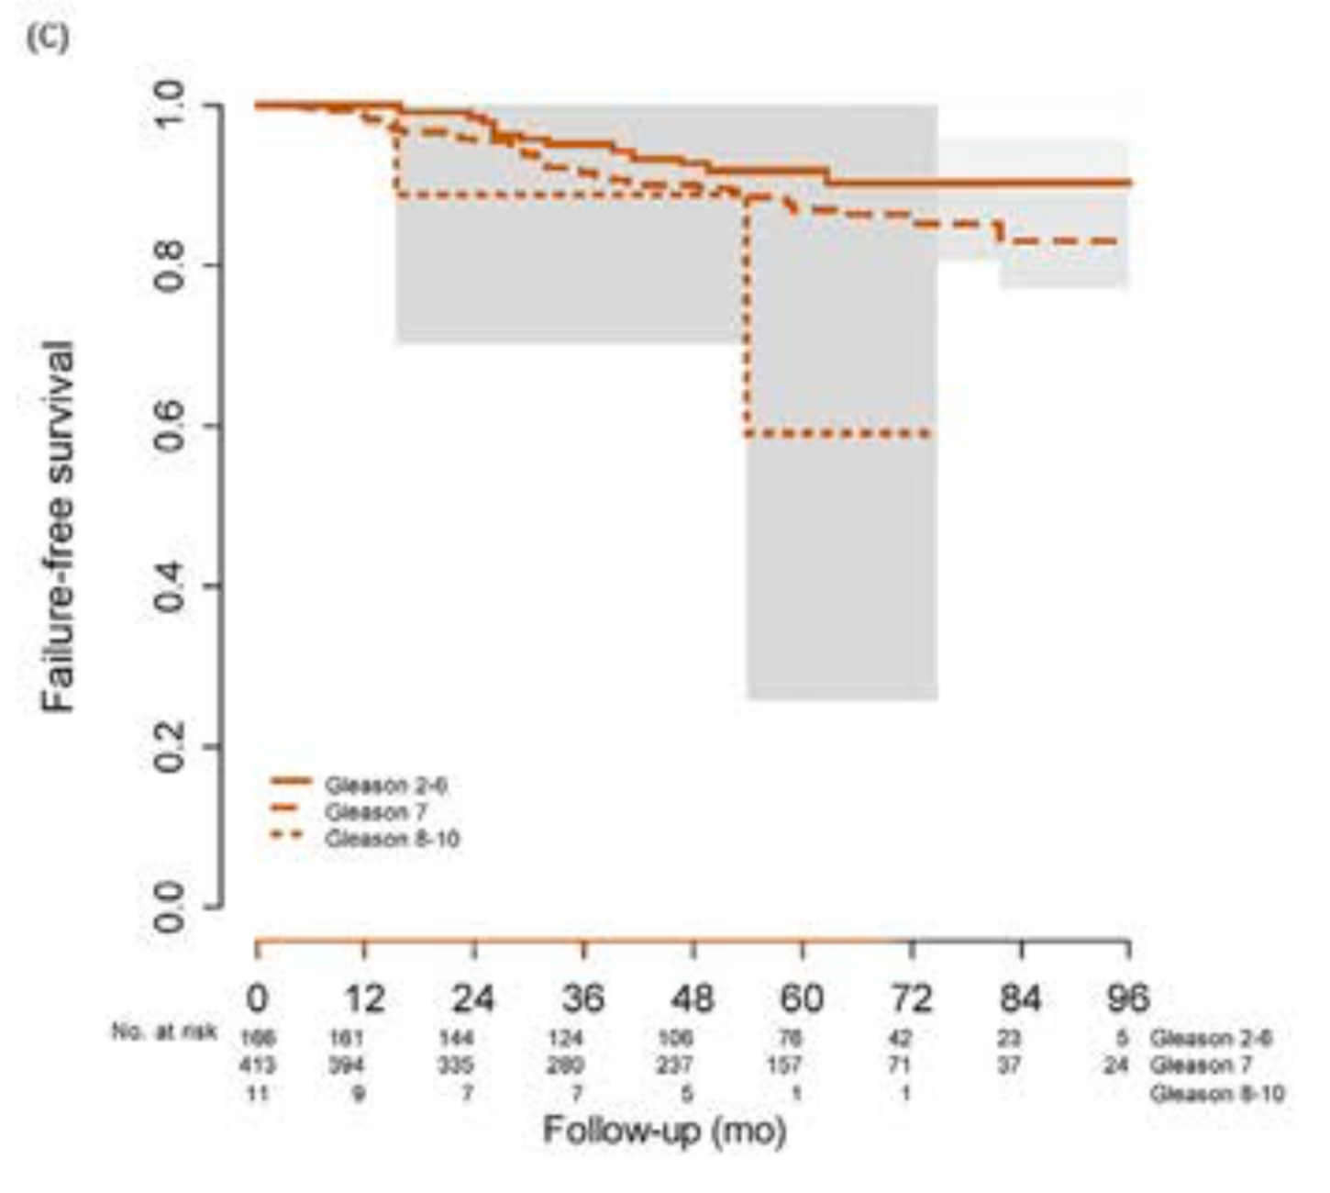
5-year multi-site study of Focal Therapy (n=625)
Failure-free survival 88%
Metastasis-free survival 98%
Cancer-specific survival 100%
Overall survival 99%
Urinary incontinence 2%
Guillaumier S, et al. A Multicentre Study of 5-year Outcomes Following Focal Therapy in Treating Clinically Significant Nonmetastatic Prostate Cancer. Eur Urol (2018), https://doi.org/10.1016/j.eururo.2018.06.006

Slide 11
Who is Eligible?
References
Nassiri N, Chang E, Lieu P, et al. Focal Therapy Eligibility Determined by Magnetic Resonance Imaging/Ultrasound Fusion Biopsy. Journal of Urology. 2018;199(2):453-458
Mohler JL, Armstrong AJ, Bahnson RR, et al. Prostate Cancer, Version 1.2016. Journal of the National Comprehensive Cancer Network. 2016;14(1):19-30.
Jarow JP, Ahmed HU, Choyke PL, Taneja SS, Scardino PT. Partial Gland Ablation for Prostate Cancer: Report of a Food and Drug Administration, American Urological Association, and Society of Urologic Oncology Public Workshop. URL. 2016;88(C):8-13. doi:10.1016/j.urology.2015.11.018.
Tay KJ, Scheltema MJ, Ahmed HU, et al. Patient selection for prostate focal therapy in the era of active surveillance: an International Delphi Consensus Project. 2017;20(3):294-299. doi:10.1038/pcan.2017.8.
Scheltema MJV, Hentschel AE, la Rosette de JJMCH. Positioning Focal Therapy from Consensus to Guidelines. In: Imaging and Focal Therapy of Early Prostate Cancer. Vol 16. Current Clinical Urology. Cham: Springer International Publishing; 2017:447-463. doi:10.1007/978-3-319-49911-6_35.

Slide 12
Where to Target?
Index lesion – Largest or most aggressive lesion
Highest Gleason Score
Longest Length or Size
Highest MRI Grade (PI-RADS)

Slide 13
How Much to Treat?
Depends…
Priester A et al, J Urol, 197(2); 320-326, 2017
Le Nobin J, Rosenkrantz AB, Villers A, et al. Image Guided Focal Therapy for Magnetic Resonance Imaging Visible Prostate Cancer: Defining a 3-Dimensional Treatment Margin Based on Magnetic Resonance Imaging Histology Co-Registration Analysis. J Urol. 2015;194(2):364-370.
Notes:
Through this work, we determined that in order to treat all cancer, a uniform margin of 1.5 cm would be needed. This is akin to treating 2/3 of the prostate on average.

Slide 14
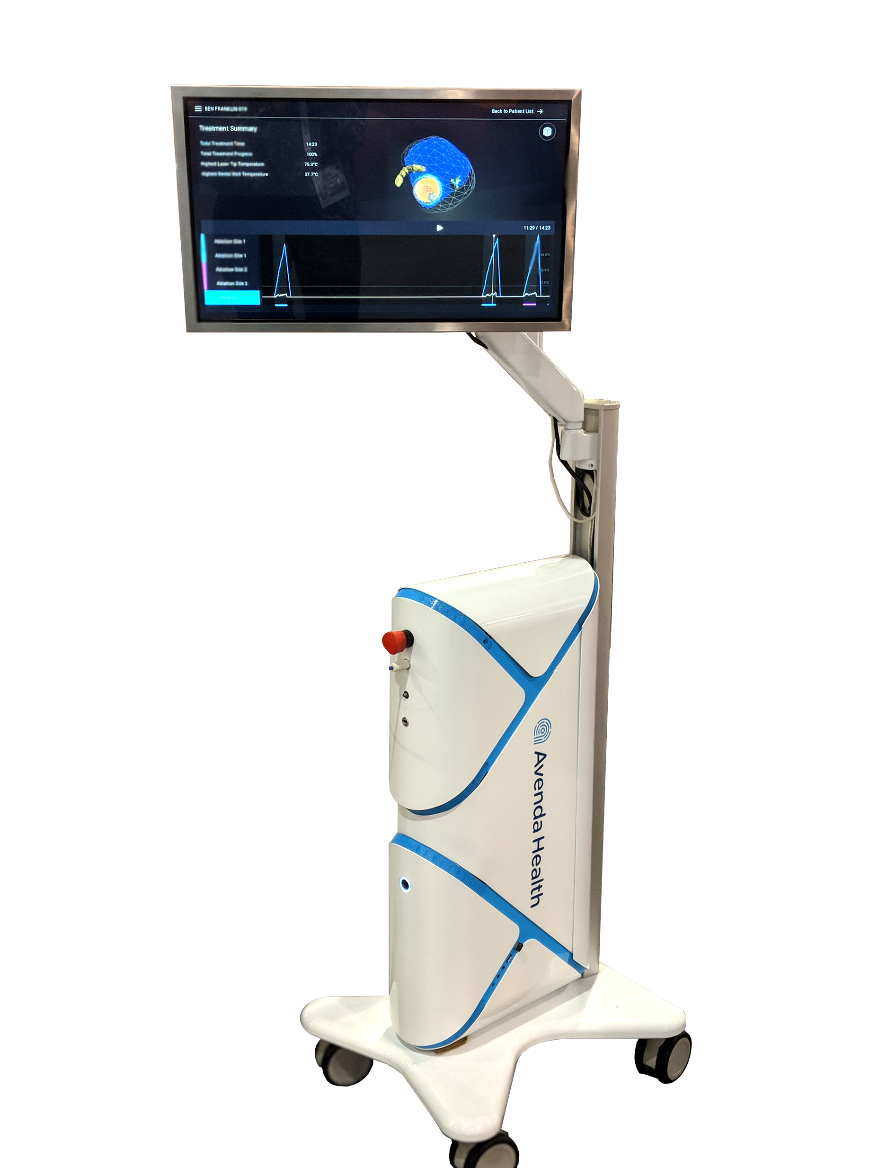
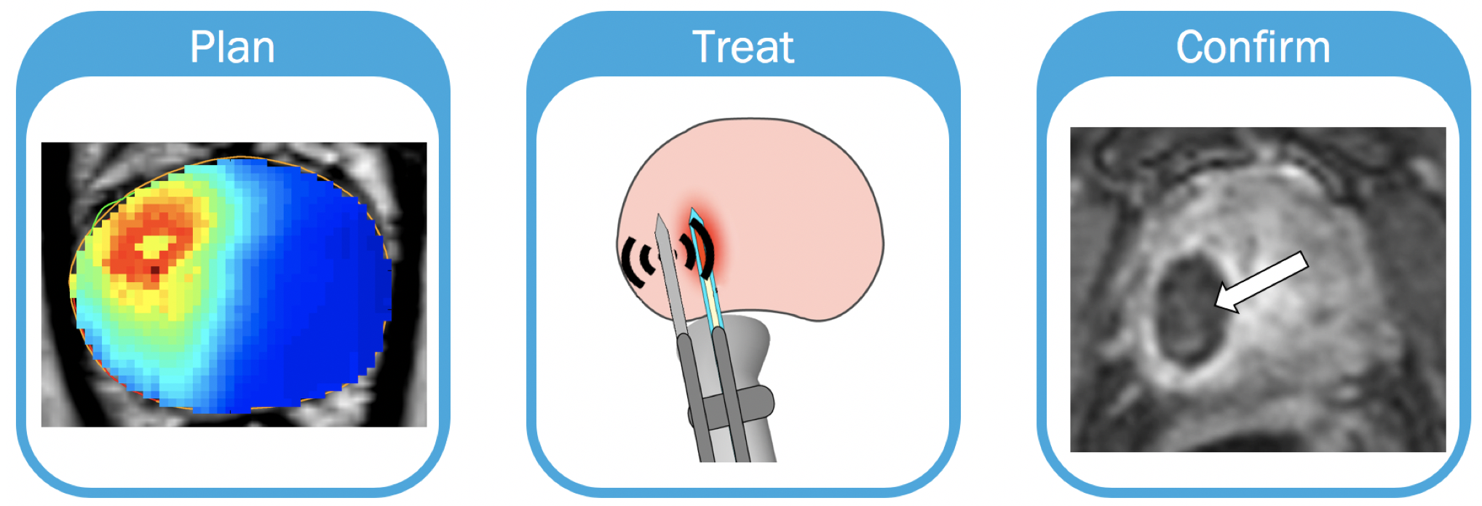
What we are building:
Patient-Specific Treatment in an Office Setting
Margin Prediction
Office-based Laser Ablation
Post-treatment Feedback
* INVESTIGATIONAL DEVICE AND TECHNIQUE. NOT VALIDATED OR COMMERCIALLY AVAILABLE.
Notes:
The Avenda Health system is an easy to use laser-based system for outpatient focal therapy treatment. The system includes AI powered treatment planning and margin prediction software, a low-cost workstation that includes a laser source and allows the physician to monitor treatment in real-time, and a disposable kit with a laser fiber and proprietary sensors.

Slide 15
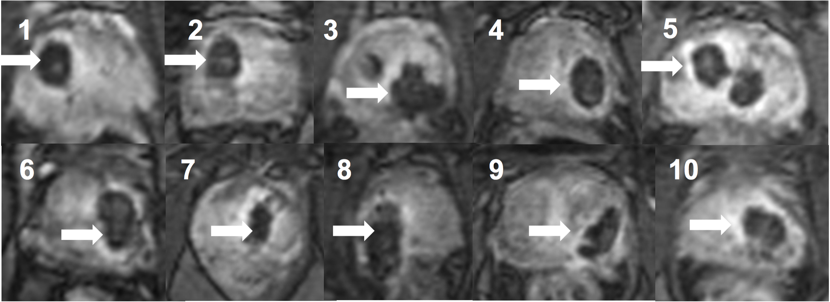
Phase I Safety Trial (10 patients @ UCLA)
No hospitalizations during and after treatment
No change in Sexual or Urinary function
PSA decreased in 8/10 men
Preliminary evidence of efficacy observed
Natarajan S, Jones T, Priester A et al, Focal Laser Ablation of Prostate Cancer: Feasibility of Magnetic Resonance Imaging-Ultrasound Fusion for Guidance. J Urol, 2017.

Slide 16
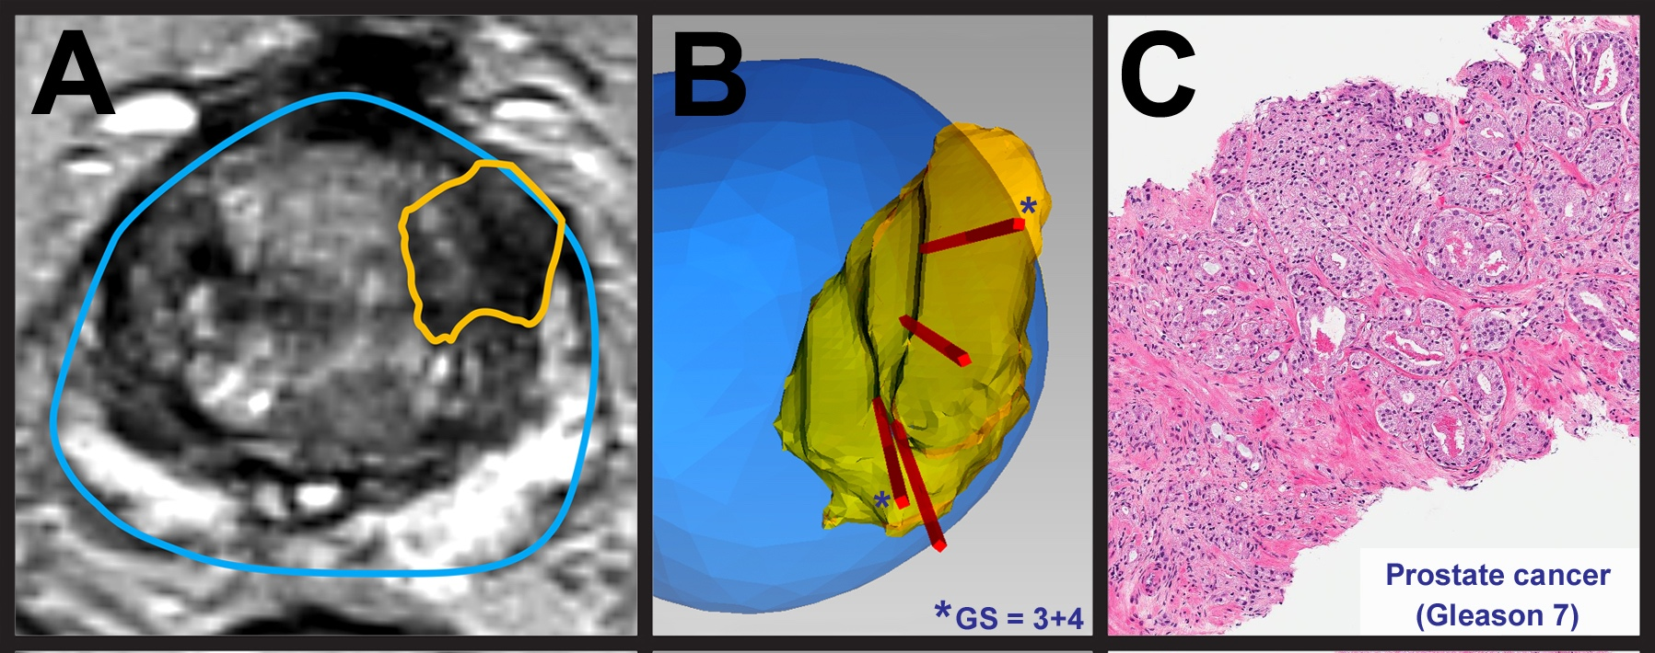
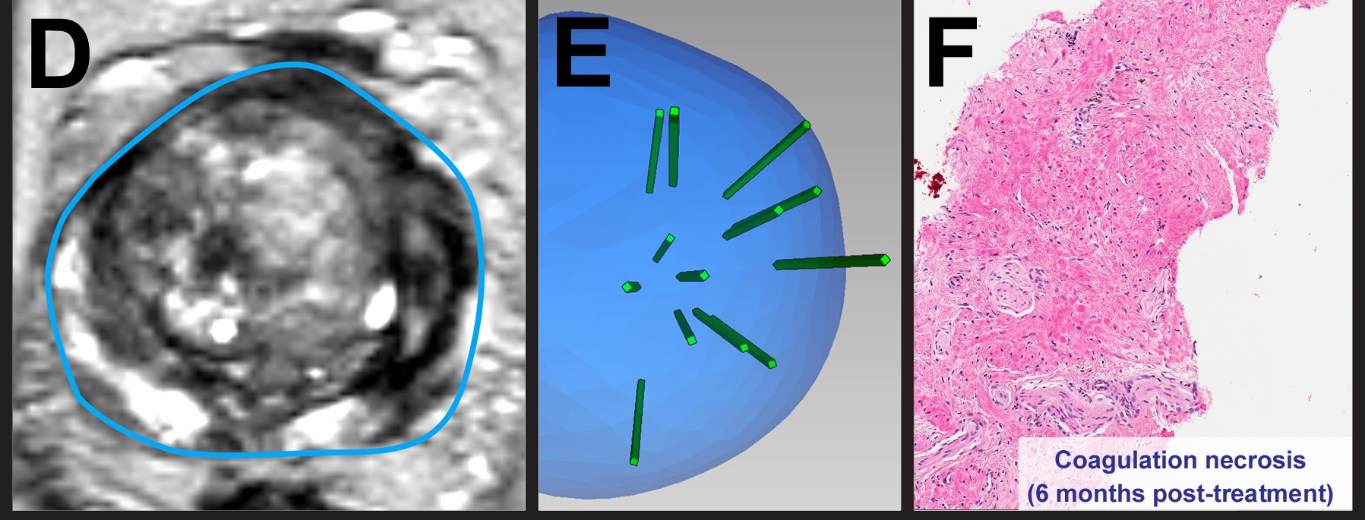
Office-based Focal Laser Ablation – Patient Example
Before:
Gleason 3+4, 2 cores, 11mm
Gleason 3+3, 2 cores. 4.5mm
After (@ 6 mo):
No cancer
MRI
3D Biopsy
Tissue
COMPANY CONFIDENTIAL
Natarajan A, Jones T, Priester A et al, Focal Laser Ablation of Prostate Cancer: Feasibility of Magnetic Resonance Imaging-Ultrasound Fusion for Guidance. J Urol, 2017.

Slide 17
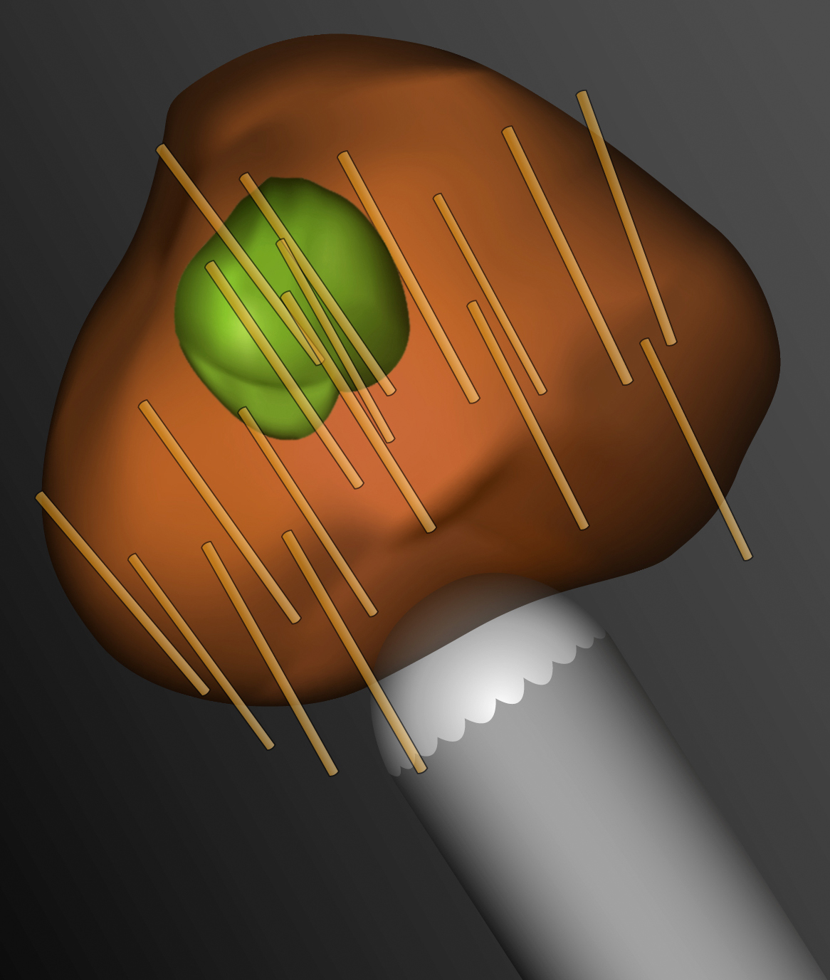
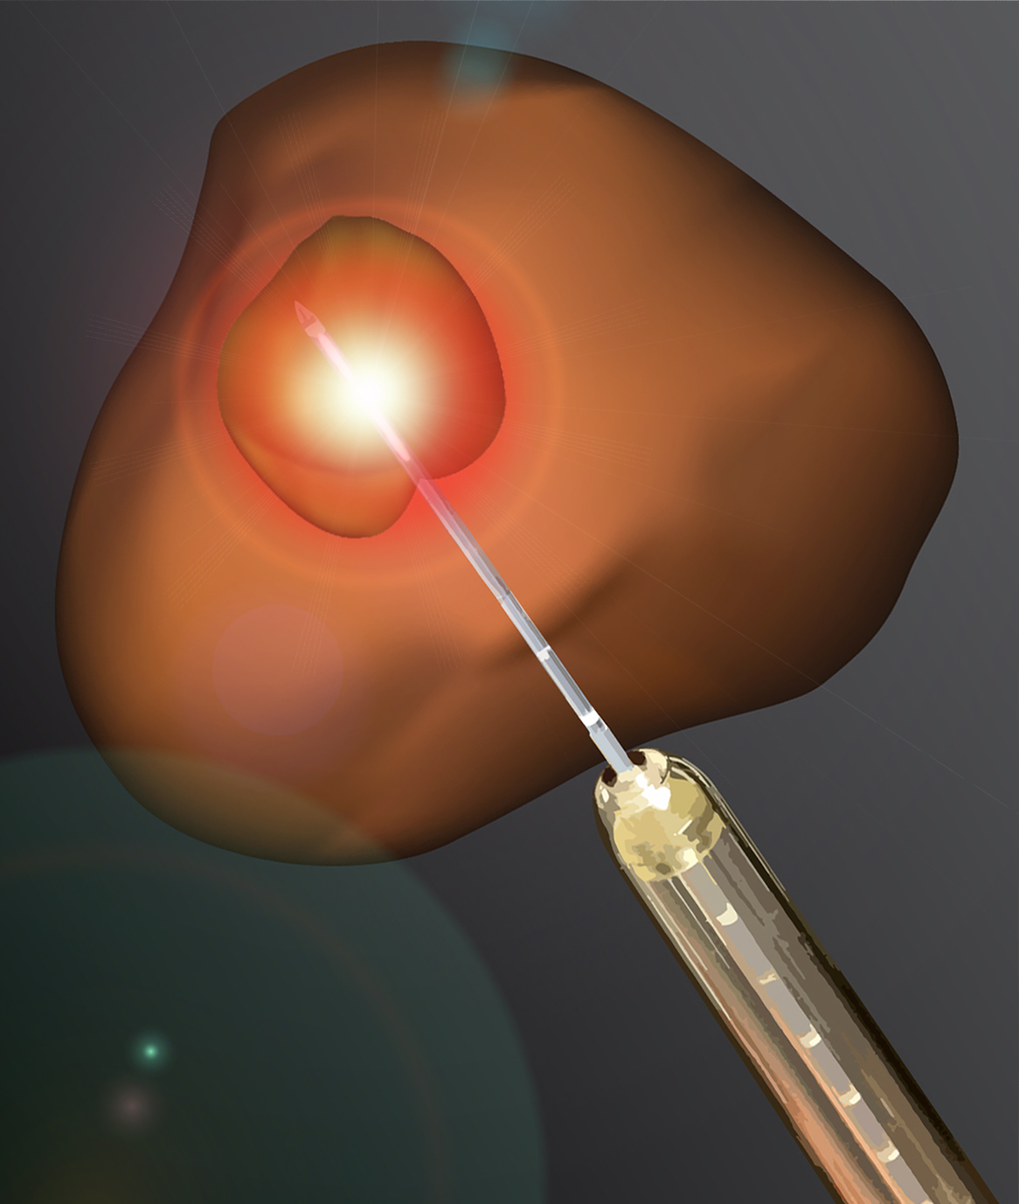
Moving towards image-guided management of PCa
MRI
Targeted
Biopsy
Focal
Therapy

Slide 18
Key Challenges
Length and Protocol of follow-up
Absence of randomized controlled trials – disagreement about comparator
Standardization in practice
Cost, Reimbursement
Valerio M, Cerantola Y, Eggener SE, et al. New and Established Technology in Focal Ablation of the Prostate: A Systematic Review. European Urology. 2017;71(1):17-34.

Slide 19

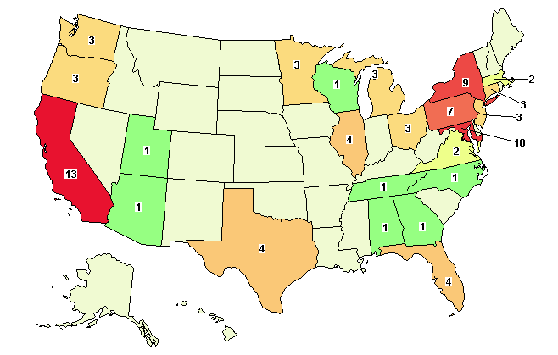
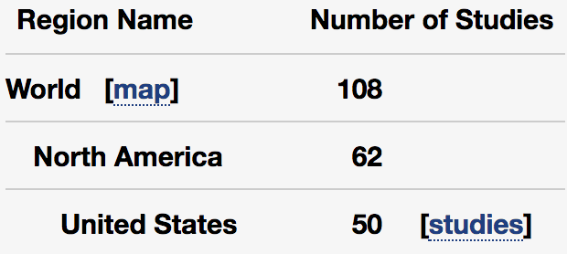
Numerous clinical trials actively recruiting

