Slide 1


ML 291 Rev. A

Slide 2
Agenda
Prostate cancer overview
Why a prostate-rectum spacer is needed
What is a SpaceOAR hydrogel
Clinical Evidence
ML 291 Rev. A

Slide 3

Prostate Cancer
About 1 man in 9 will be diagnosed with prostate cancer during his lifetime¹
Prostate cancer is the second leading cause of cancer death in American men, behind lung cancer. About 1 man in 41 will die of prostate cancer.¹
https://www.cancer.org/cancer/prostate-cancer/about/key-statistics.html
ML 291 Rev. A

Slide 4
Common Treatment Options
Risks & Side Effects
Radiation Therapy
Active Surveillance
Surgery
ML 291 Rev. A

Slide 5
Common Treatment Options
3D conformal radiation therapy (3D CRT)
Intensity-modulated radiation therapy (IMRT)
Stereotactic body radiotherapy (SBRT)
Brachytherapy (LDR & HDR)
Proton
Risks & Side Effects
Radiation Therapy
Active Surveillance
Surgery
Because prostate cancer often grows very slowly, some men (especially those who are older or have other serious health problems) might never need treatment for their prostate cancer. Instead, their doctors may recommend approaches known as watchful waiting or active surveillance. (Other terms sometimes used include observation or expectant management.)
Bowel
Urinary
Sexual
Radical rectopubic prostatectomy
Radical perineal prostatectomy
Lapraoscopic radical prostatectomy
Robotic-assisted laparoscopic radical prostatectomy
ML 291 Rev. A

Slide 6
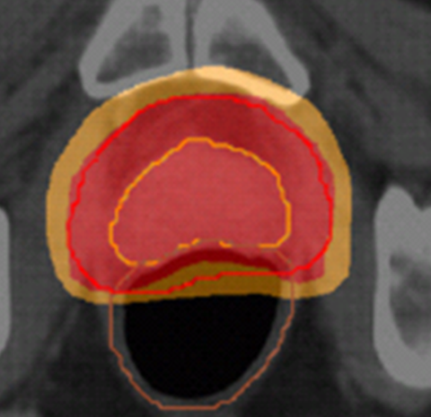
OAR – Organ at Risk
The rectum has been the dose-limiting factor
Rectal Toxicity / Rectal complications
  Bleeding, frequency, urgency, pain, fistulas
Loss of Quality of Life
  Radiation injury can lead to bowel, urinary and sexual symptoms that can affect patient health and quality of life during RT and for years afterward
ML 291 Rev. A

Slide 7
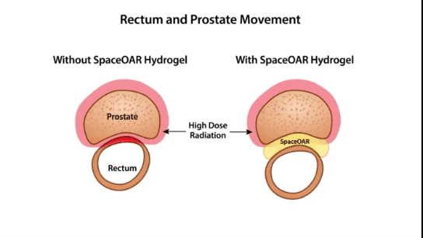
Rectal radiation is currently unavoidableClose proximity to prostate
Prostate movement between treatments
Prostate movement during treatments
Rectal radiation is currently unavoidable
Close proximity to prostate
Prostate movement between treatments
Prostate movement during treatments
ML 291 Rev. A

Slide 8
What is SpaceOAR Hydrogel?
Indication: SpaceOAR Hydrogel is intended to temporarily position the anterior rectal wall away from the prostate during radiotherapy for prostate cancer and in creating this space it is the intent of SpaceOAR System to reduce the radiation dose delivered to the anterior rectum.
Commercially available in the United States April 2015
SpaceOAR hydrogel temporarily positions the anterior rectal wall away from the prostate creating a space of approximately 1 cm
ML 291 Rev. A

Slide 9
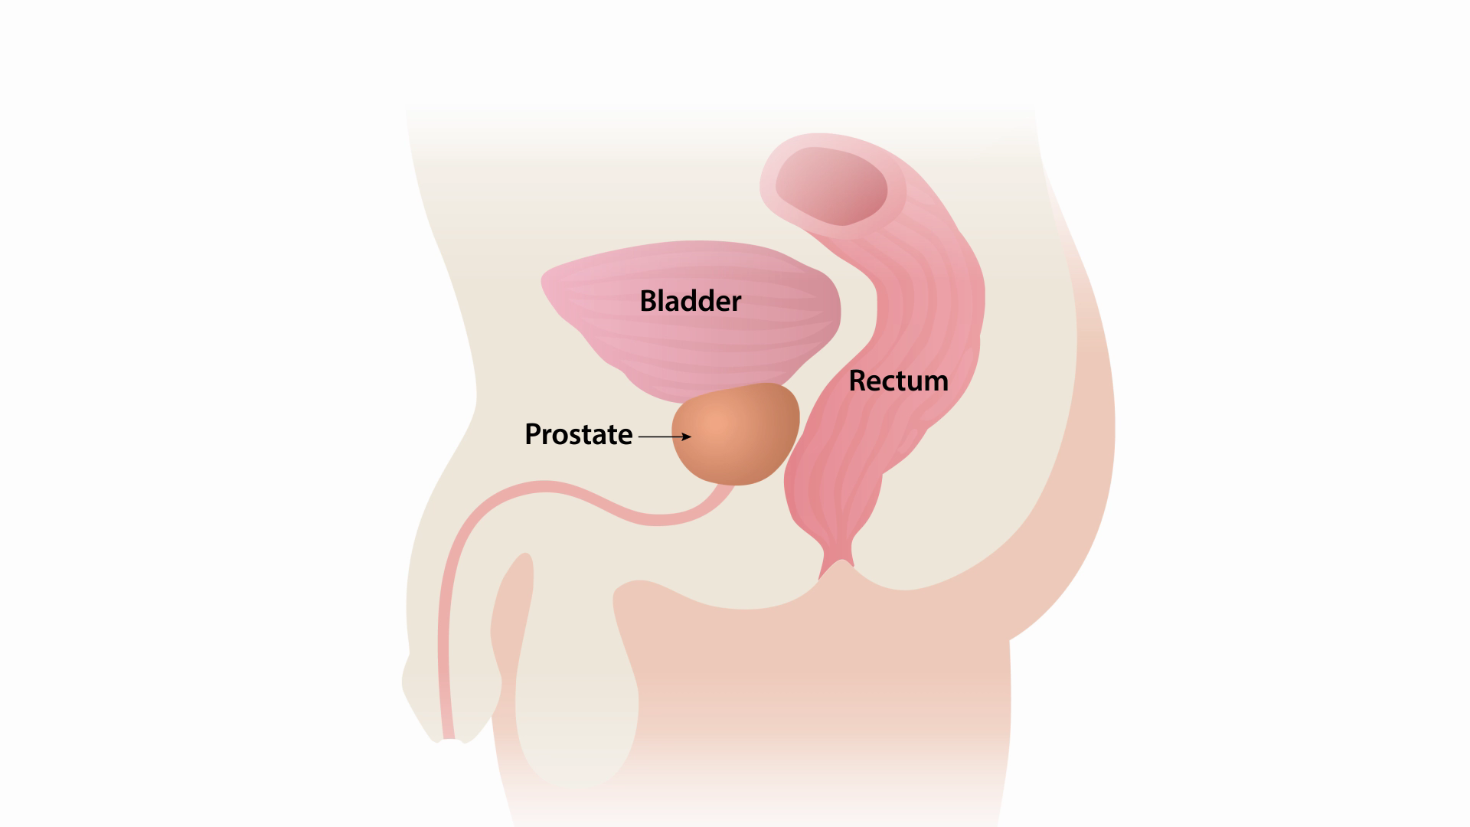
SpaceOAR hydrogel temporarily positions the rectum away from the prostate during prostate radiotherapy thereby reducing rectal wall/mucosa radiation exposure.
ML 291 Rev. A

Slide 10
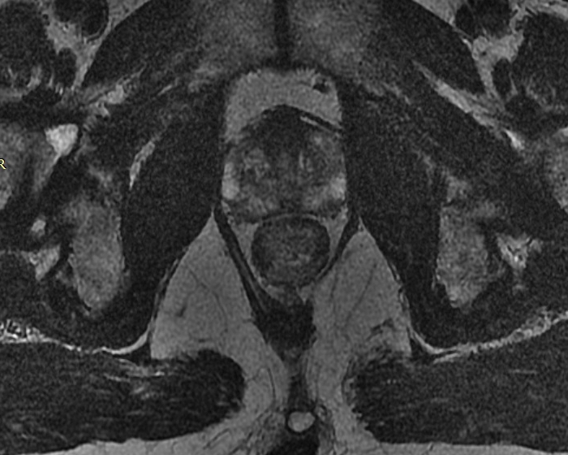
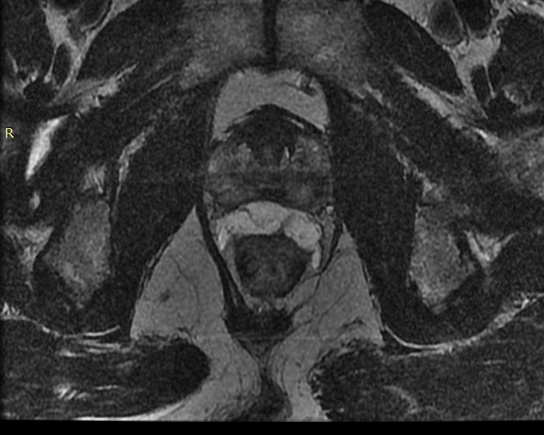
Anatomy Pre-Implant
Anatomy Post-Implant
ML 291 Rev. A

Slide 11
Anatomy Pre-Implant
Anatomy Post-Implant
SpaceOAR Hydrogel
ML 291 Rev. A

Slide 12
Made of mostly water and polyethylene glycol (PEG)
PEG is used in many medical products including artificial tears, prescription drugs, and medical implants
Synthetic, biocompatible, non-toxic
Absorbs in approximately 6 months
Material
Outpatient procedure
Local, regional or general anesthesia
Procedure
SpaceOAR hydrogel provides space between the rectum and the prostate, reducing high dose radiation to the rectum.
Control patients were: 8x more likely to have a decline in bowel, urinary and sexual quality of life when compared to SpaceOAR patients at median 3 years ^{1,2}
Clinically Proven
1) Hamstra D, et al. Continued Benefit to Rectal Separation for Prostate RT: Final Results of a Phase III Trial. Int J Radiation Oncol Biol Phys, Vol. 97, No. 5, pp. 976-985, 2017
2) Hamstra D, et al. Evaluation of sexual function on a randomized trial of a prostate rectal spacer. J Clin Oncol 35, 2017 (suppl 6S; abstract 69
ML 291 Rev. A

Slide 13
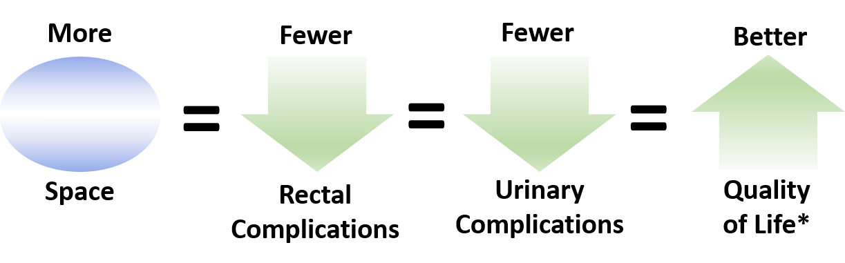
Clinical Results
*After radiotherapy was complete, control patients experienced a clinically significant (1X MID) decline in bowel, urinary and sexual QOL 8 times more often than SpaceOAR patients.^{1,2}
1) Hamstra D, et al. Continued Benefit to Rectal Separation for Prostate RT: Final Results of a Phase III Trial. Int J Radiation Oncol Biol Phys, Vol. 97, No. 5, pp. 976-985, 2017
2) Hamstra D, et al. Evaluation of sexual function on a randomized trial of a prostate rectal spacer. J Clin Oncol 35, 2017 (suppl 6S; abstract 69
ML 291 Rev. A

Slide 14




SpaceOAR Hydrogel Facts
60+ Peer Reviewed Publications
Used in many of the leading cancer centers in the United States
Over 30,000 patients treated worldwide
Reimbursed by Medicare in most States
ML 291 Rev. A

Slide 15
Frequently Asked Questions
Why Should I Have SpaceOAR Hydrogel?
The goal of radiation therapy is to maximize radiation to the prostate and to avoid radiating surrounding normal tissue. The prostate and rectum are very close and are only naturally separated by a small space. Due to this closeness, prostate radiation therapy can accidentally cause damage to the rectum. SpaceOAR hydrogel is a gel-like material that temporarily moves the rectal wall away from the prostate during radiotherapy. By separating the prostate from the rectum, SpaceOAR hydrogel reduces radiation dose delivered to the rectum and may eliminate or reduce damage to the rectum. It may also allow your doctor to enhance radiation treatment to your prostate to better target the cancer or to reduce the total number of treatment sessions.
Is SpaceOAR Hydrogel Safe?
SpaceOAR hydrogel is made of two liquids that when combined form a soft gel-like synthetic material that is mostly made of water. Because of its water content it is called a hydrogel. The material that the SpaceOAR hydrogel is made from has been used in other implants such as surgical sealants used on the eye, brain and spine. Studies have shown that the material is biocompatible and can be used safely in the body. SpaceOAR hydrogel is commercially available in the United States and approved in countries outside the United States.
ML 291 Rev. A

Slide 16
What Are the Risks?
SpaceOAR is intended to temporarily position the anterior rectal wall away from the prostate during radiotherapy for prostate cancer and in creating this space it is the intent of SpaceOAR hydrogel to reduce the radiation dose delivered to the anterior rectum. The SpaceOAR hydrogel is composed of biodegradable material and maintains space for the entire course of prostate radiotherapy treatment. It is completely absorbed by the patient’s body over time.
Clinical data comparing patients with and without SpaceOAR hydrogel demonstrated the benefits of SpaceOAR hydrogel to include reduction of rectal toxicity resulting in improved bowel function, improvements in urinary function, and a higher likelihood to maintain sexual function.
Potential complications associated with SpaceOAR hydrogel include but are not limited to pain associated with SpaceOAR hydrogel injection; pain or discomfort associated with SpaceOAR hydrogel, needle penetration of the bladder, prostate, rectal wall, rectum, or urethra; injection of SpaceOAR hydrogel into the bladder, prostate, rectal wall, rectum, or urethra; local inflammatory reactions; infection; injection of air, fluid or SpaceOAR hydrogel intravascularly; urinary retention; rectal mucosal damage, ulcers, necrosis; bleeding; constipation; and rectal urgency.
Visit SpaceOAR.com For More Information
ML 291 Rev. A

