Slide 1
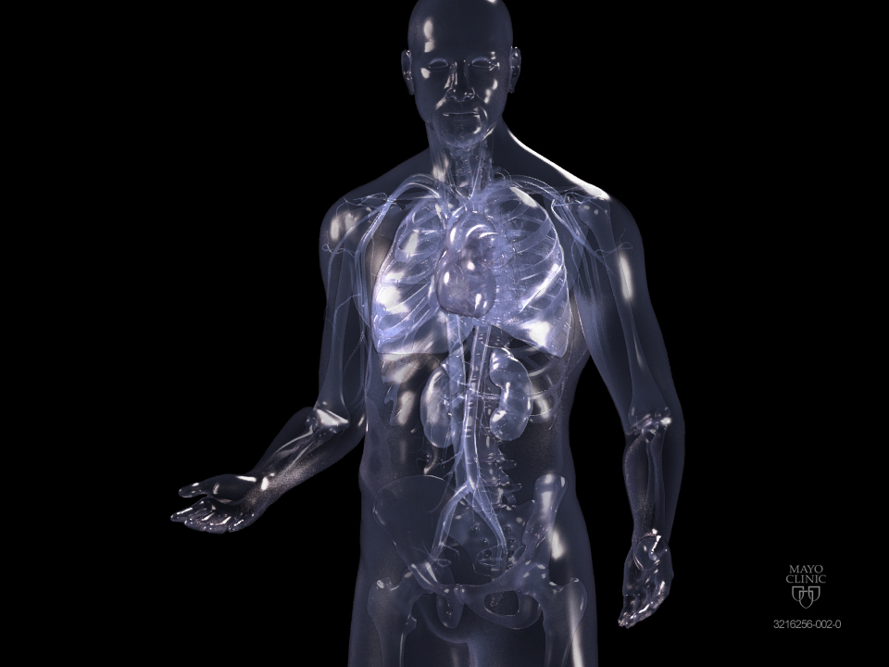
Positron Emission Tomography For Evaluation of Prostate Cancer
Eugene D Kwon MD
Professor of Urology and Immunology
Co-Chair IRB, Mayo Clinic
National Prostate Coalition
Washington DC
October 2018

Slide 2
Disclosure
Dr. Kwon and Mayo Clinic receive licensing payments for PD - 1
immunotherapy-related intellectual properties.
Medarex, Bristol Myers Squibb
AstraZeneca, Amplimmune
Medimmune , Merck
Genentech
Ipilimumab (Yervoy), Nivolumab (Opdivo), Pembrolizumab (Keytruda)

Slide 3


Slide 4
Treatments as of 2002
Surgery
Radiation Therapy
Hormone Therapy
*Like Boston, 3-note rock band

Slide 5
Treatments as of 2018
Agent | Year “Approved” | H - Sensitive | H - Resistant | OS Advantage
Hormone Therapy | 1947 | Y | Y | Y ?
Taxotere (docetaxel) | 2002 | Y / N | Y | Y
Jevtana (cabazitaxel) | 2010 | N | Y | Y
Provenge (sipuleucel-T) | 2010 | N | Y | Y
Zytiga (abiraterone) | 2012 | Y / N | Y | Y
Xtandi (enzalutamide) | 2013 | Y / N | Y | Y
Lynparza (olaparib) | 2018? | N | Y
Erleada (apalutamide) | 2018? | N | Y
Xofigo (Rad 223) | 2013 | N | Y | Y
177 PSMA Lutetium | 2020 ? | ? | ? | ?
HT + Taxotere | 2015-16 | Y / N | Y | Y
HT + Zytiga | 2017-18 | Y / N | Y | Y ?
HT + Xtandi |  | Y / N | Y | Y ?
HT + Xtandi + Xofigo |  | N | Y | Y ?
IMRT
SBRT / Cryo
HIFU
oRRP
RoRP
44,000 men • 2,200 Treatment Pathways

Slide 6
In my opinion … the greatest single advance in PCa management
… has been our ability to clearly visualize the disease

Slide 7
Image-Guided Advanced Prostate Cancer Clinic
Prostate Cancer Relapse After Failed Primary Therapy Affects ~ 100,000 Men Annually
4000 to 5000 patients / year
87% of patients from out-of-state
All patients have failed [1-8] prior therapies for prostate cancer
All seek best understanding of their disease and best plan for treatment
MRI and [¹¹C] - Choline PET serve as vital technologies

Slide 8
MRI and [¹¹C] - Choline PET at Mayo
Dedicated prostate MRI or Abdominal Pelvic MRI
4000 scans / year: ~ 10,000 scans between 2012 - 2017
[¹¹C] - choline approved by FDA (Mayo Clinic) September 2012
[¹¹C] - choline is produced on Mayo Campus
Approved for evaluation of prostate cancer treatment failure
PSA = 2.0 ng/mL
3000 scans / year : ~ 15,000 scans as of 2017
Mantra = Imaging is not Everything. It is the Only Thing !

Slide 9
Why is Imaging So Important?
MRI
MR PET
C¹¹ - Choline PET
C¹¹ - Acetate PET
Ga⁶⁸ - PSMA PET
Auxumin PET
Imaging has completely revolutionized our understanding of prostate cancer

Slide 10
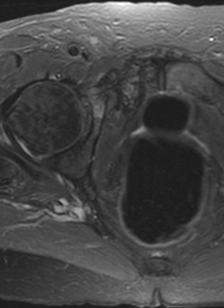
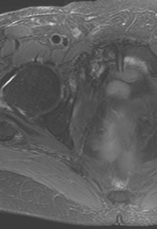
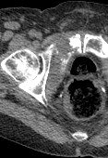
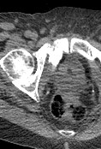
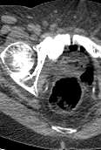
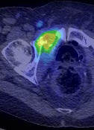
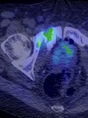
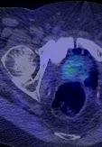
[¹¹C] - Choline PET vs MRI and CT Scanning
Oct 2014
May 2015
Aug 2015
MRI
CT
C¹¹-Choline PET
Notes:
Scott 7-480-343
10

Slide 11
Traditional Paradigm*
PSA
First Therapy
*Halstedian Model of Cancer Progression

Slide 12
Traditional Paradigm
Local Relapse
PSA
Regional Metastases
Distant Metastases
Not Exactly True !

Slide 13
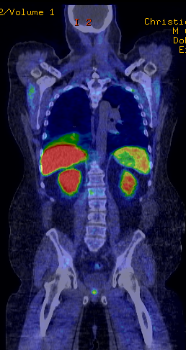


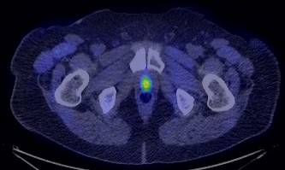
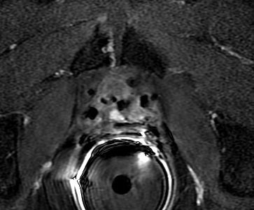
After RRP
PSA = 0.94 ng/mL • VU Recurrence
Notes:
Christie 5-019-460
13

Slide 14
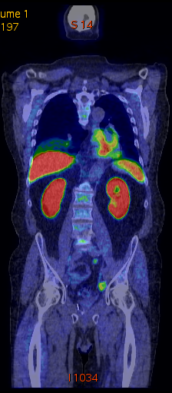
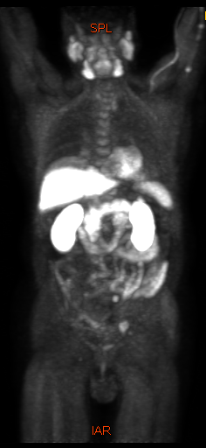
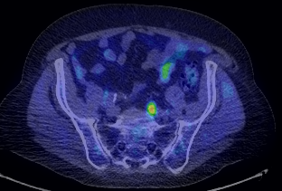
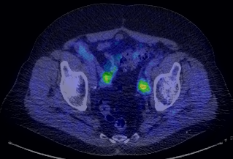
Lymph Node Relapse
PSA = 0.9 ng/mL • Int + Com Iliac LN Met
Notes:
Boughton 7-476-141. This is a very nice 74-year-old civil law attorney who is retired and resides in Washington, DC. The patient underwent a radical prostatectomy in 2005 by Dr. H. Ballentine Carter at Johns Hopkins. At that time, the patient was ultimately diagnosed to have Gleason 9 prostate cancer, pT2 disease with no lymph nodes and no metastatic involvement discernible. His PSA at the time of surgery was 2.5. Eight and a half years after his surgery, the patient had an undetectable PSA. The patient is otherwise in excellent shape and has no significant complaints. The patient does have a diagnosis of Ehlers-Danlos syndrome which manifests in bleeding after any surgical procedure. Last year, the patient had a barely detectable PSA of 0.2 and in June of this year had a PSA of 0.9. The patient is concerned regarding the possibility of relapsing prostate cancer. The patient has no significant complaints at the present time and is a seeking a C-11 choline evaluation for relapsing prostate cancer. Consistent with indications, the patient has failed routine restaging with a CT scan as well as bone scan. The patient has not been able to identify a site of relapse to date.
14

Slide 15
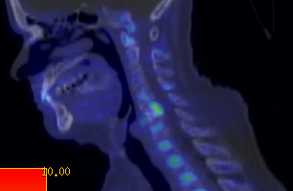
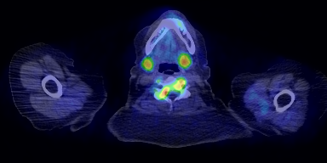
Spine Relapse
PSA = 1.4 ng/mL • C5 Met
Notes:
Rosenberger 6-143-422
15

Slide 16
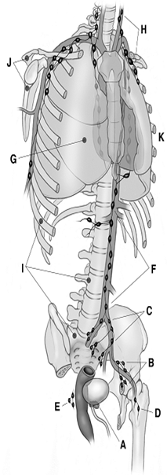
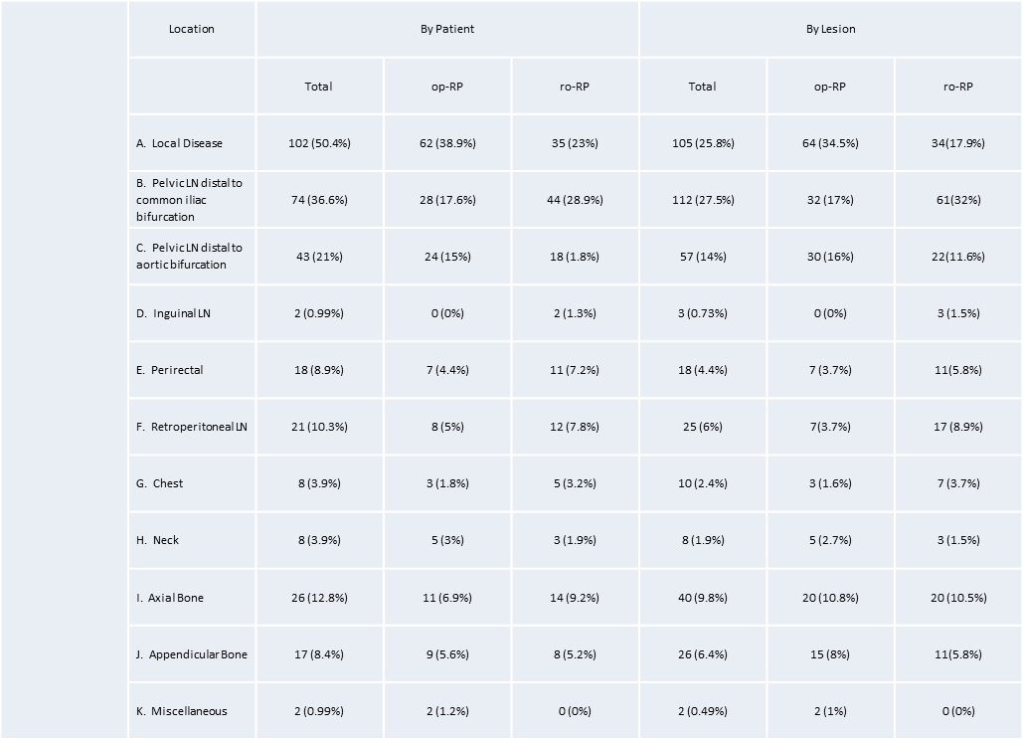
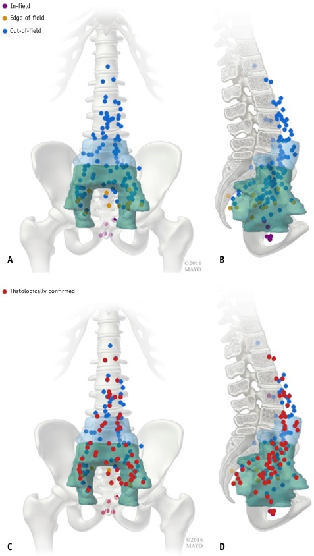
Mapping Sites of Recurrence
# Subjects | 1st Treatment | Publication
41 | Fossa XRT | Parker WP Int J Rad Oncol Biol Phys 97(3) 2017
161 | Prostate XRT | Parker WP Eur Urol 71(3) 2017
202 | RRP No HT or RT | Sobol I J Urol 197(1): 2017
550 | RRP Yes HT or XRT | Nehra A J Urol 2017

Slide 17
Lesions After RRP
(No HT or RT)

Slide 18
Local 33 %

Slide 19
Metastatic 45 %

Slide 20
Local + Metastatic 22 %

Slide 21
Within Pelvis
66.0 %

Slide 22
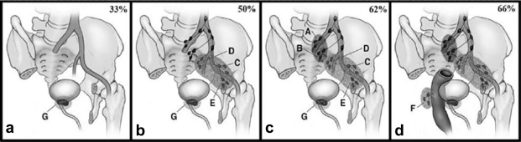
New Discoveries from Contemporary Mapping of Relapse After RRP
Sobol I, et al. J Urol 197(1): 2017
Patterns of relapse after surgery in our studies do not resemble patterns described in the literature
Our studies challenge the logic for prostate “fossa-only” XRT for rising PSA after RRP
Suggest that “whole pelvic” XRT might be more effective than “bed-only” XRT

Slide 23
Others Surprises from Relapse Distribution Studies

Slide 24
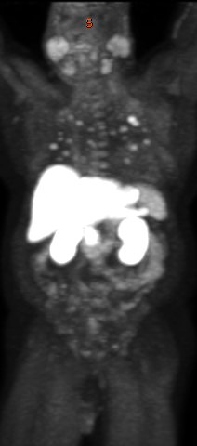
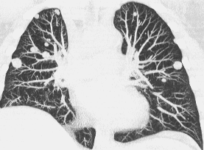
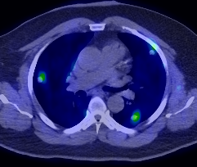
Lung Relapse
PSA = 16.7 ng/mL • Pulmonary Metastases
Notes:
CRPC - 7 443 594 French Griffin Initial PSA = 16.7
24

Slide 25
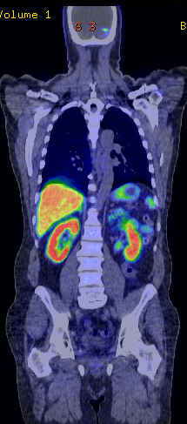
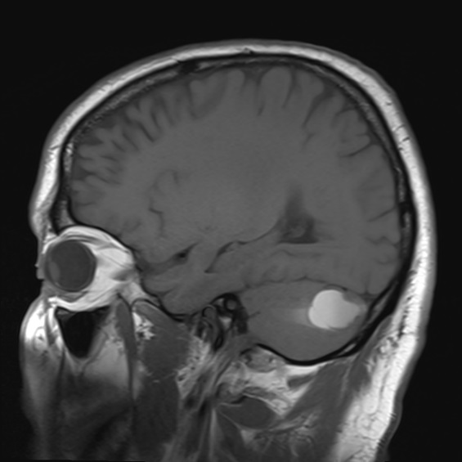
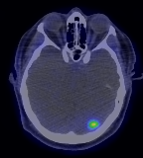
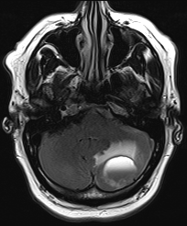
Brain Relapse
PSA = 7.3 ng/mL • Cerebellar Met
Notes:
8-662-060, Mr. Harvey Allen Baird PSA 7.3 ng/mL
25

Slide 26
Surprises from Relapse Distribution Studies
# of Lesions
1 | 106 (52.5)
2 | 51 (25.2)
3 | 25 (12.4)
4 | 10 (4.6)
5 or more | 10 (4.6)
PSA at positive scan 2.3 ng/mL
Time BCR to 1st Lesion
  15 months* versus 8 years**
  * Sobol I, et al. J Urol 197(1): 2017
  **Pound et al, JAMA 281, 1999
Surprising sites of metastasis -- lung, liver and brain
Metastases can be identified 1.3 yrs from PSA failure -- Not after 8 yrs as previously published
Thus, newer imaging provides a ~ 7 yr “lead-time” in detection of 1st lesion compared to conventional imaging
Preponderance of solitary or oligometastatic disease
M0 disease (PSA rising without obvious metastases) is an artifact
Metastatic disease is not synonymous with systemic disease

Slide 27
Paradigm Change
Local Relapse
Systemic Relapse

Slide 28
Focal Relapse
Local Relapse
Focal Relapse
Systemic Relapse
“Oligometastases”
(1-5 lesions; Hellman & Weichselbaum)

Slide 29
Oligometastases

Slide 30
Worsening Cancer Burden, Foci and Heterogeneity Over Time
Number of Foci
Amenable to Targeted Definitive Therapy
Tumor Size
Tumor Heterogeneity
Time

Slide 31
The Grim Statistics of CRPC
CRPC = PSA rising while on hormone therapy
HT Only
Added Therapy
Overall Survival
0.9 - 1.7 yrs
1.5 - 4.0 yrs
Reviewed in Fang M, et al. Prostate Cancer 2017

Slide 32
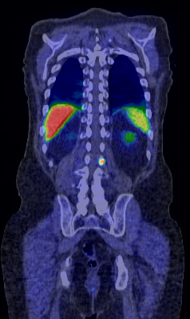
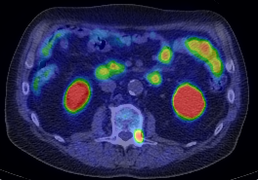
CRPC L2 Vertebral Met
PSA = 1.2 ng/mL • June 2012
Treated with SBRT
Notes:
02-914-878 Stamschror
32

Slide 33
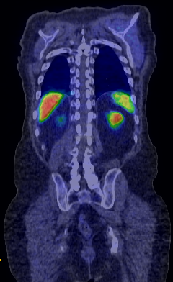
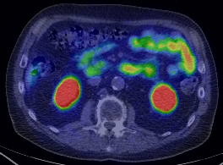
CRPC L2 Vertebral Met
PSA = < 0.10 ng/mL • June 2018
6y later • No additional therapy
Notes:
02-914-878 Stamschror
33

Slide 34
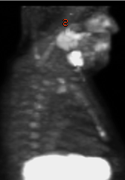
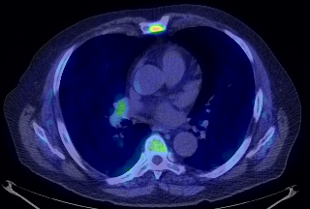
CRPC Sternal Met
PSA = 2.7 ng/mL • October 2012
Treated with SBRT
Notes:
Pautze 2-860-037
34

Slide 35
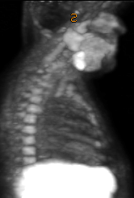
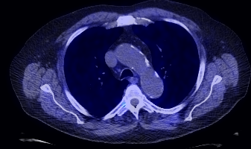
CRPC Sternal Met
PSA = < 0.10 ng/mL • October 2018
6y later • No additional therapy
Notes:
Pautze 2-860-037
35

Slide 36
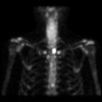
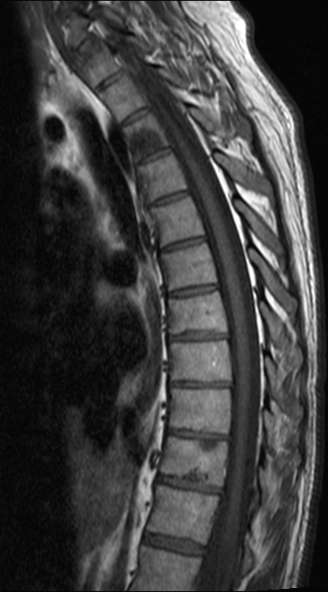
T3 & T10 Vertebral Met
PSA = 2.1 ng/mL • Jan 2010
Treated with SBRT + Taxotere x 6 cycles + ADT
Notes:
7-115-495, Timothy G. Taylor Post Robotic RP, PSA 2.1 (no XRT or HT). T3 and T10 mets with PSA 2.1 (Jan 2010)
36

Slide 37
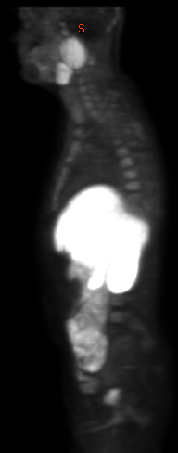
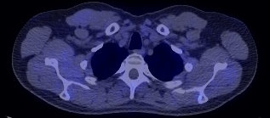
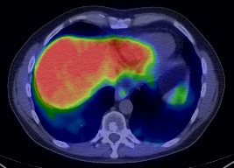
T3 & T10 Vertebral Met
PSA = < 0.10 ng/mL • Test = 377 • July 2018
8yr + 6m later • No additional therapy
Notes:
7-115-495, Timothy G. Taylor Post Robotic RP, (post SBRT, Tax x 6, ADT). T3 and T10 mets with PSA <0.10 July 2014, Test = 377
37

Slide 38
Multiple studies have now suggested that metastasis-directed therapy (MDT) can profoundly delay requirements for next treatment(s) as well as improve PFS and overall survival
Ahmed KA et al, Front Oncol, 2012
Muldermans JL et al, Int J Radiation Oncol Biol Phys, 95, 2016
Karnes RJ et al, J Urol, 193, 2014
Ost P et al, JCO 35, 2017

Slide 39
Novel Use of Imaging to Guided Complex Treatment

Slide 40
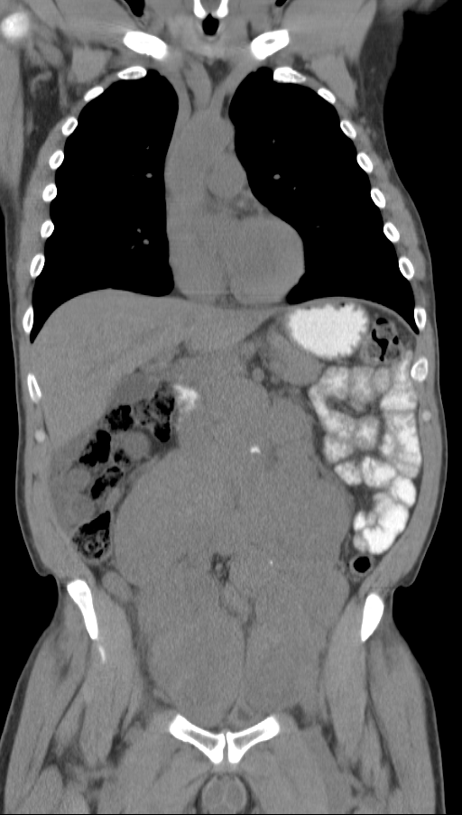
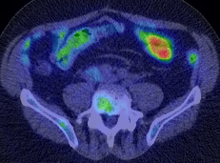
Complex Disease
PSA = > 25,000 ng/mL • June 2011
ADT x 1y + 4m
PSA = 0.45 ng/mL • Oct 2012
Nadir then CRPC
Notes:
Dickey 7-240-938
40

Slide 41
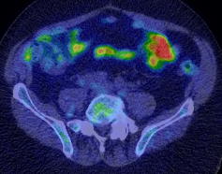
Complex Disease
PSA = 1.1 • Jan 2013
PSA = 1.0 • March 2013
Tax x 6 → Zytiga
Worsening Disease
Surgery RPLND
Notes:
Dickey 7-240-938
41

Slide 42
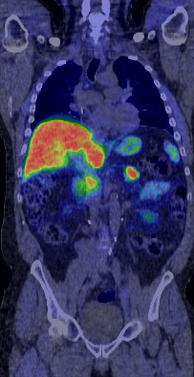
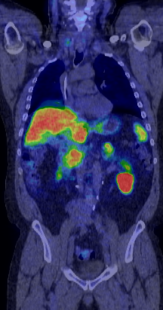
Complex Disease
PSA = < 0.10 • Dec 2013
PSA = < 0.10 • Dec 2017
6y + 6m later
Notes:
Dickey 7-240-938
42

Slide 43
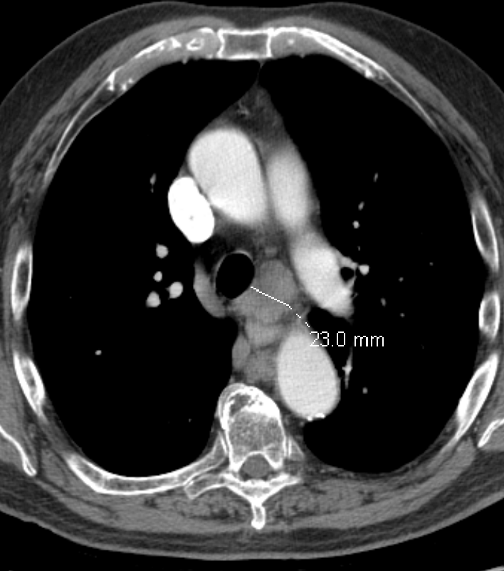
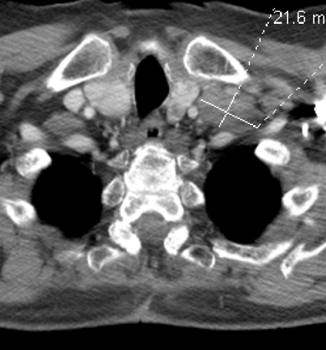
Complex Disease
Failed HT and Taxotere • PSA = 88.0 ng/mL • June 2011
Treated with Ipilimumab
Notes:
Goodnetter 7-238-903
43

Slide 44
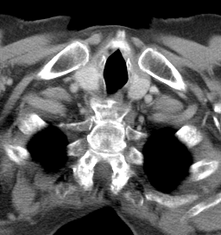

Complex Disease
PSA = 1.3 ng/mL • May 2012

Slide 45


Complex Disease
PSA = 1.8 ng/mL • May 2013
Surgical Resection
June 2013
Notes:
Goodnetter 7-238-903
45

Slide 46



Complex Disease
PSA = < 0.10 ng/mL • June 2017
6y later
Notes:
Goodnetter 7-238-903
46

Slide 47
Surprise of PSA Zero

Slide 48



After RRP
PSA = < 0.10 ng/mL
Notes:
6-064-378; Douglas Allen Nelson July 2014 PSA = <0.10 x 2 years…CRPC without PSA
48

Slide 49

After XRT
PSA = < 0.10 ng/mL • Widespread Metastases
Notes:
McGinniss 7-359-095
49

Slide 50


Paradoxical Responses to Therapy
PSA Response ≠ Clinical Response
Zytiga
PSA = 44.5 ng/mL
May 2014
PSA = 14.0 ng/mL
July 2014
Notes:
Wulf 2-551-838 on Zytiga for CRPC. PSA in May 2014 = 44.5. PSA in July = 14.0 Scans getting worse and not better.
50

Slide 51
Types of Prostate Cancer PET Imaging

Slide 52


Prostate Cancer PET Scanning
Metabolic
Marker-Specific
Metabolic
C¹¹ - choline
Ga⁶⁸ - PSMA
Axumin
F¹⁸ - fluciclovine

Slide 53
Different Types of Prostate Cancer PET
All forms of PET scanning have strengths and weaknesses
Arguments about which PET scans are superior are silly
Thus far, studies suggesting superiority of one PET over another are either premature (too small or flawed)
Ultimately, type of PET is not as important as the expertise of the medical group
Biopsy verification of lesions is usually important

Slide 54
Different Types of Prostate Cancer PET
Ga⁶⁸ PSMA imaging is an excellent and evolving form of PET (64 different types)
But, it is estimated that Ga⁶⁸ PSMA PET can’t see cancer in 20% of patients
C¹¹-choline might be able to see nearly 100% of disease, but might also be less specific
Multi - PET imaging will probably be the most effective for evaluation
Mayo C¹¹-choline + G⁶⁸ PSMA PET will be available in October 2018

Slide 55
PET Marker - Targeted Therapy

Slide 56

PSMA ¹⁷⁷ Lutetium
⁶⁸Ga PSMA PET Scan
⁶⁸Ga
¥
S
P
M
A
AR +
PSA
PSA

Slide 57
PSMA ¹⁷⁷ Lutetium
¹⁷⁷ Lu
¥
S
P
M
A
Adenocarcinoma
S
P
M
A
Small Cell or Unclassified
Neuroendocrine

Slide 58

PSMA ¹⁷⁷ Lutetium
β
S
P
M
A
¹⁷⁷ Lu
β
β
¥
Adenocarcinoma
S
P
M
A
Small Cell or Unclassified
β
S
P
M
A
β
Neuroendocrine

Slide 59
PSMA ¹⁷⁷ Lutetium
PSA 1160 ng/ml
PSA 71 ng/ml

Slide 60
177 PSMA Lutetium and Other Radioligands
An exciting form of therapy that can partly address the heterogeneity of prostate cancer metastases in the advanced cancer setting
VISION Registrational Trial = 800 men globally : Advanced Prostate Cancer
Dr. Kendi = PI at Mayo Clinic for VISION Trial
PSMA-Actinium-225 = Actinium-225, an α emitter with a 10 day half-life has therapeutic potential to treat metastatic prostate cancer.
Xofigo = radium 223 dichloride contains α particle-emitting isotope radium-223. The drug forms complexes with the bone mineral hydroxyapatite at areas of increased bone metastases

Slide 61
Heterogeneity of Prostate Cancer Markers
Synaptophysin +
Chromogranin A +
Neuron Specific Enolase +
S
P
M
A
AR +
AR –
PSA - and PSMA -
Markers –
PSA
PSA
Adenocarcinoma
Neuroendocrine
Small Cell or Unclassified
Good
Bad
Ugly
Aggressiveness

Slide 62



PSMA ¹⁷⁷ Lutetium Failure
Ga⁶⁸ - PSMA
C¹¹ - choline
Pre-treatment
Post Tx
Post Tx
Post Tx
Ga⁶⁸ - PSMA
C¹¹ - choline
Notes:
Hopkins

Slide 63




PSMA ¹⁷⁷ Lutetium Failure
Ga⁶⁸ - PSMA
C¹¹ - choline
PSA = 2.1 ng/mL
Notes:
Haas 7-463-696

Slide 64
In Summary
Improvements in Imaging …
Have revolutionized our understanding of prostate cancer
Have facilitated earlier and more definitive treatment of relapsing cancer
Have fostered more rational and optimal use of current therapies
Have empowered patients to take a role in their own care

Slide 65
My Predictions of the Future
More clinical trials to assess
  image-guided treatment outcomes
  image based predictors of favorable response
  pros and cons of imaging technologies
  use of radionuclide therapy for treatment of metastatic prostate cancer (i.e., early versus late treatment?
  imaging for expedited drug testing
¹⁷⁷ Lutetium PSMA, ¹⁷⁷ Lutetium Dotatate, ²²⁵ Actinium, ⁹⁰ Yttrium
Will likely economize and improve management of advanced cancer
YOU will need to be proactive and fight for insurance coverage
The future is very exciting and promising

Slide 66
Kwon.eugene@mayo.edu

Slide 67

Last Words
Owning a Stradivarius Doesn’t Make You an Itzhak Perlman

Slide 68
Thanks To
PET Group: Drs. Lowe, Nathan, Hung, Goenka, Johnson, Jacobson, DeGrado,
Minimal Invasive Group: Drs. Mynderse, Caldstrom, Atwell, Woodrum, Morris, Karup
MRI Group: Drs. King, Kawashima, Froemming, Kim, Takahashi
Salvage Surgeon: Dr. Karnes, Tollefson
Radiation Oncology: Drs. Olivier, Park, Davis, Stish, Choo
Thoracic Surgery: Dr. Cassivi
Medical Oncology: Drs. Hugec, Siddiqui
Immunotherapy Group: Drs. Kwon, Dronca
Nurse Specialists: Jamie Olson, Christine Van-Dyke
Physician Assistants: Carrie Schuer, Madison Roberts, Amy Lagvine
Agencies: FDA, NIH, NCI, DOD, CMS, PCRI

Slide 69
The End

Slide 74
How to Keep Prostate Cancer from Killing You ?
Visit Your Radiologist !

Slide 75

Notes:
Hopkins

Slide 76



Lymph Node Lung Relapse
PSA = 10.2 ng/mL • Pulmonary Hilar Lymph Node Met
Notes:
7-283-239 - Galvin, James
76

Slide 77


Lung Relapse
PSA = 31.2 ng/mL
Treated with Surgery
Notes:
Gundrum 7-398-597
77

Slide 78


Right Pulmonary Met
PSA = 0.43 ng/mL
1m later
Notes:
Gundrum 7-398-597
78

Slide 79

Notes:
Sergiyenko 10-576-994

Slide 80




Hormone-Refractory CaP
PSA = 0.11 ng/mL • Sept 2014
Notes:
sanders 6093-871 lung adenocarcinoma psa =
80

Slide 81

Notes:
Hopkins

Slide 82
Notes:
Hopkins

Slide 83
Treatments as of 2018
Agent | Year “Approved” | H - Sensitive | H - Resistant | OS Advantage
Hormone Therapy | 1947 | Y | Y | Y ?
Taxotere (docetaxel) | 2002 | Y / N | Y | Y
Jevtana (cabazitaxel) | 2010 | N | Y | Y
Provenge (sipuleucel-T) | 2010 | N | Y | Y
Zytiga (abiraterone) | 2012 | Y / N | Y | Y
Xtandi (enzalutamide) | 2013 | Y / N | Y | Y
Lynparza (olaparib) | 2018? | N | Y
ARN 509 (apalutamide) | 2018? | N | Y
Xofigo (Rad 223) | 2013 | N | Y | Y
HT + Taxotere | 2015-16 | Y / N | Y | Y
HT + Zytiga | 2017-18 | Y / N | Y | Y ?
HT + Xtandi |  | Y / N | Y | Y ?
HT + Xtandi + Xofigo |  | N | Y | Y ?
IMRT
SBRT / Cryo
HIFU
oRRP
RoRP

Slide 84
Treatments as of 2018
Agent | Year “Approved” | H - Sensitive | H - Resistant | OS Advantage
Hormone Therapy | 1947 | Y | Y | Y ?
Taxotere (docetaxel) | 2002 | Y / N | Y | Y
Jevtana (cabazitaxel) | 2010 | N | Y | Y
Provenge (sipuleucel-T) | 2010 | N | Y | Y
Zytiga (abiraterone) | 2012 | Y / N | Y | Y
Xtandi (enzalutamide) | 2013 | Y / N | Y | Y
Lynparza (olaparib) | 2018? | N | Y
ARN 509 (apalutamide) | 2018? | N | Y
Xofigo (Rad 223) | 2013 | N | Y | Y
HT + Taxotere | 2015-16 | Y / N | Y | Y
HT + Zytiga | 2017-18 | Y / N | Y | Y ?
HT + Xtandi |  | Y / N | Y | Y ?
HT + Xtandi + Xofigo |  | N | Y | Y ?
IMRT
SBRT / Cryo
HIFU
oRRP
RoRP
44,000 men • 2,200 Treatment Pathways

Slide 85



Liver Relapse
Post-Gad T1
T2 MRI
Notes:
Hall 7-302-087
85

Slide 86


Sternal Relapse
PSA = 5.4 ng/mL • Sternal Met
Notes:
Reinsmoen

Slide 87




To Optimize Systemic Therapy
Taxotere x 3
CP + VP16 x 3
CP + VP16 x 3
PSA = 1002 ng/mL
Mar 2014
PSA = 1951 ng/mL
May 2014
PSA = 2.8 ng/mL
July 2014
PSA = <0.10 ng/mL
June 2017
Notes:
Landt 7-443-615
87

Slide 88
Lung Relapse
PSA = 31.2 ng/mL
PSA = 0.43 ng/mL
Treated with Surgery

Slide 89
Treatments as of 2018
Agent | Year “Approved” | H - Sensitive | H - Resistant | OS Advantage
Hormone Therapy | 1947 | Y | Y | Y ?
Taxotere (docetaxel) | 2002 | Y / N | Y | Y
Jevtana (cabazitaxel) | 2010 | N | Y | Y
Provenge (sipuleucel-T) | 2010 | N | Y | Y
Zytiga (abiraterone) | 2012 | Y / N | Y | Y
Xtandi (enzalutamide) | 2013 | Y / N | Y | Y
Lynparza (olaparib) | 2018? | N | Y
Erleada (apalutamide) | 2018? | N | Y
Xofigo (Rad 223) | 2013 | N | Y | Y
177 PSMA Lutetium | 2020 ? | ? | ? | ?
HT + Taxotere | 2015-16 | Y / N | Y | Y
HT + Zytiga | 2017-18 | Y / N | Y | Y ?
HT + Xtandi |  | Y / N | Y | Y ?
HT + Xtandi + Xofigo |  | N | Y | Y ?
IMRT
SBRT / Cryo
HIFU
oRRP
RoRP

