Slide 1
FDA Approvals for Systemic Treatment of Prostate Cancer in 2018
William R Berry MD
Prostate Oncology
Duke Cancer Center Cary

Slide 2
New FDA approvals for the treatment of prostate cancer in 2018
  Apalutamide, February 14
  Enzalutamide, July 13
  Abiraterone acetate, February 7
  Apa and Enza are non-steroidal anti-androgens
    Bind directly to ligand binding domain of androgen receptor (AR)
    Prevent AR translocation from cytoplasm to nucleus
    Prevent AR binding to DNA
    Prevent AR mediated transcription
  Both agents were approved for a specific prostate cancer clinical state
    non metastatic castration resistant disease
  Enzalutamide previously FDA approved for metastatic castration resistant disease

Slide 3
Abiraterone acetate (with prednisone)
Approved in combination with prednisone for high-risk castration-sensitive metastatic prostate cancer
Androgen biosynthesis inhibitor that inhibits CYP17, a bifunctional enzyme that includes 17-alpha hydroxylase and C17,20-lyase activity
CYP17 is needed for the synthesis of androgens
Since Abiraterone works at the enzyme level, it blocks androgen synthesis in the testes, adrenals, and prostate cancer tissue

Slide 4
Prostate Cancer Clinical States Model
Anatomic stage
  Localized and confined to prostate
  Localized and advanced or high risk
  PSA only evidence of disease after primary therapy
  Metastatic
Castration sensitive or resistant disease

Slide 5
Prostate Cancer Clinical States
Localized PC
  Newly diagnosed-localized disease
  Newly diagnosed-locally advanced and/or high risk localized disease
    T3a,T3b,T4 or Gleason 8 or higher
Rising PSA only
  Castration sensitive
  Castration resistant
Hormone sensitive metastatic disease
  Newly diagnosed, with metastases present at diagnosis
  Previously diagnosed, with metastases developing in non-castrate setting
Castration resistant metastatic disease (mCRPC)
  Asymptomatic or minimally symptomatic
  Symptomatic
  This state can be further divided by types of therapy previously received for mCRPC

Slide 6
Newly Diagnosed Localized Disease
Newly diagnosed and localized to gland
Very low, low, or intermediate risk
Projected 2020 incidence
  259,715
  84% of newly diagnosed cases
Projected 2020 prevalence
  2,075,945
Projected all cause mortality in this clinical state
  10,915 (5%)
Projected annual progression to later clinical state
  5% weighted average for all localized disease

Slide 7
Locally Advanced Disease
High risk localized disease
  Extend beyond prostate capsule with any Gleason score or Gleason 8 or higher
    T3a-extends through the capsule
    T3b-invades seminal vesicles
    T4-invades adjacent organs such as bladder or rectum
    N1-pelvic nodal disease
  Projected 2020 incidence
    37,300
    12% of newly diagnosed cases
  Projected 2020 prevalence
    237,515
  Projected 2020 all cause mortality while in this clinical state
    13,920
  Projected annual progression to a later clinical state
    5% weighted average for all localized disease

Slide 8
Rising PSA after Primary Therapy
Castration sensitive
  Rising PSA after treatment of localized disease
  Non-castrate levels of testosterone
  Projected 2020 incidence
    98,800
  Projected 2020 prevalence
    528,770
  Annual all cause mortality in this clinical state
    6%
  Annual progression to more advanced clinical state
    11%
Castration resistant (nmCRPC)
  Rising PSA while on androgen deprivation therapy
  Castrate levels of testosterone
  Projected 2020 incidence
    58,960
  Projected 2020 prevalence
    112,065
  Annual all cause mortality in this clinical state
    16%
  Annual progression to more advanced clinical state
    34%

Slide 9
Newly Diagnosed Metastatic Disease, Castration Sensitive by Definition
Metastases detectable by some form of imaging at time of original diagnosis
  Projected 2020 incidence
    13,575
    5% of newly diagnosed patients
  Projected 2020 prevalence
    41,495
  Projected 2020 all cause mortality
    6,565
  Annual progression to more advanced clinical state
    14%
  Annual all cause mortality in this clinical state
    16%

Slide 10
Metastatic Castration Resistant Disease
Asymptomatic or minimally symptomatic (no narcotics for pain)
  Projected 2020 incidence
    20,255
  Projected 2020 prevalence
    8320
  Projected 2020 all cause mortality
    2785
Symptomatic
  Projected 2020 incidence
    58,340
  Projected 2020 prevalence
    68,370

Slide 11
Definition of Castration Resistant
NCCN and PCWG2 define CRPC as:
  Castrate level of testosterone (<50 ng/dL)
  Disease progression despite ADT demonstrated by radiographic evidence or rising PSA values
Term evolved from HRPC/AIPC based on new information on biology of resistance to androgen deprivation therapies
  Many tumors remain sensitive to novel AR antagonists or androgen synthesis inhibitors
  Amplifications and mutations in AR develop
  Synthesis of androgenic precursors increases
  Not truly hormone refractory
NCCN=National Comprehensive Cancer Network; PCWG2=Prostate Cancer Clinical Trials Working Group 2; HRPC=hormone-refractory prostate cancer; AIPC=androgen-independent prostate cancer; AR=androgen receptor.
Hotte SJ et al. Current Oncology. 2010;17:S72-S79; NCCN. Prostate Cancer. NCCN Clinical Practice Guidelines in Oncology. V1.2015; Scher HI et al. J Clin Oncol. 2008;26:1148-1159; Mottet N et al. Eur Urol. 2011;59:572-583; Bellmunt J et al. Ther Adv Med Oncol. 2010;2:189-207; Aggarwal R et al.Oncologist. 2011;16:264-275; Antonarakis ES et al. Clinical Oncol News. 2011;30-45.

Slide 12
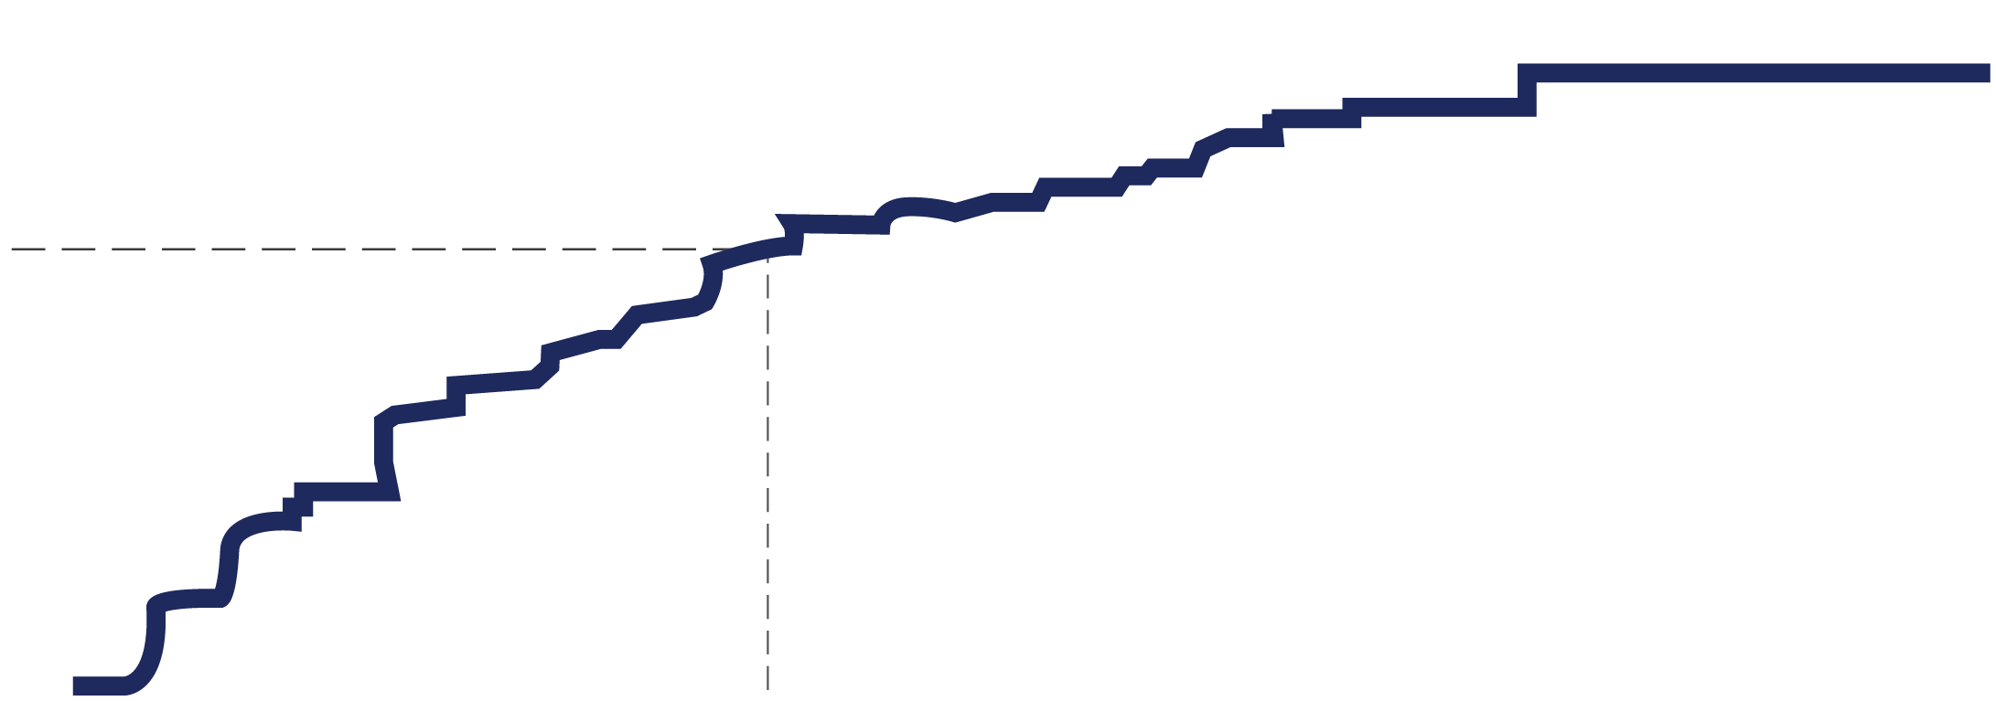
Progression to mCRPC Is Rapid
46% of men with nmCRPC will develop metastases within 2 years
Time to Onset of Metastases in Men With CRPC
0.7
0.6
0.5
0.4
0.3
0.2
0.1
0.0
Probability of
Bone Metastases
0
12
24
36
48
60
Months Since Randomization
Data are from the placebo arm (n=331) of a randomized, controlled study to evaluate the effects of atrasentan on time to disease progression in men who had progressive CRPC and no radiographic evidence of bone metastases.
Smith MR et al. Cancer. 2011;117:2077-2085.

Slide 13
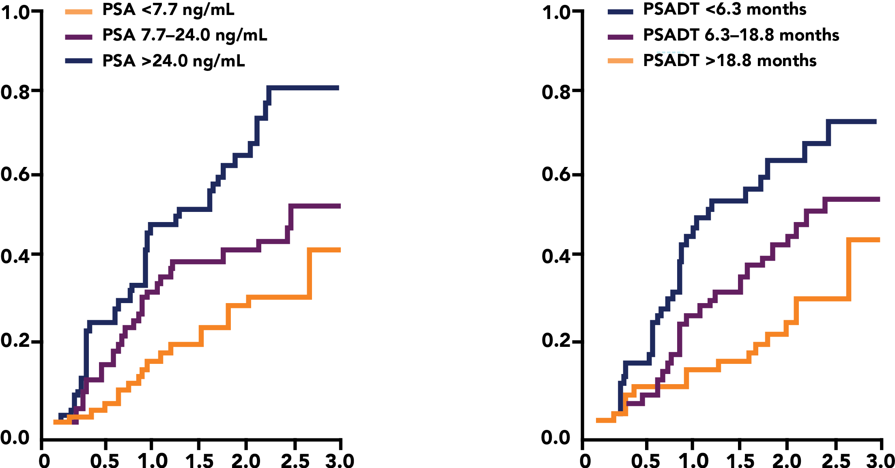
Higher absolute value of PSA and more rapid PSA doubling times correlate with more rapid development of metastases
Time to Bone Metastases or Death Stratified by PSA and PSADT
Proportion of Patients
Years Since Random Assignment
Years Since Random Assignment
Data are from the placebo arm (n=201) of a randomized, double-blind, controlled study to evaluate the effects of zoledronic acid on time to first bone metastases in men with prostate cancer.
PSADT=prostate-specific antigen doubling time.
Smith MR et al. J Clin Oncol. 2005;23:2918-2925.

Slide 14
Metastatic Disease Is Often Occult
Over 30% of men thought to have nonmetastatic CRPC were found to have metastatic disease when screened via imaging for a recent clinical trial
Leading Cause of Screening Failures Patients
(N=2577)
Detection of metastatic disease | 818 (32%)
Data represent screening failures of patients trying to enroll in the phase 3 study comparing zibotentan with placebo. Of the 2577 patients, 818 who were presumed to have nonmetastatic CRPC actually had metastatic disease and did not qualify for the study.
Yu EY et al. J Urol. 2012;188:103-109.

Slide 15
PROSPER
PROSPER was a double blind randomized phase III clinical trial
  Eligible men had castration resistant prostate cancer
  PSA doubling time 10 months or less
  No imaging evidence of metastatic disease (technetium bone scans and CT scans)
  Enzalutamide 160 mg vs placebo
  Randomized 2:1 in favor of enzalutamide
  1401 men were enrolled
  Primary endpoint was metastasis free survival
    Time from initiation of therapy to radiographic progression or death
  Secondary endpoints
    Time to PSA progression
    PSA response rate
    Time to initiation of a new therapy
    Quality of life assessments
    Safety
    Overall survival
.

Slide 16
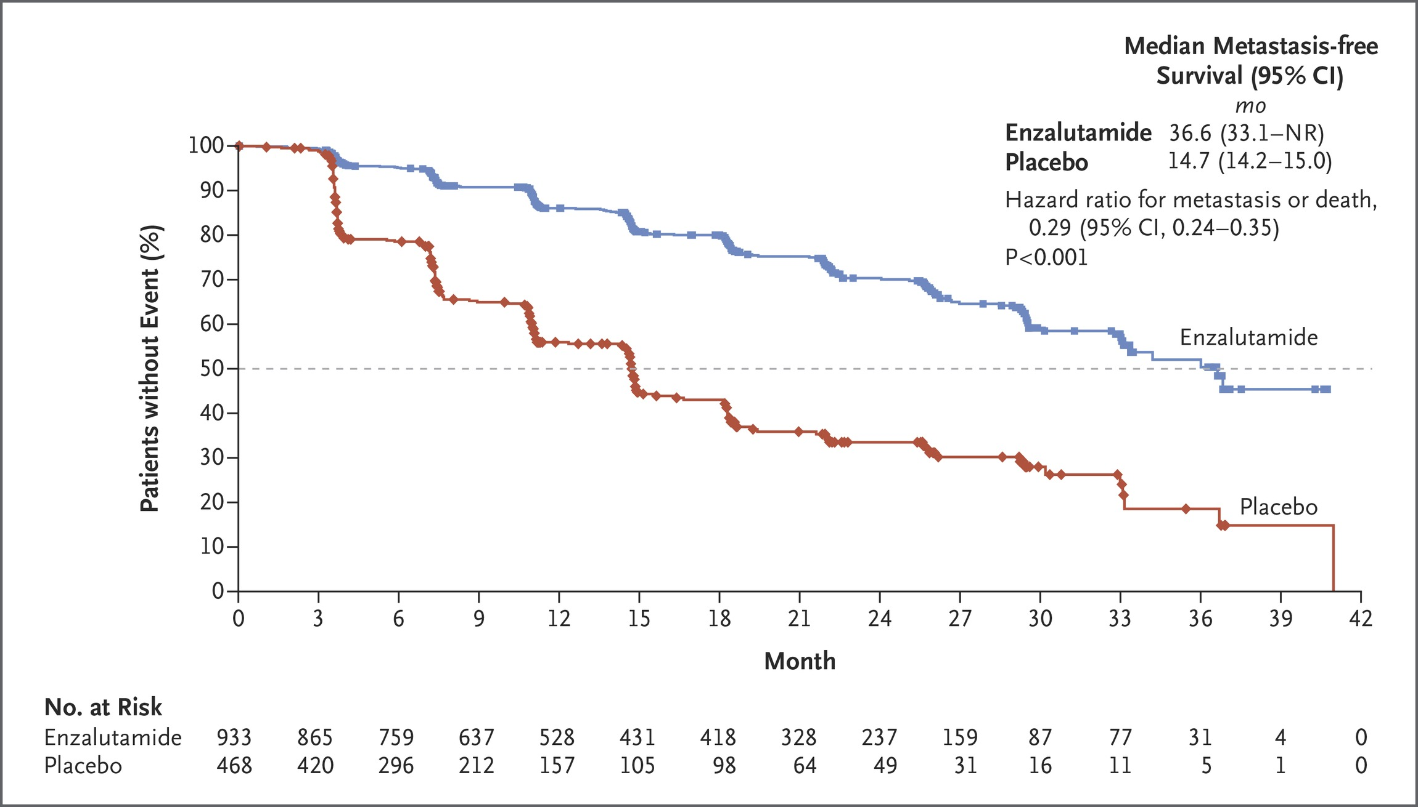

METAMM.
Hussain M et al. N Engl J Med 2018;378:2465-2474
Notes:
Figure 1 Kaplan–Meier Estimate of Metastasis-free Survival. Shown are data for the primary end point of metastasis-free survival. The dashed line indicates the median. The hazard ratio was based on a Cox regression model that was stratified according to the prostate-specific antigen (PSA) doubling time (<6 months vs. ≥6 months) and previous or current use of a bone-targeting agent (yes vs. no), with trial group as the only covariate and a value less than 1.00 favoring enzalutamide treatment. Symbols indicate censored data. NR denotes not reached.

Slide 17
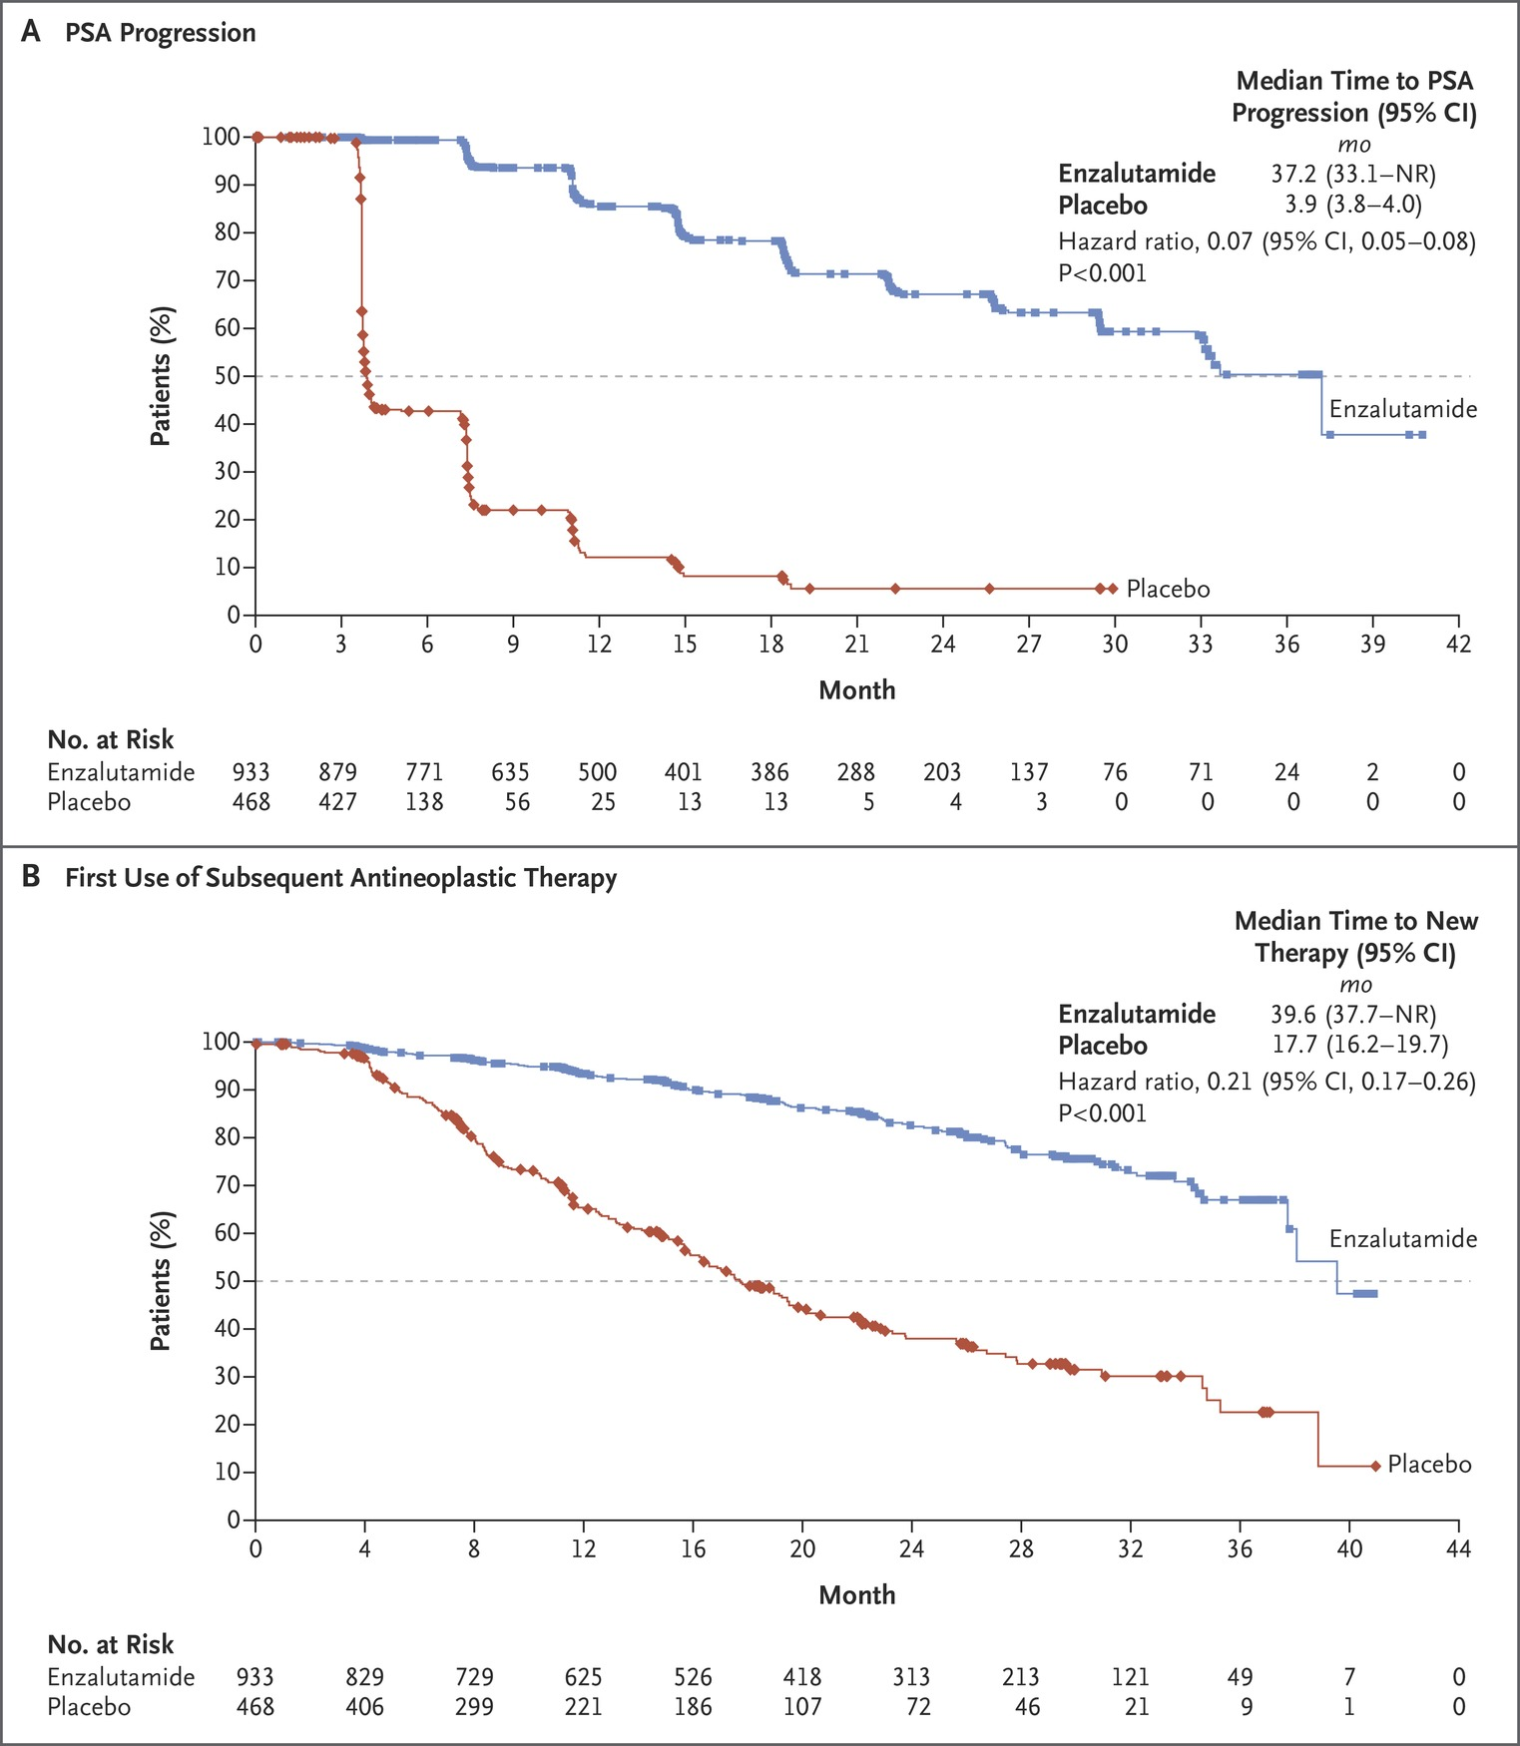
Kaplan–Meier Est to the First Use of Subsequent Antineoplastic Therapy.
Hussain M et al. N Engl J Med 2018;378:2465-2474
Notes:
Figure 2 Kaplan–Meier Estimates of the Time to PSA Progression and the Time to the First Use of Subsequent Antineoplastic Therapy. Shown are data for the secondary efficacy end points: the time to PSA progression (Panel A) and the time to the first use of a subsequent antineoplastic therapy (Panel B). The dashed line in each panel indicates the median. Hazard ratios were based on Cox regression models that were stratified according to the PSA doubling time (<6 months vs. ≥6 months) and previous or current use of a bone-targeting agent (yes vs. no), with trial group as the only covariate and values less than 1.00 favoring enzalutamide treatment. Symbols indicate censored data.

Slide 18
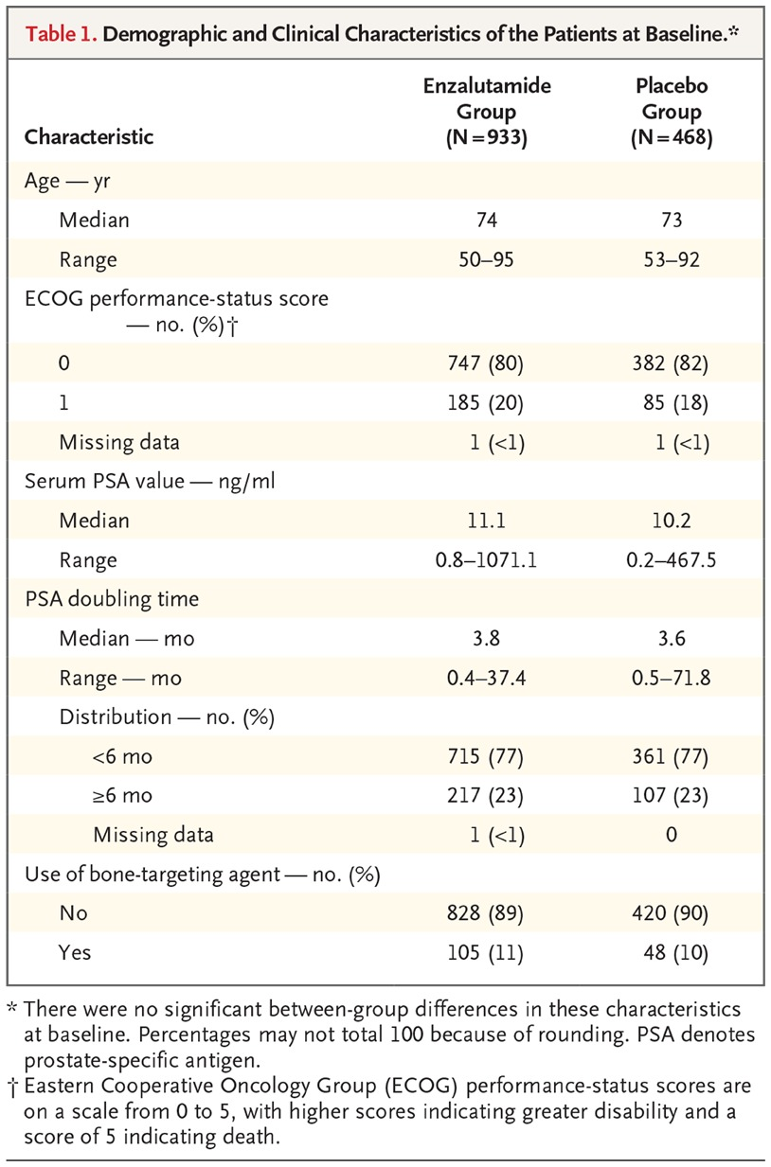
Demographic and Clinical Characteristics of the Patients at Baseline.
Hussain M et al. N Engl J Med 2018;378:2465-2474
Notes:
Table 1 Demographic and Clinical Characteristics of the Patients at Baseline.

Slide 19
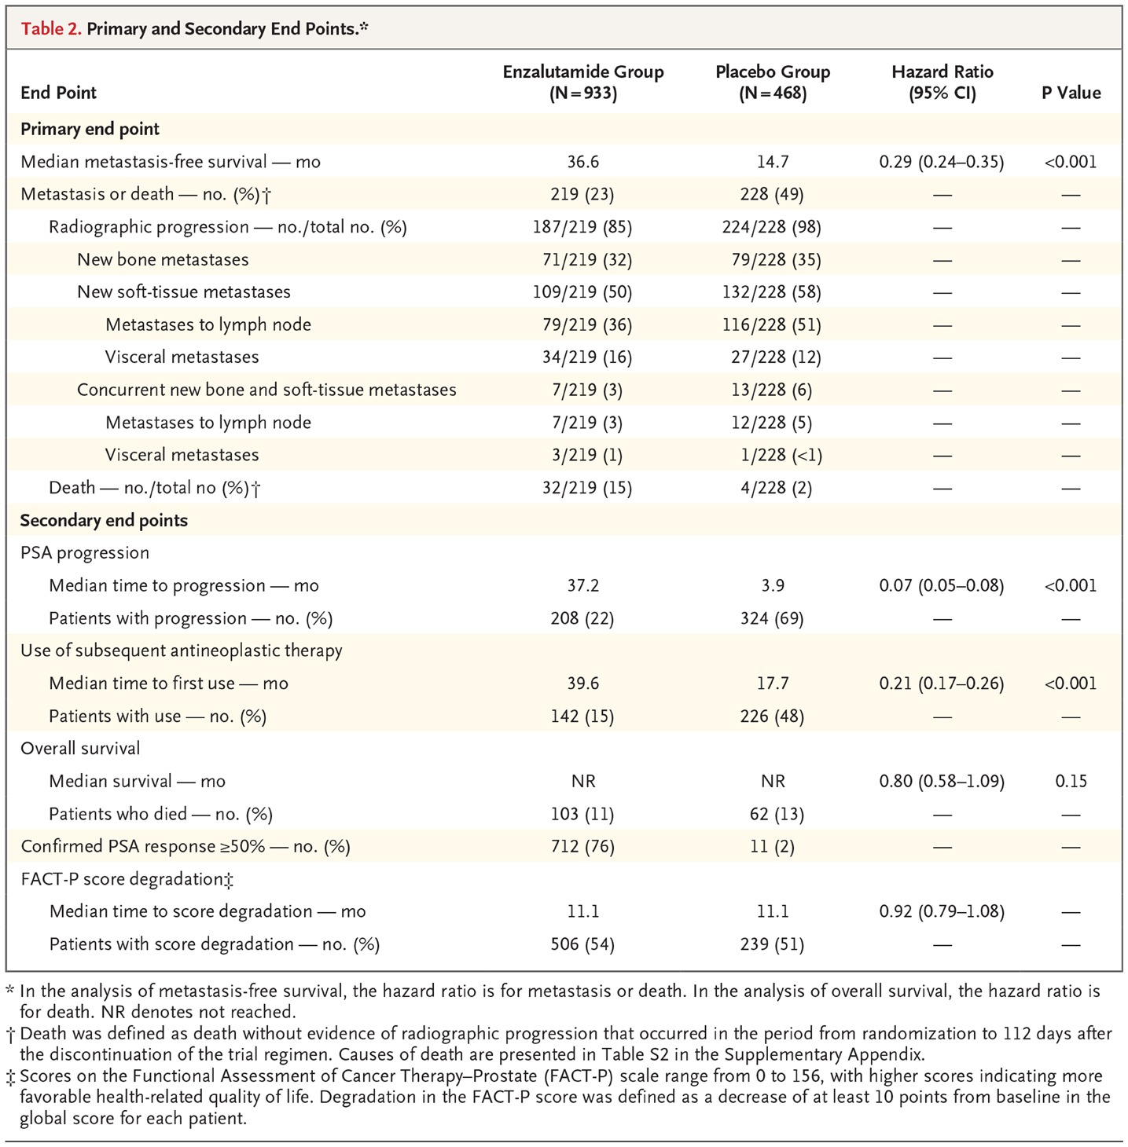
Primary and Secondary End Points.
Hussain M et al. N Engl J Med 2018;378:2465-2474
Notes:
Table 2 Primary and Secondary End Points.

Slide 20
SPARTAN
SPARTAN was a double blind randomized phase III clinical trial
  Eligible men had castration resistant prostate cancer
  PSA doubling time 10 months or less
  No imaging evidence of metastatic disease (technetium bone scans and CT scans)
  Apalutamide 240 mg daily versus placebo
  Randomized 2:1 in favor of apalutamide
  1207 patients were enrolled
  Primary endpoint was metastasis free survival
    Time from initiation of therapy to radiographic progression or death
  Secondary endpoints
    Time to symptomatic progression
    Overall survival
    Time to initiation of cytotoxic chemotherapy

Slide 21
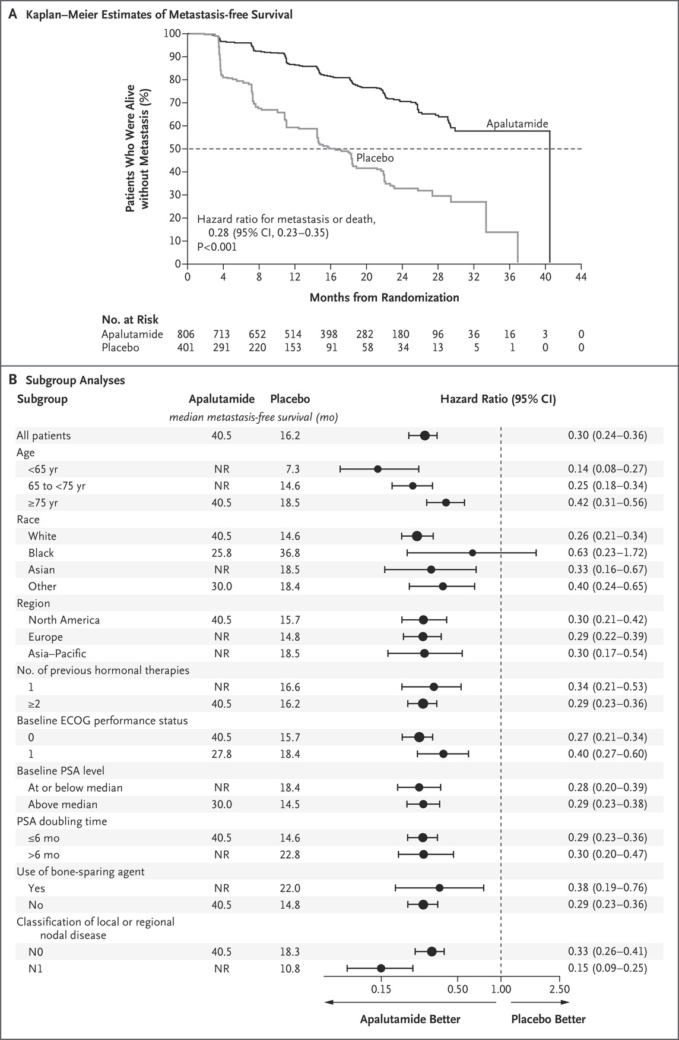
Metastasis-free Survival.
Smith MR et al. N Engl J Med 2018;378:1408-1418
Notes:
Figure 1 Metastasis-free Survival. Panel A shows Kaplan–Meier estimates of metastasis-free survival in the apalutamide group and the placebo group. The dashed line indicates the median. The analysis was performed with the use of a log-rank test with stratification according to prostate-specific antigen (PSA) doubling time (>6 months vs. ≤6 months), use of bone-sparing agents (yes vs. no), and classification of local or regional nodal disease (N0 vs. N1) at the time of trial entry. Panel B shows subgroup analyses of metastasis-free survival. In the forest plot, the size of the circle reflects the number of patients affected. The analysis of all patients and all subgroup analyses were unstratified. An Eastern Cooperative Oncology Group (ECOG) performance-status score of 0 indicates asymptomatic, and a score of 1 indicates restricted in strenuous activity but ambulatory. Race was reported by the patient. NR denotes not reached.

Slide 22
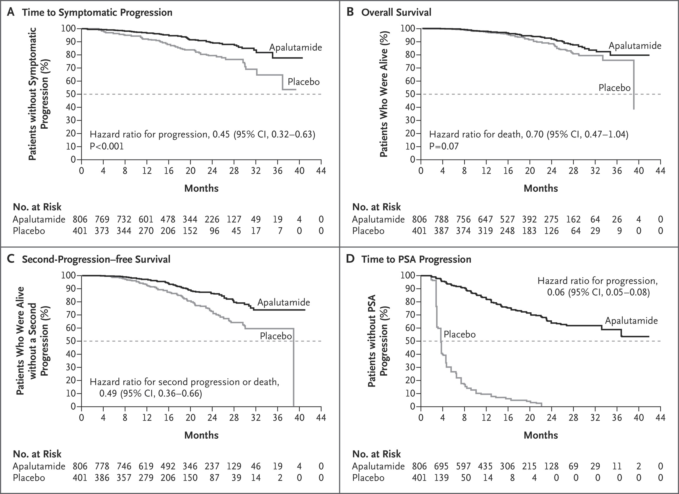
Prespecified Secondary and Exploratory Efficacy End Points.
Smith MR et al. N Engl J Med 2018;378:1408-1418
Notes:
Figure 2 Prespecified Secondary and Exploratory Efficacy End Points. Shown are Kaplan–Meier estimates of the time to symptomatic progression (Panel A), overall survival (Panel B), second-progression–free survival (Panel C), and time to PSA progression (Panel D) in the apalutamide group and the placebo group. The dashed lines indicate the medians. All analyses were performed with the use of a log-rank test with stratification according to PSA doubling time (>6 months vs. ≤6 months), use of bone-sparing agents (yes vs. no), and classification of local or regional nodal disease (N0 vs. N1) at the time of trial entry. The analysis of second-progression–free survival included patients who received any subsequent therapy (approved or nonapproved).

Slide 23
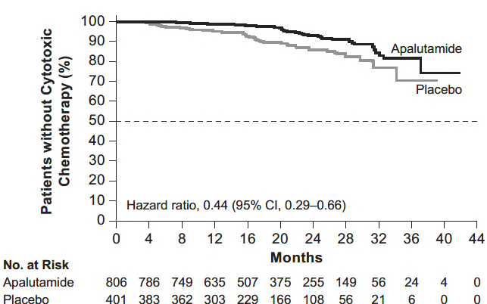

Slide 24
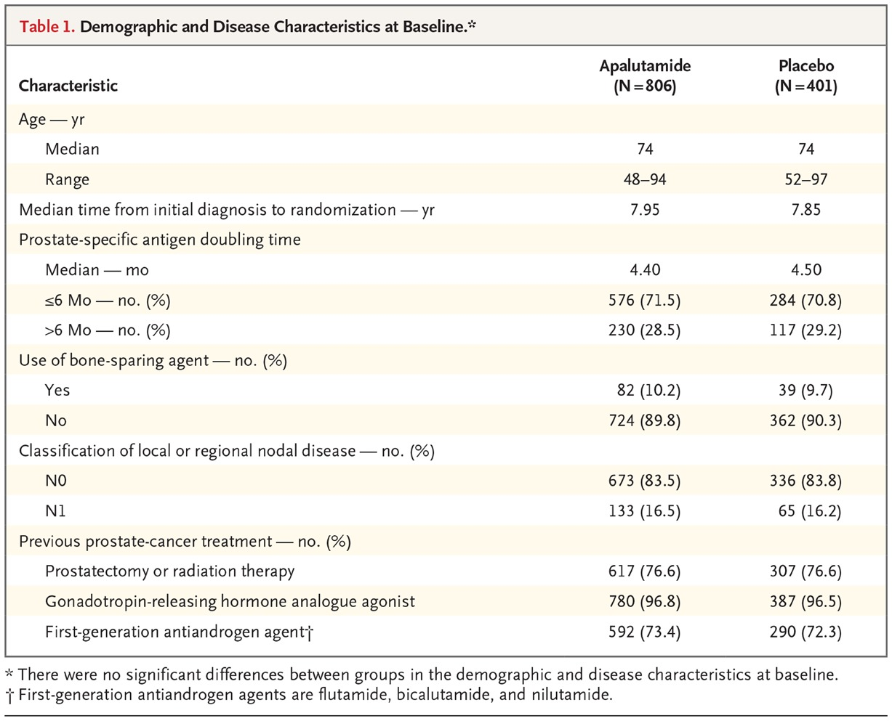
Demographic and Disease Characteristics at Baseline.
Smith MR et al. N Engl J Med 2018;378:1408-1418
Notes:
Table 1 Demographic and Disease Characteristics at Baseline.

Slide 25
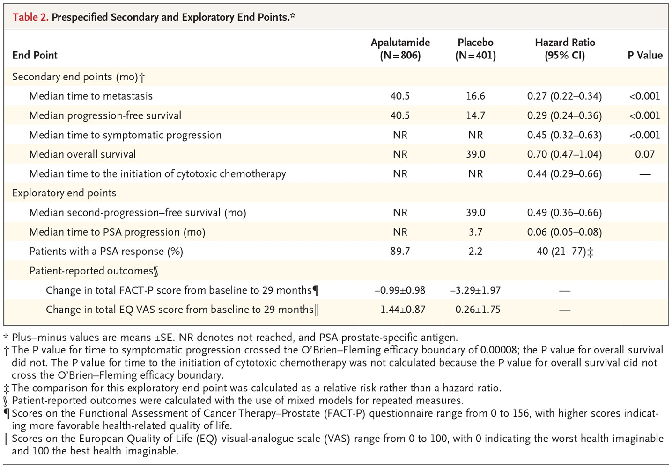
Prespecified Secondary and Exploratory End Points.
Smith MR et al. N Engl J Med 2018;378:1408-1418
Notes:
Table 2 Prespecified Secondary and Exploratory End Points.

Slide 26
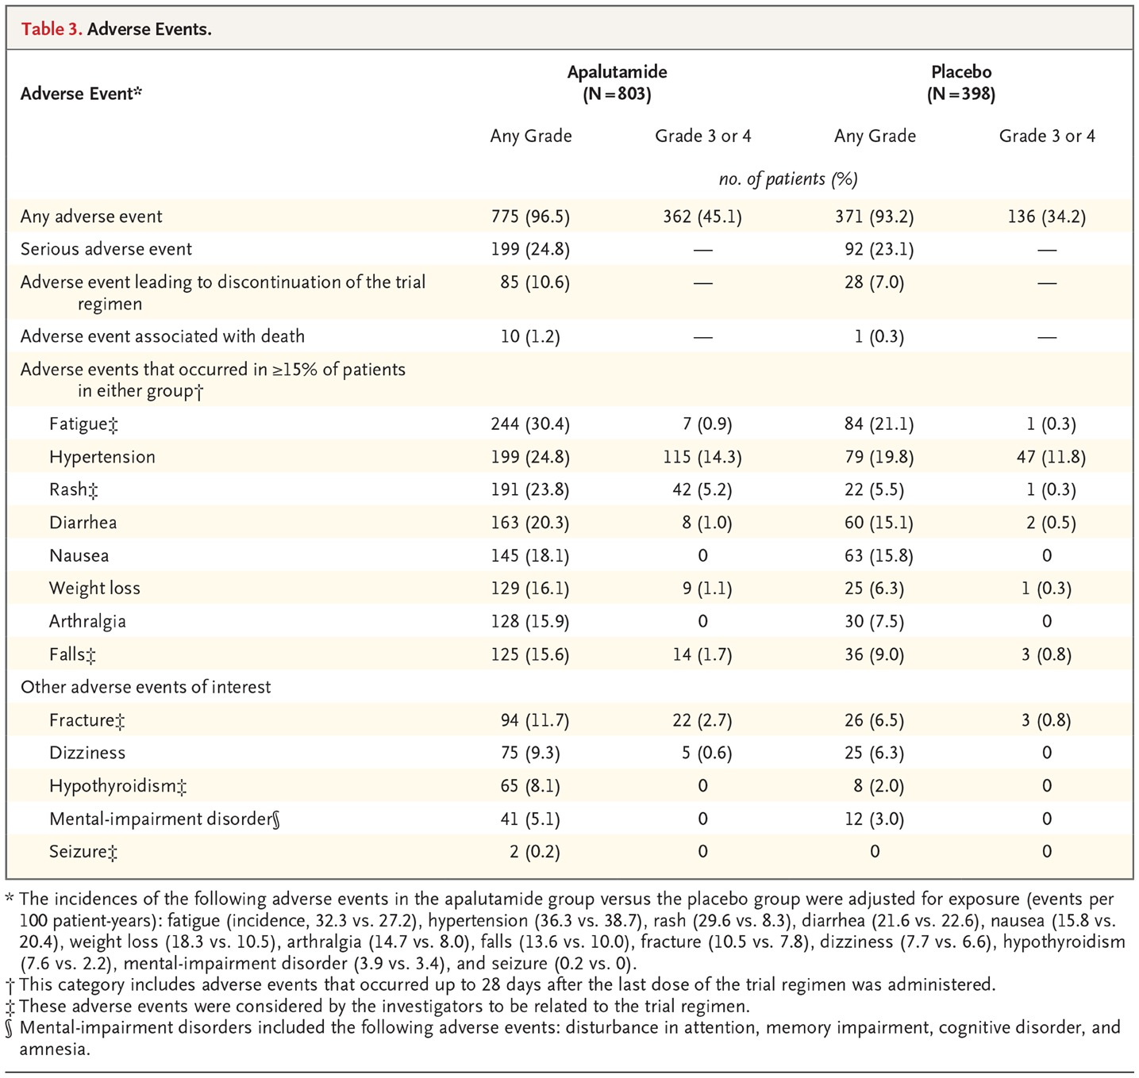
Adverse Events.
Smith MR et al. N Engl J Med 2018;378:1408-1418
Notes:
Table 3 Adverse Events.

Slide 27
Abiraterone acetate (with prednisone) was FDA approved for treatment of high risk castration sensitive metastatic prostate cancer
Based on LATITUDE, a phase III placebo controlled trial
  Abiraterone acetate with 5 mg prednisone daily versus 2 placebos
  All patients received LHRH agonist or bilateral orchiectomy
  1199 patients randomized 1:1
  Primary endpoints
    Overall survival
    Radiographic progression free survival
  Secondary endpoints
    Time to next symptomatic skeletal related event
    Time to PSA progression
    Time to next therapy
    Time to initiation of cytotoxic chemotherapy
    Time to pain progression

Slide 28
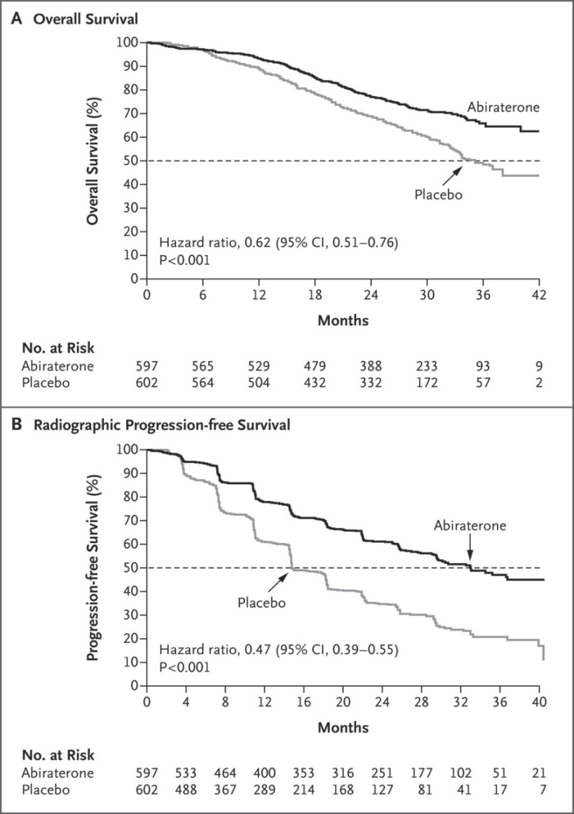

Fizazi K et al. N Engl J Med 2017;377:352-360.
Kaplan–Meier Estimates of the Two Primary End Points.
Notes:
Figure 1. Kaplan–Meier Estimates of the Two Primary End Points. Shown are data for overall survival (Panel A) and for radiographic progression-free survival (Panel B). The dashed lines indicate the median. The median rate of overall survival was not reached in the abiraterone group and was 34.7 months in the placebo group; the corresponding medians for progression-free survival were 33.0 months and 14.8 months. CI denotes confidence interval.

