Slide 1

ADVANCED PROSTATE CANCER: BONE ISSUES AND METASTASES
Samuel Denmeade, MD
Professor of Oncology, Urology and Pharmacology
The Johns Hopkins University School of Medicine

Slide 2
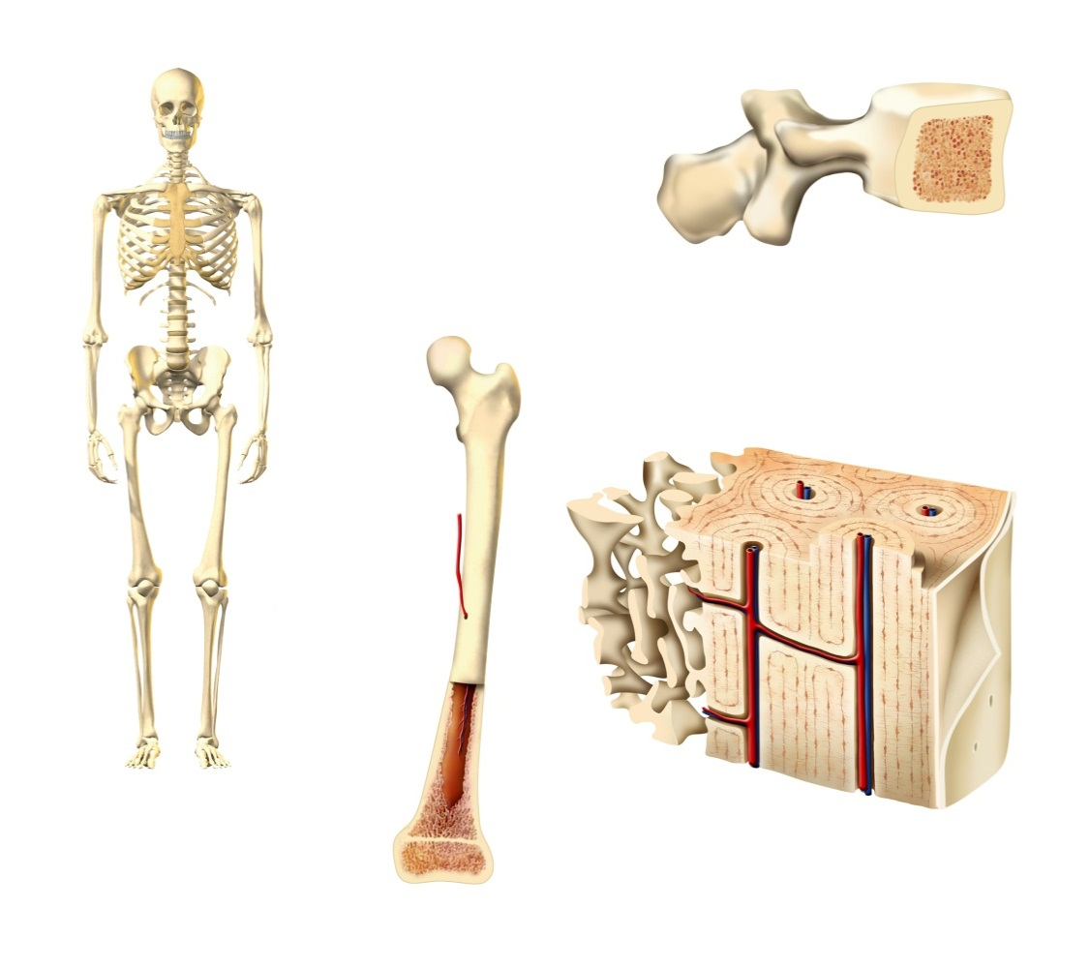
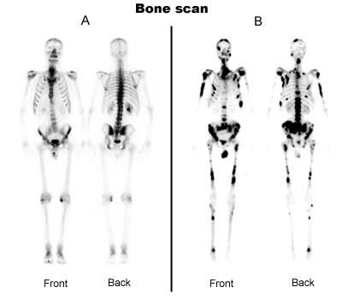
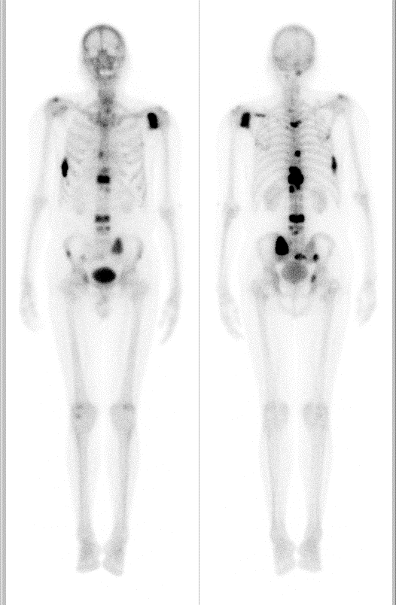
Spectrum of Therapy and Bone Disease in Prostate Cancer
Osteoporosis and Treatment-related fractures
New bone metastases
Disease-related
skeletal complications
ADT
+ 2nd Line
ADT
Castrate-resistant non-metastatic
No Rx
ADT
± Chemo
Castrate-sensitive
Non-Metastatic
Prostate Cancer
Castrate-resistant metastatic
Castrate-sensitive metastatic
Notes:
2

Slide 3

“To Treat or Not to Treat, That is the Question…”
No Randomized Trial Showing Survival Advantage for ADT
No good data to support “early” vs. “late” use of ADT
Should we give ADT to non-Metastatic patients?

Slide 4
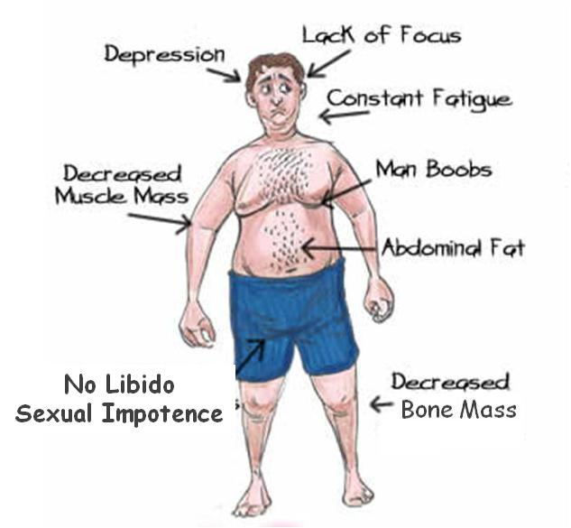
Androgen Deprivation Therapy Side Effects

Slide 5
Negative Impact of Bone Complications
Increased medical costs^{[1]}
Treatment of bone complications more than doubles the total treatment costs for patients with bone metastases
Diminished
quality of life^{[2-4]}
History of a
skeletal complication
is associated with lower
QoL in breast and
prostate cancer
Impaired mobility^{[6]}
Hip fracture
associated with a 50% disability rate; 25% of these require nursing home care
Skeletal
Complications
Negative impact on survival^{[5]}
Men with prostate cancer without
skeletal fracture survived 39 mos longer than those with a fracture
1. Groot MT, et al. Eur Urol. 2003;43:226-232. 2. Weinfurt KP, et al. Ann Oncol. 2002;13(suppl 5):180.
3. Weinfurt KP, et al. Med Care. 2004;42:164-175. 4. Saad F, et al. Eur Urol. 2004;46:731-740.
5. Oefelein MG, et al. J Urol. 2002;168:1005-1007. 6. Riggs BL, et al. Bone. 1995;17:505S-511S.
Notes:
5
QOL, quality of life.
Disease-related skeletal complications have serious negative effects: They increase medical costs, they are associated with diminished quality of life, and they have functional consequences for patients, including impaired mobility. Importantly, SREs, as well as treatment-related fractures, are associated with shorter patient survival.
References:
1. Weinfurt KP, Li Y, Castel LD, et al. The impact of skeletal-related events on health-related quality of life of patients with metastatic prostate cancer. Ann Oncol. 2002;13 (suppl 5):180. Abstract 662P.
2. Weinfurt KP, Castel LD, Li Y, et al. Health-related quality of life among patients with breast cancer receiving zoledronic acid or pamidronate disodium for metastatic bone lesions. Med Care. 2004;42:164-175.
3. Saad F, Olsson C, Schulman CC. Skeletal morbidity in men with prostate cancer: quality-of-life considerations throughout the continuum of care. Eur Urol. 2004;46:731-740.
4. Groot MT, Boeken Kruger CG, Pelger RC, et al. Costs of prostate cancer, metastatic to the bone, in The Netherlands. Eur Urol. 2003;43:226-232.
5. Oefelein MG, Ricchiuti V, Conrad W, et al. Skeletal fractures negatively correlate with overall survival in men with prostate cancer. J Urol. 2002;168:1005-1007.
CORE

Slide 6
ADT-Associated Bone Loss
Healthy men^{[1]}
0.5%
Late menopausal women^{[1]}
1.0%
Early menopausal women^{[1]}
2.0%
AI therapy in postmenopausal women^{[2]}
2.6%
Bone marrow transplant^{[3]}
3.3%
Androgen deprivation therapy^{[4]}
4.6%
AI therapy + GnRH agonist^{[5]}
7.0%
Ovarian failure
secondary to chemotherapy^{[6]}
7.7%
0
2
4
6
8
Lumbar Spine BMD Loss at 1 Yr (%)
1. Kanis JA. Osteoporosis. Blackwell Healthcare Communications Ltd; 1997. 2. Eastell R, et al. J Bone Mineral Res. 2002;17(suppl 2). Abstract 1170. 3. Lee WY, et al. J Clin Endocrinol Metab. 2002;87:329-335. 4. Maillefert JF, et al. J Urol. 1999;161:1219-1222. 5. Gnant M. Breast Cancer Res Treat. 2002; 76(suppl 1):S31. Abstract 12. 6. Shapiro CL, et al. J Clin Oncol. 2001;19:3306-3311.
Notes:
CORE

Slide 7
Fractures Impact Mortality and Life Expectancy
Hip fracture
  Affects life expectancy dramatically^{[1,2]}
    Aged 60-69 yrs: 11.5 yrs of decreased life expectancy
    Aged 0-79 yrs: 5.0 yrs of decreased life expectancy
Vertebral facture
  Prevalence in men is high (20%)^{[3]}
  Clinical consequences: pain, kyphosis, loss of height, respiratory problems^{[4,5]}
    4 x increased risk of subsequent fracture^{[6]}
  Predict increased mortality in men with a 10-yr HR of 2.4
  (95% CI: 1.6-3.9)^{[6,7]}
1. Cree M, et al. J Am Geriatr Soc. 2000;48:283-288. 2. Center JR, et al. Lancet. 1999;353:878-882. 3. O’Neill TW, et al. J Bone Miner Res. 1996;11:1010-1018. 4. Matthis C, et al. Osteoporosis Int. 1998;8: 364-372. 5. Francis RM, et al. QJM. 2004;97:63-74. 6. Johnell O, et al. Osteoporos Int. 2004;15:175-179. 7. Lau E, et al. J Bone Joint Surg Am. 2008;90:1479-1486. 8. Hasserius R, et al. Osteoporos Int. 2003;14:61-68.
Notes:
7

Slide 8
Clinical Case
80-yr-old male with biochemically recurrent, nonmetastatic prostate cancer starting ADT for a PSA of 15
5′9″ (175.3 cm), 158 lbs (72.1 kg)
DEXA scan at baseline reveals T-score of -0.9 at the femoral neck of the left hip and -0.2 at the spine
Patient also has Crohn’s disease and frequently receives steroid treatment
Drinks 4 glasses of wine/day and is a 60 pack-yr cigarette smoker
No previous history of fracture
Notes:
Now, let’s move on to case two. This is an 80-year-old Caucasian gentleman with biochemically recurrent nonmetastatic prostate cancer, who started androgen deprivation therapy when his PSA got up to a level of 15. He had a DXA scan at baseline that revealed a T-score of -0.9 at the femoral neck of the left hip and -2.0 at the spine, so no osteoporosis or osteopenia. The patient, however, also has Crohn’s disease and is frequently put on steroid therapy to help manage his Crohn’s disease. He is a significant drinker by drinking 4 glasses of wine each day, and he also has a 60 pack/year history of cigarette smoking. He, however, has no history of fractures.

Slide 9
Screening for Bone Loss in Men:
Who Is at Risk?
Demographic Factors | 65 yrs of age or older
History | Family history of osteoporotic fracture Fragility fracture after 40 yrs of age Significant height loss
Lifestyle and Dietary Factors | Smoking Excessive intake of alcohol or caffeine (> 4 cups/day) Inadequate dietary calcium intake Weight < 57 kg (or loss of > 10% of weight at 25 yrs of age)
Physical Findings | Vertebral deformity (eg, kyphosis) or osteopenia evident on x-ray
Diseases Associated With Bone Loss | Prostate cancer COPD Malabsorption syndrome Hyperparathyroidism Hyperthyroidism Hypogonadism Rheumatoid arthritis Renal insufficiency Vitamin D deficiency
Treatments Associated With Bone Loss | ADT Anticonvulsants Heparin Systemic glucocorticoids (duration > 3 mos)
Entries in bold are considered major risk factors.
Brown JP, et al. CMAJ. 2002;167:S1-S34. Greenspan SL. J Clin Endocrinol Metab. 2008;93:2-7.
Notes:
There are many risk factors for bone loss in men, including age ≥ 65 years, prostate cancer itself, and hypogonadism (including ADT-induced hypogonadism)^{1,2}
References:
Brown JP, Josse RG; Scientific Advisory Council of the Osteoporosis Society of Canada. 2002 clinical practice guidelines for the diagnosis and management of osteoporosis in Canada. CMAJ 2002;167(Suppl 10):S1-S34.
Greenspan SL. Approach to the prostate cancer patient with bone disease. J Clin Endocrinol Metab 2008;93:2-7.

Slide 10
FRAX Calculation Tool
Consider Therapy if:
T-score ≤-2.5 femoral neck
10 year hip fracture probability ≥ 3%
10 year probability of major osteoporosis fracture ≥ 20%

Slide 11
National Osteoporosis Foundation Fracture Prevention Guidelines for Men
Consider FDA-approved medical therapies based
on the following
  A vertebral or hip fracture
  Femoral neck or spine T-score ≤ -2.5
  FRAX 10-yr probability of a hip fracture ≥ 3% or 10-yr probability of any major fracture ≥ 20%
    http://www.shef.ac.uk/FRAX
National Osteoporosis Foundation. Clinician’s Guide to Prevention and Treatment of Osteoporosis.
Washington, DC: National Osteoporosis Foundation; 2010.
Notes:
11

Slide 12


Overview: Bone-Targeted Agents
P
P
P
P
Bisphosphonates
(Zoledronic Acid,
^{99m}Technetium)
P
P
P
P
P
P
P
P
Zoledronic acid- FDA Approval 2001
Denosumab- FDA Approval 2011

Slide 13
FDA-Approved Agents to Increase Bone Mass in Men With Osteoporosis
Agent | Drug Class | Recommended Dose and Schedule
Alendronate | Bisphosphonate | 70-mg tablet once weekly 1 bottle 70-mg oral solution once weekly 1 10-mg tablet once daily
Zoledronic acid | Bisphosphonate | 4 or 5 mg IV annually 4 mg IV quarterly
Risedronate | Bisphosphonate | One 35-mg tablet once weekly
Teriparatide* | Parathyroid hormone | 20 mg SQ once daily
Denosumab RANK Ligand Inhibitor 60 mg SQ every 6 month.
Alendronate, denosumab, or zoledronic acid approved for men with prostate cancer receiving ADT, when warranted to improve bone density
Denosumab also shown to prevent fractures
Notes:
ADT, androgen deprivation therapy; FDA, US Food and Drug Administration; NCCN, National Comprehensive Cancer Network

Slide 14
Conclusions
Osteoporosis and fractures are an important health problem in older men
ADT for prostate cancer increases risks for osteoporosis and fractures
Some but not all men require drug therapy to prevent fractures during ADT
Effective therapies are available
  Bisphosphonates increase BMD
  Denosumab increases BMD and decreases vertebral fractures

Slide 15
Spectrum of Therapy and Bone Disease in Prostate Cancer
New bone metastases
Disease-related
skeletal complications
No Rx
ADT
± Chemo
Castrate-sensitive
Non-Metastatic
Prostate Cancer
Castrate-resistant metastatic
Castrate-sensitive metastatic
Notes:
15

Slide 16
Randomized Controlled Clinical Trials in CSPC Patients
Clodronate vs placebo
  Oral clodronate at 2080 mg/day for up to 3 yrs in men with metastatic disease (311) and non-metastatic disease (508)
  Clodronate confers an OS benefit when compared with placebo (HR: 0.77; 95% CI: 0.60-0.98; P = .032) in metastatic disease
  No benefit in non-metastatic disease
  Median follow-up of 11.5 yrs
  Clodronate causing more gastrointestinal toxicities
Dearnley DP, et al. Lancet Oncology. 2009;10:872-876.

Slide 17
STAMPEDE Study- CSPC
Men with Castration Sensitive Prostate Cancer
4 armed study
  (1) ADT (2) ADT + Zoledronic Acid (ZA)
  (3) ADT+ Docetaxel (4) ADT + Docetaxel + ZA
Findings
  Docetaxel showed survival improvement
  ZA showed no evidence of survival improvement when added to ADT or to ADT + Docetaxel
  Time to first SRE improved with Docetaxel +ADT and Docetaxel + ADT + ZA vs ADT alone
  No improvement to time to first SRE in ADT + ZA vs ADT
Conclusion
  ZA not useful in men with CSPC

Slide 18
The Alliance Study
Zoledronic acid vs placebo
  CALGB/CTSU 90202 trial
  Enrolled 645 men out of planned 680 with prostate cancer and bone mets on ADT within 6 mos
  Study ended early after sponsor withdrew study drug supply
  Zoledronic acid 4 mg IV every 4 wks
  Conclusion: Early ZA not associated with increased time to first SRE or improvement in survival
Smith MR, et al. J Clin Onc. 2014;32:1143-50.

Slide 19
Spectrum of Therapy and Bone Disease in Prostate Cancer
Osteoporosis and Treatment-related fractures
New bone metastases
Disease-related
skeletal complications
ADT
+ 2nd Line
ADT
Castrate-resistant non-metastatic
Castrate-sensitive
Non-Metastatic
Prostate Cancer
Castrate-resistant metastatic
Notes:
19

Slide 20
Predicting Bone Metastases in
Non-Metastatic CRPC
1.0
PSADT < 6.3 mos
PSADT 6.3-18.8 mos
PSADT > 18.8 mos
0.8
0.6
Proportion of Patients With Bone Metastases or Death
0.4
0.2
0
0
0.5
1.0
1.5
2.0
2.5
3.0
Yrs Since Random Assignment
Smith MR, et al. J Clin Oncol. 2005;23:2918-2925. Reprinted with permission. © 2005 American Society
of Clinical Oncology. All rights reserved.
Notes:
Rapid PSA doubling time (PSADT) predicts shorter time to first bone metastasis and shorter survival.¹ Different tertiles of PSADT, shown on graph, were associated with different bone metastasis-free survival.
The independent predictive value of PSA velocity suggests that PSA kinetics may provide an effective strategy to identify men at high risk for bone metastases or death. As the optimal management of patients at high risk of metastatic disease remains uncertain, frequency of bone scans should be based on overall risk factors.
Reference:
1. Smith MR, Kabbinavar F, Saad F, et al. Natural history of rising serum prostate-specific antigen in men with castrate nonmetastatic prostate cancer. J Clin Oncol 2005; 23:2918-2925.

Slide 21
Denosumab to Prevent Metastases
Patients with CRPC
and no bone metastases;
PSA > 8 or PSADT
< 10 mos
(N = 1435)
Denosumab 120 mg monthly
Placebo monthly
Primary endpoint: bone metastasis–free survival
Smith MR, et al. Lancet. 2012.

Slide 22
Primary Endpoint: Bone Metastasis-Free Survival
1.0
15% Risk Reduction
HR: 0.85 (95% CI: 0.73-0.98; P = .028)
0.8
Smith MR, et al. Lancet. 2012.
0.6
Proportion of Patients With
Bone Metastasis–Free Survival
0.4
0.2
Median Mos
Placebo
Denosumab
25.2
29.5
0
0
3
6
9
12
15
18
21
24
27
30
33
36
39
42
Study Mo
February 2012-FDA ODAC voted 12 to 1 against denosumab
  Modest improvement in metastasis-free survival
  5% Osteonecrosis; no improved overall survival
April 2012-FDA stated denosumab did not have sufficient risk-benefit profile to be approved for treatment of men with nonmetastaic CRPC

Slide 23
Spectrum of Therapy and Bone Disease in Prostate Cancer
Disease-related
skeletal complications
Castrate-Resistant Metastatic
Notes:
23

Slide 24
Skeletal-Related Events (SREs)
Reducing Bone Complications in Metastatic CRPC
Pathologic fracture
Spinal cord compression
Radiation therapy to bone
Surgical intervention
Change in systemic oncologic therapy
Symptomatic Skeletal Events (SSEs)
SYMPTOMATIC fracture
Spinal cord compression
Radiation therapy to bone
Surgical intervention

Slide 25
Randomized Controlled Clinical Trials in
CRPC Patients
Zoledronic acid vs placebo (Zometa 039)^{[1]}
Pamidronate vs placebo (CPG 032/INT 05)^{[2]} (Negative)
Clodronate vs placebo with mitoxantrone and prednisone (NCIC CTG PR.6) (Negative)
Denosumab vs zoledronic acid (Denosumab 20050103)^{[4]}
1. Saad F, et al. J Natl Cancer Inst. 2002;94:1458-1468. 2. Small EJ, et al. J Clin Oncol. 2003;21:4277-4284. 3. Ernst DS, et al. J Clin Oncol. 2003;21:3335-3342. 4. Fizazi K, et al. Lancet. 2011;377:813-822.

Slide 26
Zoledronic Acid in mCRPC
Zoledronic acid 4 mg q3 wks
(n = 214)
Eligibility Criteria
R
A
N
D
O
M
I
Z
E
D
Patients with prostate cancer
Castration resistant
Bone metastases
(N = 643)
Zoledronic acid 4 mg q3 wks
(initially 8 mg)
(n = 221)
Placebo q3 wks
(n = 208)
Patients in 8-mg arm reduced to 4 mg owing to renal toxicity
Primary outcome: proportion of patients having ≥ 1 SRE
Secondary outcomes: time to first on-study SRE, proportion of patients with SREs, and time to disease progression
Saad F, et al. J Natl Cancer Inst. 2002;94:1458-1468.
Notes:
What about zoledronic acid? Well, there was a 3‑arm study looking at zoledronic acid with men with bone metastatic castration‑resistant prostate cancer randomized to 4 mg every 3 weeks, initially 8 mg every 4 weeks or placebo every 3 weeks. And the 8-mg dose rapidly was converted to 4 mg, as they saw too much nephrotoxicity, and so really the 4-mg doses were then combined. The primary outcome was looking at a proportion of patients having 1 or more skeletal‑related events. Secondary outcomes looked at time to first on‑study skeletal‑related event, proportion of patients with skeletal‑related events, and time to disease progression.

Slide 27
Zoledronic Acid vs Placebo
643 men with CRPC, asymptomatic or minimally symptomatic bone metastasis received zoledronic acid
4 mg (reduced from 8 mg due to increased creatinine)
IV every 3 wks vs placebo for 15 mos
At 15 mos, 33.2% men in zoledronic acid arm 4 mg had SREs compared with 44.2% in the placebo arm (P = .021)
No significant difference between 8/4 mg arm and placebo
Zoledronic acid increased median time to first SRE vs placebo (423 vs 321 days; P = .047)
Saad F, et al. J Natl Cancer Inst. 2002;94:1458-1468.
Saad F, et al. J Natl Cancer Inst. 2004;96:879-882.

Slide 28
Zoledronic Acid Inhibits uNTx, a Specific Marker of Osteoclast Activity
Zoledronic acid
Placebo
20
0
-20
Change From Baseline (%)
-40
-60
-80
0
1
3
6
9
12
15
Mos
Saad F, et al. J Natl Cancer Inst. 2002;94:1458-1468.
Notes:
Zoledronic acid achieved target inhibition
In the placebo group, NTx was markedly elevated at baseline and remained elevated throughout the study
In contrast, zoledronic acid decreased osteoclast activity by approximately 70%
NEXT

Slide 29
Effect of Longer-Interval vs Standard Dosing of Zoledronic Acid on Skeletal Events in Patients With Bone Metastases
Randomized study in 1822 patients with prostate, breast cancer and myeloma
Compared zoledronic acid every 4 wks vs every 12 wks
690 patients with prostate cancer
No difference in SREs (5% in each group)
Himelstein AL, et al. JAMA. 2017;317:48-58.

Slide 30
Denosumab vs Zoledronic Acid
Prospective, double-blind, placebo-controlled phase III trial
Denosumab 120 mg SC +
Placebo IV q4w
(n = 950)
  Patients with CRPC
  and bone metastases,
  no current or previous
  IV treatment with
  bisphosphonate
(N = 1901)
Zoledronic Acid 4 mg IV +
Placebo SC q4w
(n = 951)
Fizazi K, et al. Lancet. 2011;377:813-822.

Slide 31
Denosumab vs Zoledronic Acid
Primary endpoint was time to first on-study SRE
Results revealed that denosumab was superior to zoledronic acid for
  Delaying time to first SRE (18% Risk Reduction)
  Delaying time to first SSE (22% Risk Reduction)
  Reducing rates of multiple SREs (18% Risk Reduction)
  Delayed time to development of moderate-severe pain (6.5 vs 4.7 months; 17% Risk Reduction)
No difference in Overall Survival or Time to Disease Progression
Fizazi K, et al. Lancet. 2011;377:813-822.
Smith MR, et al. Ann Oncol. 2015;26:363-74

Slide 32
Denosumab vs Zoledronic Acid:
Time to First On-Study SRE
18% Risk Reduction
HR: 0.82 (95% CI: 0.71-0.95;
P = .0002 noninferiority;
P = .008 superiority)
1.00
0.75
Proportion of Subjects
Without SRE
0.50
KM Estimate of
Median, Mos
0.25
Denosumab
Zoledronic acid
20.7
17.1
0
0
3
6
9
12
15
18
21
24
27
Study Mo
Fizazi K, et al. Lancet. 2011;377:813-822.

Slide 33
Denosumab vs Zoledronic Acid
Zoledronic
Acid
Denosumab
Difference
First SSE
First SRE
Pathologic Fracture
Jaw Osteonecrosis
Low Calcium
Kidney Injury
Cost for one year/pt
25.4
35.9
14
2
13
15
$36,000
30.4
40.6
15
1
6
16
$1200
5
4.7
1
30-fold

Slide 34
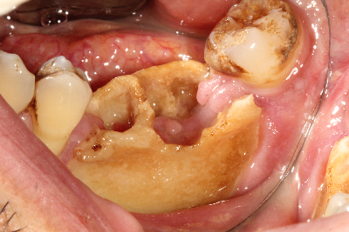
Osteonecrosis of the Jaw
1-5 % incidence in prostate cancer trials of BTAs
Associated with both bisphosphonates and denosumab
Risk increases with increased duration of treatment
Risk Factors
  Dental Abscess
  Tooth extraction
  Prior radiation to head and neck
  Smoking

Slide 35
FDA-Approved Agents for Prevention of SREs in Metastatic Prostate Cancer
Agent | Drug Class | Recommended Dose and Schedule
Zoledronic acid | Bisphosphonate | 4 mg IV q3-4w
Denosumab | RANKL-targeted MAb | 120 mg SQ q4w
NCCN recommends either zoledronic acid or denosumab for prevention/delay of SREs in men with metastatic CRPC^{[1]}
Choice between agents may be guided by
  Underlying comorbidities
  Adverse events: renal insufficiency, ONJ, hypocalcemia
  Logistics - Differences in administration (SQ vs IV)
  Cost considerations- More complicated since Zometa patent expiration in 2013.
1. NCCN. Clinical practice guidelines in oncology: prostate cancer. v.4.2011.
Notes:
MAb,monoclonal antibody; CRPC, castration-resistant prostate cancer; SREs, skeletal-related events

Slide 36
Prostate Cancer Drug Costs
Lupron $1,625 (3 month)
Enzalutamide $13,000/month
Abiraterone $12,240/month
Radium 223 $100,000 (6 cycles)
Zoledronic Acid $33 to $200/dose (generic)
Zometa $1,200/dose
Denosumab $2,800/dose
Pricing Source: Lexicomp (https://online.lexi.com/lco/action/home)
Disclaimer: A representative AWP (Average Wholesale Price) price or price range is provided as reference price only.

Slide 37
National Institute for Health and Care Excellence (NICE)
NIH-equivalent in United Kingdom-2012 Guidance
Adults with cancer that has spread to the bone from solid tumours except for prostate cancer
  NICE recommends denosumab as a possible treatment for preventing complications that result from cancer spreading to the bone from solid tumours, except for prostate cancer...
Adults with cancer that has spread to the bone from prostate cancer
  NICE does not recommend denosumab for preventing complications that result from prostate cancer spreading to the bone.
Why has NICE said this?
  In people with prostate cancer that has spread to the bone denosumab does not provide enough benefit to patients to justify its high cost so NICE did not recommend it.
https://www.nice.org.uk/guidance/TA265

Slide 38
The Report of the Advanced Prostate Cancer Consensus
Conference APCCC 2015 and 2017
Prostate Cancer Experts met in 2015 and 2017 in St Gallen, Switzerland to discuss important areas of controversy in Prostate Cancer
Topic: Reducing risk of skeletal complications in men with prostate cancer and bone metastases
2015
2017
Yes to BTA for:
Castration Naive
Non-metastatic CRPC
Metastatic CRPC
Preferred Agent
Denosumab
Zoledronic Acid
Either
Duration
2 yr
Indefinitely
Dental Check?
3
3
62
42
30
27
47
50
76
NA
NA
86
54
8
24
68
32
NA
(%)
(%)

Slide 39
Conclusions
Bisphosphonates not indicated for CSPC patients
Denosumab has marginal benefit in preventing bone metastases in CRPC but not FDA-approved
Zoledronic acid and Denosumab both can prevent SREs in men with CRPC and bone metastases
Denosumab is marginally better than Zoledronic acid at preventing SREs but more costly
Multiple new effective therapies that directly kill CRPC cells in bone may later landscape for bone targeted therapies

Slide 40
Recurrent Prostate Cancer:
Evolving Treatment Paradigm
Surgical Castration
or LHRH Agonist
Castration Resistant
Prostate Cancer (CRPC)
+/- Docetaxel (mets)
+/- Abiraterone (mets)
Add More Hormone Therapy
Bicalutamide (Casodex) (also Nilutamide/Flutamide)
Ketoconazole
Abiraterone (Zytiga) 2011 Enzalutamide (Xtandi) 2012
Apalutamide (Erleada) 2018
Clinical Trials
Immunotherapy
PARP Inhibitors
PSMA Targeted
Novel AR therapies…
Provenge
Vaccine 2010
Docetaxel
Chemotherapy
(FDA Approval 2004)
Radium 223
(Xofigo) 2013
Cabazitaxel
(Jevtana) 2010

Slide 41
Strategies to Target Bony Metastatic CRPC
Alpharadin
  Radium 223
  Radium 223 combinations (hormone therapy, immunotherapy, DNA repair inhibitors
PSMA-targeted radiopharmaceuticals
  177-Luteium (beta-emitter)
  225-Actinium (alpha-particle)
Combination BTAs + Chemotherapy
Combination BTAs + Second Line Hormone Therapy

Slide 42
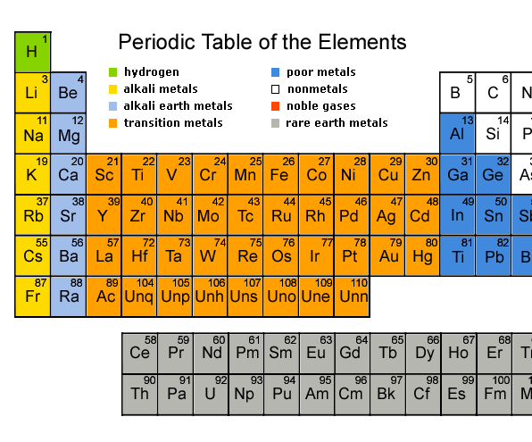
Radium-223 Targets Bone Metastases
Radium-223 acts as a calcium mimic
Naturally targets new bone growth in and around bone metastases
Radium-223 is excreted by the small intestine
Ca
Sr
Ra

Slide 43
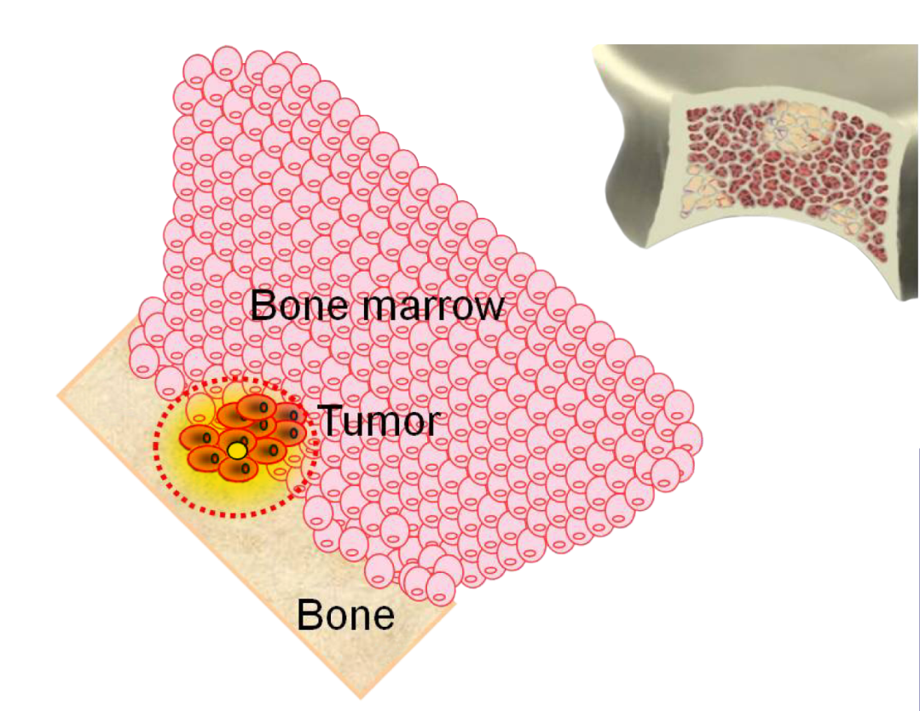
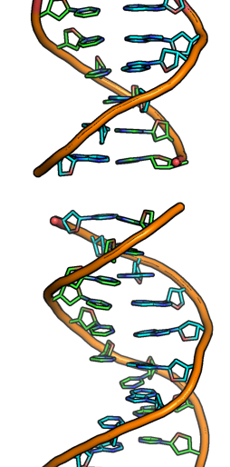
Radium-223 Targets Bone Metastases
Double Strand Break
Range of alpha-particle
Radium-223
Bone surface
Alpha-particles induce double-strand DNA breaks in adjacent tumor cells
  Short penetration=highly localised tumor cell killing and minimal damage to surrounding normal tissue

Slide 44
ALSYMPCA Time to
First Skeletal-Related Event
100
39% Risk Reduction
90
HR 0.610; 95% CI, 0.461-0.807
P = 0.00046
80
70
Radium-223, n = 541
Median: 13.6 months
60
% Without SRE
50
40
Placebo, n = 268
Median: 8.4 months
30
20
10
0
Month | 0 | 3 | 6 | 9 | 12 | 15 | 18 | 21

Slide 45
ALSYMPCA Adverse Events of Interest
 | All Grades |  | Grades 3 or 4
 | Radium-223 (n = 509) n (%) | Placebo (n = 253) n (%) | Radium-223 (n = 509) n (%) | Placebo (n = 253) n (%)
Hematologic
Anemia | 136 (27) | 69 (27) | 54 (11) | 29 (12)
Neutropenia | 20 (4) | 2 (1) | 9 (2) | 2 (1)
Thrombocytopenia | 42 (8) | 14 (6) | 22 (4) | 4 (2)
Non-Hematologic
Bone pain | 217 (43) | 147 (58) | 89 (18) | 59 (23)
Diarrhea | 112 (22) | 34 (13) | 6 (1) | 3 (1)
Nausea | 174 (34) | 80 (32) | 8 (2) | 4 (2)
Vomiting | 88 (17) | 32 (13) | 10 (2) | 6 (2)
Constipation | 89 (18) | 46 (18) | 6 (1) | 2 (1)

Slide 46
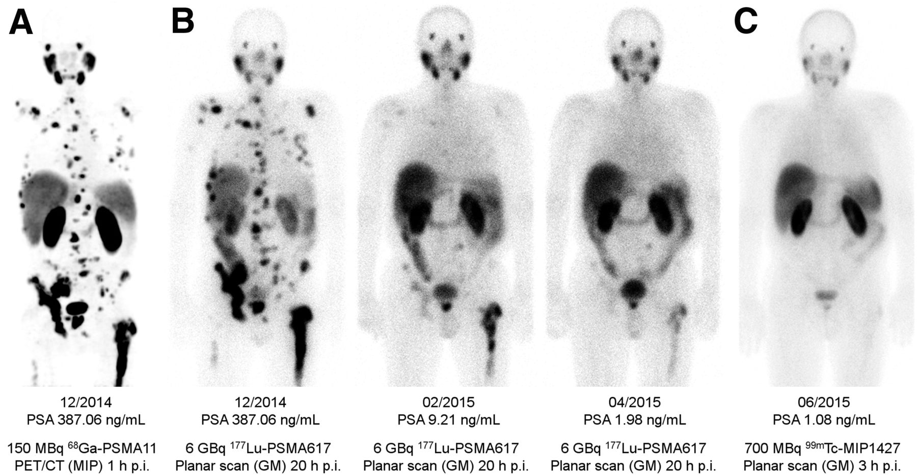
177-Lu-PSMA-targeted Therapy

Slide 47
TRAPEZE Study
Patients with bone metastatic CRPC
Docetaxel ± Zoledronic Acid or Docetaxel ± Strontium89 (radioactive calcium mimic)
No Impact on Overall Survival, Pain Progression Free Interval or Clinical Progression Free Survival
Zoledronic Acid prolonged SRE-free interval by 2.4 months
Zoledronic Acid + Chemo decreased overall SREs by 30% (424 vs 605 docetaxel alone) and severe SREs by 54%
Sr89 had no effect on SREs

Slide 48
Effect of Enzalutamide
Second Line Hormone Therapy on SREs
PREVAIL Study -Enzalutamide vs Placebo in chemotherapy naïve men with CRPC
  Enzalutamide reduced risk of first SRE by 5% vs placebo
  No effect on Time to First SRE vs placebo
  Enzalutamide showed more benefit on Progression Free Survival in those who did not receive BTAs
AFFIRM Study-Enzalutamide vs Placebo post- docetaxel chemotherapy in men with CRPC
  Enzalutamide reduced Time to first SRE by 31% (16.7 v 13.3) and time to pain progression compared to placebo
Fizazi K et al. Lancet Oncol. 2014;15:1147-56

Slide 49
Bipolar Androgen Therapy (BAT) for mCRPC
Two Studies evaluating effects of high dose testosterone in asymptomatic men with mCRPC
RESTORE Study- 30% PSA response, 40% Objective Response in 30 men progressing on Enzalutamide
TRANSFORMER Study-
  194 men progressing on ADT and abiraterone
  Randomized 1:1 to receive Enzalutamide vs BAT
CT scan-based image analysis to determine effect of BAT on lean body mass and fat
Time to first SRE secondary endpoint.

Slide 50
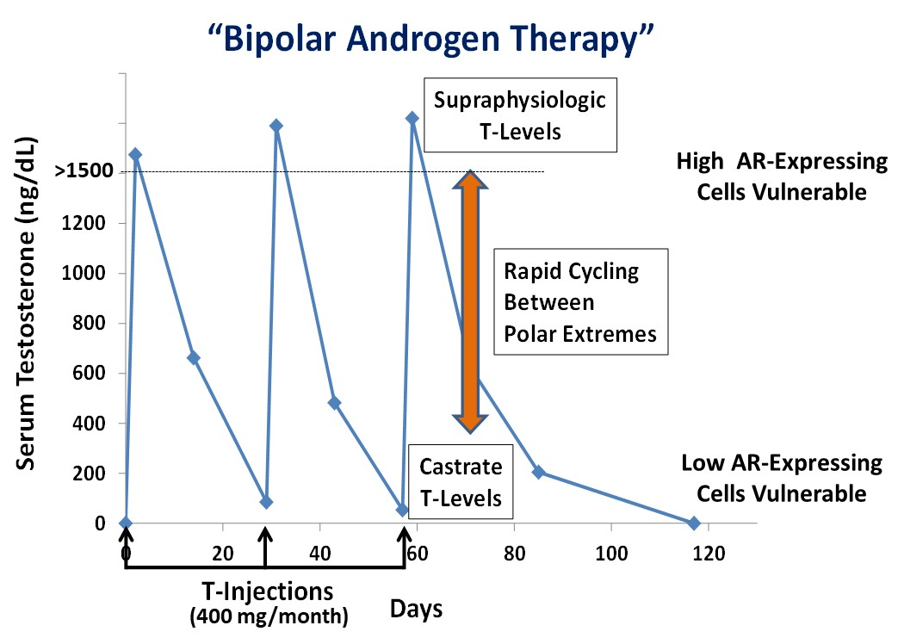
Bipolar Androgen Therapy (BAT)

Slide 51
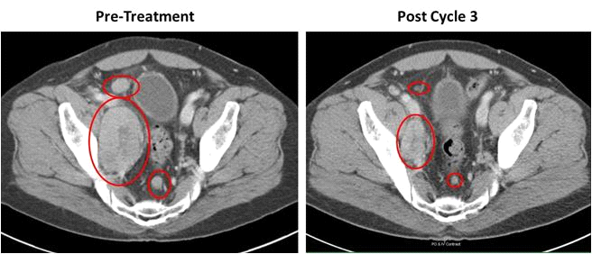
PSA ng/mL
Back to
Castrate T
Testosterone
+ Etoposide
Testosterone Only
(15 cycles)

Slide 52
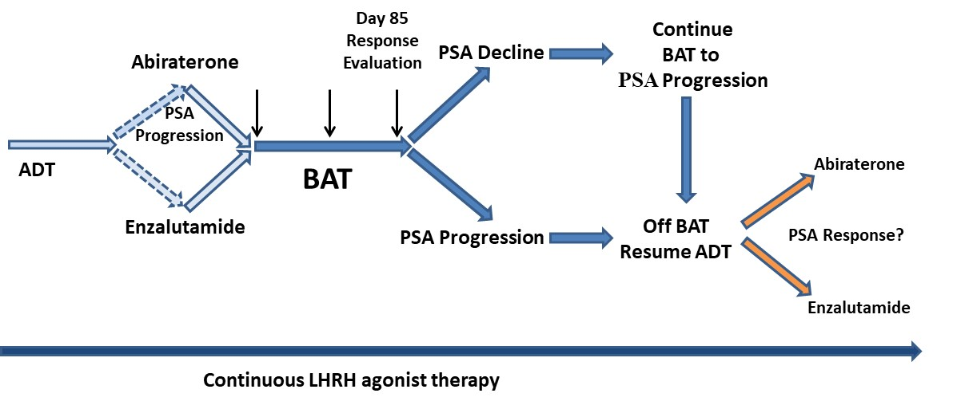
RE-sensitizing with Supraphysiologic Testosterone
to Overcome REsistance
(The RESTORE Study)

Slide 53
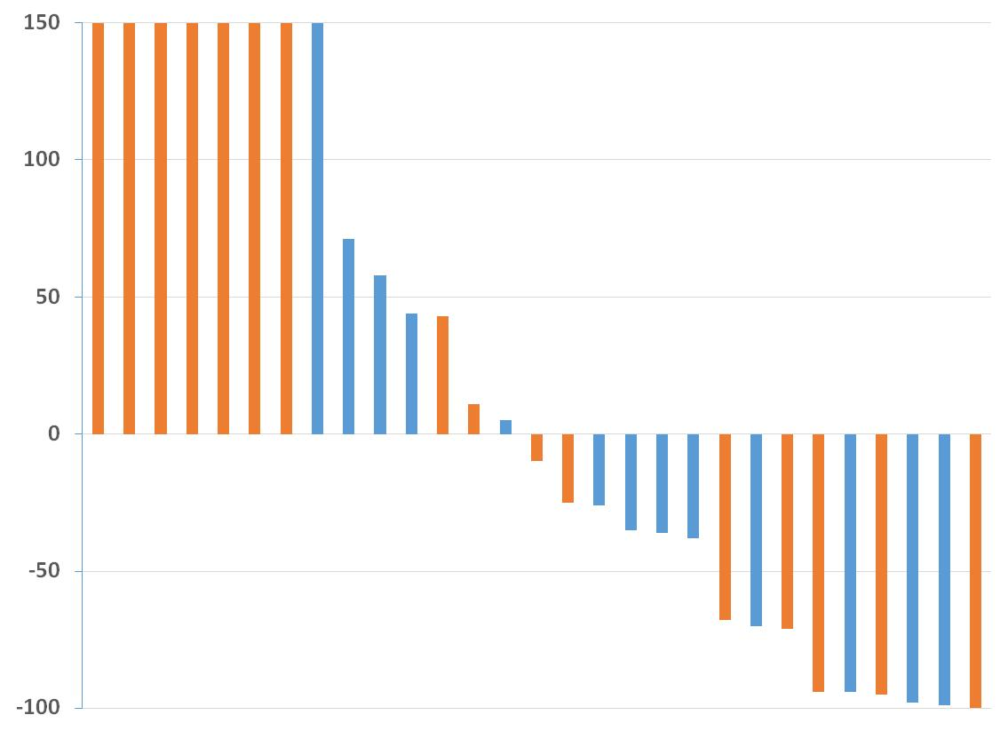
PSA Response to BAT in Post-Enzalutamide Patients
Post-Enzalutamide
Post-Abiraterone & Enzalutamide
Percent Change in PSA in Response to BAT

Slide 54
Can BAT Potentiate Response to
Immune Checkpoint Inhibition?

Slide 55
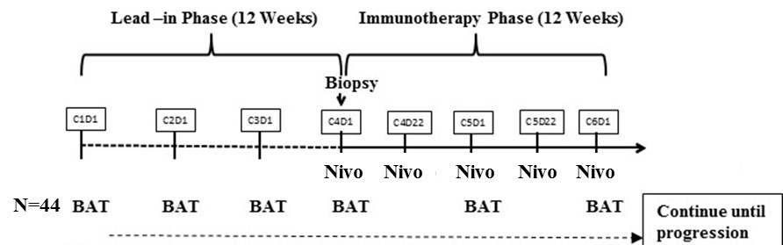
COMbination of Bipolar Androgen Therapy and Nivolumab in Patients with Metastatic Castration-Resistant Prostate Cancer
[COMBAT-CRPC]
PI: Mark Markowski, MD, PhD
Biopsy
J1812
BMS-sponsored
44 Patient Trial
Opened August 2018
Extensive Immune Correlates

Slide 56
Sex-mismatched haploidentical bone marrow transplantation as a platform therapy for metastatic prostate cancer

Slide 57
Prostate Cancer-related Bone Disease
Continuum of bone related complications has produced greater understanding of biology and natural history
RANK Ligand inhibitors and bisphosphonates reduce SREs
Agents with direct anti-tumor activity in bone mets showing survival advantage
Exciting times, with lots more innovative therapies for prostate cancer on the way!

Slide 58

THANK YOU

