Slide 1
Genomics and Prostate Cancer
Cecilia Hammond, MSN
Senior Medical Science Liaison
Genomic Health Medical Affairs

Slide 2
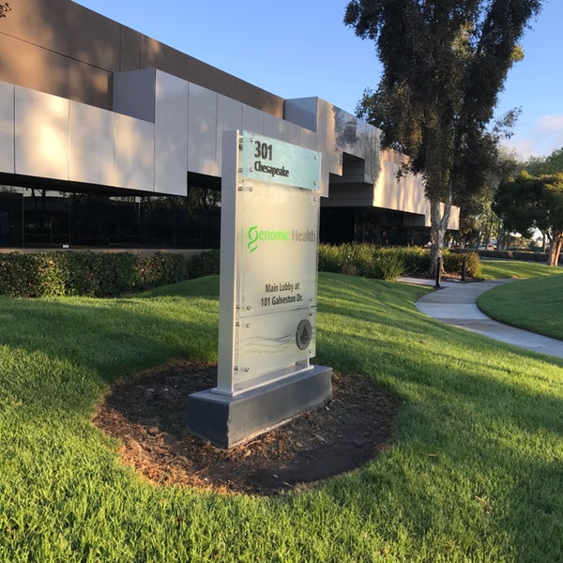
Genomic Health, Inc.
Established the same year the human genome was first sequenced in 2000
Our Mission: To transform treatment decisions and outcomes in cancer by delivering clinically actionable diagnostics and services for patients.
Our Vision: To revolutionize the treatment of cancer throughout the patient journey
Served >950,000 patients in 90+ countries

Slide 3






BREAST
PROSTATE
COLON
Genomic Health and Oncotype IQ: Transforming Patient Management and Improving Clinical Outcomes
Notes:
Focused assays on improving pt outcomes by changing pt management
Informing treatment decisions through tests designed to individualize treatment

Slide 4

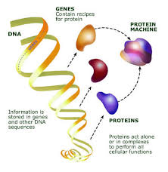
Genetics & Genomics Are Not the Same
GENETICS: The study of heredity and variations in genes
  Examines the presence of specific genes, their mutations and variations
  Can be used to predict the risk of developing a disease
    BRCA1 & 2: Increased risk of breast, ovarian, and other tumors
  Can also be used to locate “targets” for intervention (companion diagnostics)
GENOMICS: The study of genes and their functions
  Examines a single gene or groups of genes and their expression in order to identify their combined influence on an organism
  Used to understand the activity of gene in a tumor
  Can also be used to predict response or sensitivity of a tumor to a particular treatment or therapy

Slide 5
The Expanding Role of Genomics in Oncology
Not all patients and not all tumors are the same
Genomic-based diagnostics enable us to treat cancer based on the individual biology, by providing insight into:
Prognosis: What is the likelihood a patient will have disease recurrence? Prognostic tests assess the likelihood that a cancer will return or spread.
Prediction of treatment benefit: What is the likelihood that a patient will have a greater or lesser relative benefit from treatment? Predictive tests assess the likelihood that a cancer will respond to a particular type of treatment.
Notes:
Main point: Genomic-based diagnostics are important in clinical decision-making.
Cancer genomics is the study of genes that contribute to the development of a cancer and its progression from a localized cancer to one that grows uncontrolled and metastasizes.
The use of genomics in oncology is expanding, including in breast cancer.
Genomic assays are multi-gene expression assays that provide clinical classification of a tumor based on the expression levels of specific component genes.
These genomic assays can be used to evaluate prognosis and prediction of treatment benefit.
National Cancer Institute. Available at: http://www.cancer.gov/cancertopics/understandingcancer/cancergenomics.
Simon R. J Clin Oncol. 2005;23:7332-7341.

Slide 6

Genomic Testing in Newly Diagnosed Patients

Slide 7


Prostate Cancer Management:
A Guide for Patients and Caregivers
Oncotype DX® Prostate Cancer Assay:
The Role of Genomics In Your Decision-Making
Is Active Surveillance Right For You?
7
Notes:
GHI40101_0914

Slide 8
Prostate cancer is an important public health concern
Over >180,000 cases of prostate cancer are diagnosed annually in the USA
Most prostate cancers are slow growing but others may be aggressive
Many physicians and professional organizations advocate SELECTIVE screening & treatment
http://www.cancer.org/cancer/prostatecancer/detailedguide/prostate-cancer-key-statistics accessed 8/18/2015

Slide 9
The Risk Assessment Conundrum
Final Pathology – GS 7 (3 + 4)
4
+
4
3
+
3
3
+
3
3
+
4
(-)

Slide 10
The Importance of Getting it Right
Biopsy Gleason Score | Prostatectomy Gleason Score
 |  | 3+3=6 | 3+4=7 | 4+3=7 | 3+5=8 | 5+3=8 | 4+4=8 | GS 9,10
 | 3+3=6 | 72% | 22% | 4% | 0% | 0% | 1% | 1% | 5610
 | 3+4=7 | 21% | 56% | 18% | 1% | 0% | 1% | 2% | 2216
 | 4+3=7 | 9% | 32% | 40% | 1% | 0% | 9% | 9% | 1136
 | 3+5=8 | 4% | 36% | 36% | 13% | 0% | 2% | 9% | 55
 | 5+3=8 | 5% | 30% | 20% | 10% | 15% | 0% | 20% | 20
 | 4+4=8 | 3% | 11% | 26% | 1% | 0% | 38% | 21% | 436
 | GS 9,10 | 1% | 7% | 10% | 4% | 2% | 8% | 67% | 338
 |  | 4609 | 2968 | 1246 | 86 | 18 | 364 | 520 | 9811
Single Institution Experience (JHH) Matched Bx & RP 2004-2014;J. Epstein 9-13-15

Slide 11
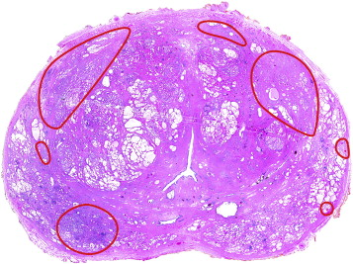
The Tools We Really Need
The Ideal Biomarker
High
grade
High
grade
Low
grade
Biopsy

Slide 12
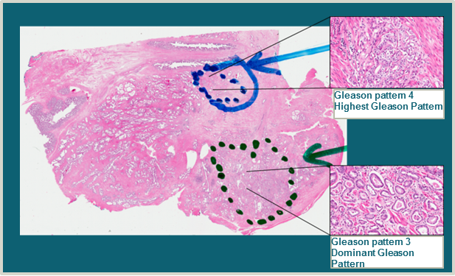
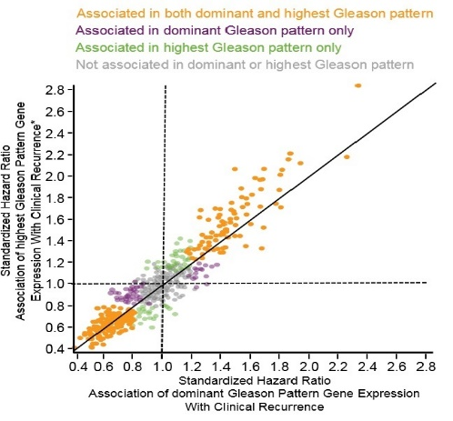
GPS Is Based on Genes Relevant to Prostate Cancer
Development Studies
Development Studies
(n = 712)
The expression of 727 cancer-specific genes was quantified in tissue from the dominant and highest Gleason patterns in prostatectomy specimens
Only genes predictive of clinical recurrence in both specimens were selected for further development in biopsy specimens
Validation Studies
Clinical Utility
Study 1 (n = 158)
Study 2 (n = 211)
Clinical Utility Studies
Validation
Studies
Clinical Practice
Experience
Knezevic et al. BMC Genomics. 2013; Klein et al. Eur Urol. 2014.
Notes:
Key Messages
Genes were selected from multiple relevant pathways in prostate cancer (PCa) for performance in biopsies and prediction of adverse pathology, biochemical recurrence, clinical metastasis, and cancer-specific survival.
The combination of multiple pathways is more predictive than any single pathway.
Speaker Notes
The initial development study assessed expression of 727 cancer-related genes in prostatectomy specimens from the Cleveland Clinic. Men who developed clinical recurrence (distant metastasis or local recurrence) were included in the dataset along with men who did not; differential gene expression was independently assessed in two distinct areas of each prostate specimen; the highest Gleason grade present and the dominant (most common) Gleason grade present. If only a single Gleason grade was present, two spatially distinct specimens were obtained. The purpose of this extra step was to identify genes that were reliably modulated in both areas of tumor in an effort to address issues of heterogeneity and multifocality.
Transition Note
Consider a slide transition along the lines of “Once genes relevant to outcomes were determined, it was essential to confirm that the RNA could be extracted from prostate biopsy cores. The second development study was designed to identify relevant genes that were predictive of meaningful endpoints (ie, adverse pathology) and expressed RNA which could be recovered from needle biopsy cores.”
Reference
1. Knezevic D, Goddard AD, Natraj N, et al. Analytical validation of the Oncotype DX prostate cancer assay—a clinical RT-PCR assay optimized for prostate needle biopsies. BMC Genomics. 2013;14:690.
More Information
Please see the following APPENDIX slides for more information about the development studies:
GPS Specifically Designed to Work in Biopsy Tissue
Gene Expression in Both Primary and Highest Gleason Score
More detailed information about the biologic pathways and genes:
Androgen Pathway
AZGP1, KLK2, SRD5A2, FAM13C
Androgen receptor signaling is critically important for the growth and maintenance of the normal prostate gland as well as development of prostate cancers (PCa). More aggressive tumors show downregulation of genes in the androgen signaling pathway. Higher expression of the androgen signaling genes is thus associated with less aggressive PCa biology.
Cellular Organization
FLNC, GSN, TPM2, GSTM2
Members of the cellular organization gene group are critical in maintenance of cellular structural integrity, including normal cell shape and cell-cell adhesion. Low expression of these genes is indicative of impaired tissue integrity, de-differentiation, and greater metastatic potential.
Stromal Response
BGN, COL1A1, SFRP4
Tissue stroma provides a supportive framework for normal epithelium and becomes activated in the setting of wound healing and organ regeneration. This pathway is often co-opted by tumors to provide structure and growth factors to support tumor growth and metastasis,¹ and thus activation of stromal response is associated with poor prognosis in several tumors, including prostate.
Proliferation
TPX2
The expression of this group is indicative of how fast tumor cells divide. High expression of this group is found in rapidly growing and more aggressive PCa.
The assay requirements and analytical performance provide physicians with test results from a robust and reliable assay.

Slide 13
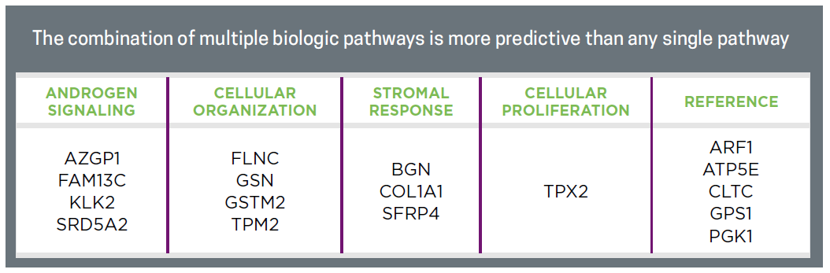
Incorporating multiple genomic pathways important in prostate cancer

Slide 14


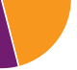
The Key Question to Drive Treatment Selection:
Active Surveillance or Intervention
Favorable Pathology @ RP
Organ Confined
Gleason 3+3 OR Gleason 3+4
`
?
70-80%
Does my patient have occult high risk
disease?
Key Decision Point
Likelihood of Adverse Pathology
is pivotal in risk stratification & initial management selection
5-Year
BCR
15-Year
PCSM
10-Year
Mets
Post RP
20-30%
Adverse Pathology @ RP
Gleason ≥4+3 and/or ≥pT3
Progression-free
Survival (Time 0)
Biochemical Recurrence
(5 years)
Metastasis
(10 years)
Prostate Cancer–specific Mortality (15 years)
Epstein JI et al. Eur Urol. http://dx.doi.org/10.1016/j.eururo.2015.06.046; Eggener SE et al. J Urol. 2011; Dinh KT et al. J Urol. 2015; Cooperberg MR et al. Cancer. 2011; nTilki D et al. J Urol. 2015.
Notes:
Key Messages
Approximately 70%-80% of men who have favorable pathology on initial biopsy will have favorable pathology on RP, in contemporary series. Favorable pathology on biopsy in the setting of clinically low-risk disease is in most cases predictive of favorable pathology on radical prostatectomy (RP). However, between 20%-30% of men who are clinically low risk on biopsy will harbor occult adverse pathology (AP) features on surgical pathology after RP. AP is a critical determinant of long-term prognosis.
Because the men who have AP at surgery are the ones at greatest risk of disease progression, accurately determining which patients are at high risk of having AP at surgery (and hence benefit from immediate treatment) should be determined BEFORE surgery. Similarly, men who are at low risk for AP and have favorable disease are the best candidates to defer treatment and consider active surveillance.
A genomic test can provide the actionable information about who is at risk for AP.
Speaker Notes
How do we most accurately answer these questions: “How bad is my cancer?” and “What are my treatment options?”
Gleason score on surgical pathology is the best indicator of long-term prognosis in men with prostate cancer (PCa). Existing metrics to predict surgical pathology (prostate-specific antigen [PSA], biopsy Gleason score, age, clinical stage, etc) are helpful but limited in their ability to accurately predict surgical pathology. In cases where these parameters suggest high risk, there is minimal controversy about whether treatment is indicated. Much of the contemporary controversy about PCa detection and treatment is centered on patients who are clinically low risk based on existing metrics. Many of these men will do well with Active Surveillance; however, a small but important percentage may be under-sampled due to limitations of current imaging and biopsy techniques. A way to predict which patients have AP will help inform management discussions and facilitate optimal patient management.
[builds]
Approximately 70%-80% of men who have favorable pathology on initial biopsy will have favorable pathology on RP. However, between 20%-30% of men who are clinically low risk harbor occult AP features on surgical pathology after RP. AP (defined here as Gleason >4+3 and/or pT3+) at the time of surgery is a critical determinant of long-term prognosis.
Over time, few men with favorable pathology on prostatectomy specimens progress to biochemical recurrence, metastasis, and prostate cancer–specific mortality. Men with adverse surgical pathology are likely to have significantly worse outcomes over time; they are more likely to progress to biochemical recurrence (BCR), metastases, and death. Because the men who have AP at surgery are the ones at greatest risk of disease progression, accurately determining which patients have AP (and hence benefit from immediate treatment) should be determined BEFORE surgery.
What is needed is a tool that can predict the likelihood of favorable pathology and provide both physicians and patients with the confidence that they have made the appropriate management decision. The GPS was designed to provide this actionable information.
How the pie chart proportions were generated
The estimates for rate of adverse versus favorable pathology have been gleaned from a variety of studies including Epstein, Eggener, and Dinh.¹⁻³ There is obvious variability in rate of pathologic upgrading in different patient populations but this range is broadly reflective of current trends.
The estimates for rates of biochemical recurrence, metastasis, and death from PCa are composites from Epstein (BCR within 5 years),¹ Cooperberg and Tilki (metastasis within 10 years),^{4,5} and Eggener (prostate cancer–specific mortality within 15 years),² respectively. In the raw data, the rate of metastasis at 10 years (reported by Cooperberg⁴ and Tilki⁵) was somewhat lower than the rate of death at 15 years reported by Eggener.² This led to some formatting issues with the way the data would be presented so the metastasis slice of pie is a bit higher than Tilki and Cooperberg reported but within an approximate range.
Because AP as defined in the Oncotype DX® test comprises a wide range of aggressiveness (Gleason 4+3 to Gleason 5+5 and pT3a to pT4), the percentage estimates are derived from averaging between prognostic groups. Compared with the percentages depicted here, the rate of BCR/mets/death is lower in men with Gleason 4+3 and higher in men with Gleason 8-10, but to keep the slide simple all these groups were collapsed together.
The pie chart depicting the Favorable Pathology group includes men ranging from low volume Gleason 3+3=6 to men with higher volume but organ-confined Gleason 3+4=7 disease. Hence, the ranges depicted here are also a composite of a variety of percentage estimates which were collapsed together. The difference in rate of various adverse events is obviously lower in this group compared with the AP group because outcomes are generally similar for organ-confined Gleason 3+3 and organ-confined Gleason 3+4.
The outcomes data is an approximation based on multiple sources.
Transition Note
On the next slide, we discuss the Oncotype DX® family of tests, which have been developed and widely utilized to help patients facing cancer make more informed and personalized decisions. Consider a transition statement along the lines of “We need better tools to help patients determine their likelihood of prostate cancer that merits immediate action (ie, cancer with adverse pathological features).”
References
1. Epstein JI, Zelefsky MJ, Sjoberg DD, et al. A contemporary prostate cancer grading system: a validated alternative to the Gleason score. Eur Urol. http://dx.doi.org/10.1016/j.eururo.2015.06.046.
2. Eggener SE, Scardino PT, Walsh PC, et al. Predicting fifteen-year cancer-specific mortality based on the pathological features of prostate cancer. J Urol. 2011;185:869-875.
3. Dinh KT, Mahal BA, Ziehr DR, et al. Incidence and Predictors of Upgrading and Up Staging among 10,000 contemporary patients with low risk prostate cancer. J Urol. 2015;194:343-349.
4. Cooperberg MR, Hilton JF, Carroll PR. The CAPRA-S score: a straightforward tool for improved prediction of outcomes after radical prostatectomy. Cancer. 2011;117:5039-5046.
5. Tilki D, Mandel P, Schlomm T, et al. External validation of the CAPRA-S score to predict biochemical recurrence, metastasis and mortality after radical prostatectomy in a European cohort. J Urol. 2015;193:1970-1975.

Slide 15
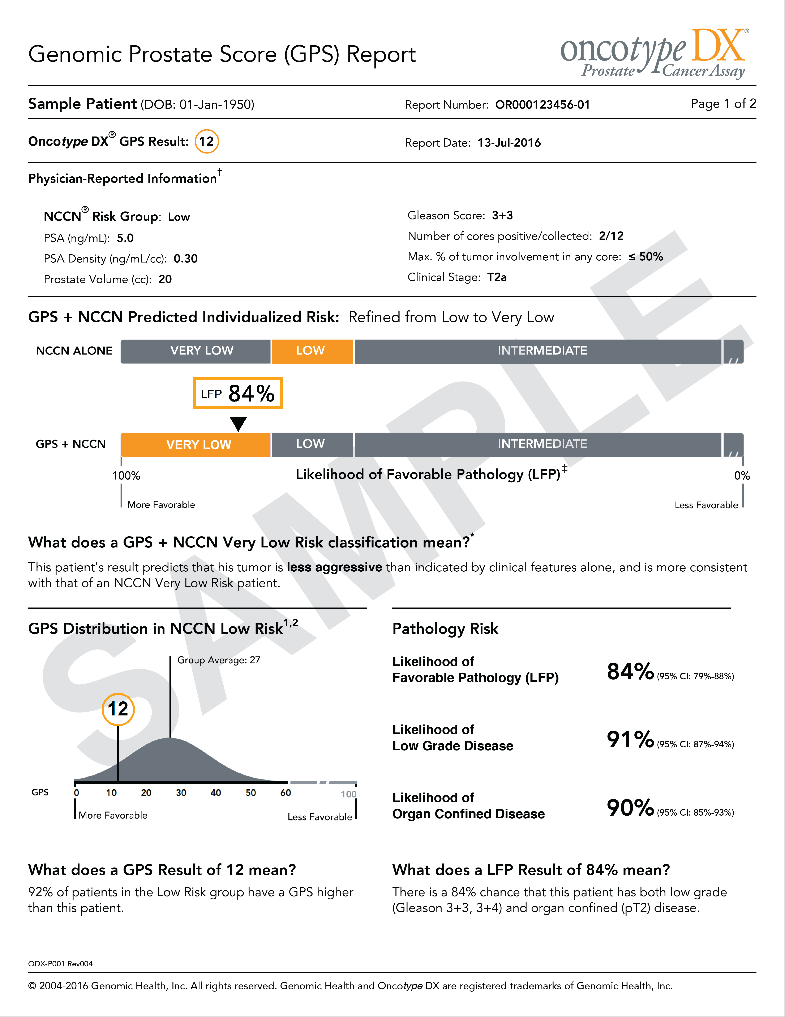
The Oncotype DX® Genomic Prostate Score™
WHY
do the test?
  To improve risk stratification and treatment decisions by incorporating underlying tumor biology
Men with clinically localized disease may consider use of a tumor-based molecular assay. Retrospective case cohort studies have shown that molecular assays…provide prognostic information independent of NCCN risk groups.
NCCN 2016 Prostate Cancer
Clinical Practice Guidelines v2*
6.0
WHAT
is the test?
  A gene expression assay that produces a Genomic Prostate Score (GPS) to help guide initial treatment decisions at the time of biopsy
WHO
is the
test for?
  Men with clinically low-risk and favorable intermediate disease (Gleason score 3+3 & 3+4)
HOW
are the test
results
reported?
  Adverse Pathology: Presence of aggressive prostate cancer
  Risk of mortality
  Risk of metastasis
*NCCN Clinical Practice Guidelines in Oncology®, Prostate Cancer v2.2016, page 7, footnote b.
© National Comprehensive Cancer Network, 2016
NCCN is a registered trademark of the National Comprehensive Cancer Network, which does not endorse any product or therapy.
Notes:
Key Messages
Oncotype DX® is biopsy-based genomic assay is designed to provide additional information on the biology of the tumor at the time of biopsy, when important management decisions need to be made.
Oncotype DX uses prostate tumor tissue from a needle biopsy to measure the activity of genes that regulate four SPECIFIC cellular pathways that are known to be associated with prostate cancer biology, and is designed to provide additional information on the biology of the tumor at the time of biopsy.
Oncotype DX was designed and is intended for men newly diagnosed with low- to low-intermediate risk prostate cancer.
The Oncotype DX GPS, in conjunction with NCCN risk group, provides a percentage estimate representing the Likelihood of Favorable Pathology, defined as the freedom from high-grade (primary pattern 4 or any pattern 5) and/or non-organ-confined disease (pT3 or higher) on surgical pathology.
Speaker Notes
WHY DO THE TEST? The Oncotype DX test provides a personalized and nuanced assessment of tumor activity that can help predict adverse pathology and thus inform management recommendations. This biopsy-based genomic assay is designed to provide additional information on the biology of the tumor at the time of biopsy, when important management decisions need to be made.
[build]
WHAT IS THE TEST? Oncotype DX uses prostate tumor tissue from a needle biopsy to measure the activity of genes that regulate four SPECIFIC cellular pathways that are known to be associated with prostate cancer biology. This gene expression information is used to calculate a Genomic Prostate Score (GPS). The GPS provides important information on the biology of a patient’s cancer and its propensity to have aggressive features; this information can be used in conjunction with other clinical parameters to guide management decisions.
[build]
WHO IS THE TEST APPROPRIATE FOR? Oncotype DX was designed and is intended for men newly diagnosed with low- to low-intermediate risk prostate cancer. Oncotype DX was designed to answer a SPECIFIC question in a PRECISELY defined target population…this “fit for purpose” approach enhances the ability to provide clinically meaningful information for men with clinically low-risk cancer. The NCCN 2015 Prostate Cancer Clinical Practice Guidelines recognizes the role of Oncotype DX in the initial clinical assessment of prostate cancer: “Men with clinically localized disease could consider use of a tumor-based molecular assay to stratify better risk of adverse pathology at radical prostatectomy or chance of biochemical recurrence or disease-specific mortality after radical prostatectomy.”
[build]
HOW ARE THE RESULTS REPORTED? The Oncotype DX GPS, in conjunction with NCCN risk group, provides a percentage estimate representing the Likelihood of Favorable Pathology, defined as the freedom from high-grade (primary pattern 4 or any pattern 5) and/or non-organ-confined disease (pT3 or higher) on surgical pathology.
Transition Note
On the next slide, we discuss the aspects of Oncotype DX that make it superior to the competitors’ text. Consider a transition question along the lines of “So why should you use Oncotype DX instead of one of the competing molecular assays?”

Slide 16
What Makes Oncotype DX® Different?
Relevant
Developed specifically for men with clinically low-risk prostate cancer
Validated in contemporary cohorts
Comprehensive
727 prostate cancer–related genes were screened
12 genes from 4 unique molecular pathways selected for the final assay
Synthesis of 4 pathways was more predictive than any single pathway
Actionable
Refines estimate of Likelihood of Adverse Pathology at surgery and long term outcomes (i.e. Metastasis and Death)
Klein et al. Eur Urol. 2014; Cullen et al. Eur Urol. 2015.
Notes:
Key Messages
Oncotype DX® is unique in that it was custom built from scratch to address the need of patients with clinically low-risk prostate cancer for additional prognostic information that can be used to inform management decisions.
Oncotype DX is RELEVANT because it was developed in contemporary cohort of men with clinically low-risk prostate cancer, most of whom were diagnosed with cancer based on PSA screening. This focus on a narrow population allowed for better customization of the assay to the specific needs of this population.
Oncotype DX is COMPREHENSIVE because it assesses 4 gene pathways (androgen receptor, stromal response, cellular organization, and proliferation) that are known to be relevant specifically to prostate cancer.
Oncotype DX is ACTIONABLE because it refines estimation of likelihood of favorable pathology, an immediately relevant endpoint that is highly prognostic .
Speaker Notes
Oncotype DX is unique in that it was custom built from scratch to address the need of patients with clinically low-risk prostate cancer for additional prognostic information that can be used to inform management decisions.
Oncotype DX is RELEVANT because it was developed in contemporary cohort of men with clinically low-risk prostate cancer, most of whom were diagnosed with cancer based on PSA screening. This focus on a narrow population allowed for better customization of the assay to the specific needs of this population; it is not meant to be a “one size fits all” prostate cancer assay. Because long term outcomes in this population are generally favorable, this population is faced with the difficult decision of treatment versus Active Surveillance. Oncotype DX® provides information that helps men better estimate their risks of long-term morbidity/mortality from prostate cancer.
The Prolaris® assay was initially reported on a cohort of men diagnosed largely by TURP and managed by Watchful Waiting in the United Kingdom.¹ A follow-up validation study for the endpoint of metastatic disease was conducted to prove that a cell-cycle progression (CCP; the actual result of the Prolaris test) could be calculated on biopsy tissue; interestingly, in the first phase of this research project, 48% of the biopsy tissues utilized were “simulated” biopsies, created by sampling a needle core of paraffin-embedded prostatectomy tissue and subjecting that needle core to the Prolaris assay…hence 48% of the tissues used in this analysis were not actual TRUS-guided prostate biopsy tissue.²
Furthermore, although the Prolaris test has been validated as a significant predictor of outcomes in high-risk patients, in two separate multivariable analyses the prognostic performance of the test did not meet criteria for statistical significance for men with Gleason 3+3=6, PSA <4 ng/mL,^{3,4} CAPRA scores 2-7 of 10,⁴ and Gleason 7 cancer.³ The predicted hazard ratio in all of these cases was > 1 so there is evidence of some efficacy, but the wide confidence intervals imply that the test is not robust at the lower ends of prostate cancer risk.
Oncotype DX is COMPREHENSIVE because it assesses 4 gene pathways (androgen receptor, stromal response, cellular organization, and proliferation) that are known to be relevant specifically to prostate cancer. In the development/validation studies, it was determined that the combination of 4 separate pathways was a more accurate predictor than any single pathway.
The single genomic pathway assessed by Prolaris incorporates 31 cancer -related genes, all of which deal with cell cycle progression. As intimated on prior slides, CCP is an important determinant of cancer behavior but the performance of this single pathway in low-risk cancer is less robust. Furthermore, a single pathway approach neglects the importance other cancer-specific pathways in prostate cancer, specifically androgen signaling., a key pathway with which urologists are very familiar as a determinant of prostate cancer biology.
Oncotype DX is ACTIONABLE because it refines estimation of likelihood of favorable pathology, an immediately relevant endpoint that is highly prognostic.^{5,6} Oncotype DX was also validated for prognostication of biochemical recurrence in the second validation study.⁶ The longer term outcomes, including metastasis and death, are clearly relevant but the rate of each of these is so low in clinically low-risk patients that the absolute changes in risk estimates obtained in the majority of patients assessed with Prolaris are quite low—a few percentage-point change in likelihood of prostate cancer–specific mortality at 10 years is less immediately relevant to a patient confronting the choice of immediate treatment versus Active Surveillance.
More Information
There is marked confusion in the urology community about genomic testing. Many practicing urologists have difficulty distinguishing between assays due to the newness of the technology and similar trade names. [A table listing the various genomic and related assays for prostate cancer is included in the APPENDIX slides.]
Prolaris (Myriad, Salt Lake City, UT) and Promark (Metamark, Cambridge, MA) are the only other assays that are specifically indicated in patients who are making initial treatment decisions for prostate cancer. The Prolaris assay is a 46-gene PCR-based test that assesses 31 genes relevant to cell cycle progression. Prolaris is the same 46-gene assay used by Myriad for prognostication in lung cancer.⁷; it was not custom built with clinically low-risk prostate cancer in mind. It was validated for prognostication of death from prostate cancer and designed to be broadly inclusive of all prostate cancer patients, before or after radical prostatectomy. Of note, the test was initially validated in a cohort of patients managed by Watchful Waiting in the UK, some of whom were diagnosed with prostate cancer at TURP.¹
The Promark test is a proteomic assay that assesses the 8 protein molecules identified in prostate biopsy specimens. It is validated for prognostication of adverse pathology (defined similar to the Oncotype DX assay) in men with clinically low-risk prostate cancer. The Promark test is a newcomer to the market and has relatively few publications at this time.
Transition Note
On the next slide, we discuss how the Oncotype DX was developed to be a superior diagnostic test to help guide treatment decisions in clinically low-risk prostate cancer. Consider a transition along the lines of “On the next slide, we’ll discuss how this relevant, comprehensive, and actionable test was developed.”
References
1. Cuzick J, Swanson GP, Fisher G, et al. Prognostic value of an RNA expression signature derived from cell cycle proliferation genes in patients with prostate cancer: a retrospective study. Lancet Oncol. 2011;12:245-255.
2. (Bishoff 2014)
3. Cuzick J, Berney DM, Fisher G, et al. Prognostic value of a cell cycle progression signature for prostate cancer death in a conservatively managed needle biopsy cohort. Br J Cancer. 2012;106:1095-1099.
4. Cuzick J, Stone S, Fisher G, et al. Validation of an RNA cell cycle progression score for predicting death from prostate cancer in a conservatively managed needle biopsy cohort. Br J Cancer. 2015;113:382-389.
5. Klein EA, Cooperberg MR, Magi-Galluzzi C, et al. A 17-gene assay to predict prostate cancer aggressiveness in the context of Gleason grade heterogeneity, tumor multifocality, and biopsy undersampling. Eur Urol. 2014;66:550-560.
6. Cullen J, Rosner IL, Brand TC, et al. A biopsy-based 17-gene Genomic Prostate Score predicts recurrence after radical prostatectomy and adverse surgical pathology in a racially diverse population of men with clinically low- and intermediate-risk prostate cancer. Eur Urol. 2015;68:123-131.
7. Wistuba II, Bherens C, Lombardi F, et al. Validation of a proliferation-based expression signature as prognostic marker in early stage lung adenocarcinoma. Clin Cancer Res. 2013;19:6261-6271.

Slide 17
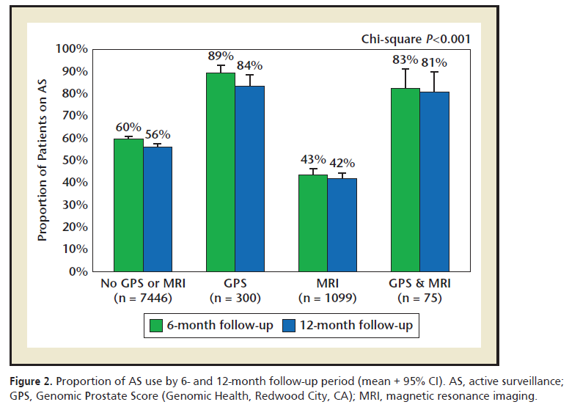
Raising the Bar for Patients’ Standard of Care
Canfield et al. Rev Urol. 2018
Largest clinical utility study of a genomic test in prostate cancer to date with nearly 9,000 patients assessed
30% growth in Active Surveillance among GPS tested compared to untested and MRI
>90% persistence on AS at 1 year
GPS tested AS was strong across each year of assessment (2013, 2014, 2015, 2016)
Eure et al. revealed 89% persistence on AS at one year

Slide 18
Raising the Bar for Patients’ Standard of Care
Publication | Sample Size |  | Active Surveillance, %
 | Baseline (Non-GPS tested) | GPS tested | Baseline (Non-GPS tested) | GPS tested | Absolute difference
Dall’Era et al. Urology Practice. 2015 | 68 | 85 | 49% | 76% | +27%
Albala et al. Rev Urology. 2016 | 71 | 51 | 38% | 59% | +21%
Eure et al. Urology. 2017 | 167 | 179 | 50% | 79% | +29%
Canfield et al. Rev Urology. 2018 | 7,746 | 375 | 60% | 89% | +29%
Studied in nearly 9,000 low risk patients across the U.S.
Consistently confirms increased use of AS in patients who may have otherwise chosen immediate treatment
OncotypeDX GPS builds the largest amount of real-world clinical utility data in the industry

Slide 19
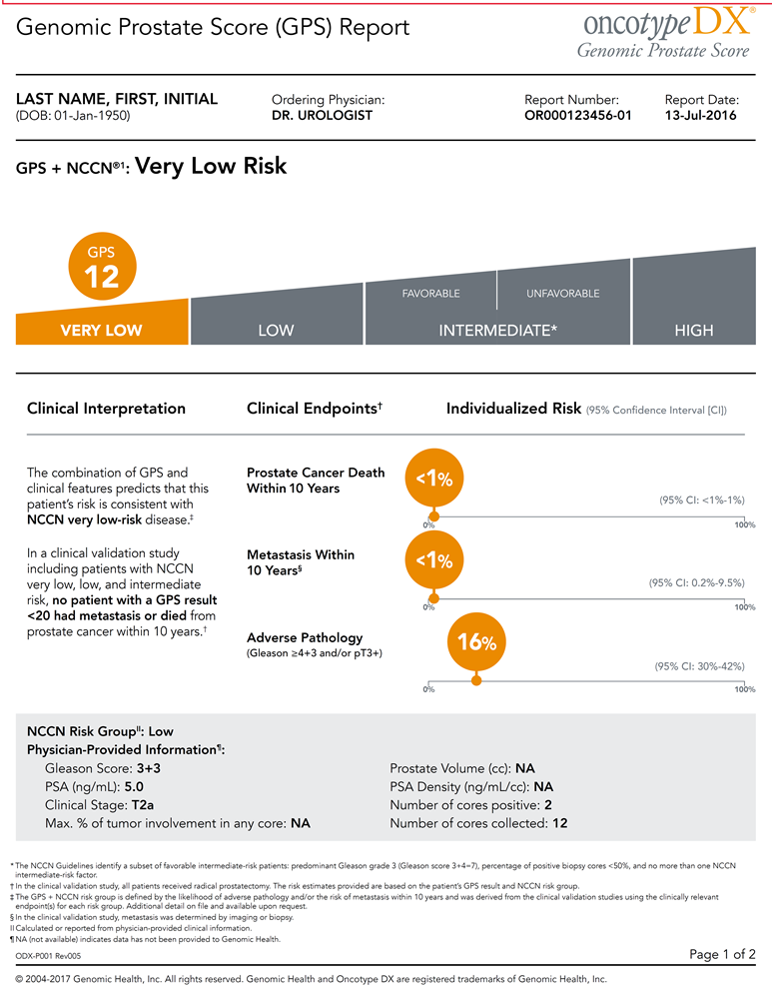
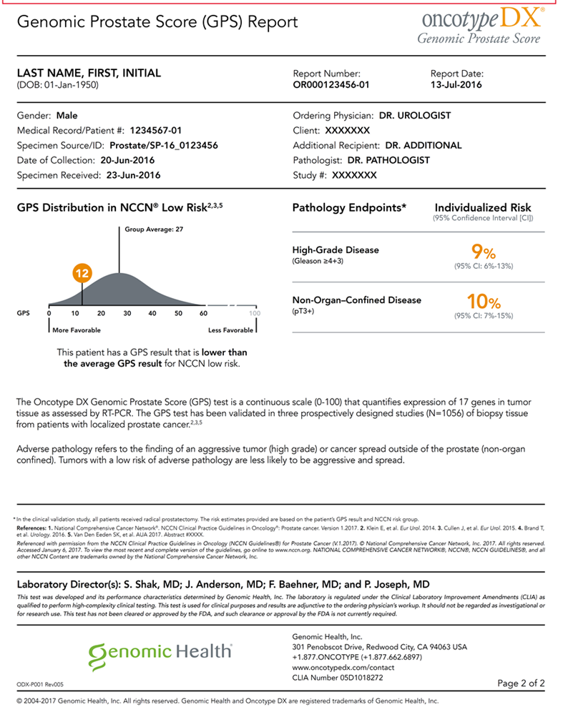
The Oncotype DX GPS report
Topline results integrate GPS and Clinical variables into a single composite risk estimate
Comparison of individual GPS result versus other men with similar clinical risk
Risk for specific outcomes clearly articulated on a slider bar
Estimates for specific pathological features supplied to the side
Baseline clinical data highlighted for ease of reference during discussion with patient
Confidential

Slide 20


Resources for Patients
MyProstateCancerCoach for any newly diagnosed patient
  Prostate cancer 101 information
  Personalized treatment guide
  Caregiver tips and advice
  https://www.myprostatecancercoach.org
MyCancerCoach app for on-the-go Coach resources and tools (on Google Play & Apple stores)
  Calendar
  Personal journal (for audio & video record keeping)
  Questions to Ask Your Doctor
MyProstateCancerTreatment for patients seeking information on genomics
and personalizing cancer treatment
  Doctor discussion guide
  Patient videos and personal stories
  Eligibility quiz and insurance coverage information
  https://www.myprostatecancertreatment.org

Slide 21

Genomic Access Program (GAP) for patients
GHI believes that everyone should have access to the information they need for their cancer treatments
GAP helps eligible patients navigate insurance and other payment options and offers financial assistance for patients with financial hardship
Our team helps patients
  Work with their physician to get prior authorization from your insurance company (if required).
  Process the claim once the test is complete.
  Assist in the appeal process if a claim is denied.
Contact: 888-ONCOTYPE (888-662-6897) or customerservice@genomichealth.com
Visit www.oncotypedxgps.com for more information

Slide 22
Thank you

