Slide 1
Genomic Testing: When and Why?
Rob Finch, MS, CGC
Certified Genetic Counselor
Medical Science Liaison
Myriad Genetic Laboratories

Slide 2
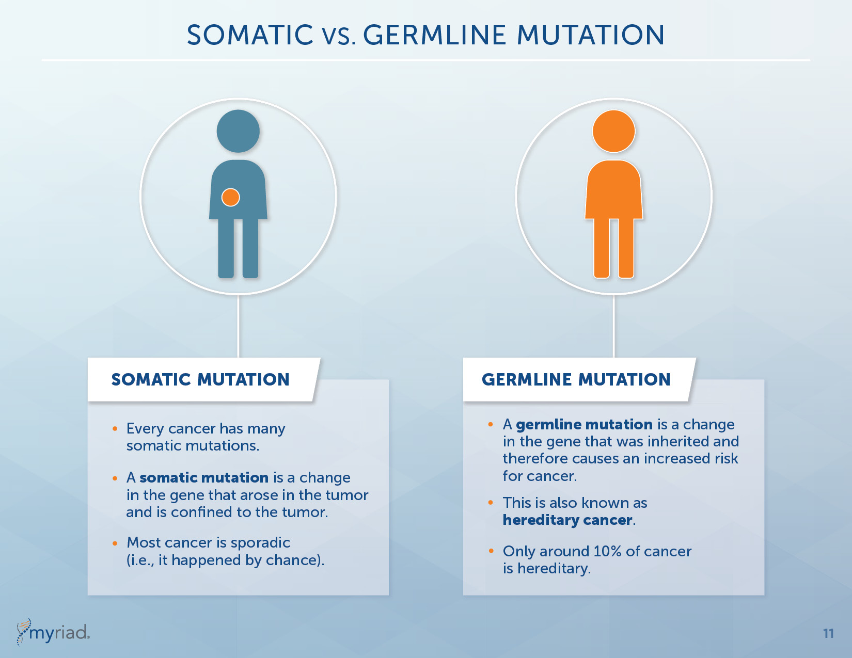
Somatic vs. Germline Mutation

Slide 3
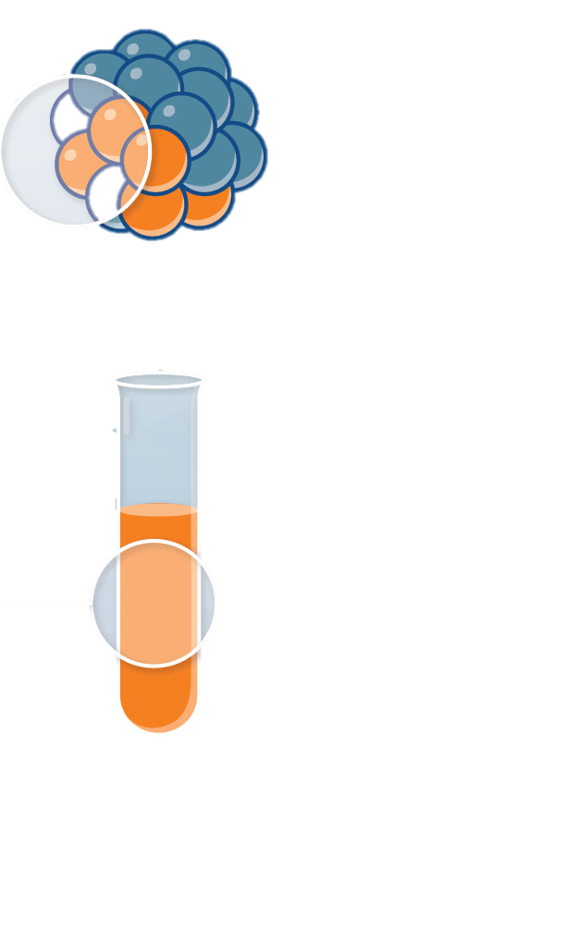
Tumor Testing vs. Germline Testing
Tumor testing can help guide treatment options
Tumor Biopsy
Germline testing (blood or buccal) can help determine if a mutation was inherited and help guide treatment and risk management options for patient and family members
Blood Test

Slide 4


Slide 5
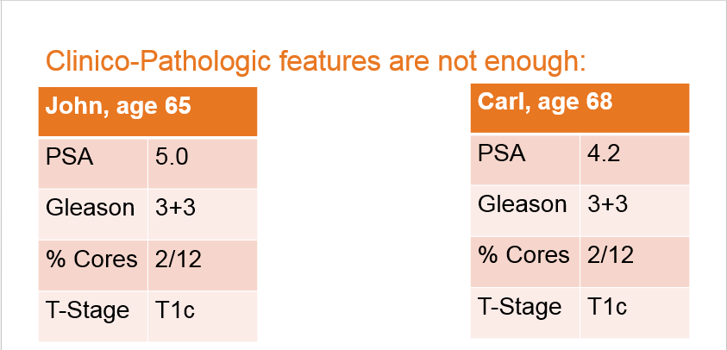
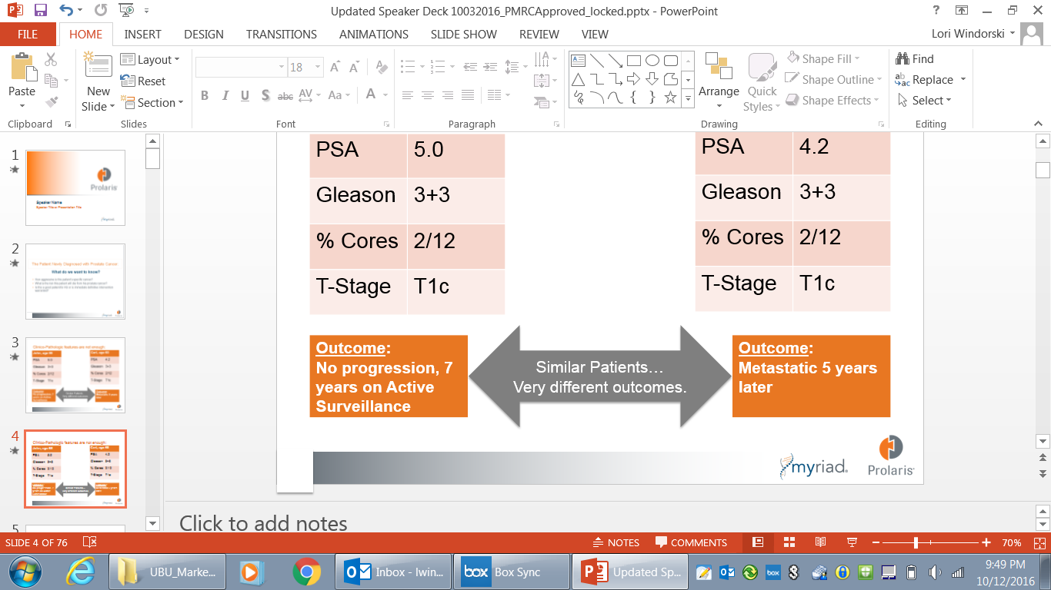

Slide 6
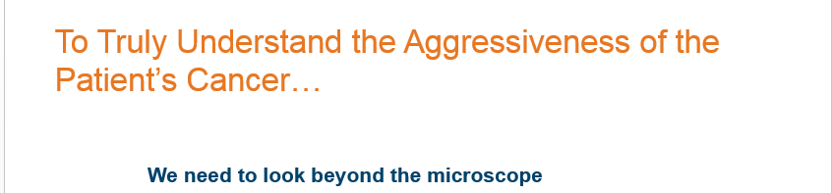




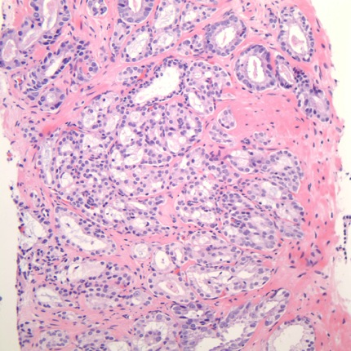








We need to look beyond the microscope
Cell prepares
to divide
Cell division
(mitosis)
G2
M
Cycle
begins
Replication
of DNA
G1
S
R
Cell grows
Cell decides
whether to continue
Image reproduced with permission of Kirk J. Wojno, M.D.
Further reproduction prohibited without permission

Slide 7

Adding Prolaris More than Doubles the Amount of Predictive Information Provided by PSA and Gleason
PSA
(p<1.5x10⁻⁴)
Gleason
(p<2.1x10⁻⁷)
CCP
(p<3.7x10⁻¹⁵)
Prediction of Prostate Cancer Death
Cuzick J, et. al. Br J Cancer 2012; 13(6):1095-9; Cuzick J, et. al. Br J Cancer 2015; 113(3):382-9

Slide 8
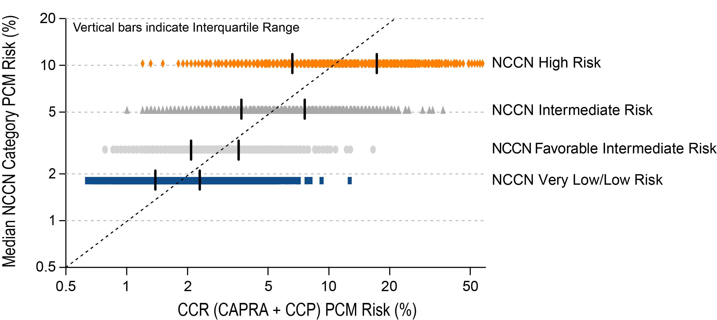
Prolaris Adds Precision to Risk Assessment
(Prolaris result)

Slide 9
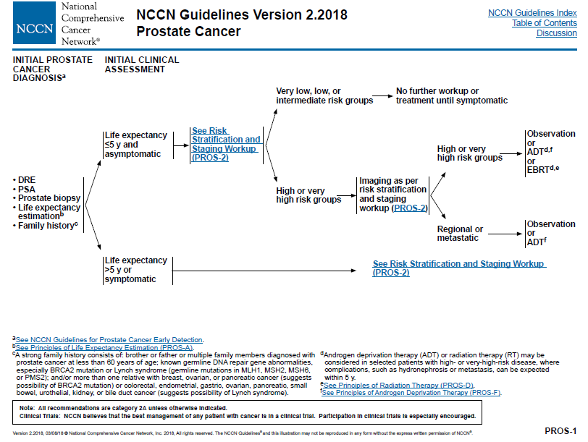
Updated NCCN Guidelines
¹National Comprehensive Cancer Network. (2017 February, Version 2.2017), retrieved June 2017 from: http://www.nccn.org.

Slide 10
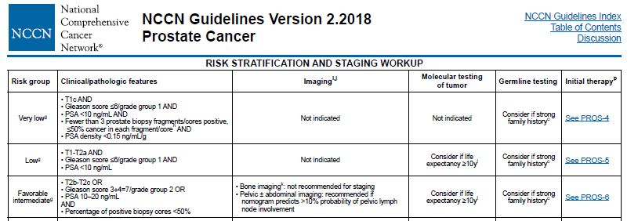
Updated NCCN Guidelines
NCCN Category 2A recommendation
National Comprehensive Cancer Network. Prostate Cancer Guidelines v2.2018, retrieved February 2018 from: http://www.nccn.org.

Slide 11
Conclusions
CCP score (Prolaris) has been extensively validated and shown to be associated with aggressive disease in diverse patient cohorts and clinical settings, and across all risk groups.
  Better risk discrimination means better clinical management for patients
Prolaris is part of NCCN guidelines as an important tool to add risk discrimination in newly diagnosed prostate cancer.
Genomic testing should be available to patients to help better refine their risk levels.

