Slide 1
Active Surveillance for Low Risk
Prostate Cancer
Michael A. Gorin, M.D.
Assistant Professor of Urology, Oncology, and Radiology
Johns Hopkins University School of Medicine

Slide 2
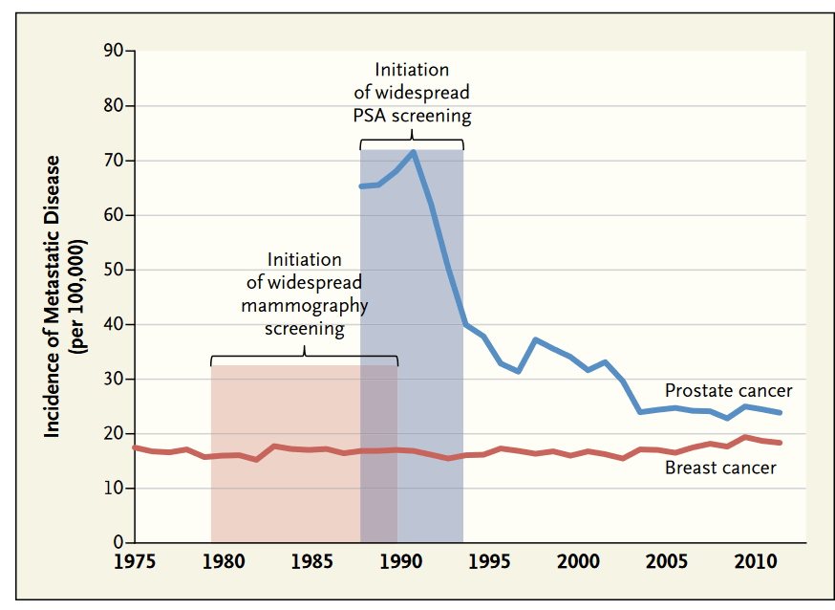
Benefits of PSA Screening
Welch et al., NEJM. 2015; 373: 1685.

Slide 3
PSA Screening in the USA
30 million
PSA Screenings
1.5 million
Abnormal PSA Test Results
1,000,000
Prostate Biopsy Procedures
250,000
Diagnosed with Prostate Cancer
30,000
Prostate Cancer Deaths
~750,000
Negative Biopsy Procedures
Shoag et al. J Urol. 2016; 196: 1047.

Slide 4
PSA Screening in the USA
30 million
PSA Screenings
1.5 million
Abnormal PSA Test Results
1,000,000
Prostate Biopsy Procedures
250,000
Diagnosed with Prostate Cancer
30,000
Prostate Cancer Deaths
5% Infectious
Complication Rate
~750,000
Negative Biopsy Procedures
Shoag et al. J Urol. 2016; 196: 1047.

Slide 5
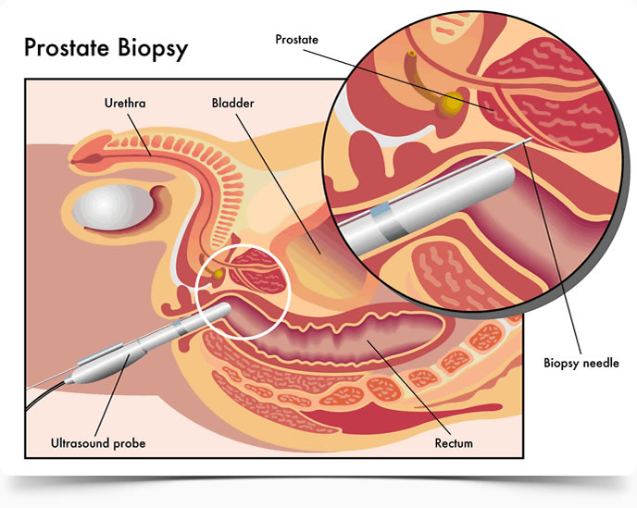

Slide 6
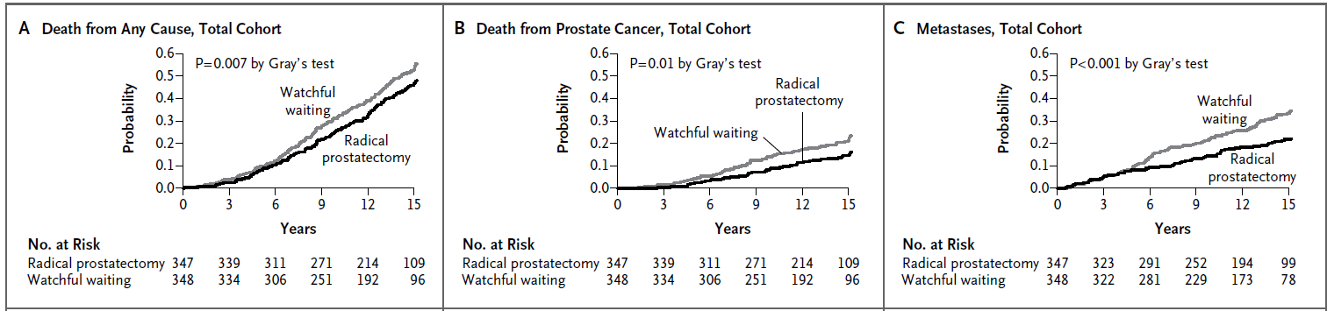
Treatment Saves Lives – Data from SPCG-4
Bill-Axelson et al. NEJM 2011; 364: 1708.

Slide 7
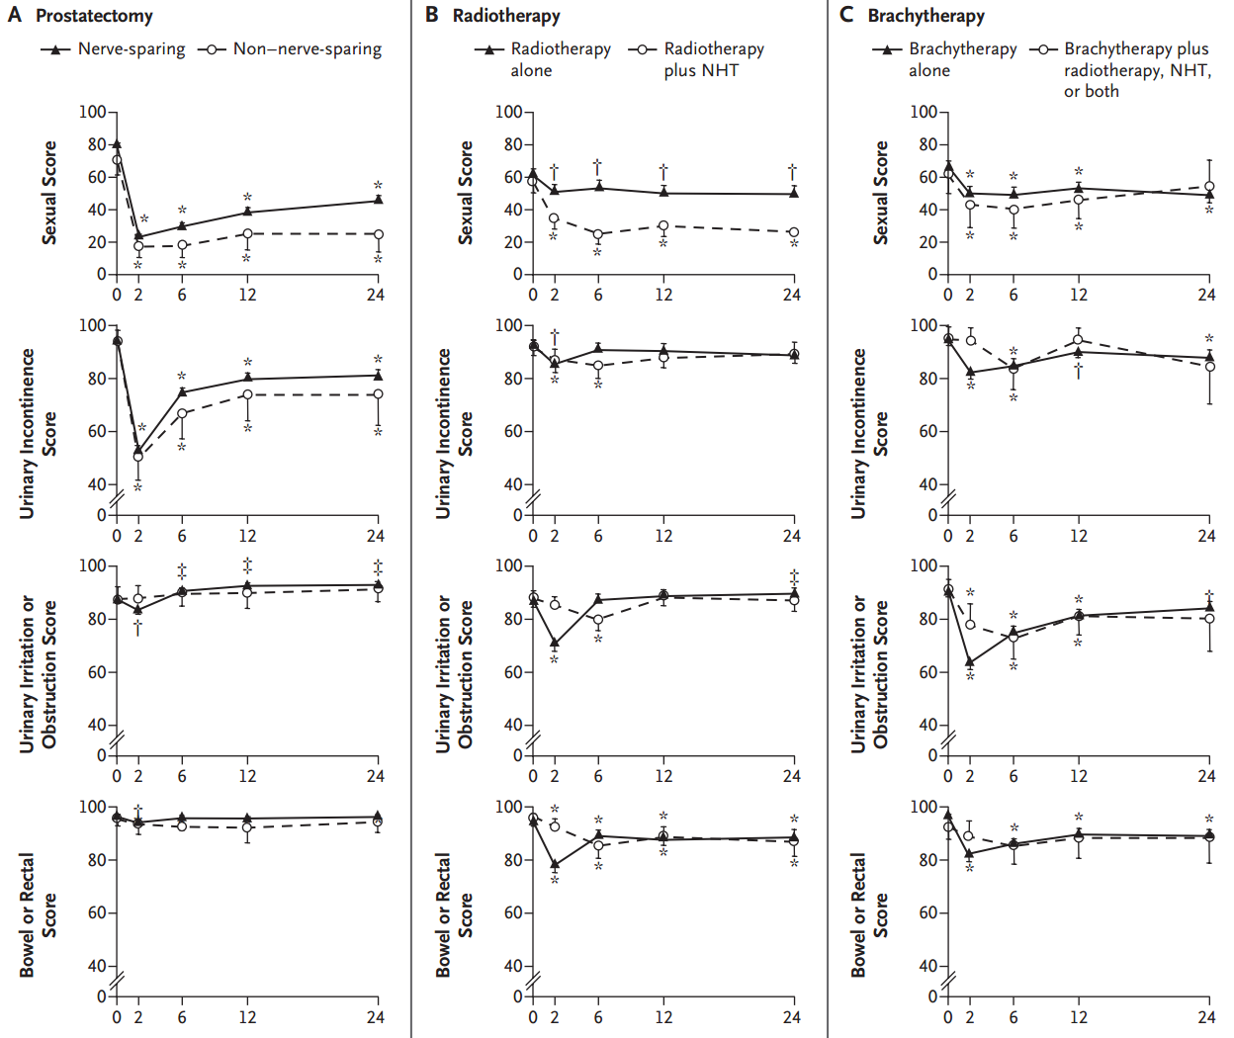
But….Treatment Comes at a Cost
Sanda et al. NEJM 2008; 358: 1250.

Slide 8
USPSTF: Discourage Use of PSA Testing for All Men
Grade D Rating
Harm = Moderate to Substantial
Benefit = Small to
Moderate
Harms of False Positive Tests
Reduction in PCa Death
Cost of False Positive Tests
Harms of Treatment
Notes:
A public health perspective
Independent panel of non-Federal experts in prevention and evidence-based medicine; Conduct scientific evidence reviews of preventive health care services and develop recommendations for PCP’s and health systems; for the USPSTF to recommend a service, the benefits of the service must outweigh the harms

Slide 9
Harms of treatment are addressed with the advent of active surveillance.

Slide 10
Active Surveillance: A strategy to treat only if and when a man’s prostate cancer warrants treatment.

Slide 11
Selecting the Correct Patients for AS:
The Epstein Criteria
Clinical Stage T1c
PSA <10 ng/mL
PSA Density <0.15 ng/mL/gm
Gleason 6 in ≤2 cores with ≤50 involvement
Tosoian et al., JCO. 2015; 33: 3379.

Slide 12
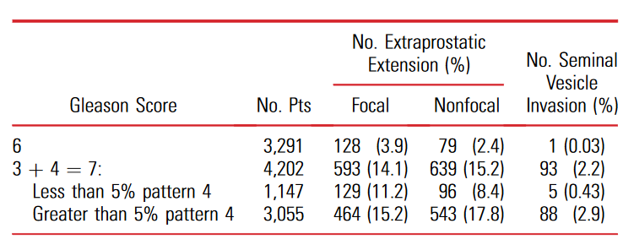
Why Treatment Can Be Deferred for Gleason 6
Prostate Cancer
Of over 14,000 totally embedded radical prostatectomies from multiple institutions, there was not a single case of a Gleason 6 tumor with lymph node metastases.
Hassan et al., J Urol 2018 199: 1482.
Ross et al., Am J Surg Pathol 2012 36: 1346.

Slide 13
JHU Active Surveillance Algorithm

Slide 14
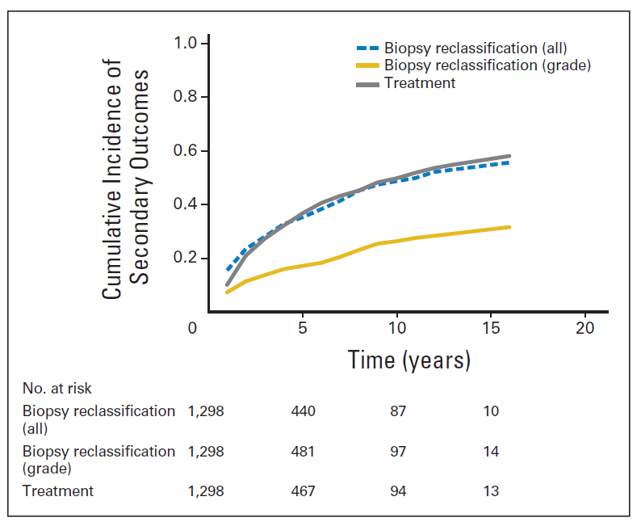
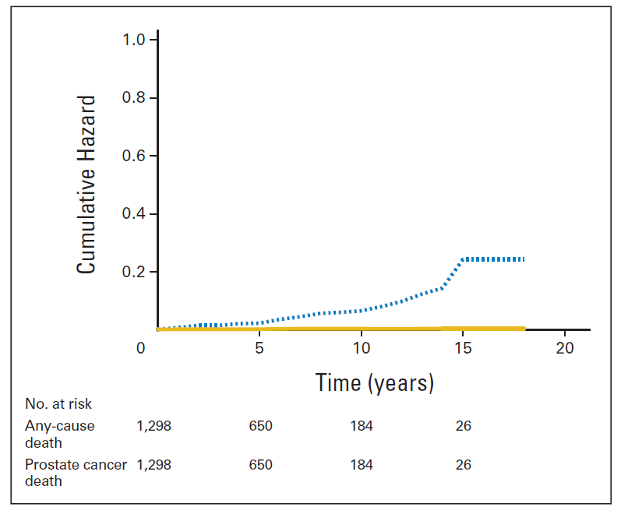
JHU Active Surveillance Experience
n = 1,298
n = 1,298
Epstein Criteria = cT1c, PSAD <0.15, PSA <10, & Gleason 6 in ≤2 cores with ≤50 involvement
Tosoian et al., JCO. 2015; 33: 3379.

Slide 15

Standard 12-core Template Biopsy
Samples <1% of the Entire Gland

Slide 16
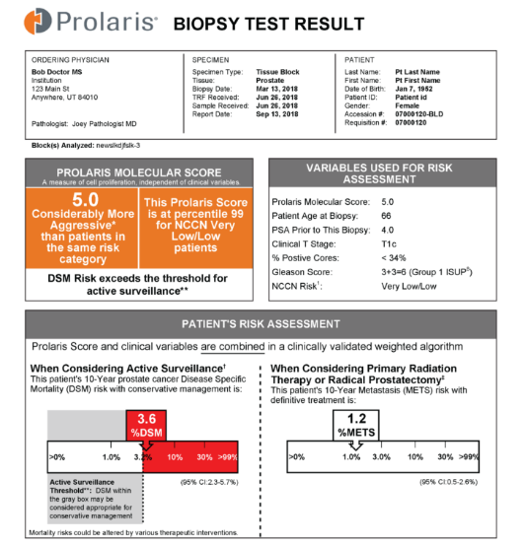
Helping Men Decide if AS is Right for Them

Slide 17
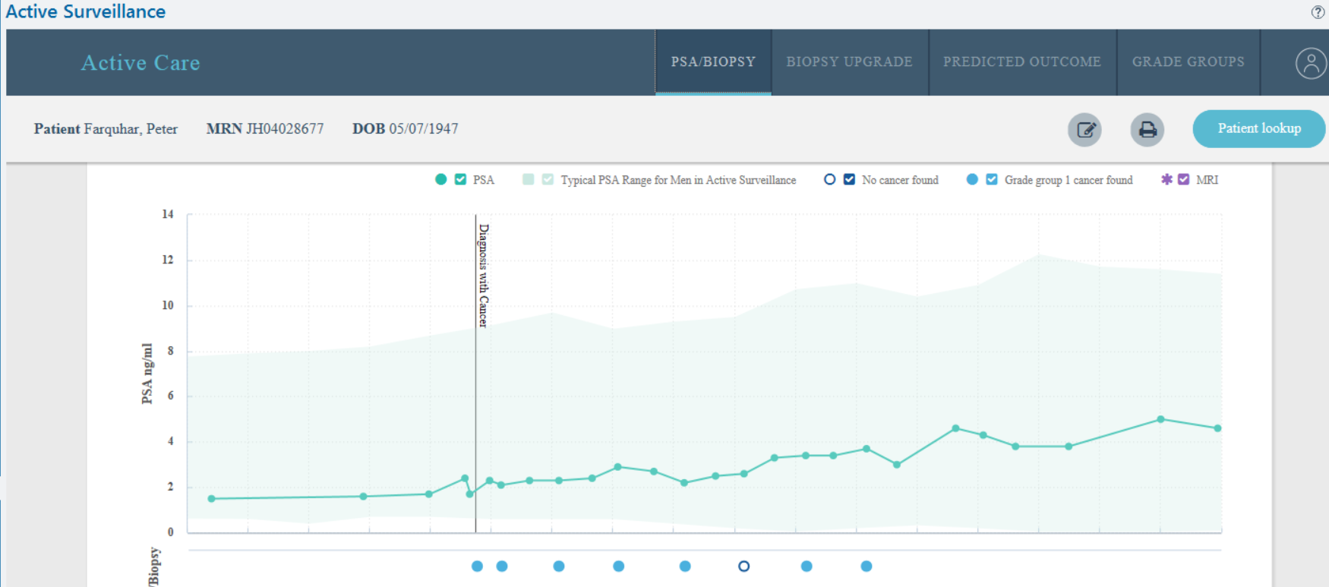
Helping Men Decide if AS is Right for Them

Slide 18
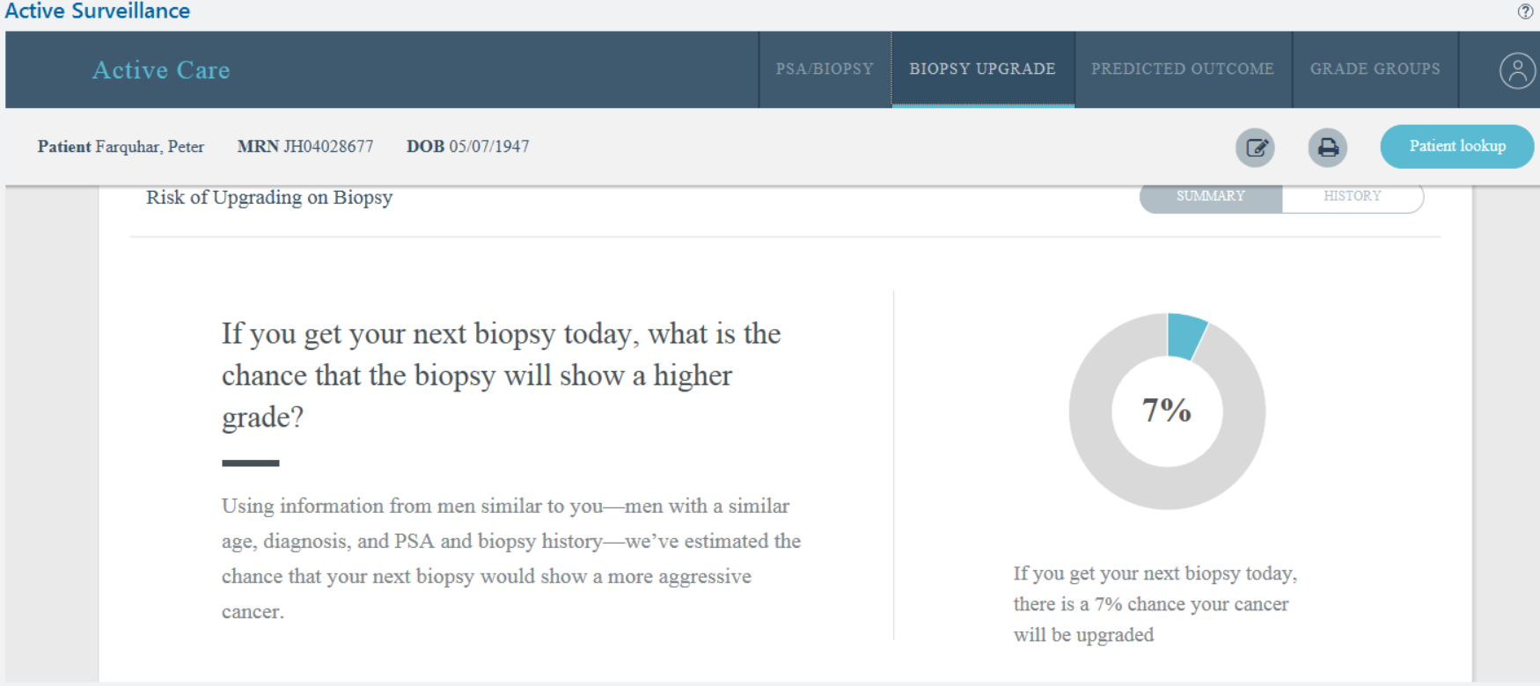
Helping Men Decide if AS is Right for Them

Slide 19
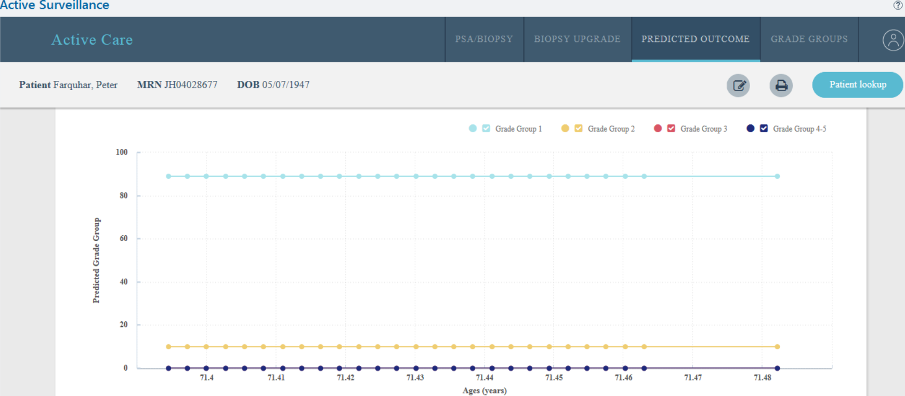
Helping Men Decide if AS is Right for Them

Slide 20
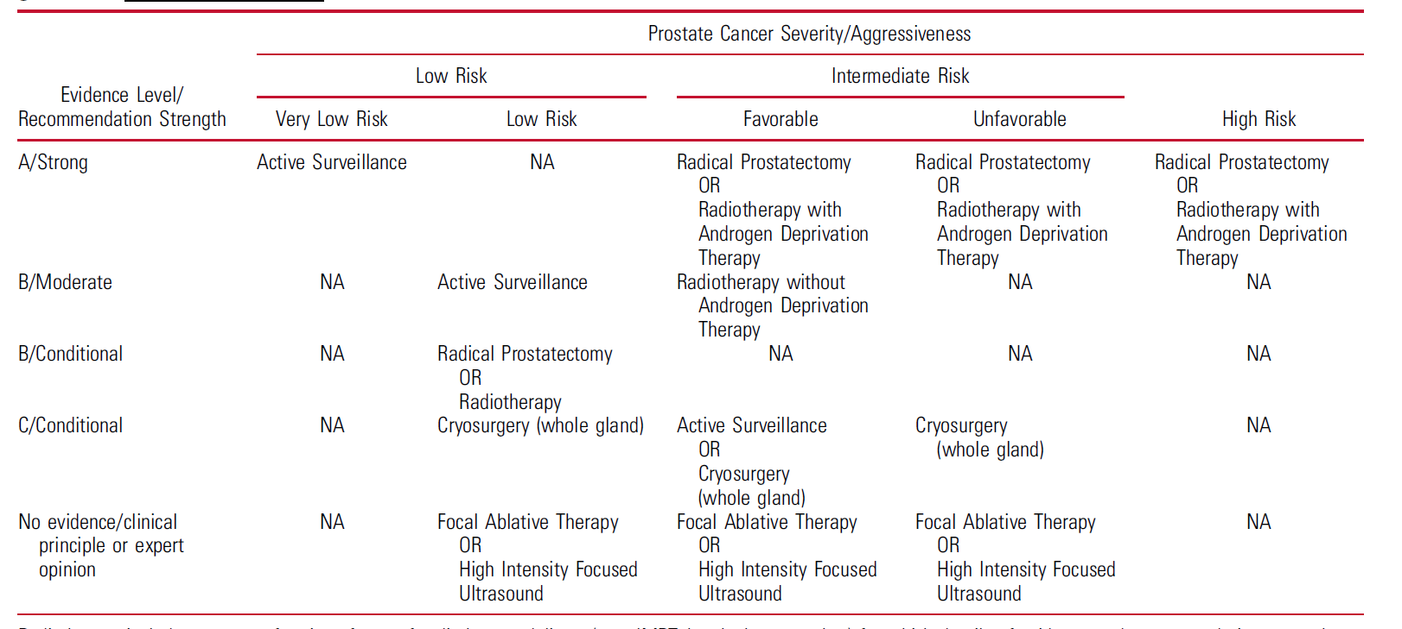
Active Surveillance is the Standard of Care for
Very-low & Low Risk Prostate Cancer
Sanda et al., J Urol 2018; 199: 683.

Slide 21
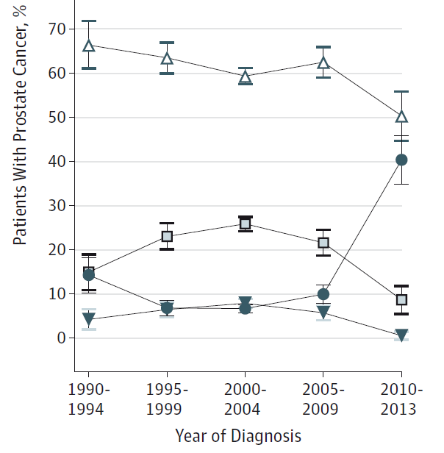

Marked Growth in Active Surveillance
Cooperberg & Carroll, JAMA. 2015; 314: 80.

Slide 22
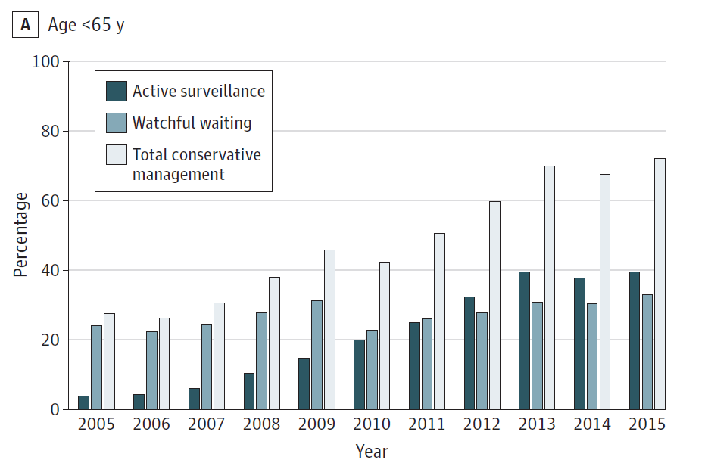
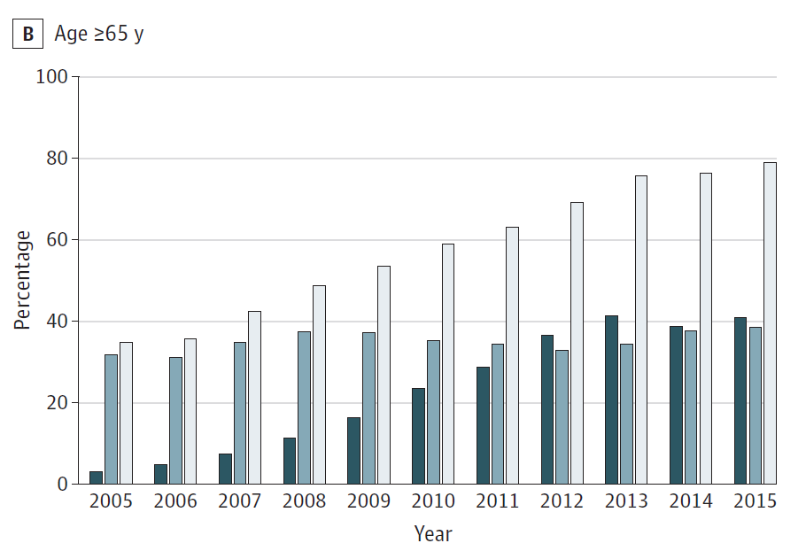
Marked Growth in Active Surveillance
Loeb et al., JAMA. 2018; 319: 2231.

Slide 23
Reconsidering Prostate Cancer Screening
Harm = Small
Harms of False Positive Tests
Benefit = Small to
Moderate
Cost of False Positive Tests
Reduction in PCa Death
Notes:
A public health perspective
Independent panel of non-Federal experts in prevention and evidence-based medicine; Conduct scientific evidence reviews of preventive health care services and develop recommendations for PCP’s and health systems; for the USPSTF to recommend a service, the benefits of the service must outweigh the harms

Slide 24
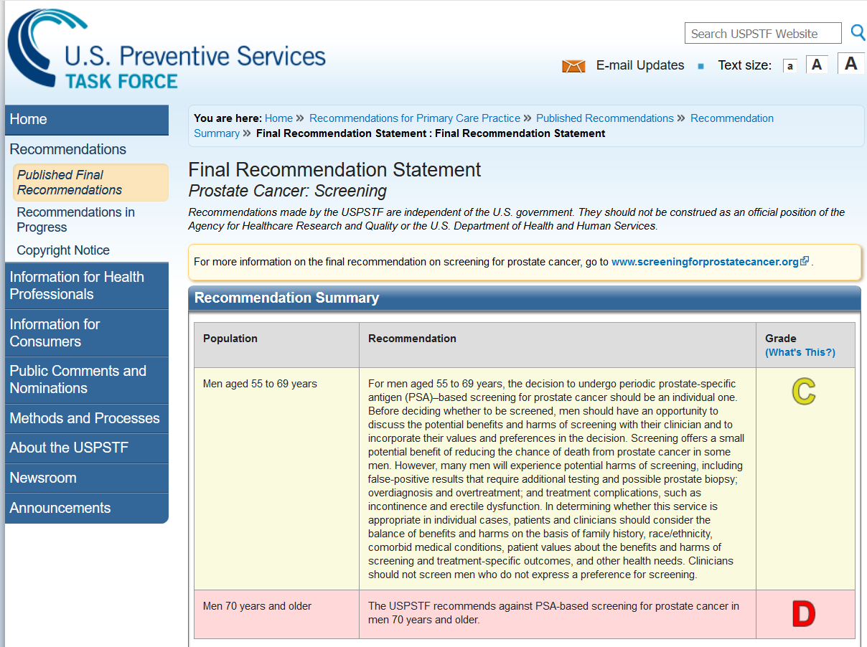
Updated UPSTF Recommendation: May 2018

Slide 25
Conclusions
PSA screening has led to a marked decline in prostate-cancer related mortality.
Use of PSA screening has led to the unfortunate overtreatment of men with low-risk prostate cancer.
Active surveillance prevents the overtreatment of these men while allowing for the continued safe use of PSA screening.
Active surveillance is the first-line option for men with very-low to low risk prostate cancer.
New decision tools can help men decide if this management strategy is right for them.

Slide 26

Questions?

