Slide 1


NASPCC:
Chemotherapy Options for Advanced Prostate Cancer
Jeanny B. Aragon-Ching, M.D., F.A.C.P.
Clinical Program Director of Genitourinary Cancers, Inova Schar Cancer Institute
Associate Professor of Medicine, Virginia Commonwealth University
October 13, 2018

Slide 2
Disclosures
Served in Advisory Board for Janssen, Dendreon, Bayer
Served in Speakers’ Bureau for Sanofi, Astellas, Janssen, BMS

Slide 3
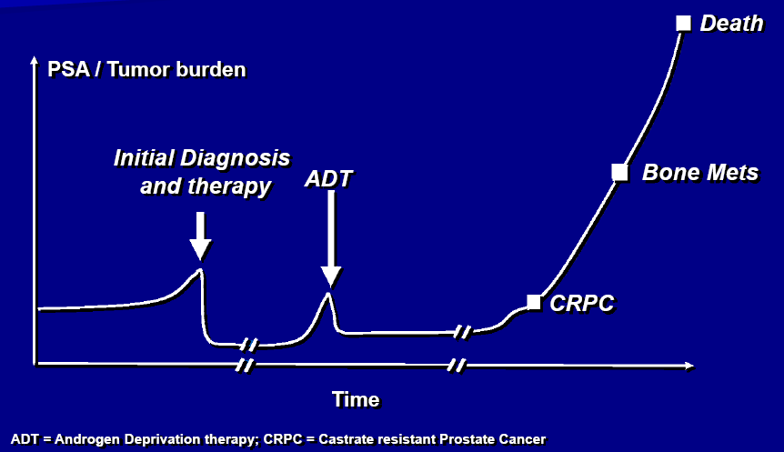
Potential Natural History of Prostate Cancer
Surgery or Radiation or Active Surveillance
Biochemical recurrence
Metasttic
CRPC
8 years
5 years
Pound et al., Natural history of progression after PSA elevation following radical prostatectomy. JAMA 1999. 281: p. 1591-7.

Slide 4
Potential Natural History of Prostate Cancer
+ Docetaxel or Abiraterone
Surgery or Radiation or Active Surveillance
De novo metastatic
or
mCSPC
8 years
5 years
mCSPC = metastatic Castrate Sensitive Prostate Cancer
Pound et al., Natural history of progression after PSA elevation following radical prostatectomy. JAMA 1999. 281: p. 1591-7.

Slide 5
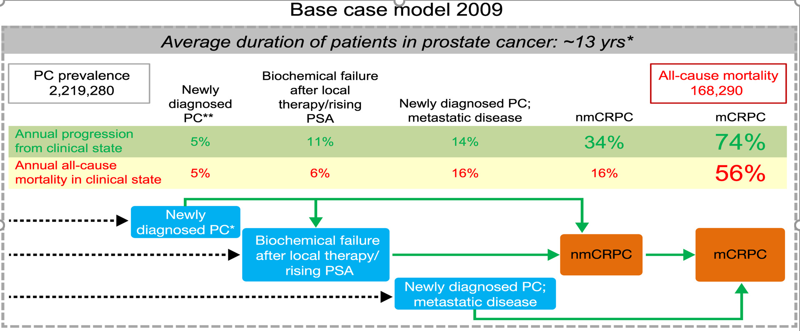
Prevalence of clinical states and mortality
Active Surveillance
RP
RT +/- ADT
Salvage Rx
ADT
Docetaxel
Abiraterone
Apalutamide
Enzalutamide
Docetaxel
Cabazitaxel
Sipuleucel-T
Abiraterone
Enzalutamide
Radium
Scher HI, et al. PLoS ONE 2015: 10(10):

Slide 6

US Regulatory Approval for Prostate Cancer
Leuprolide
Cabazitaxel
Abiraterone pre-docetaxel
Apalutamide nmCRPC
Strontium
Degarelix
Enzalutamide nmCRPC
Zoledronic Acid
Sipuleucel-T
Enzalutamide Post-docetaxel
Abiraterone mCSPC
Mitoxantrone
Docetaxel
Denosumab
Alpharadin
Samarium
Abiraterone post-docetaxel
1985 1996 2002 2010 2011 2012
1993 1997 2004 2008 2013 2018
Hormonal Therapy
Bone-Targeted Therapy or Radiopharmaceuticals
Chemotherapy
Immunotherapy
Presented by Jeanny Aragon-Ching
nmCRPC – non-metastatic castration-resistant prostate cancer

Slide 7
US Regulatory Approval for Prostate Cancer
Leuprolide
Cabazitaxel
Abiraterone pre-docetaxel
Apalutamide nmCRPC
Strontium
Degarelix
Enzalutamide nmCRPC
Zoledronic Acid
Sipuleucel-T
Enzalutamide Post-docetaxel
Abiraterone mCSPC
Mitoxantrone
Docetaxel
Denosumab
Alpharadin
Samarium
Abiraterone post-docetaxel
1985 1996 2002 2010 2011 2012
1993 1997 2004 2008 2013 2018
Hormonal Therapy
Bone-Targeted Therapy or Radiopharmaceuticals
Chemotherapy
Immunotherapy
Presented by Jeanny Aragon-Ching
nmCRPC – non-metastatic castration-resistant prostate cancer

Slide 8
Chemotherapy options for advanced prostate cancer
Chemotherapy used in prostate cancer
  Mitoxantrone
  Docetaxel
  Cabazitaxel
Metastatic Castration-Resistant Prostate cancer
Metastatic Castration-Sensitive Prostate Cancer

Slide 9
Mechanism of action of treatment approaches
Sipuleucel-T
Leuprolide, Goserelin, Degarelix
X
↑ Immune Response
10%
90%
X
Abiraterone acetate
Docetaxel/
Cabazitaxel
MDV-3100 (Enzalutamide), Bicalutamide, Flutamide, Nilutamide
Apalutamide* - recent FDA approval
Tubulin
X
X
cell division
Tumor

Slide 10
Chemotherapy for Metastatic Castration-Resistant Prostate Cancer

Slide 11
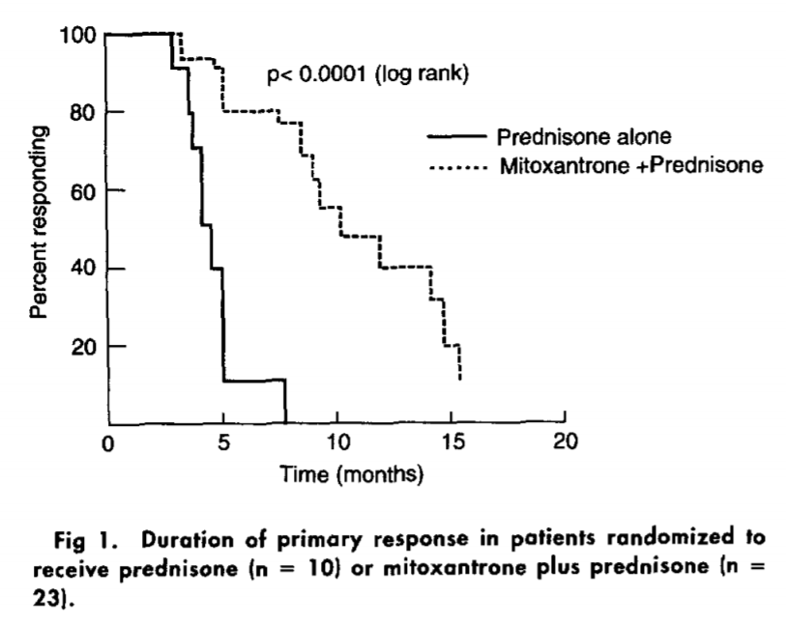
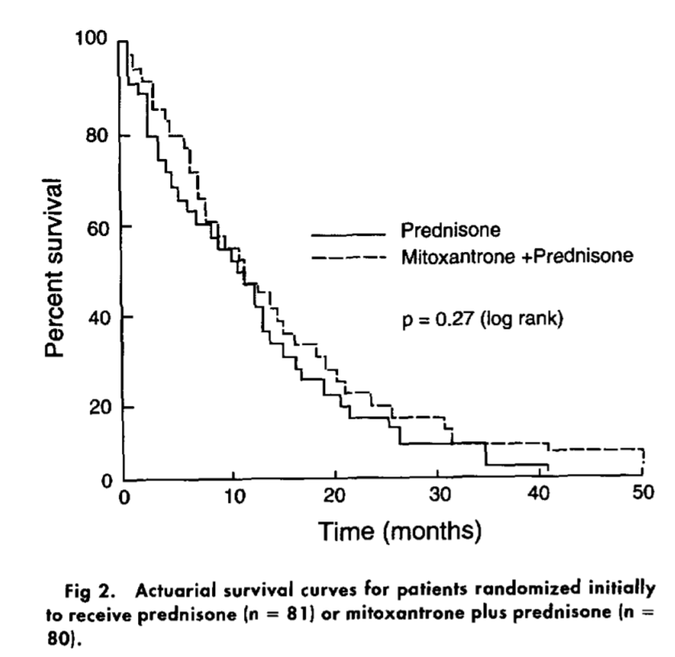
Mitoxantrone
Positive pain response
No survival benefit

Slide 12
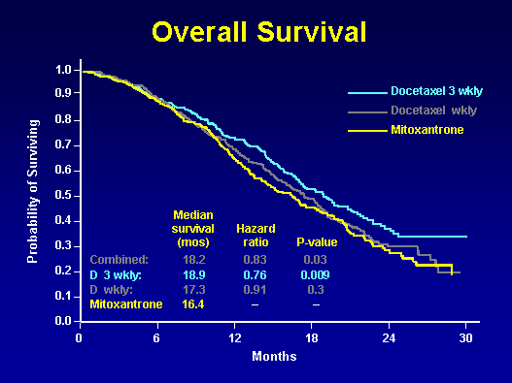
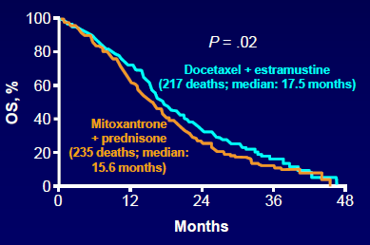
Docetaxel in mCRPC
TAX-327: Docetaxel q3 wk improved OS, pain, PSA response, QOL vs Mitoxantrone/Prednisone
SWOG 99-16: Docetaxel + estramustine improved OS by 2 mos over Mitoxantrone/prednisone
Overall Survival
Tannock et. al. NEJM 2004 Oct 7;351(15):1502-12.; Petrylak DP et al., NEJM 2004: 351: 1513.
Notes:
From March 2000 through June 2002, 1006 men with metastatic hormone-refractory prostate cancer received 5 mg of prednisone twice daily and were randomly assigned to receive 12 mg of mitoxantrone per square meter of body-surface area every three weeks, 75 mg of docetaxel per square meter every three weeks, or 30 mg of docetaxel per square meter weekly for five of every six weeks. The primary end point was overall survival. Secondary end points were pain, prostate-specific antigen (PSA) levels, and the quality of life. All statistical comparisons were against mitoxantrone

Slide 13
Docetaxel in Prostate Cancer
Docetaxel – a taxane that promotes and stabilizes microtubule assembly
Approved 2004 for overall survival benefit in mCRPC compared to mitoxantrone (which was approved in 1996 for palliation only)
Notes:
Microtubules are a component of the cytoskeleton, found throughout the cytoplasm. These tubular polymers of tubulin can grow as long as 25 micrometres and are highly dynamic. The outer diameter of microtubule is about 25 nm while the inner diameter is about 12 nm. They are found ineukaryotic cells and are formed by the polymerization of a dimer of two globular proteins, alpha and beta tubulin.
Microtubules are important in a number of cellular processes. They are involved in maintaining cell structure and together with microfilaments andintermediate filaments, they form the cytoskeleton. They also make up the internal structure of cilia and flagella.They provide platforms for intracellular transport and are involved in a variety of cellular processes that involve the movement of secretory vesicles and organelles as well as the intracellular transport of substances (see entries for dynein and kinesin).^{[1]} They are also involved in cell division (mitosis and meiosis) including the formation ofmitotic spindles, which is the process by which eukaryotic cells separate their chromatids during cell division.

Slide 14
TROPIC: cabazitaxel or mitoxantrone with prednisone in patients with metastatic CRPC previously treated with docetaxel
R
A
N
D
O
M
I
Z
E
Cabazitaxel 25 mg/m² q 3 wk
+ prednisone for 10 courses (CBZP, n=378)
Men with metastatic CRPC progressing during and after docetaxel
(N=755)
Mitoxantrone 12 mg/m² q 3 wk
+ prednisone for 10 courses (MP, n=377)
  Primary objective: Overall survival (To detect or R/O a HR<0.75)
  Secondary objectives: PFS (tumor progression, pain progression, PSA progression, or death from any cause), response rate, safety
De Bono J et. al. Lancet 2010: 1147.
Notes:
The trial enrolled 755 patients for 2nd line treatment whose disease had progressed from prior docetaxel-based chemotherapy. The primary endpoint of the trial was overall survival with secondary endpoints including progression-free survival, tumor response rate, tumor progression, prostate-specific antigen (PSA) response, PSA progression, pain response, and pain progression. Patients were randomly assigned 1:1 with 378 patients who received cabazitaxel plus prednisone/prednisolone and 377 patients assigned to the mitoxantrone plus prednisone/prednisolone (MP) arm. Patients were to receive either regimen for up to a maximum of 10 cycles. The median age was 68 years old, of whom 84% were white. The patients were heavily pre-treated with a median total prior dose of docetaxel of 529 mg/m2 in the MP arm and 576.5 mg/m2 in the cabazitaxel arm. Also, about half of patients on both arms had measurable disease.

Slide 15
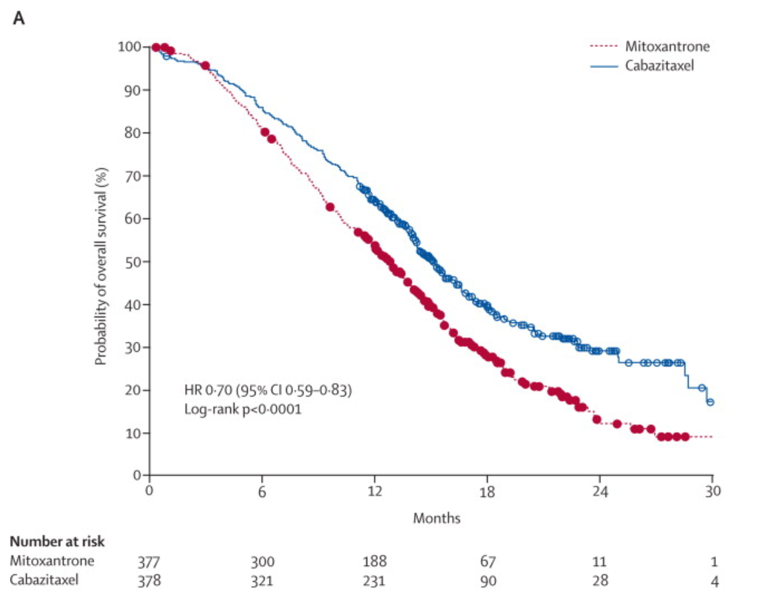
Cabazitaxel improves overall survival
MP
CBZP
Median OS (months)
12.7
15.1
Hazard Ratio
0.70
95% CI
0.59–0.83
P-value
< 0.0001
De Bono J et. al. Lancet 2010: 1147.

Slide 16
TROPIC: Important secondary results
Efficacy | MP | CBZP | p-value | Comment
Tumor response (%) | 4.4 | 14.4 | 0.0005
PSA response (%) | 17.8 | 39.2 | 0.0002 | MP consistent with other studies
Pain response (%) | 7.8 | 9.2 | 0.63 | No pain improvement
Toxicity | MP | CBZP | Comment
Toxic death | 7 (1.9%) | 18 (4.9%) | Important to use growth factors
Neutropenic sepsis | 1.3% | 7.5%
Diarrhea (≥ grade III) | 0.3% | 6.2%
Neuropathy (%) | 3.2% | 13%
Notes:
16

Slide 17
Docetaxel for Metastatic Castration-Sensitive Prostate Cancer

Slide 18

Docetaxel for Hormone-sensitive PCa:
ECOG 3805 CHAARTED: Schema
STRATIFICATION
Extent of mets
-High vs Low
Age
- >/= 70 y/o or < 70 y/o
ECOG
- 0-1 vs 2
CAB > 30 days
- Yes or No
SRE Prevention
- Yes or No
Prior Adjuvant
- </= 12 months or > 12 months
Evaluate every 3 weeks while receiving docetaxel and at week 24 then every 12 weeks
ARM A:
ADT + Docetaxel 75mg/m2 every 21 days for maximum 6 cycles
RANDOMIZe
ARM B:
ADT (androgen deprivation therapy alone)
Evaluate every 12 weeks
Time to progression and overall survival
Chemotherapy at investigator’s discretion at progression
Study revised to allow low volume
High volume: visceral metastases and/or 4 or more bone lesions (at least 1 beyond pelvis and axial skeleton
Sweeney C et. al. LBA ASCO Annual Meeting 2014; NEJM 2014

Slide 19
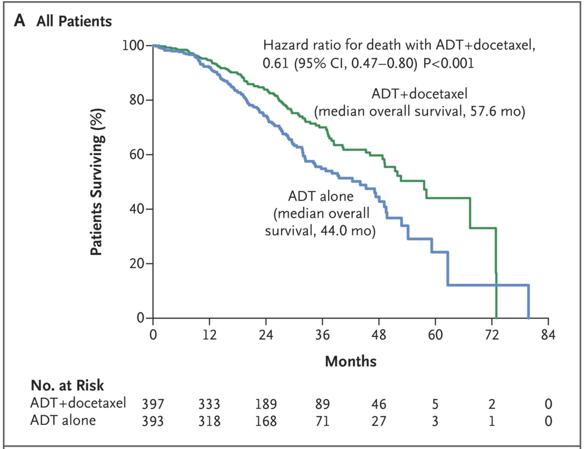
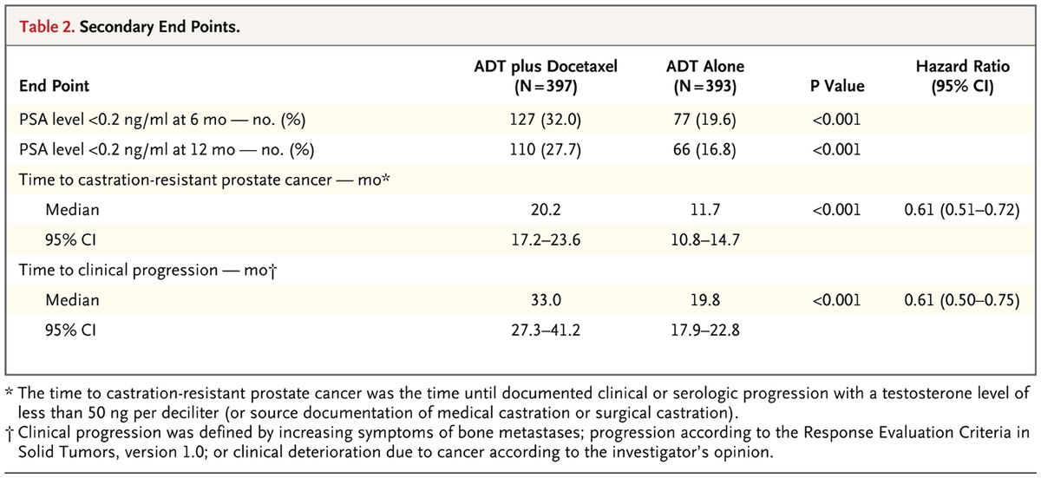
ECOG CHAARTED shows improvement in Overall Survival with early docetaxel
Improvement in OS and other endpoints
Sweeney C et. al. LBA ASCO Annual Meeting 2014; NEJM 2014

Slide 20
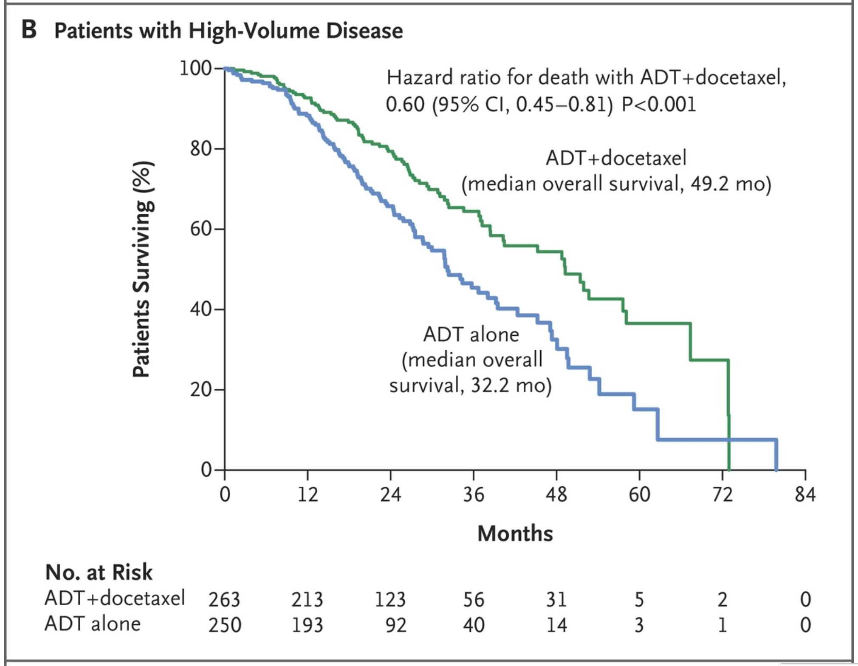
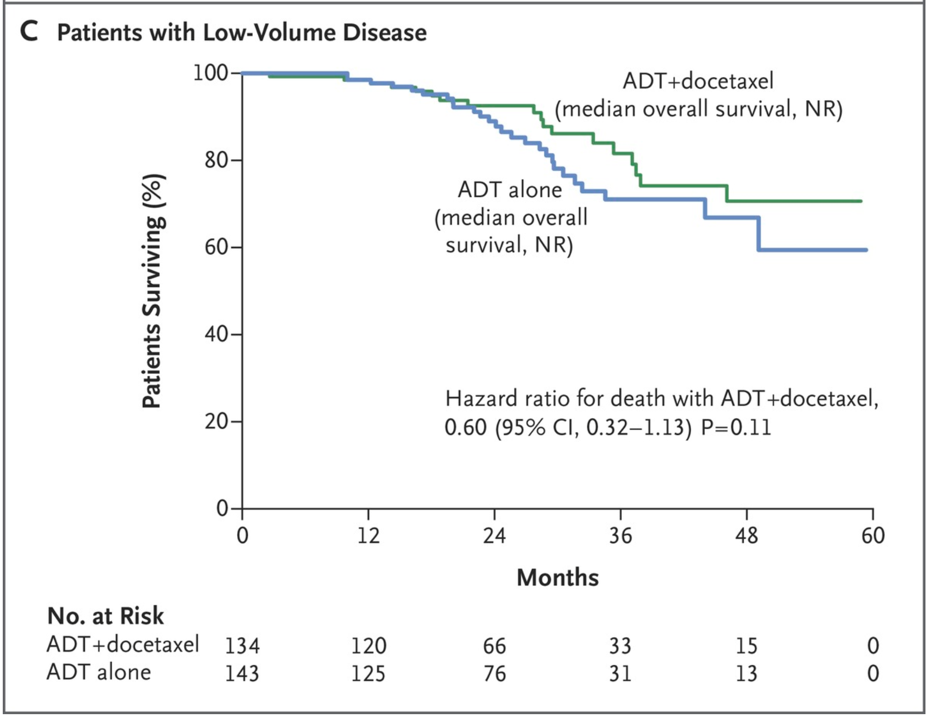
CHAARTED: High vs low volume disease
Sweeney C et. al. LBA ASCO Annual Meeting 2014; NEJM 2014

Slide 21
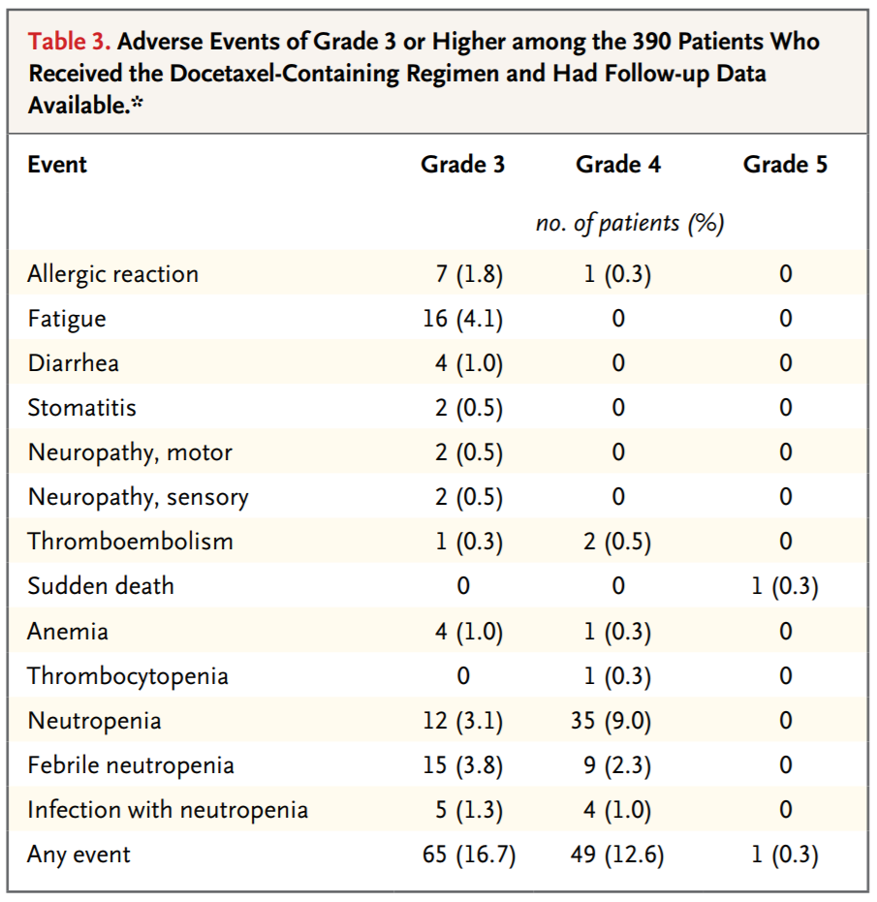
Docetaxel side-effects
Sweeney C et. al. LBA ASCO Annual Meeting 2014; NEJM 2014

Slide 22
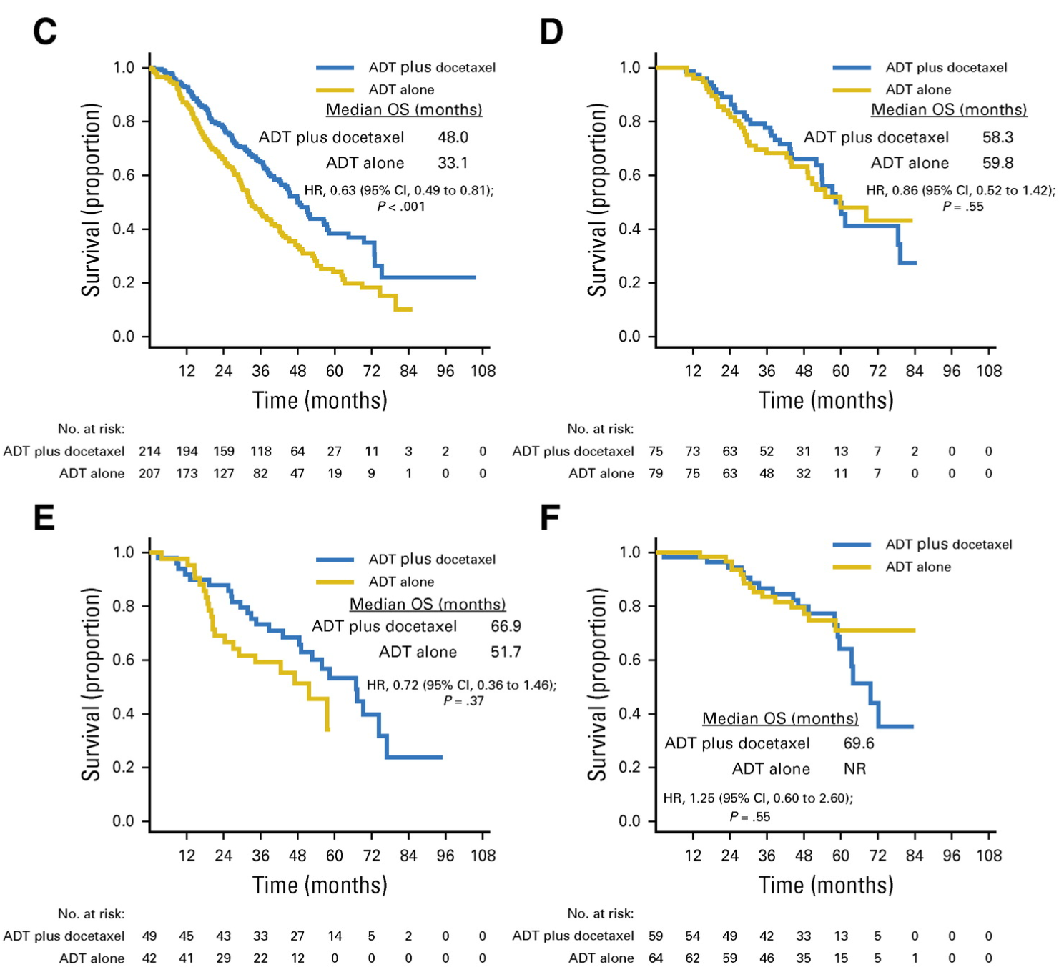
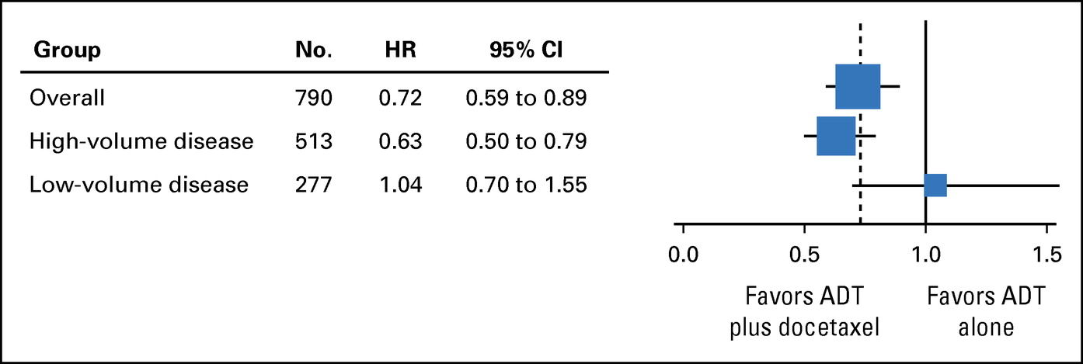
Patients with low-volume disease without OS benefit with upfront ADT + docetaxel
High volume – de novo
Low volume – de novo
High volume - progressive
Low volume - progressive
High-volume disease
Visceral metastases and/or
≥ 4 bone metastases with at least one outside of the vertebral column and pelvis
Kyriakopoulos C et al., J Clin Oncol 2018: 36 (11): 1080-1087
Notes:
Additional analyses of the prospectively defined low- and high-volume disease subgroups were performed. High-volume disease was defined as presence of visceral metastases and/or ≥ four bone metastases with at least one outside of the vertebral column and pelvis. Results At a median follow-up of 53.7 months, the median OS was 57.6 months for the chemohormonal therapy arm versus 47.2 months for ADT alone (hazard ratio [HR], 0.72; 95% CI, 0.59 to 0.89; P = .0018). For patients with high-volume disease (n = 513), the median OS was 51.2 months with chemohormonal therapy versus 34.4 months with ADT alone (HR, 0.63; 95% CI, 0.50 to 0.79; P < .001). For those with low-volume disease (n = 277), no OS benefit was observed (HR, 1.04; 95% CI, 0.70 to 1.55; P = .86). Conclusion The clinical benefit from chemohormonal therapy in prolonging OS was confirmed for patients with high-volume disease; however, for patients with low-volume disease, no OS benefit was discerned.

Slide 23
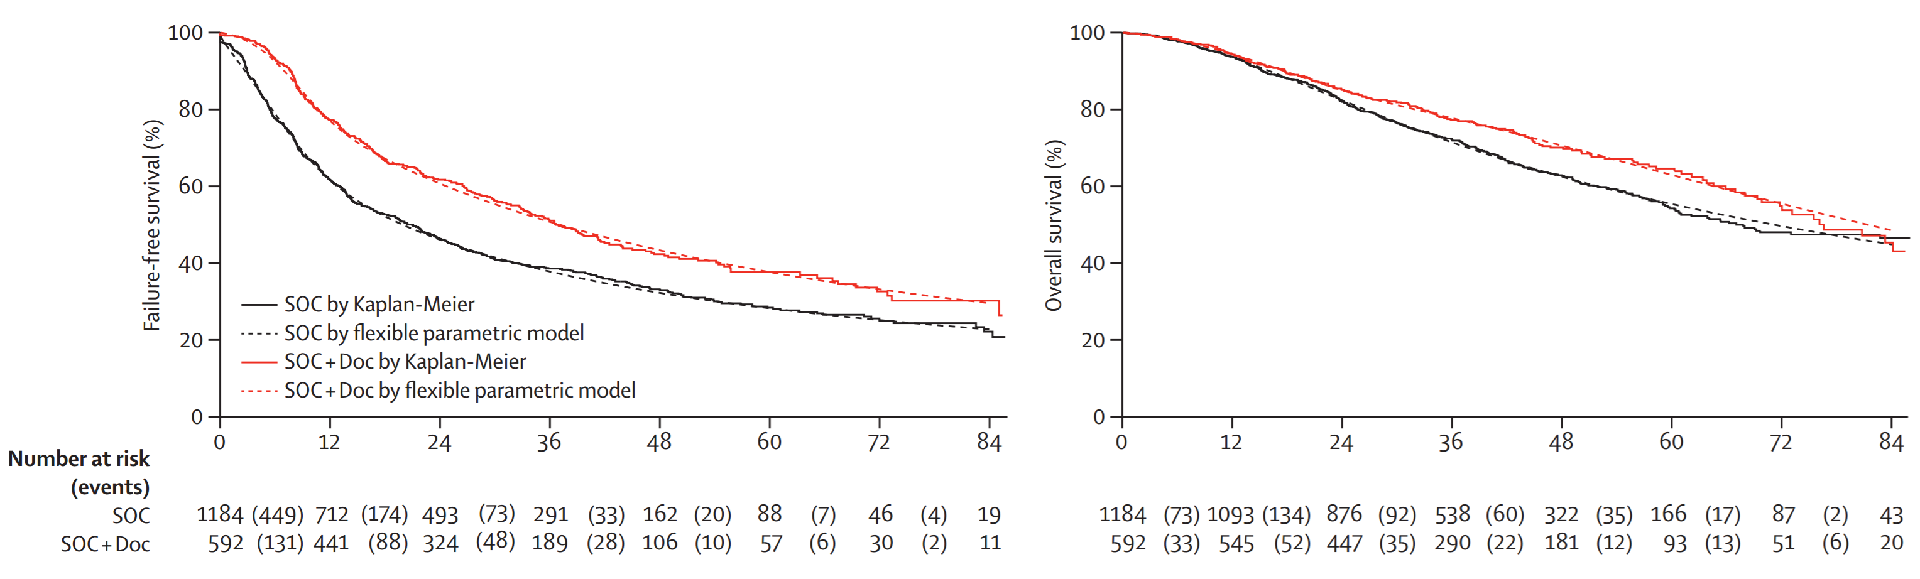
STAMPEDE: adding Docetaxel to ADT in Metastatic Hormone-sensitive PCa improves OS
Failure Free Survival
Overall Survival
95% CI 6·6–12·3; p=0·556 × 10– ¹⁰)
SOC + D = 44.2 mos
SOC + D = 81 mos
5-year OS = 63%
SOC = 34.8 mos
SOC = 71 mos
5-year OS = 55%
HR 0·78, 95% CI 0·66–0·93; p=0·006
James N et al. The Lancet. 2016. 387, 1163-1177

Slide 24

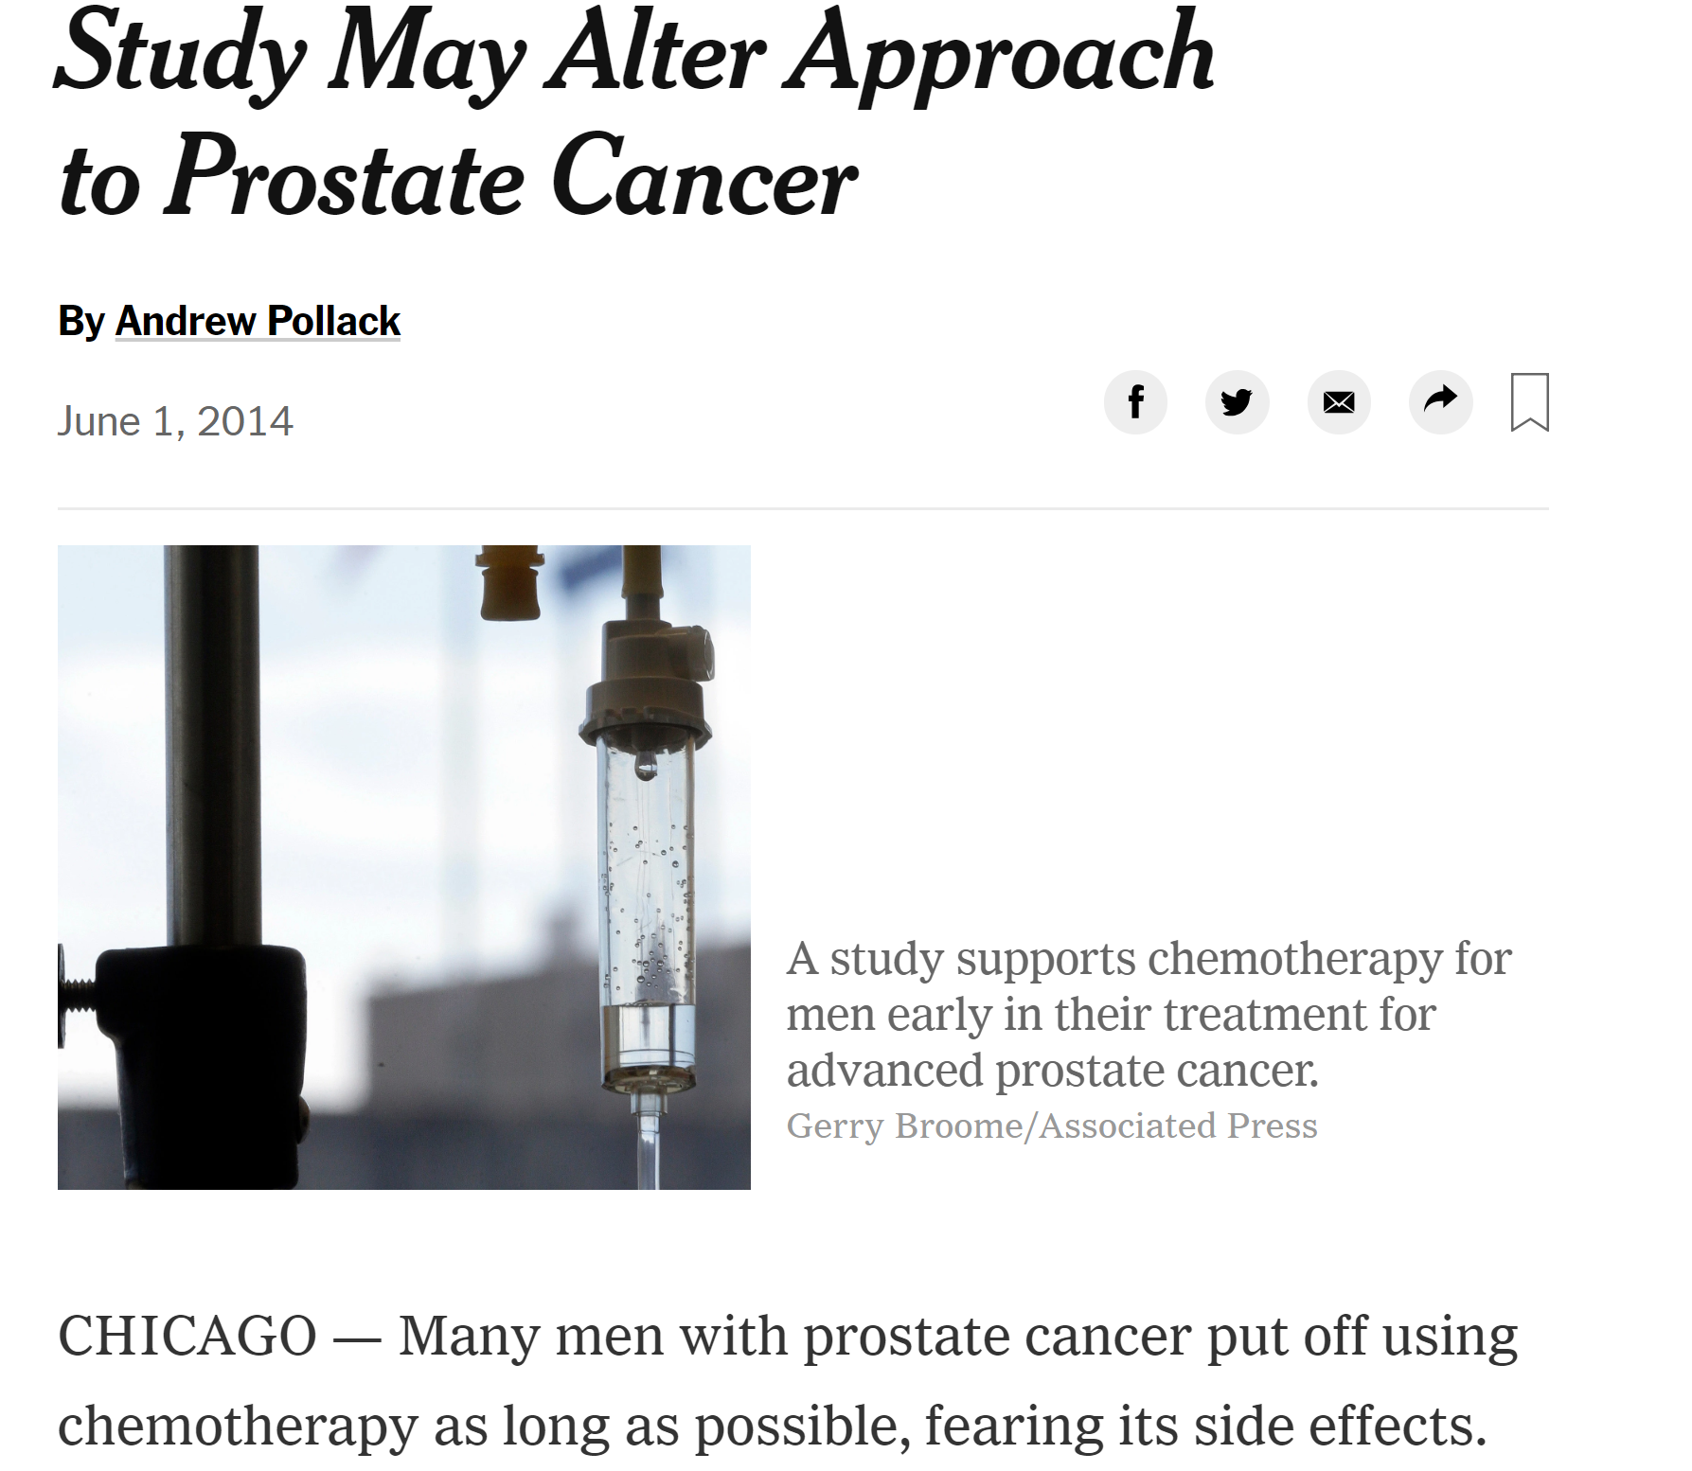

Slide 25
Adjuvant Docetaxel for High-risk Prostate cancer

Slide 26
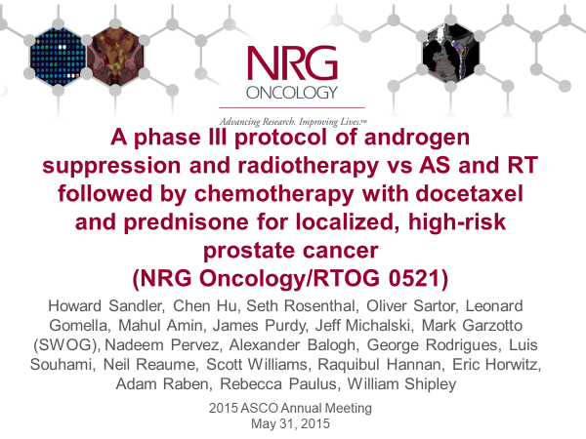
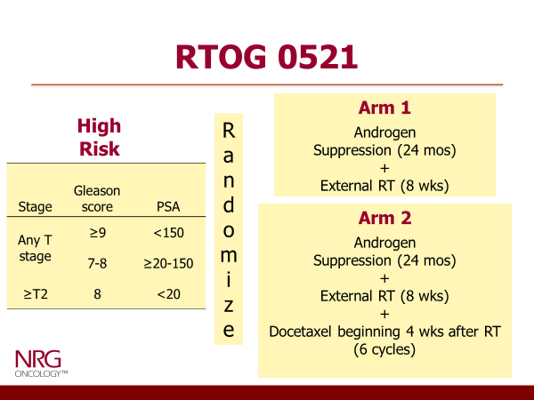
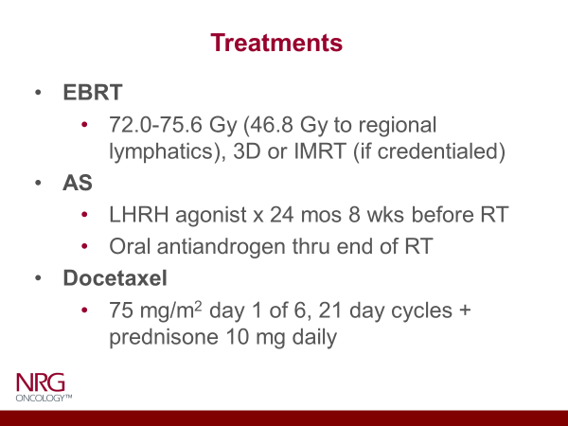
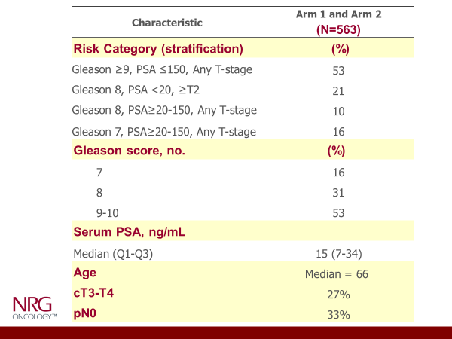

Slide 27
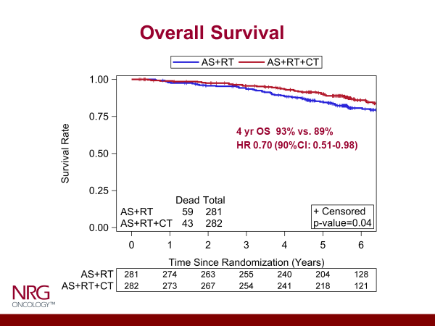
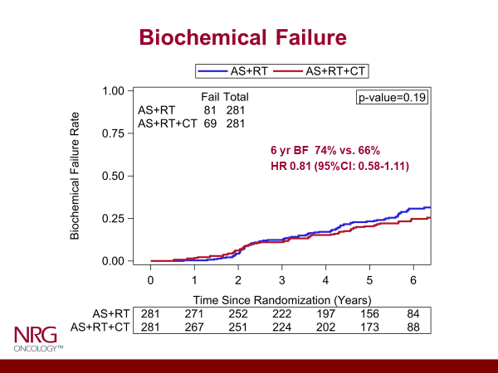
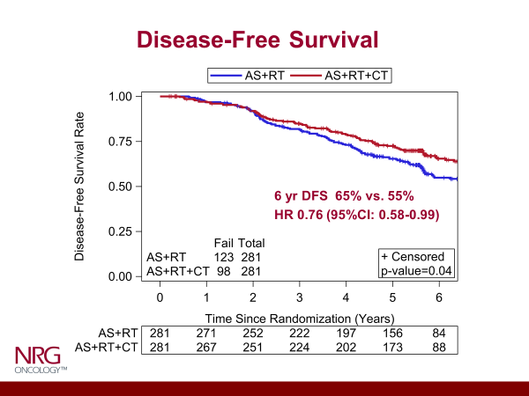
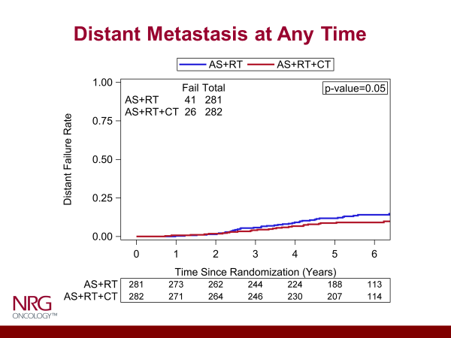

Slide 28
Other considerations…

Slide 29
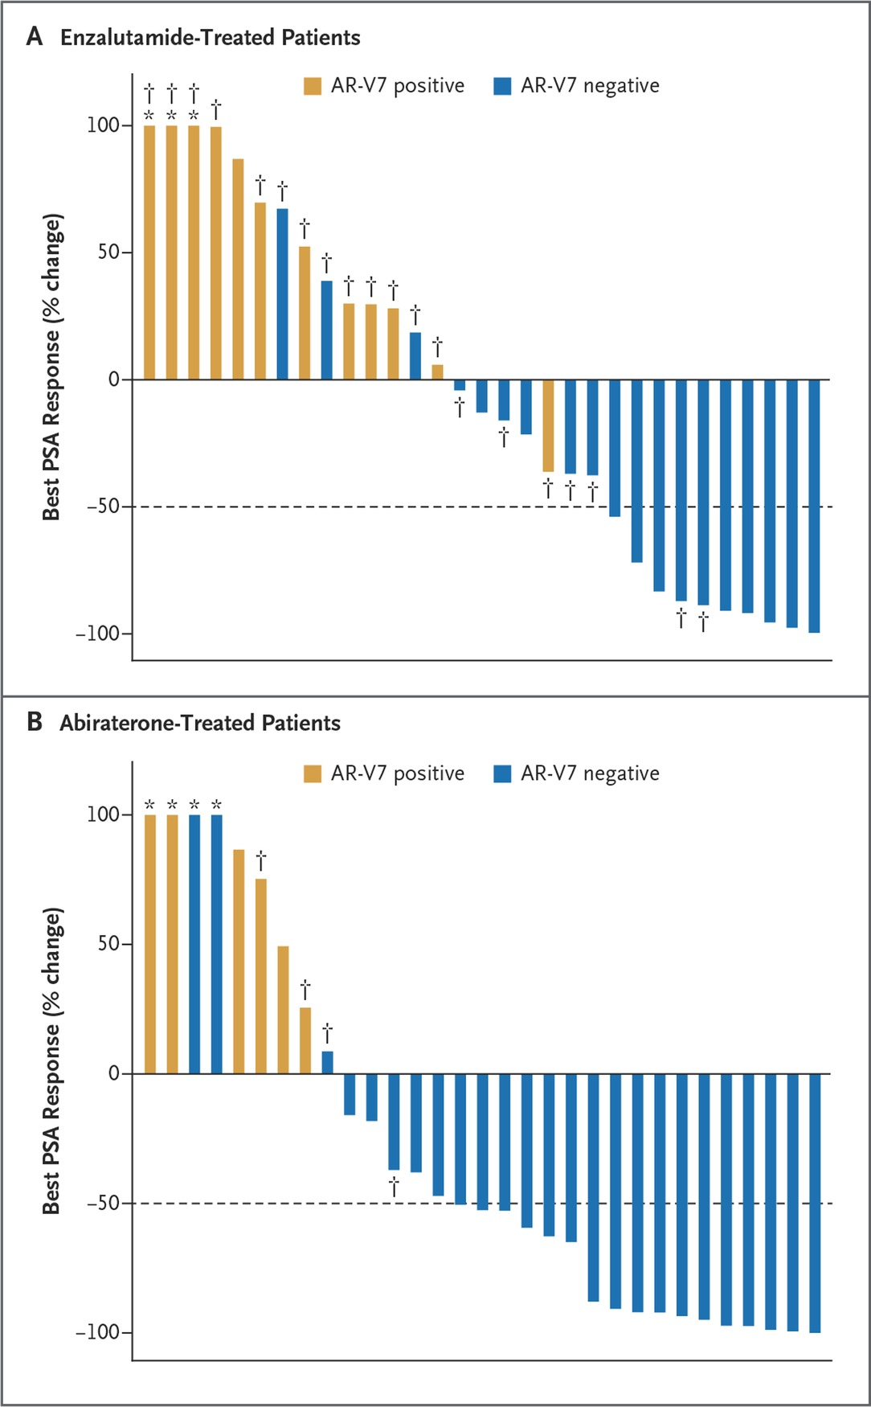
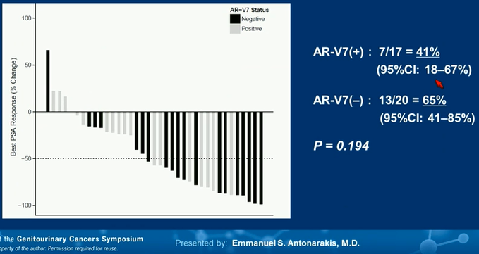
Response to AR-V7: AR-targeted agents vs Taxane
Taxane-treated
Enzalutamide
AR-V7(+) : 0/12 = 0%
(95%CI: 0–26%)
AR-V7(–) : 10/19 = 52.6%
(95%CI: 29–76%)
P = 0.004
Abiraterone
AR-V7(+) : 0/6 = 0%
(95%CI: 0–46%)
AR-V7(–) : 17/25 = 68.0%
(95%CI: 46–85%)
P = 0.004
CTC detected: 17/37 = 46%
AR-V7(+) : 41%
AR-V7(–) : 65%
P = 0.19
Antonarakis ES et al. ASCO Annual Meeting 2014; N Engl J Med 2014;371:1028-1038
Antonarakis ES et al., ASCO GU Symposium 2015: Abstract 138; Antonarakis et al.,; JAMA Oncol 2015: 1341

Slide 30
Conclusions
Chemotherapy with docetaxel has an established role in both metastatic CRPC and CSPC
2nd line chemotherapy with cabazitaxel remains a viable option for those who fail docetaxel
Potential benefit of docetaxel use in certain settings (adjuvant for high-risk prostate cancer undergoing radiation, in those with AR-V7 mutation)

Slide 31
Thank You!
Questions?

