Slide 1
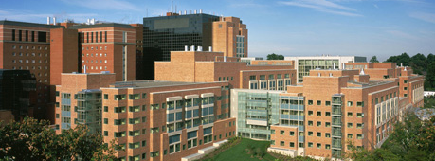
2018 UPDATE ON IMMUNOTHERAPY IN PROSTATE CANCER
James L. Gulley, M.D., Ph.D., F.A.C.P.
Chief, Genitourinary Malignancies Branch &
Director, Medical Oncology Service
Center for Cancer Research
National Cancer Institute, NIH

Slide 2
The 5 E’s of immunotherapy
TCR : pMHC
Engage
Expand
Excursion
Establish ID
Enable
Antigen Spreading
Expand
Serial Killing
Antigen Spreading

Slide 3
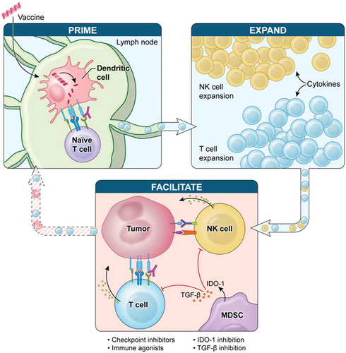
Requirements for Effective Immunotherapy
Collins et al., Expert Rev Vaccines 2018

Slide 4
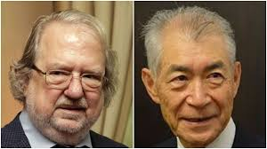
2018 Nobel Prize in Medicine (Oct 1, 2018)
Jim Allison, MD Anderson Tasuku Honjo, Kyoto University

Slide 5
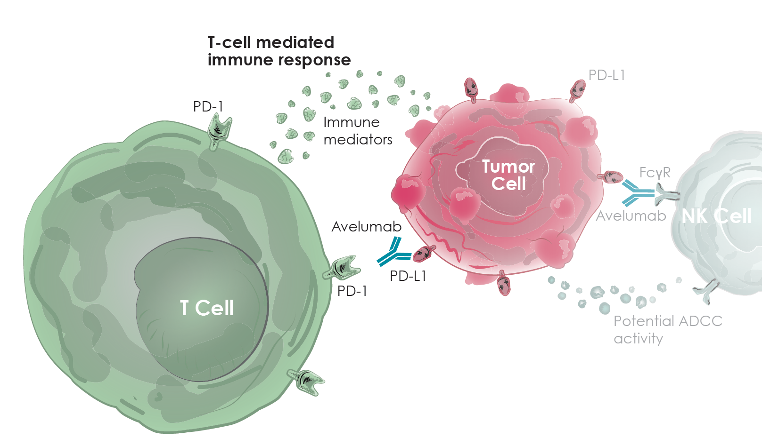
Importance of PD-1/PD-L1 blockade
NIH. News Headlines: https://ccr.cancer.gov/news/article/investigators-lead-first-human-trials-of-new-immunotherapy-drug (accessed August 2017)

Slide 6
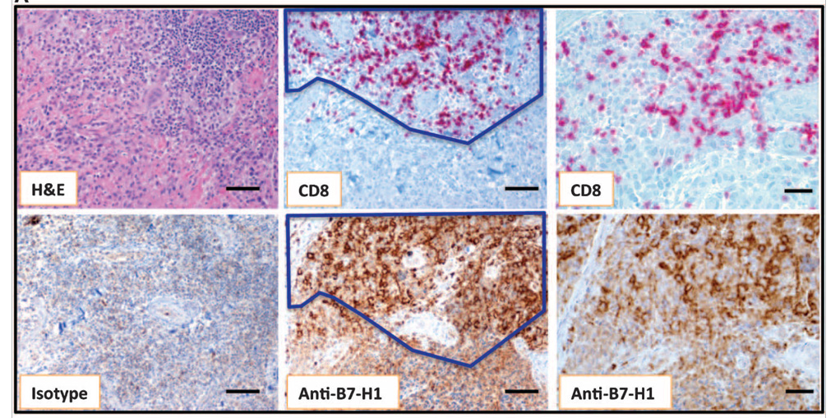
Co-localization of inflammatory response and PDL1 expression:
TILs are being blocked at tumor site (Enable)
IFN-γ upregulates PDL1 expression in vitro
Taube et al., Sci Trans Med 2012

Slide 7
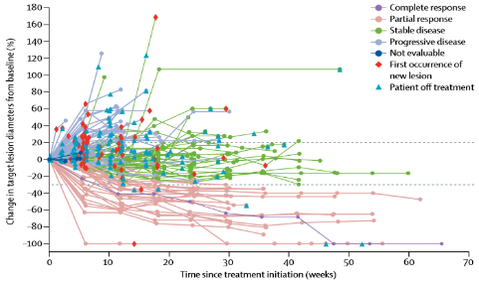
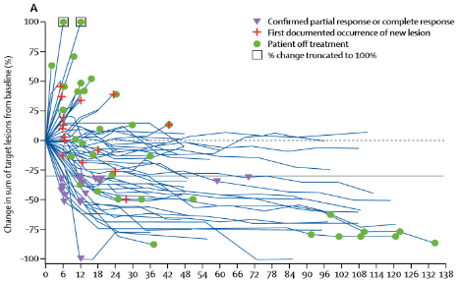
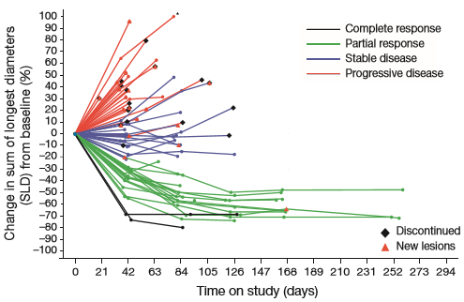
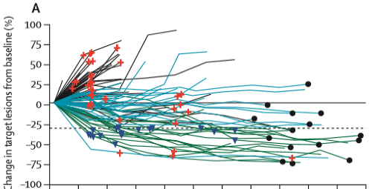
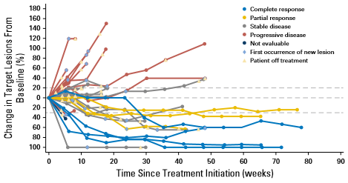
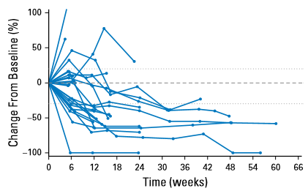
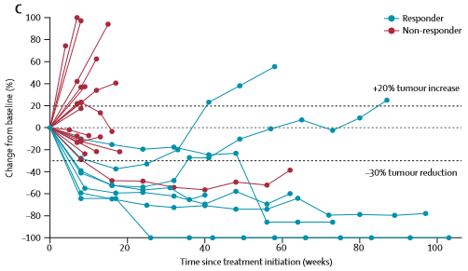
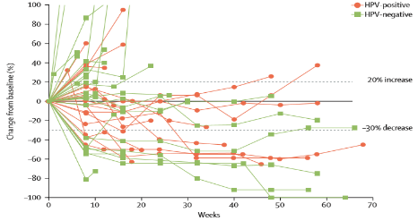

PD-1/PD-L1 inhibition
Rapid, deep, durable responses
Across a wide range of tumors
Seen in a subset of patients
Not seen in #ProstateCancer
NSCLC: avelumab
Gulley JL et al. Lancet Oncol 2017
MSI hi CRC: nivolumab
Overman MJ et al. Lancet Oncol 2017
Urothelial: atezolizumab
Powles T et al. Nature 2014
NSCLC (squamous only): nivolumab
Rizvi NA et al. Lancet Oncol 2015
Urothelial: avelumab
Apolo AB et al. J Clin Oncol 2017
Urothelial: durvalumab
Massard C et al. JCO 2016
HNSCC: pembrolizumab
Seiwert TY et al. Lancet Oncol 2016
Urothelial: pembrolizumab
Plimack ER P et al. Lancet Oncol 2017
Notes:
Challange

Slide 8
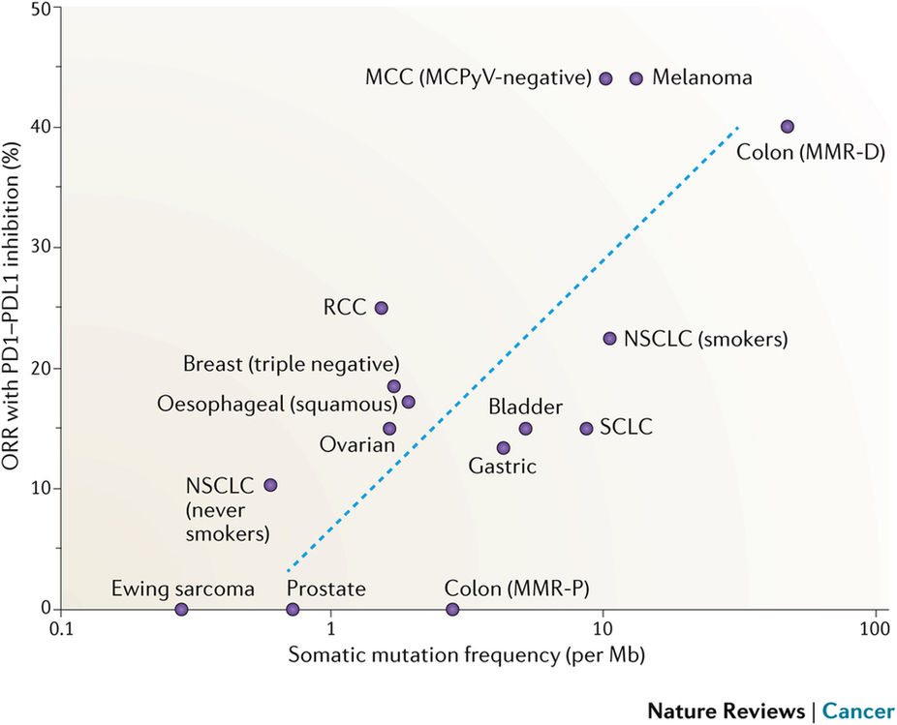
Yarchoan et al., 2017
Notes:
Challange

Slide 9
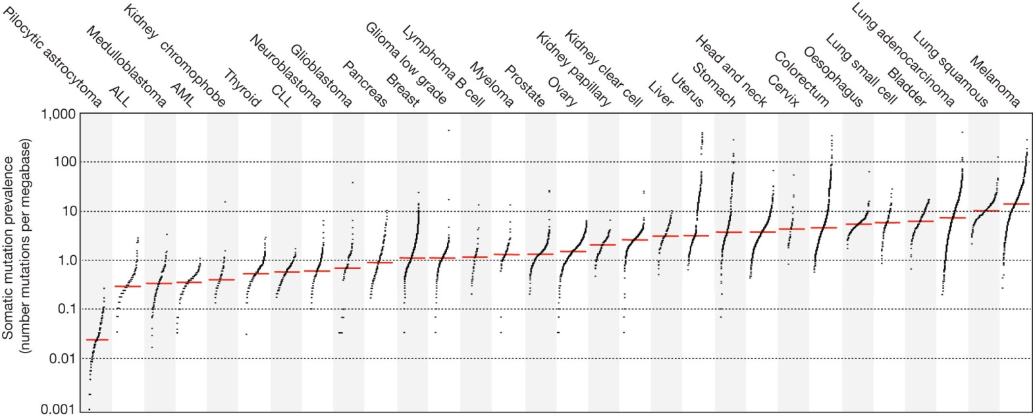

The prevalence of somatic mutations across human cancer types
MSI-hi
Likelihood of neoantigens
T-cell-poor? T-cell-inflamed?
Target self antigens → vaccine Target neoantigens
Alexandrov LB et al. Nature 2013;500:415–21.

Slide 10
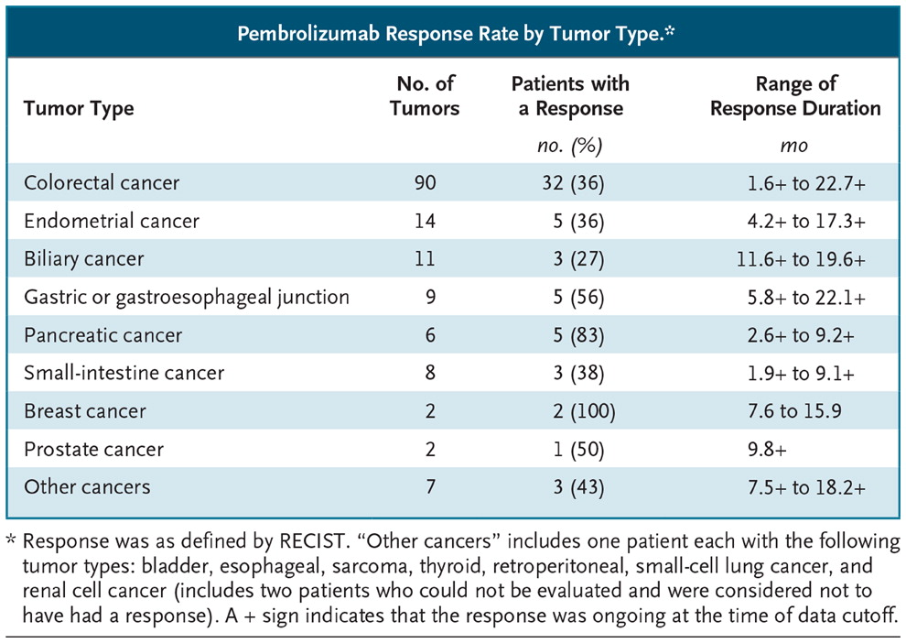
MSI Hi Prostate Cancer
Approval with pembrolizumab
Incidence
  Localized PC ~2%
  Autopsy series of mCRPC ~12%
    Pritchard et al., Nature Com 2014
  Ongoing testing suggests ~5% of mCRPC
Suggests all patients with mCRPC should be tested
Lemery et al., NEJM 2017
Notes:
Opportunity

Slide 11
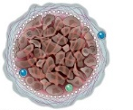
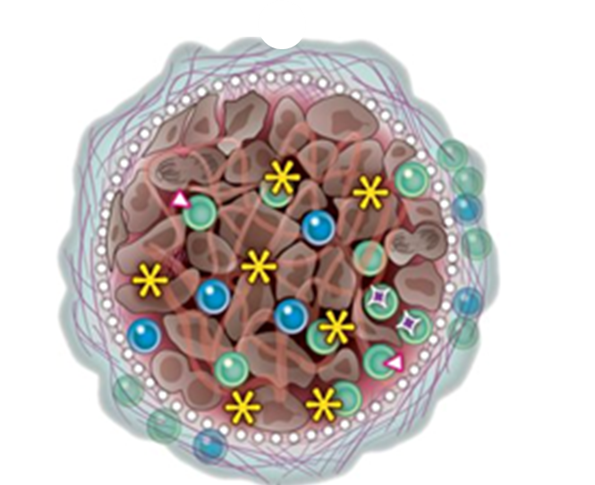
The 5 E’s of immunotherapy
Cold Tumor 95% | MSI-Hi / dMMR 5% | 5 E’s | Ag Specific (T-cells)
No |  | Engage | TCR
No |  | Expand
No |  | Excursion
No |  | Establish ID | APM⁺ / MHC⁺
No | No | Enable

Slide 12
Greatest medical advance in the last century:
Active vaccination
Percent
Year
Notes:
http://wheressputnik.com/wheres-sputnik.pdf
http://www.cdc.gov/vaccines/vac-gen/whatifstop.htm
http://www.efmoody.com/estate/lifeexpectancy.html

Slide 13
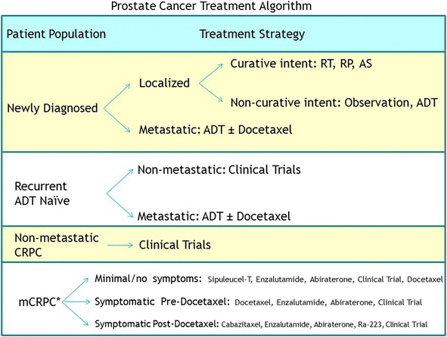
or Abiraterone
Apalutamide, Clinical Trials
Modified from: McNeel et al., JITC, Dec 2016

Slide 14
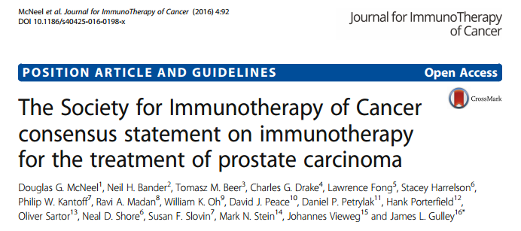
Sipuleucel-T
Sipuleucel-T
-Don’t expect PSA decreases or objective responses
-Use early, in less aggressive disease

Slide 15

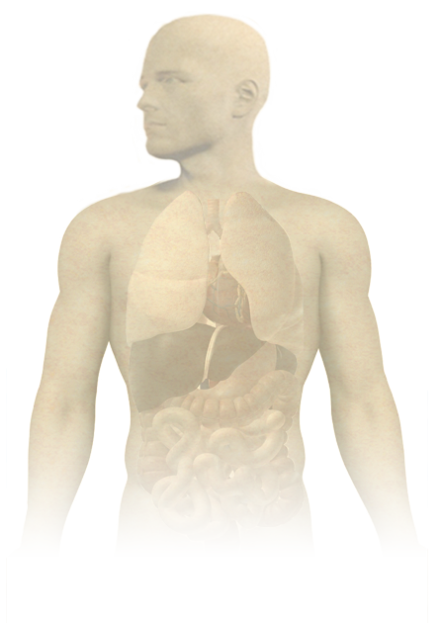

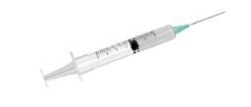
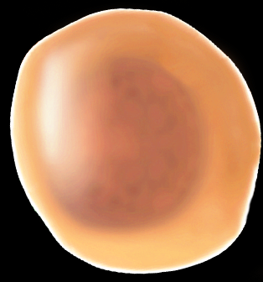

PROSTVAC-VF (PSA-TRICOM)
Tumor antigen gene
Costimulatory molecule genes
PSA
LFA-3
ICAM-1
B7-1
(TRIad of COstimulatory Molecules)
Induction of tumor-specific immune responses (T-cells)
Vaccines:
PROSTVAC-V
PROSTVAC-F
NIH Medical Arts and Photography
Notes:
78 publications on PubMed “Prostvac OR PSA-TRICOM”

Slide 16
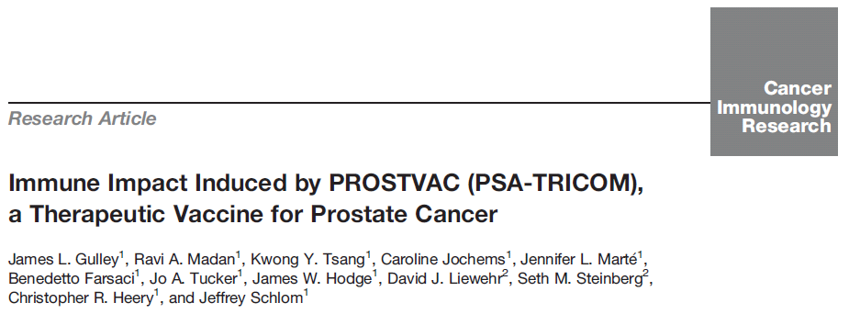
Test | Result | Comment
PSA Specific Immune response | 56.7% (59/104) | 28 days after last vaccine
--Median fold increase in PSA specific immune response | 5X | # of PSA specific T-cells identical to flu T-cells
Antigen Spreading | 67.9% (19/28)
Anti-PSA Ab | 0.57% (2/349)
2014

Slide 17
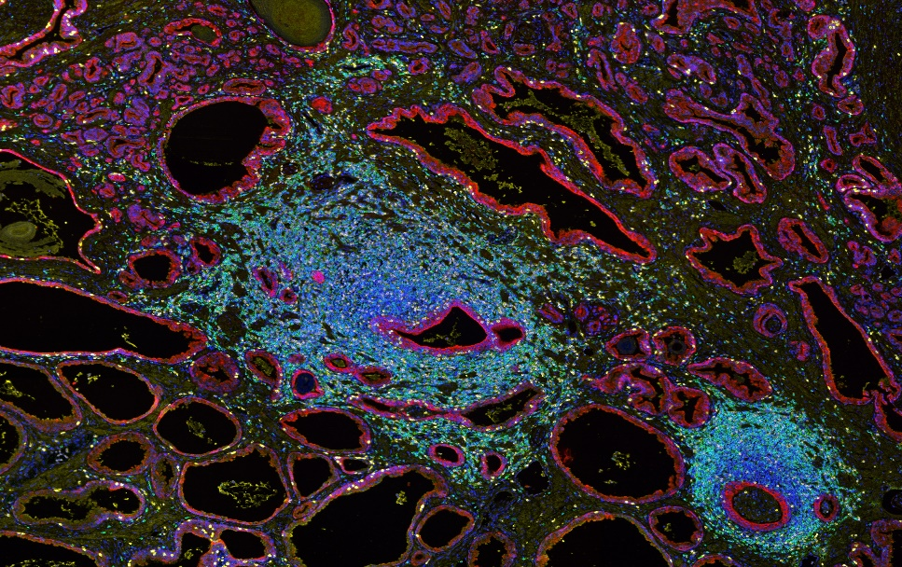
Prostvac increases intra/peritumoral immune infiltrate in patients with localized prostate cancer undergoing radical prostatectomy (NCT02153918) Sater et al, Abs 5083
Baseline | Day 1 | Day15 | Day 29 | Day 57 | 64
Biopsy | Priming Vaccination s.c. | Booster Vaccination s.c. | Booster Vaccination s.c. | Booster Vaccination s.c. | RP
 | ↑ CD8 Infiltrate |  | ↑ CD4 Infiltrate
 | No | Yes | No | Yes
No Peripheral IR | 5 | 7 | 2 | 10
Peripheral IR | 2 | 10 | 1 | 11
Total |  | 17/24 |  | 21/24
RNA expression profiles consistent with an activated immune response post vaccine
James L Gulley, NCI

Slide 18
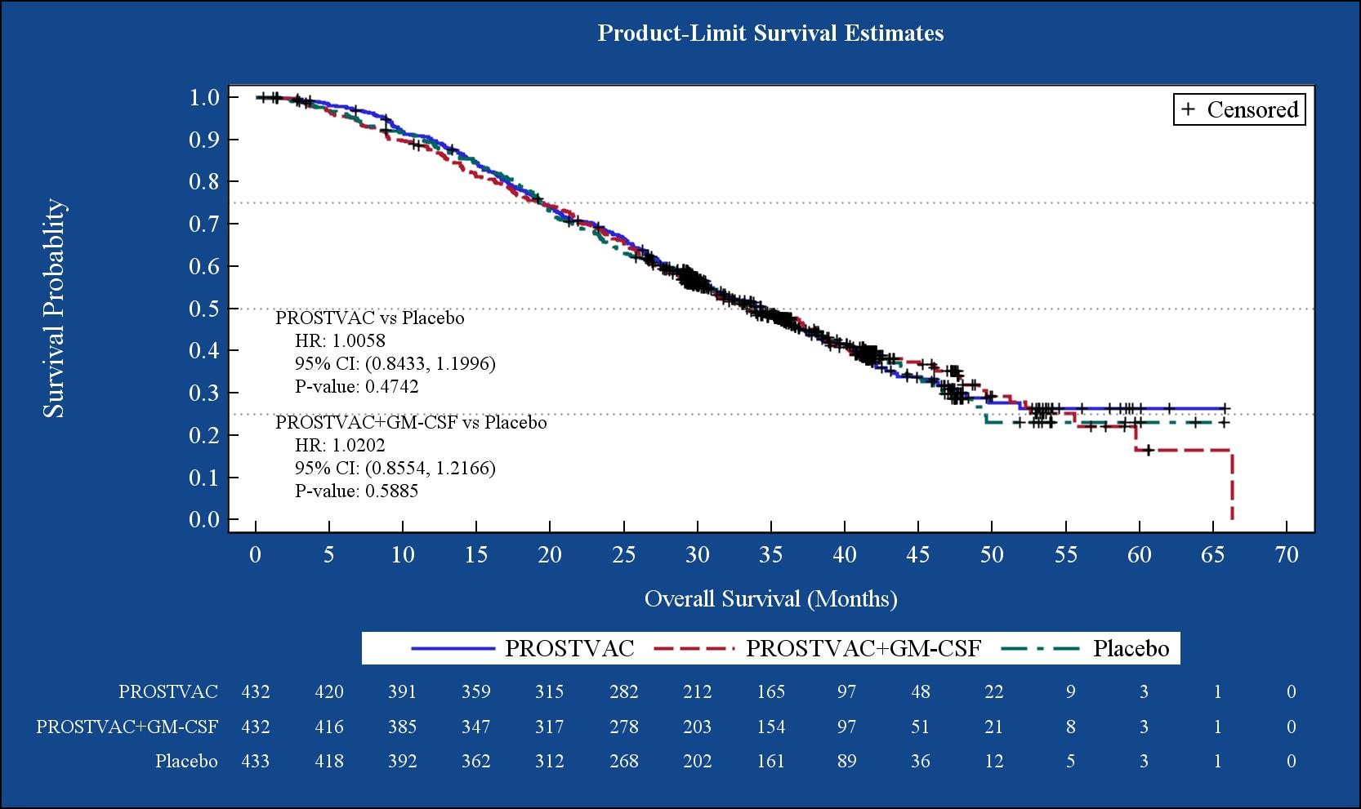
Overall Survival ITT
Sep 2017
Interim Analysis #3
DMC recommended closure of the study on grounds of futility
Median OS
PROSTVAC 34.4
PROSTVAC+ GM-CSF 33.2
Placebo 34.3
James L Gulley, NCI

Slide 19
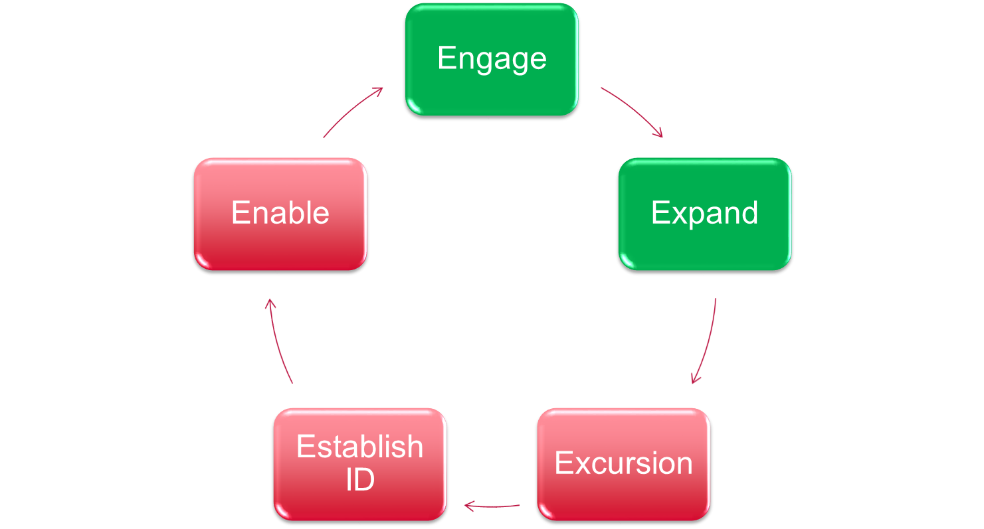
Why did Prostvac not provide therapeutic benefit to patients?

No!
Suboptimal T-cell Expansion?
T-cell that make it to
tumor site are being blocked


Slide 20
Requirements for Effective Immunotherapy
Collins et al., Expert Rev Vaccines 2018

Slide 21
Importance of PD-1/PD-L1 blockade
NIH. News Headlines: https://ccr.cancer.gov/news/article/investigators-lead-first-human-trials-of-new-immunotherapy-drug (accessed August 2017)

Slide 22
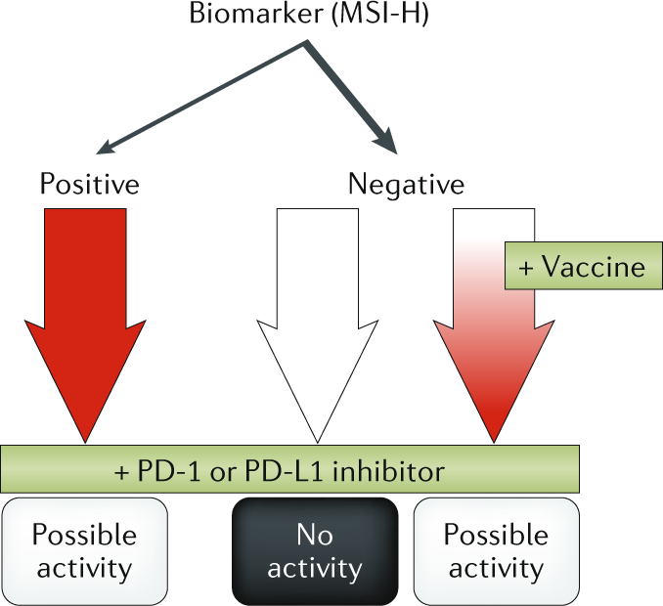

Experimental algorithm for immunotherapy for mCRPC
5%
95%
Madan and Gulley Nature Rev. Urology, 2018

Slide 23
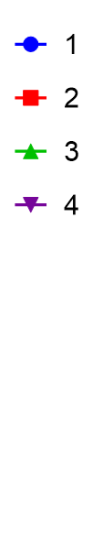
Prostvac (+ Ipilimumab) + Nivolumab (NCT02933255)
PR
mCRPC
No prior chemotherapy
Week 0 | Week 2 | Week 5 | Week 8
Prostvac-V | Prostvac-F | Prostvac-F | Prostvac-F
 | Ipilimumab | Ipilimumab | --
 | Nivolumab | Nivolumab | Nivolumab
Ipilimumab 1 mg/kg, Nivolumab 240 mg

Slide 24
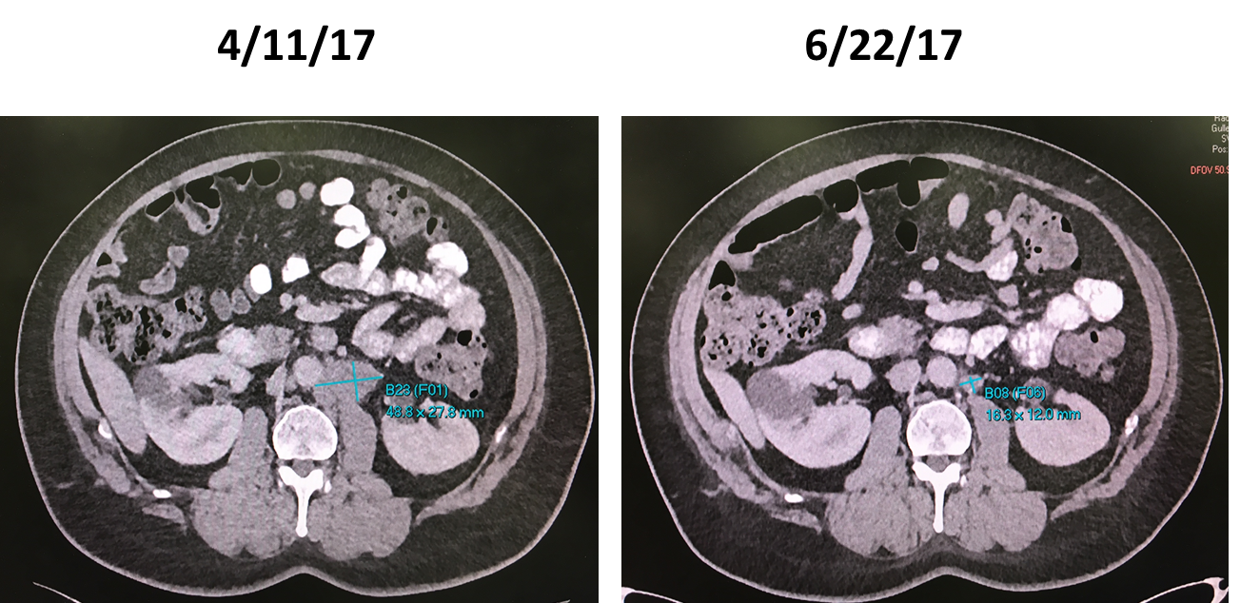

Slide 25
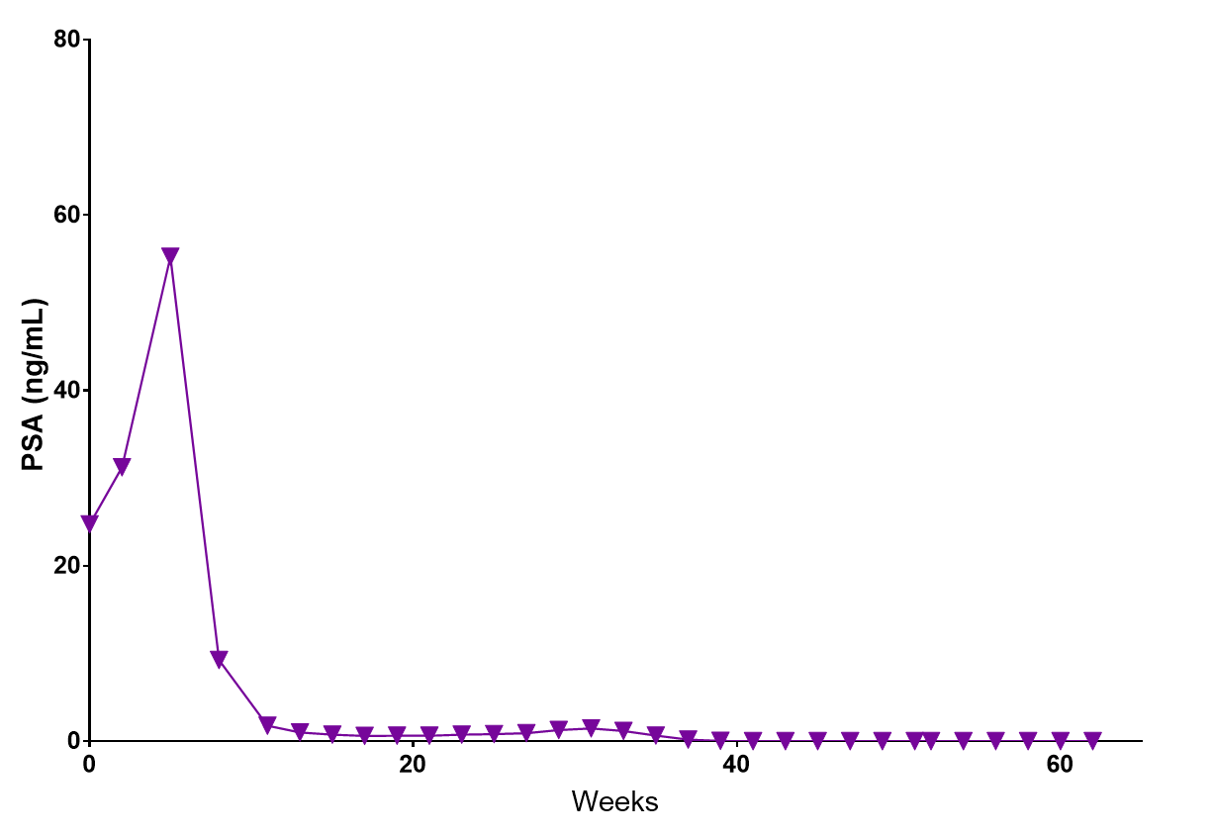

Slide 26
Brachyury Makes Cancer Cells Behave Badly
Transcription Factor Important in Embryogenesis
  Master Driver of Metastatic Process (EMT)
  Involved in Drug Resistance
  Associated with Stem-like Properties

Slide 27
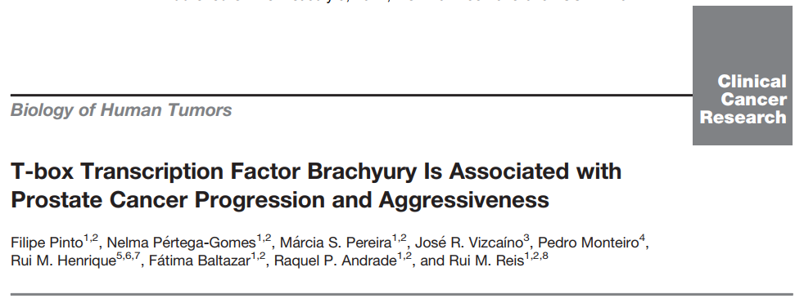
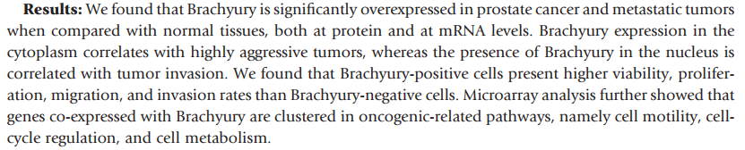
Brachyury in Prostate Cancer
Overexpressed in cancer vs. normal (protein and mRNA)
Correlates with aggressive tumors, invasion

Slide 28
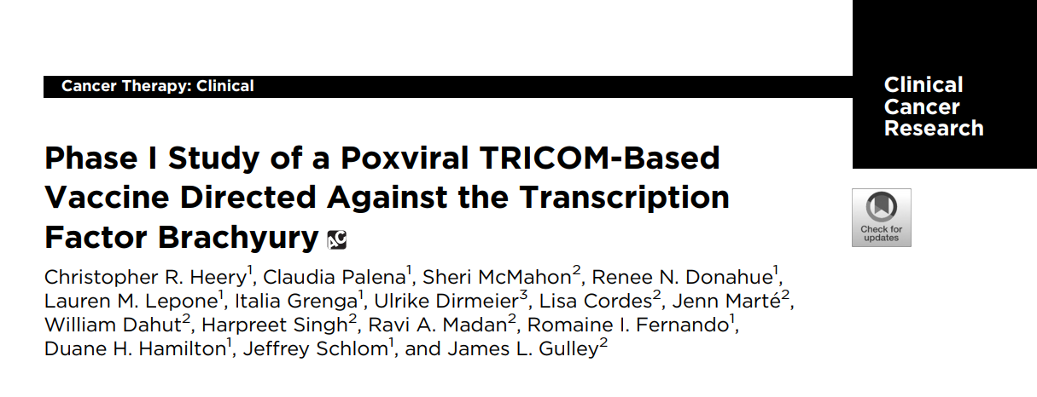
Nov 2017
Well tolerated (no DLT)
28 of 34 (82%) patients developed brachyury-specific CD4 and/or CD8 T-cell responses after vaccination

Slide 29
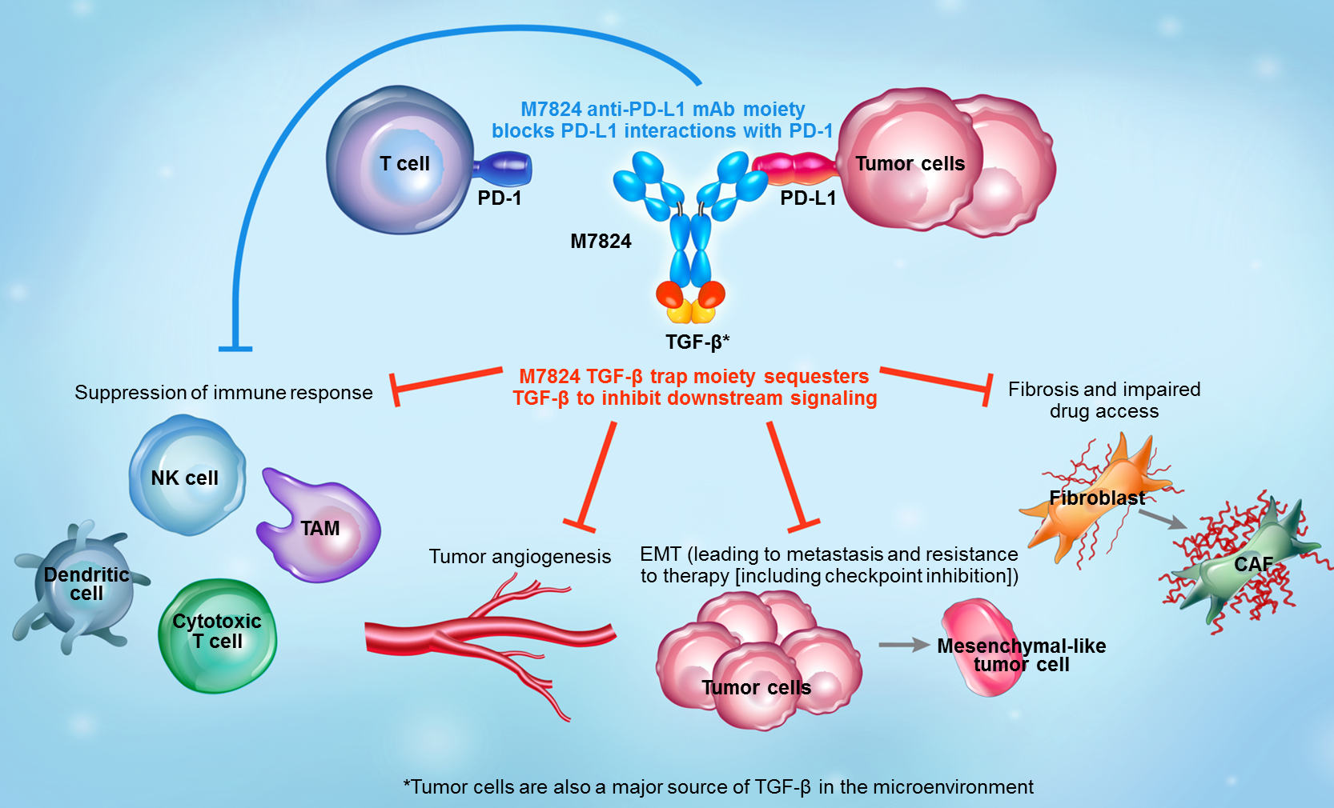
M7824
M7824 is an innovative first-in-class bifunctional fusion protein
n=19
Well tolerated
Sequesters all activated TGF-beta in plasma throughout dosing period
Promising clinical activity
  1 CR
  2 PRs (1 near PR)
  All sustained responses
ASCO June 2018
-HPV Assoc Ca ORR 35%
-NSCLC ORR 28% (41% in PDL1 ≥1%+)
Strauss…Gulley. Clin Cancer Res. 2018 Mar

Slide 30
Requirements for Effective Immunotherapy
Vaccine
IL-15
PDL1i, TGF-βi, IDOi
Collins et al., Expert Rev Vaccines 2018

Slide 31
Conclusions
T-cell poor tumors may require a “spark” to prime the immune system to recognize and seek to destroy the tumor.
  One of the most efficient ways of doing this is with vaccine
  Sipuleucel-T is approved in the US
There are some MSI hi prostate cancers (2-10% of mCRPC) that may respond to PD-1/PDL-1 inhibition (MSI testing)
The tumor immunity cycle is an ongoing iterative process that may lead to an individualized evolution of the immune response to focus on targets most immunologically relevant for a given patient (e.g., neoantigens) (#PrecisionMedicine #PersonalizedMedicine #ImmuneSculpting)
Approaches that both steer the immune system (e.g., prime with vaccine) and allow effector cells to get to and remain functional within the TME (e.g., facilitate with immune checkpoint blockade) will be optimal
  Ongoing trials should help determine the utility of this approach

